Slide 1
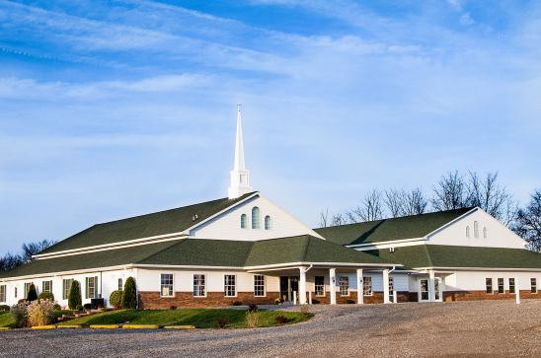
The Doctrine of the Church (Part 5)
The History, Growth, and Character of the Various New Testament Churches

Slide 3
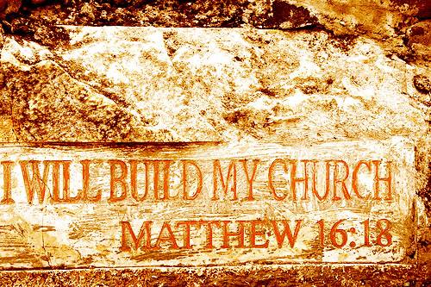

Slide 4
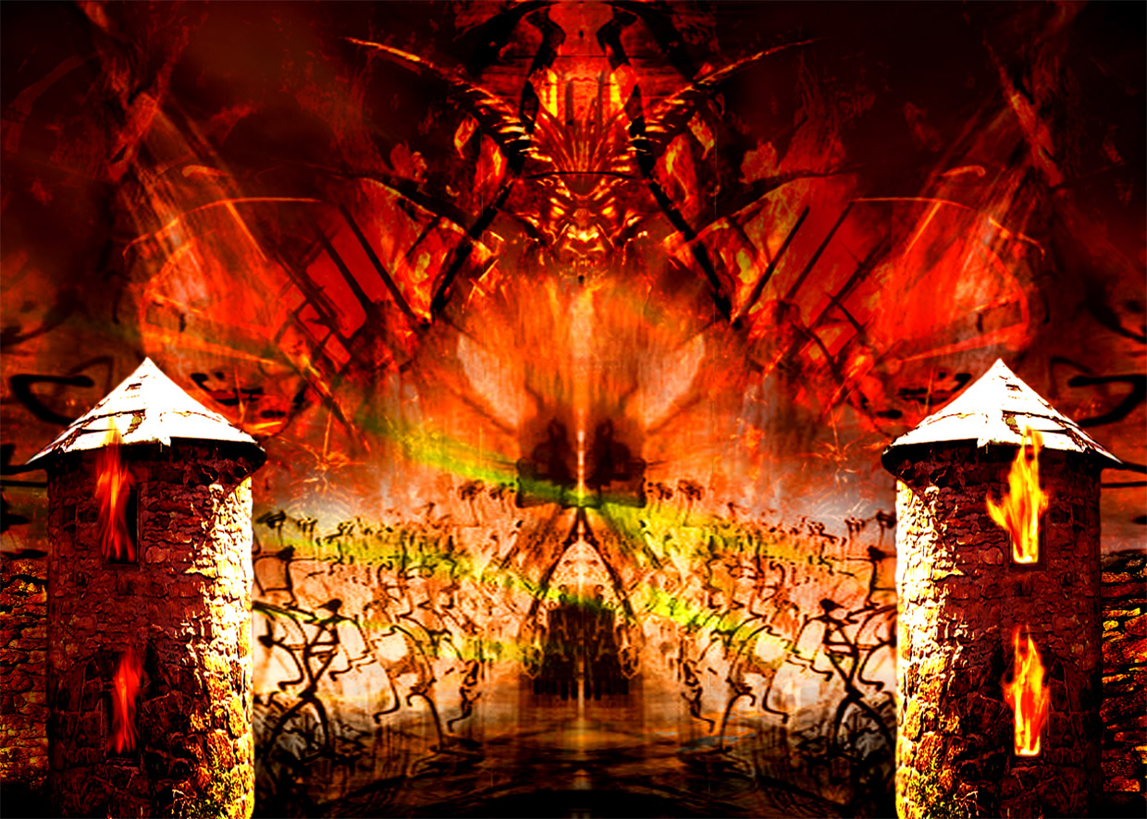
“…and the gates of hell shall not prevail against it.”

Slide 5
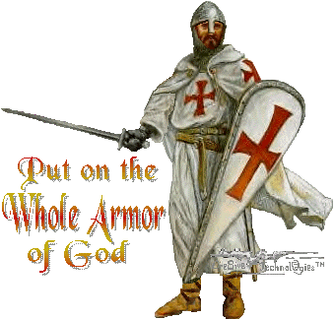

Slide 6
“Except the LORD build the house, they labor in vain that build it.” (Psalm 127:1)

Slide 7
“And are built upon the foundation of the apostles and prophets, Jesus Christ himself being the chief corner stone.” (Eph 2:20)

Slide 8
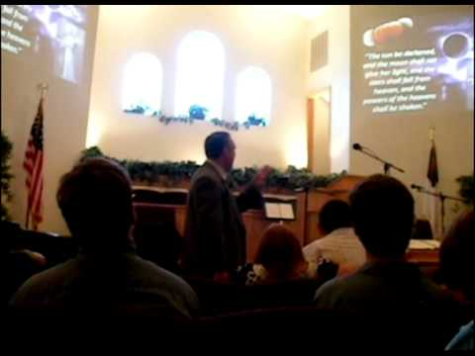
The Meaning of the Word "Church."
Thus, the literal meaning is - a call out assembly.
A called out Assembly of Baptized Believers gathered together for – Acts2:42; Phil. 3:3
1. Doctrine
2. Fellowship
3. Breaking of Bread
4. Prayers
5. Worship

Slide 9
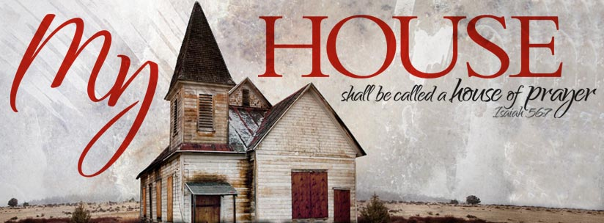
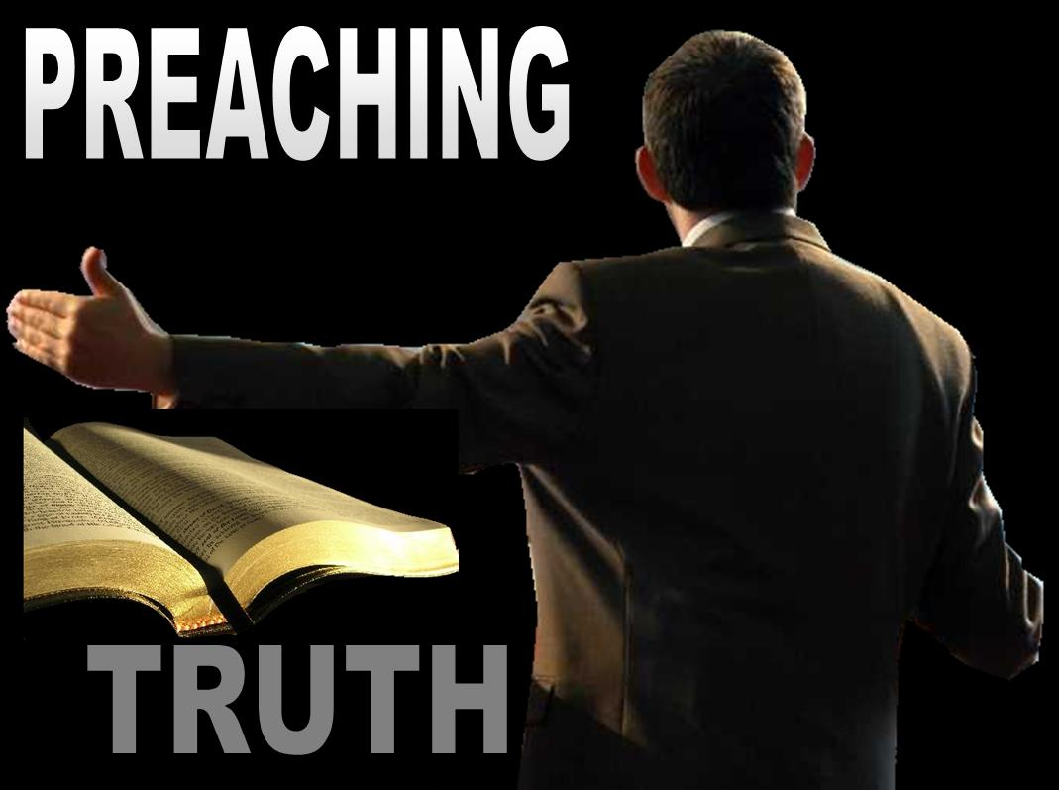
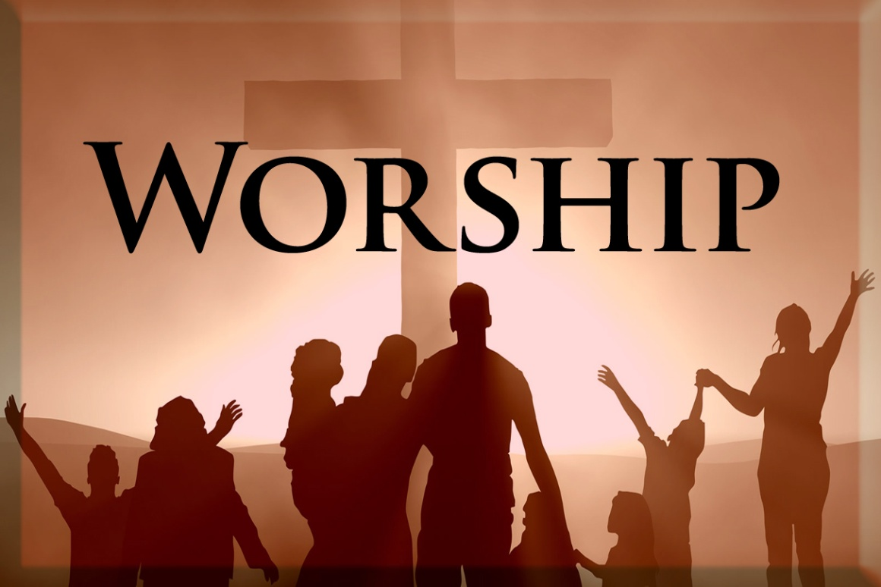

Slide 10
The Origin of the Church “When and where did the church actually begin?”

Slide 11
Several different views

Slide 12
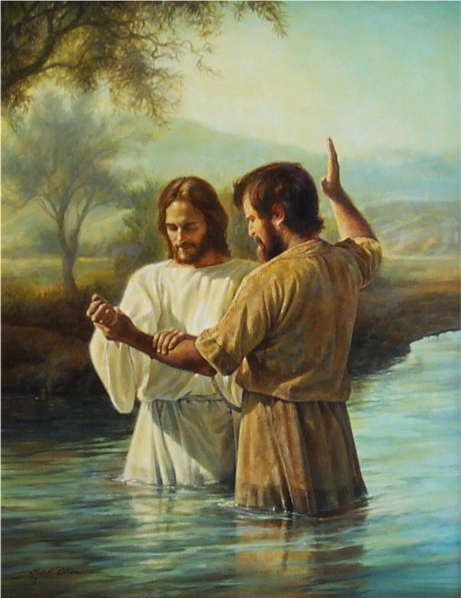
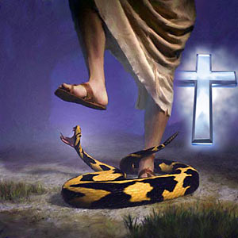
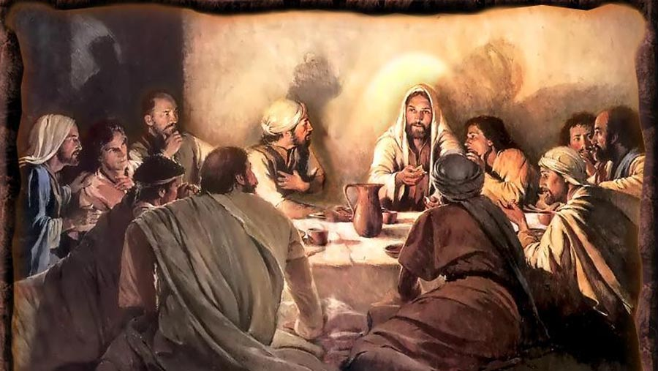
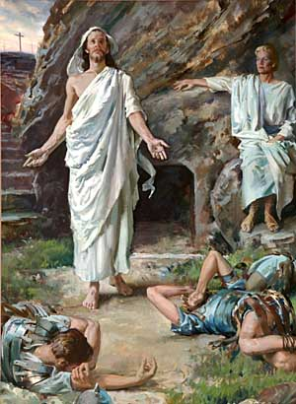
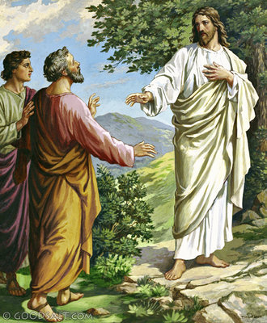
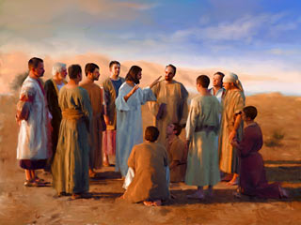
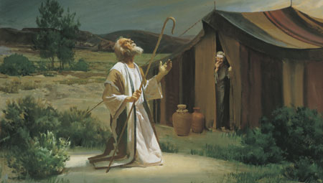

Slide 13
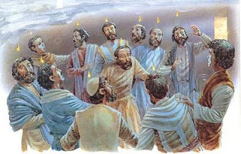
The Church begin on the Day of Pentecost

Slide 14
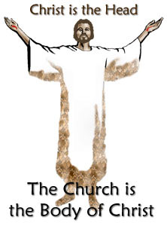
I Cor. 12:13 “For by one Spirit are we all baptized into one body, whether we be Jews or Gentiles, whether we be bond or free; and have been all made to drink into one Spirit.”
Col 1:18 “And he is the head of the body, the church: who is the beginning, the firstborn from the dead; that in all things he might have the preeminence.”

Slide 15
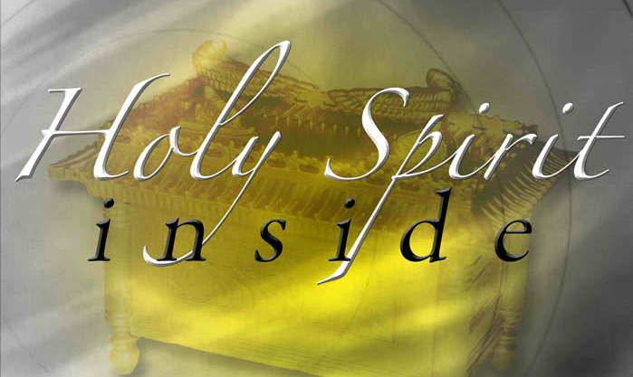

Slide 16
The Nature of the Church
“The characteristics or inherent features of the Church”

Slide 17
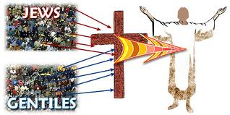
The Church is not Israel
(I Corinthians 10:32) “Give none offence, neither to the Jews (Israel), nor to the Gentiles, nor to the church of God.”
Covenant theologians teach that the church has become God’s elect people, as Israel once was.

Slide 18
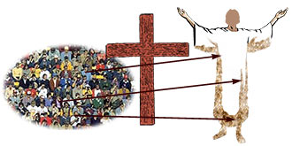
The Church is the Body of Christ
I Cor. 12:27 “Now ye are the body of Christ, and members in particular.
Eph. 4:12 “For the perfecting of the saints, for the work of the ministry, for the edifying of the body of Christ.”

Slide 19
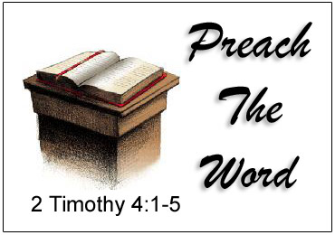
Christ is the head of the Church
Eph. 5:23 “For the husband is the head of the wife, even as Christ is the head of the church: and he is the saviour of the body.”

Slide 20
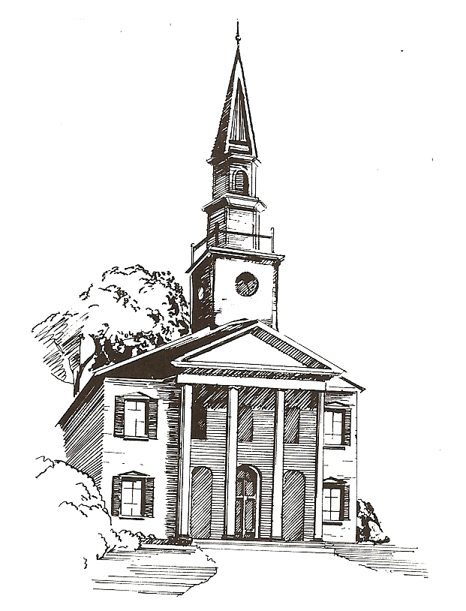
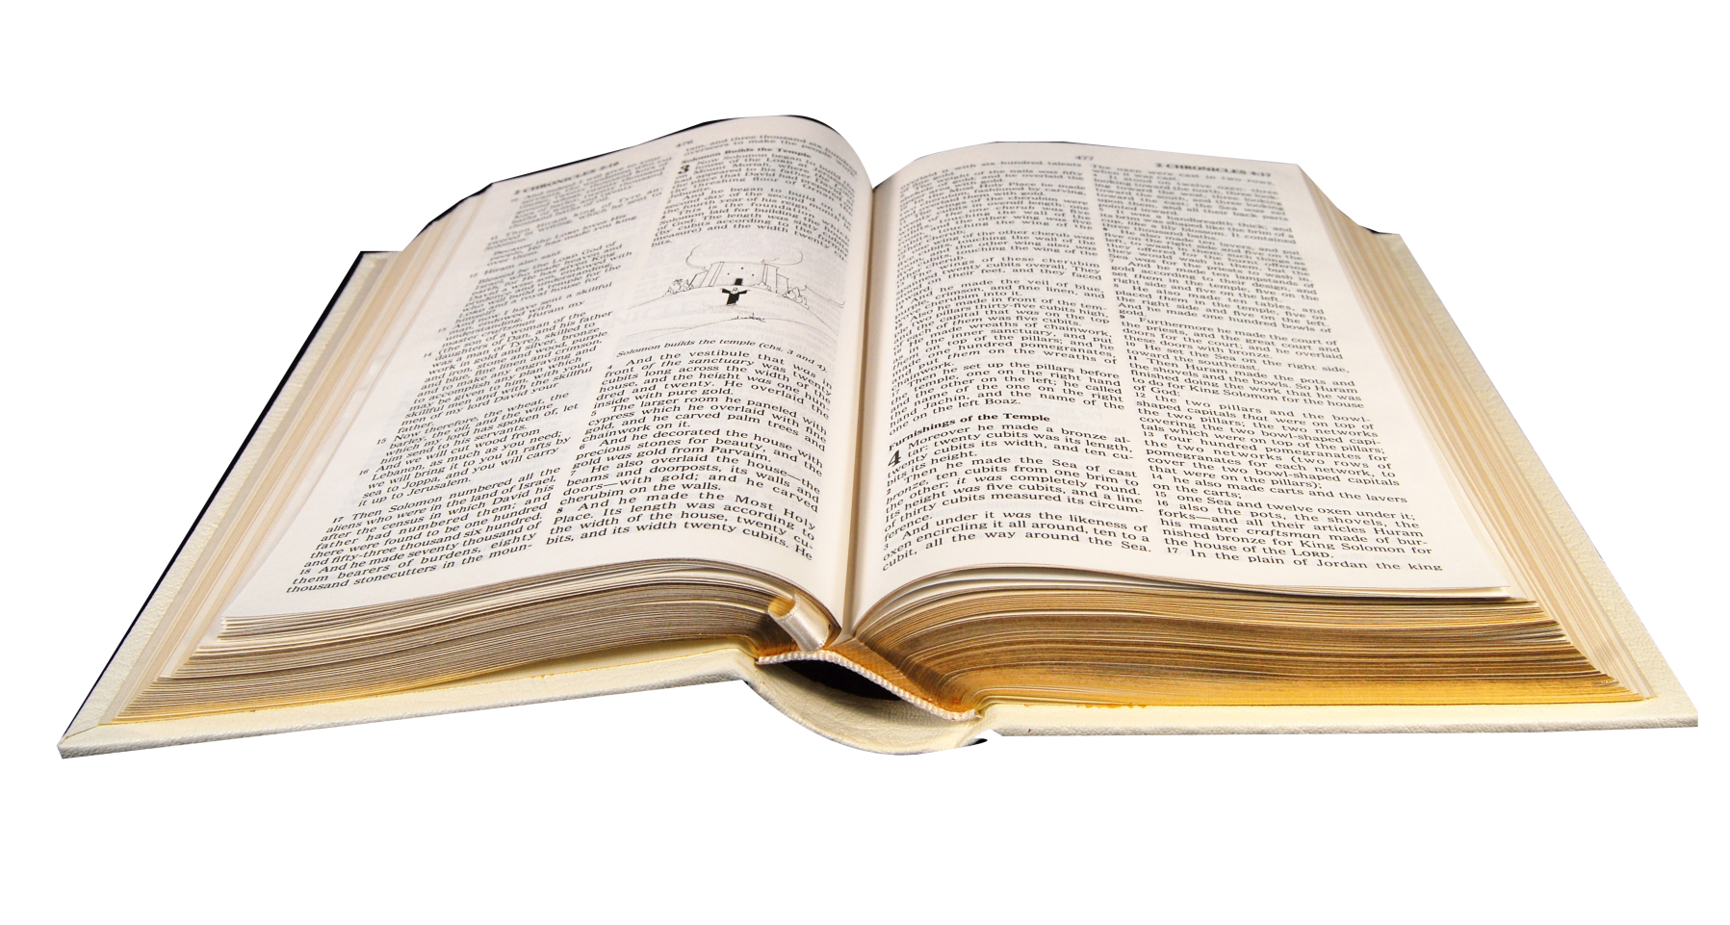
The Word of God is to be the Churches only rule of faith and practice!

Slide 21
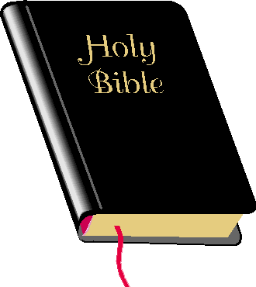
The Church is the Pillar and Ground of the Truth
I Tim. 3:15 “But if I tarry long, that thou mayest know how thou oughtest to behave thyself in the house of God, which is the church of the living God, the pillar and ground of the truth.”
Pillar = base; post; support
Ground = support; basis

Slide 22
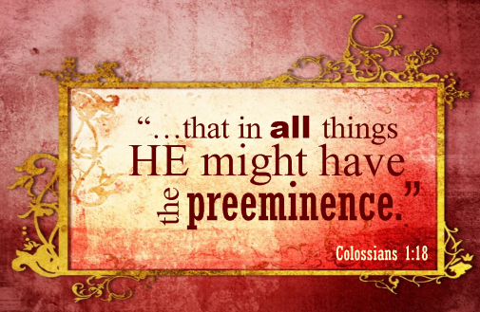
Jesus Christ alone is to have the Preeminence in His Church

Slide 24
The Main Purpose for the Church

Slide 26
“Thou art worthy, O Lord, to receive glory and honour and power: for thou hast created all things, and for thy pleasure they are and were created.” (Rev. 4:11)

Slide 27
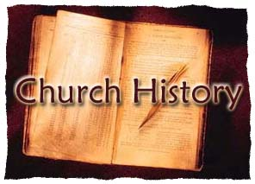
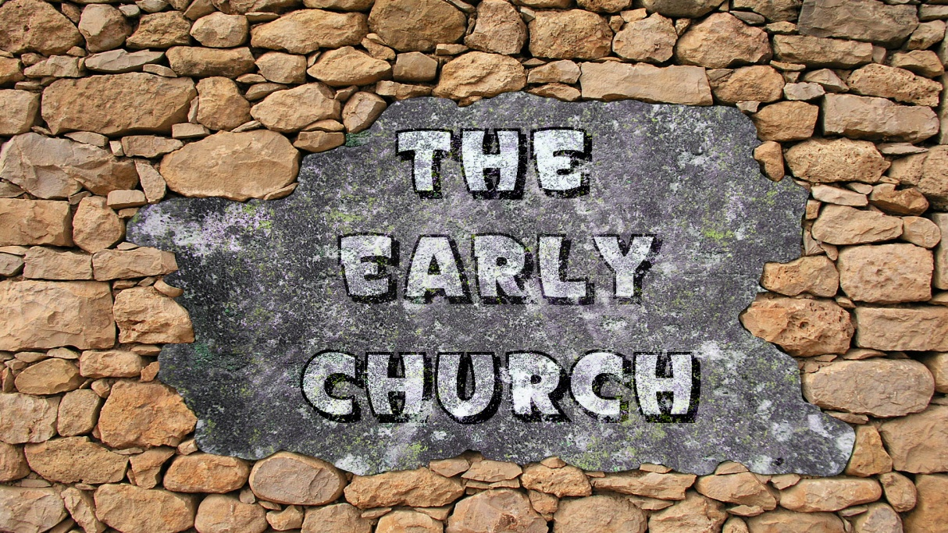
The History, Growth, and Character of the Various New Testament Churches.

Slide 28
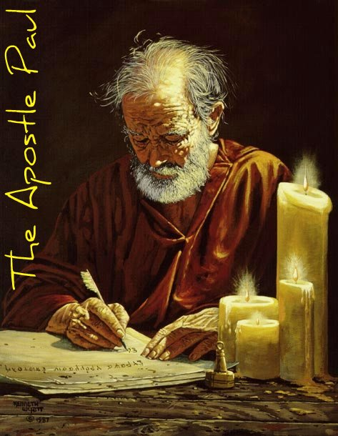
I Corinthians 10:11
"Now all these things happened unto them for ensamples: and they are written for our admonition, upon whom the ends of the world are come."
Paul, here refers to Old Testament events. But we may with Scriptural justification apply these same words to the events recorded for us in the New Testament.

Slide 29
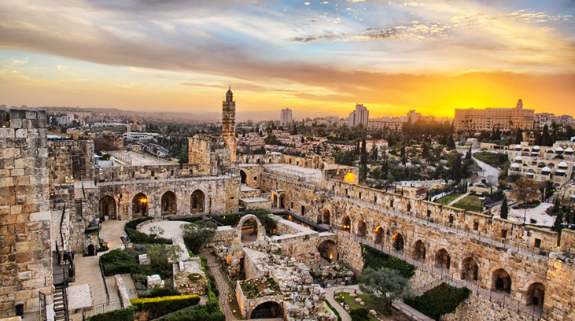
The church in Jerusalem

Slide 30
Began at Pentecost (Acts 2:47) with at least 3120 (Acts 2:41)
Was pastored by James, the half-brother of Christ (Acts 15:13)
Performed many wonders and signs (Acts 2:43; 5:12-16)
Had all things in common (Acts 2:44, 45; 4:32-35)
Were in one accord (Acts 2:46)
Spent a good deal of time in prayer (Acts 2:42; 3:1; 4:24; 12:5-17)
Witnessed at every opportunity (Acts 3:12; 4:5; 5:42; 4:33)
Radiated Jesus (Acts 4:13; 6:15)
Was kept pure by God (had standards) (Acts 5:1-11; 8:18-24)
Grew constantly (Acts 2:47; 5:14; 4:4; 12:24)

Slide 31
Endured persecution (Acts 4:1-3; 4:21; 5:17-41; 7:54-60; 8:1-3; 12:1-4)
Appointed deacons (Acts 6:1-7)
Practiced baptism and the Lord’s Supper (Acts 2:41, 46)
Sent forth missionaries (Acts 8:5, 14; 11:22; 13:1-3; 15:22)
Held the important meeting on circumcision (Acts 15)
Were Spirit-filled and Spirit-led (Acts 2:1-18; 4:31; 13:2-4; 15:28)
Preached the word (Acts 2:16-36; 3:13-26; 5:42; 6:4; 7:1-53)
Contended for the faith (Acts 15:1-21)
Later compromised with the Judaizers (Acts 15:1-29, 21:18-25)

Slide 32
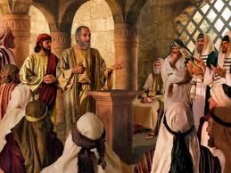
Judaizers term, derived from the Greek verb ioudaïzō = "live according to Jewish customs"
“And certain men which came down from Judaea taught the brethren, and said, Except ye be circumcised after the manner of Moses, ye cannot be saved…But there rose up certain of the sect of the Pharisees which believed, saying, That it was needful to circumcise them, and to command them to keep the law of Moses.”

Slide 33
“And the apostles and elders came together for to consider of this matter… And put no difference between us and them, purifying their hearts by faith. Now therefore why tempt ye God, to put a yoke upon the neck of the disciples, which neither our fathers nor we were able to bear?”

Slide 34
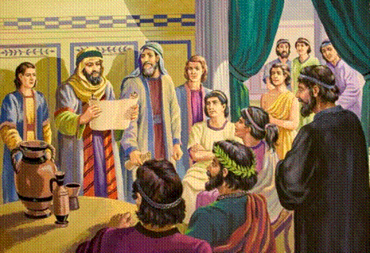
“And they wrote letters by them after this manner; The apostles and elders and brethren send greeting unto the brethren which are of the Gentiles…For it seemed good to the Holy Ghost, and to us, to lay upon you no greater burden than these necessary things; That ye abstain from meats offered to idols, and from blood, and from things strangled, and from fornication: from which if ye keep yourselves, ye shall do well. Fare ye well.”

Slide 35
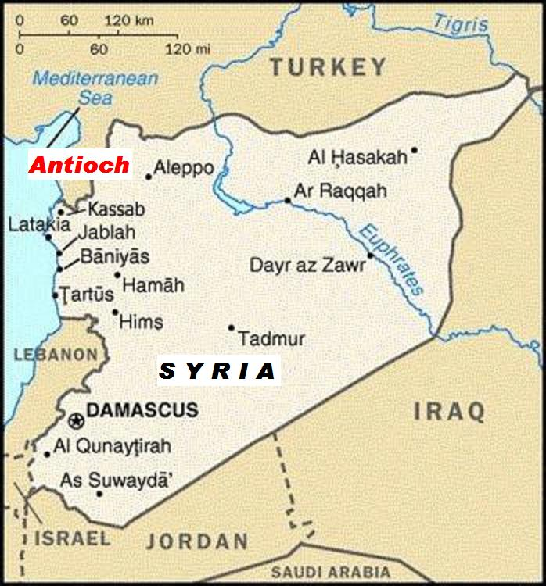
The church in Antioch of Syria

Slide 36
Was founded during that persecution period which followed the martyrdom of Stephen (Acts 11:19)
Experienced a great growth (Acts 11:21)
The Jerusalem church sent Barnabas to "check it out" (Acts 11:22)
Barnabas became the first pastor (Acts 11:23)
Many were added to the church at this time (Acts 11:24)
Barnabas then called Saul as associate pastor (Acts 11:25)
Both ministered here for a year (Acts 11:26)

Slide 37
Was where believers were first called Christians (Acts 11:26)
Took up a large love offering for the needy believers in Jerusalem (Acts 11:30)
Was the home church of the first two Christian missionaries (Paul and Barnabas) (Acts 13:1-3; 14:26)
Later became their headquarters for their missionary journeys (Acts 14:26)
Silas was from this church (Acts 15:34)
Was where Paul set Peter straight on matters of legalism (Gal. 2:11)

Slide 38
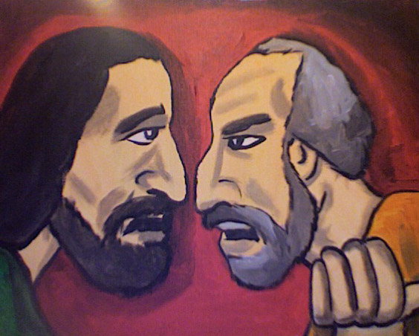
“But when Peter was come to Antioch, I withstood him to the face, because he was to be blamed. For before that certain came from James, he did eat with the Gentiles: but when they were come, he withdrew and separated himself, fearing them which were of the circumcision. And the other Jews dissembled likewise with him; insomuch that Barnabas also was carried away with their dissimulation (hypocrisy).”

Slide 39
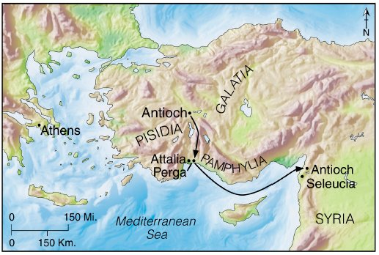
The church in Antioch of Pisidia

Slide 40
Founded by Paul during his first missionary trip (Acts 13:14)
Was where he preached his first recorded sermon (Acts 13:16)
Was formed from the converts coming out of this meeting (Acts 13:43)
Paul turned from the Jews (Acts 13:46)
Paul relates his heavenly calling as a light to the Gentiles (Acts 13:47)

Slide 41
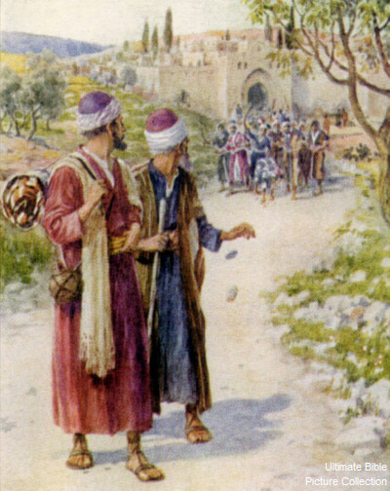
“Then Paul and Barnabas waxed bold, and said, It was necessary that the word of God should first have been spoken to you: but seeing ye put it from you, and judge yourselves unworthy of everlasting life, lo, we turn to the Gentiles. For so hath the Lord commanded us, saying, I have set thee to be a light of the Gentiles, that thou shouldest be for salvation unto the ends of the earth.”

Slide 42
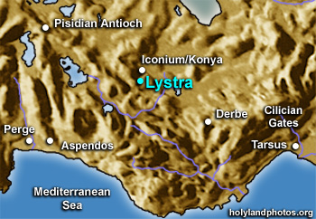
The church in Lystra

Slide 43
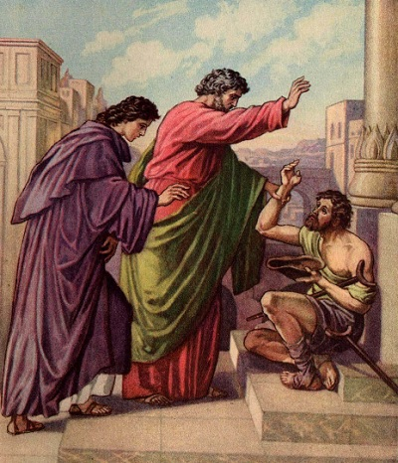
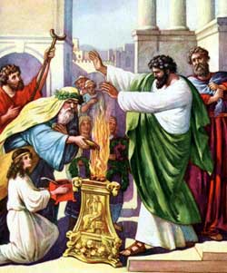
Was organized during Paul’s first missionary trip (Acts 14:6)
Was where he healed the impotent man who was crippled from birth (Acts 14:10)
This led to his being almost worshiped (Acts 14:11)

Slide 44
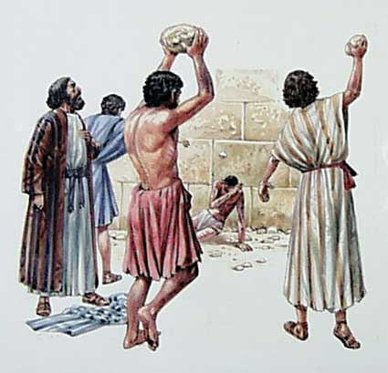
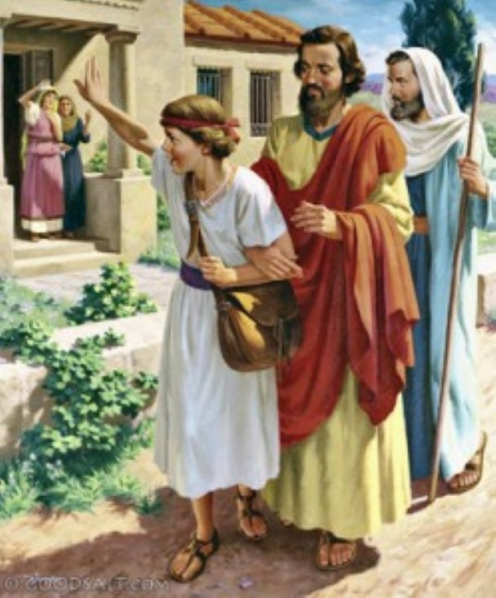
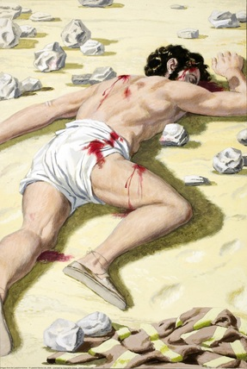
Paul was stoned (Acts 14:19; II Tim. 3:11)
Was where Paul picked up Timothy during his second missionary trip (Acts 16:1-3)

Slide 45
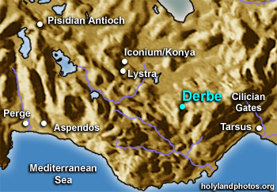
The church in Derbe

Slide 46
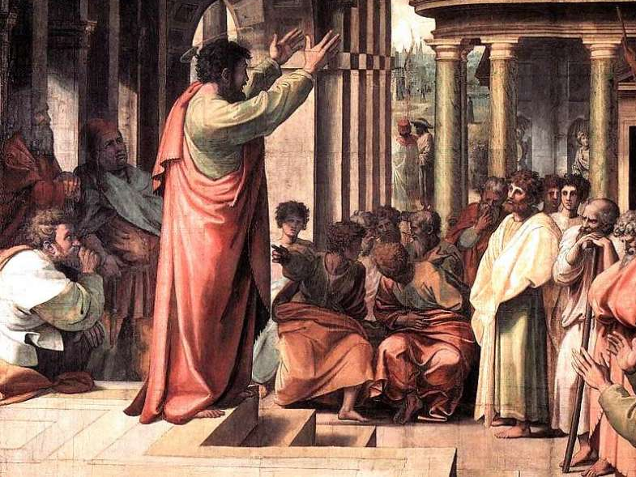
(Acts 14:21-22)
“And when they had preached the gospel to that city (Derbe), and had taught many, they returned again to Lystra, and to Iconium, and Antioch, Confirming the souls of the disciples, and exhorting them to continue in the faith, and that we must through much tribulation enter into the kingdom of God.”

Slide 47
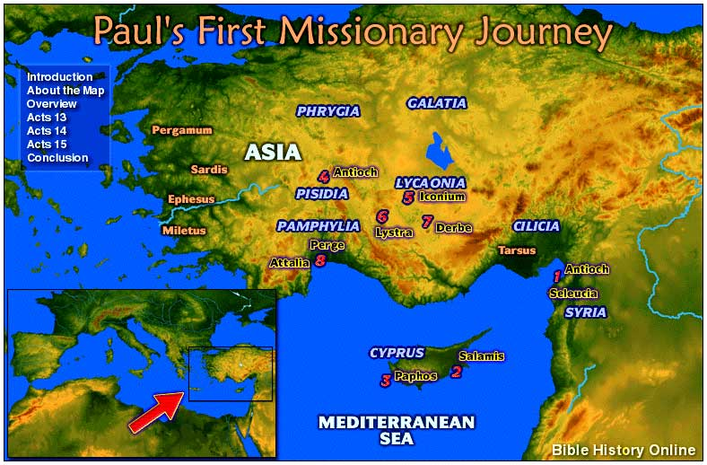
The church in Iconium

Slide 48
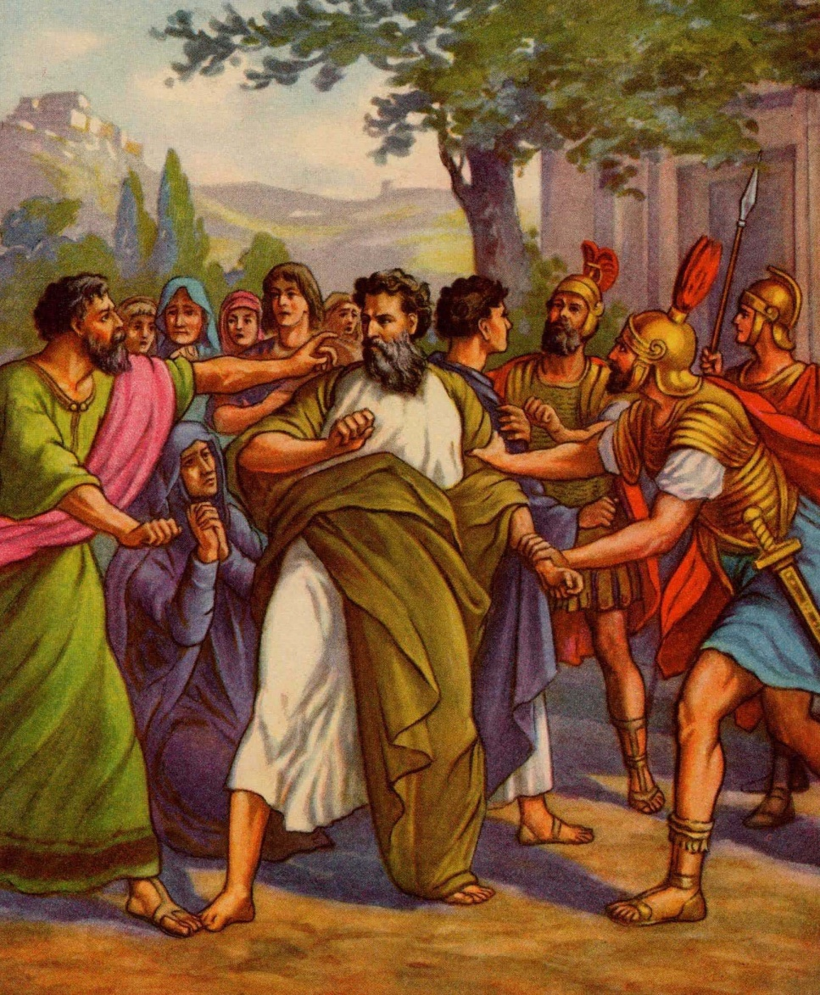
Paul led many to Christ here during his first trip (Acts 14:2)
He also worked great signs and wonders (Acts 14:3)
He was driven out by the unbelieving Jews and Gentiles who threatened to stone him (Acts 14:5)

Slide 49
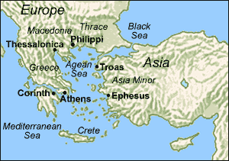
The church in Philippi

Slide 50
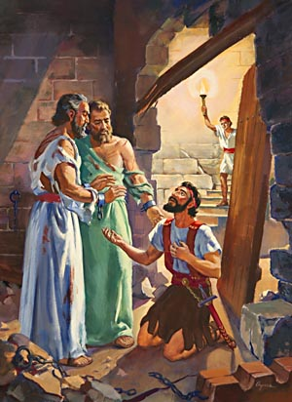
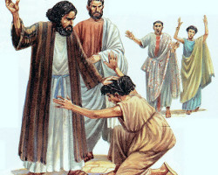
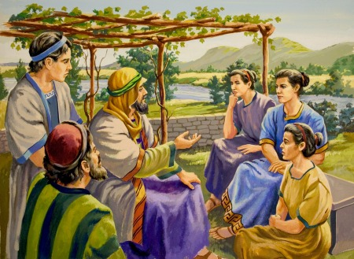
Paul organized a church in the home of a woman convert named Lydia (Acts 16:15-40)
A demon-possessed girl was his next convert (Acts 16:18)
She was followed by the Philippian jailor (Acts 16:33)

Slide 51
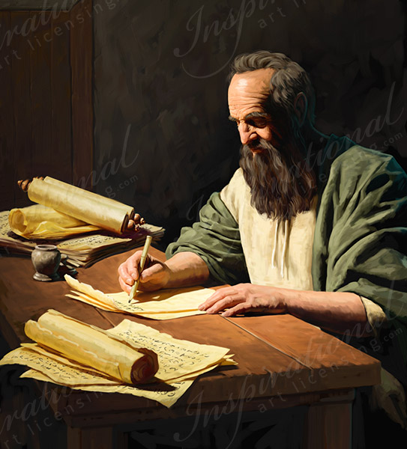
Paul later wrote a letter to this church (Phil. 1:1)
Timothy ministered to this church (Phil. 2:19)
The church sent Epaphroditus to minister to Paul while the apostle was in prison (Phil. 2:25)

Slide 52
Was in danger of legalism (Phil. 3:1-9)

Slide 53
“Finally, my brethren, rejoice in the Lord. To write the same things to you, to me indeed is not grievous, but for you it is safe. Beware of dogs, beware of evil workers, beware of the concision (cutting off). For we are the circumcision, which worship God in the spirit, and rejoice in Christ Jesus, and have no confidence in the flesh. Though I might also have confidence in the flesh. If any other man thinketh that he hath whereof he might trust in the flesh, I more: Circumcised the eighth day, of the stock of Israel, of the tribe of Benjamin, an Hebrew of the Hebrews; as touching the law, a Pharisee; Concerning zeal, persecuting the church;

Slide 54
touching the righteousness which is in the law, blameless. But what things were gain to me, those I counted loss for Christ. Yea doubtless, and I count all things but loss for the excellency of the knowledge of Christ Jesus my Lord: for whom I have suffered the loss of all things, and do count them but dung, that I may win Christ, And be found in him, not having mine own righteousness, which is of the law, but that which is through the faith of Christ, the righteousness which is of God by faith.”

Slide 55
Paul writes and asks "true yokefellow" to help two quarreling church women named Euodias and Syntyche (Phil. 4:1-3)
Helped to supply the material needs of Paul (Phil. 4:15-18)

Slide 56
The church in Thessalonica

Slide 57
Was founded during Paul’s second missionary trip (Acts 17:1)
Witnessed a great harvest of souls (Acts 17:4)
Paul other disciples were accused of turning the world upside down (Acts 17:6)
In spite of their zeal, they were not good Bible students (Acts 17:6)

Slide 58
Later Paul wrote two letters to this church (I Thess. 1:1; II Thess. 1:1)
The believers had a reputation for witnessing (I Thess. 1:8)
They were persecuted by the unbelieving Jews because of their faith (I Thess. 2:14)
Timothy was sent by Paul to ministered to this church (I Thess. 3:1-2)

Slide 59
Had some lazy members (II Thess. 3:10)
Had some busybodies (II Thess. 3:11)
Had some disobedient members (II Thess. 3:14-15)

Slide 60
The church in Berea

Slide 61
This church was commended for its knowledge of and love for the Word of God (Acts 17:11)

Slide 62
The church in Athens

Slide 63
It is not certain whether a local assembly came into being after Paul’s sermon on Mars Hill, but if so, a convert named Dionysius probably led the church. (Acts 17:34)

Slide 64
The church in Corinth

Slide 65
Was founded during Paul’s second trip (Acts 18:1)
Aquila and Priscilla aided in this (Acts 18:2)
The chief ruler of the Jewish synagogue, a man named Crispus, was one of Paul’s first converts (Acts 18:8)
His successor, was also later evidently saved (compare Acts 18:17 with I Cor. 1:1)
Paul stayed eighteen months (Acts 18:11)

Slide 66
Paul wrote several letters of correction to this church (I Cor. 5:9; II Cor. 10:9, 10)
Two of which are included in the New Testament (I Cor. 1:2; II Cor. 1:1)

Slide 67
“And I, brethren, could not speak unto you as unto spiritual, but as unto carnal, even as unto babes in Christ. I have fed you with milk, and not with meat: for hitherto ye were not able to bear it, neither yet now are ye able. For ye are yet carnal: for whereas there is among you envying, and strife, and divisions, are ye not carnal, and walk as men?” (I Corinthians 3:1-3)

Slide 68
Experienced almost total confusion in matters relating to:
Baptism (I Cor. 1:12-17)
Earthly wisdom (I Cor. 1:26)
Carnality, strife, division (I Cor. 3:1-3)
Judging others unfairly (I Cor. 4:7)
Immorality (I Cor. 5:1)
Taking other believers to court (I Cor. 6:1-4)
Marriage (I Cor. 7:1)
Christian liberty (I Cor. 8-9)
The Lord’s Table (I Cor. 11:17-34)
Spiritual gifts (I Cor. 12-14)
The doctrine of the resurrection (I Cor. 15)
Tithing (I Cor. 16)

Slide 69
Church at Corinth was later pastored by Apollos who was discipled by Paul (I Cor. 3:6)

Slide 70
The church in Ephesus

Slide 71
Was founded during Paul’s second trip (Acts 18:19)
May pastored by Apollos, Timothy, and the Apostle John.
Paul wrought many miracles there and saw much fruit (Acts 19:11-41)

Slide 72
Books of witchcraft, sorcery and magic were burned (Acts 19:19)
The magnificence of the false goddess Diana was greatly diminished causing a riot (Acts 19:27-38)
Paul went soul-winning door-to-door (Acts 20:17-21)

Slide 73
Was the only Christian church ever to receive letters from two New Testament writers. Paul wrote Ephesians to them (Eph. 1:1), and John the apostle would later direct a portion of Revelation to them (Rev. 2:1-7). According to John’s letter, this church:

Slide 74
Worked hard and possessed patience.
Had high church standards.
Suffered for Christ.
Had left their first love.
Needed to remember, repent, and return to Christ, else their candlestick be removed.
Hated the doctrine and deeds of the Nicolaitans.

Slide 75
The Doctrine of the Nicolaitans “But this thou hast, that thou hatest the deeds of the Nicolaitans, which I also hate.”
Followers of Nicolas
His Teachings –
Christians can live however they want.
Christians are “under grace”
- Christians can live a sinful life-style because they are forgiven of their sin.
- Christians can enjoy the pleasures of sin without consequence.

Slide 76
Clement of Alexandria
“The Nicolaitans abandoned the principles of Christianity to live in sinful pleasure.”

Slide 77
The church in Troas

Slide 78
Here Paul raised up Eutychus, a believer who had gone asleep during Paul’s sermon and had fallen down from the third loft of the building (Acts 20:7-12)

Slide 79
(Acts 20:11) “When he therefore was come up again, and had broken bread, and eaten, and talked a long while, even till break of day, so he departed.”

Slide 80
The church in Rome

Slide 81
The origin and founder of this church is unknown.
Priscilla and Aquila labored there and a local church met in their home (Rom. 16:3-5)
Had a good testimony throughout all the land (Rom. 1:8)
Paul mentions more personal friends here than in any other New Testament book he wrote.
The names of some twenty-six individuals may be counted in Romans 16

Slide 82
The church’s in Galatia

Slide 83
Various local churches in Galatia were organized by Paul during his first trip.
Had all apparently fallen victim to the legalistic Judaizers, who would continually challenged Paul’s gospel of grace (Gal. 1:6-9)
The New Testament epistle Galatians was written to these churches (Gal. 3:1)

Slide 84
The church in Colosse

Slide 85
Was founded by Epaphras during Paul’s third trip (Col. 2:1; 1:7, 12-13)
Philemon and Onesimus attended this church (Col. 4:9; Philemon 1:1-2)
Main theme of Colossians is the person and work of Jesus Christ and the believers position in Christ.
Paul commanded the Colossian epistle to be read to the Laodicean church and the one he wrote them to be read to the Colossian church (Col. 4:16)

Slide 86
The church in Babylon (I Peter 5:13)

Slide 87
Was filled with suffering believers (I Pet. 1:6)
Some of this suffering was due to sin (I Pet. 4:15-17)
“But let none of you suffer as a murderer, or as a thief, or as an evildoer, or as a busybody in other men's matters.”

Slide 88
The church in Smyrna (Rev. 2:8-11)

Slide 89
Had suffered much for Christ.
Had been slandered by those from the synagogue of Satan.
Satan had imprisoned some of them.

Slide 90
The church in Pergamos (Rev. 2:12-17)

Slide 91
Was located in the very center of satanic worship.
Had nevertheless remained loyal to Christ in spite of martyrdom.
Members were, however, tolerating some in the church who were guilty of sexual sins.
They were also tolerating those who held the doctrine of the Nicolaitans.

Slide 92
The church in Thyatira (Rev. 2:18-29)

Slide 93
Had performed many good deeds.
But they permitted a false prophetess named Jezebel to teach that sexual sin was not a serious matter.

Slide 94
The church in Sardis (Rev. 3:1-6)

Slide 95
Had a reputation that they were alive, but they were spiritually dead.
Was to strengthen that which was ready to die.

Slide 96
The church in Philadelphia (Rev. 3:7-13)

Slide 97
Small in number but they were spiritually strong.
Faithfull to the Lord during server persecution.

Slide 98
The church in Laodicea (Rev. 3:14-20)

Slide 99
One the worst church’s mentioned in the New Testament.
Believers were neither hot nor cold.
Bragged about their wealth, claiming they had need of nothing, but in reality were wretched, miserable, poor, blind, and naked.
God admonished them to totally repent and allow him to reenter and once again fellowship with them.

Slide 100
The character of the local church is the sum-total of the character of its members.

