Slide 1
The inherent characteristics, quality's
and features of God
(Part 13)
Overview/Application

Slide 2
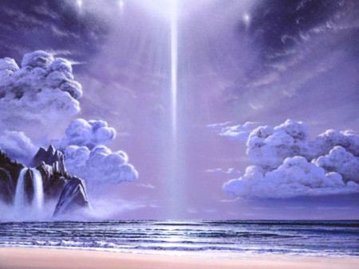
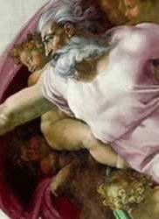
21 Attributes / Perfections of God

Slide 3
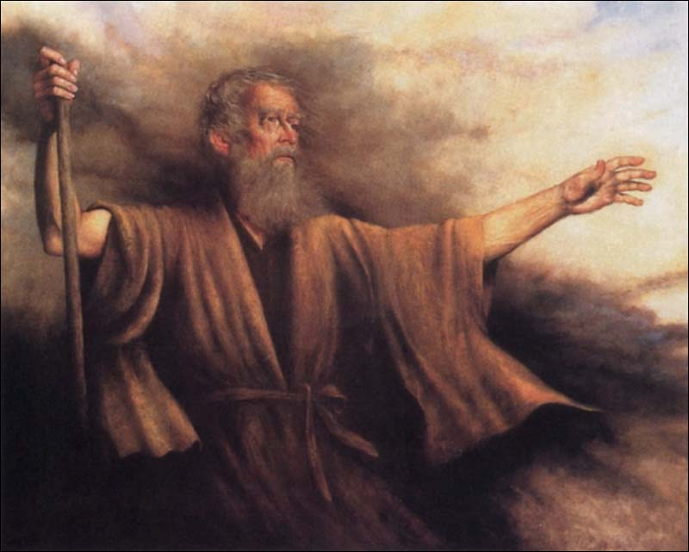
“I will publish the name of the LORD: ascribe ye greatness unto our God. He is the Rock, his work is perfect: for all his ways are judgment: a God of truth and without iniquity, just and right is he.” Deuteronomy 32:3-4

Slide 4
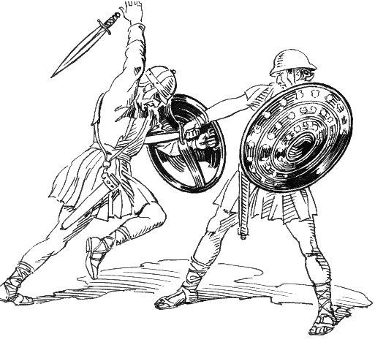
“As for God, his way is perfect: the word of the LORD is tried: he is a buckler to all those that trust in him.” Psalm 18:30

Slide 5
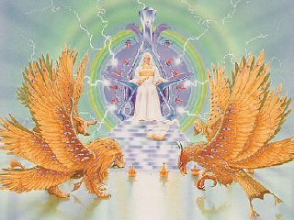
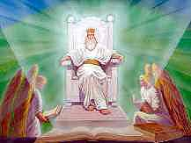
“The perfection of beauty, God hath shined.” Psalm 50:2

Slide 6
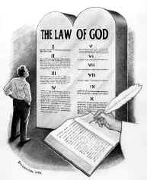
“The law of the LORD is perfect, converting the soul: the testimony of the LORD is sure, making wise the simple.” Psalm 19:7

Slide 7
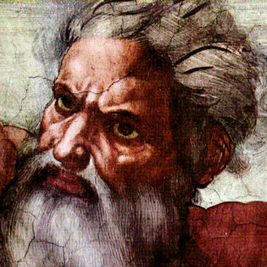
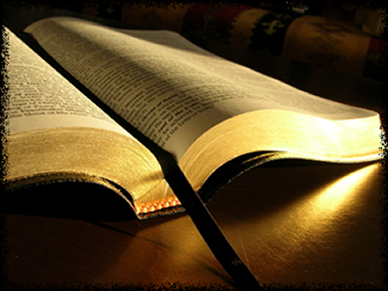
“For truly my words shall not be false: He that is perfect in knowledge is with thee.” Job 36:4

Slide 8
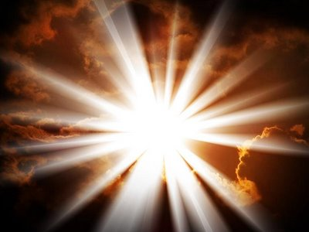
God is light
God is inscrutable
God is faithful
God is holy
God is just and righteous
God is true
God is good
God is merciful
God is gracious
God is love
God is incomprehensible
God is self-existence
God is self-sufficient
God is eternal
God is infinite
God is omnipotent
God is omnipresent
God is omniscient
God is all wise
God is immutable
God is sovereign

Slide 9
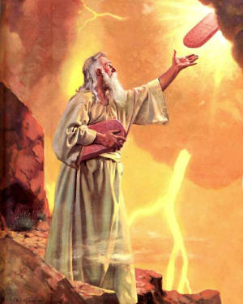
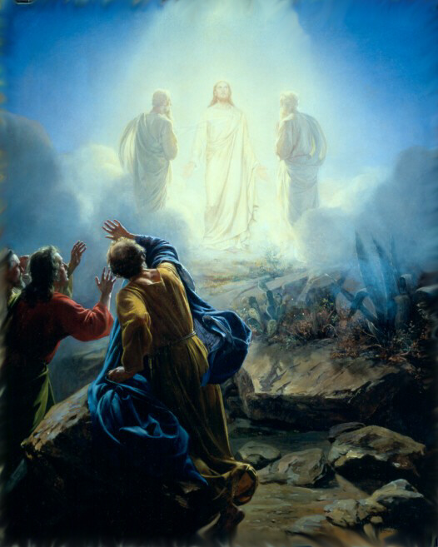
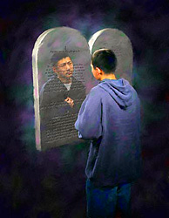
“But we all, with open face beholding as in a glass the glory of the Lord, are changed into the same image from glory to glory, even as by the Spirit of the Lord.” II Cor. 3:18

Slide 10
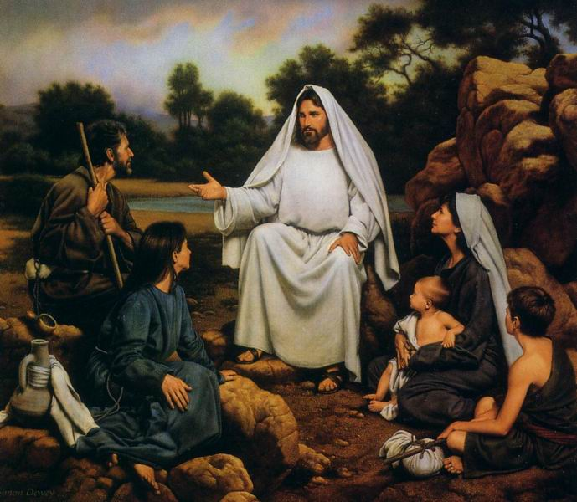
“Be ye therefore perfect, even as your Father which is in heaven is perfect.” Matthew 5:48

Slide 11
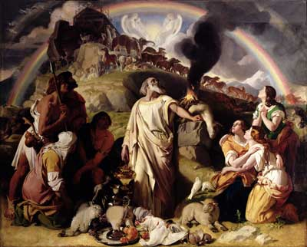
“These are the generations of Noah: Noah was a just man and perfect in his generations, and Noah walked with God.” Gen. 6:9

Slide 12
“And when Abram was ninety years old and nine, the LORD appeared to Abram, and said unto him, I am the Almighty God; walk before me, and be thou perfect.” Gen. 17:1

Slide 13
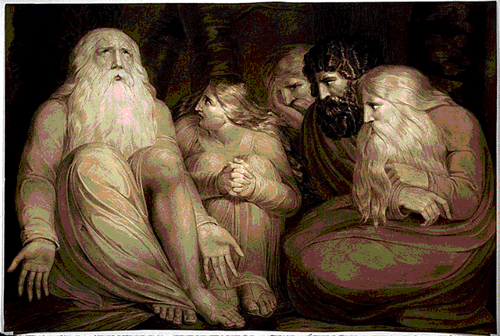
“There was a man in the land of Uz, whose name was Job; and that man was perfect and upright, and one that feared God, and eschewed evil.” Job 1:1

Slide 14
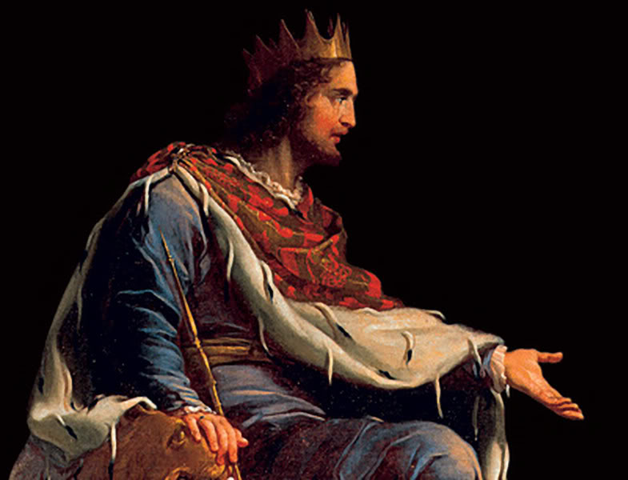
“And said, Remember now, O LORD, I beseech thee, how I have walked before thee in truth and with a perfect heart, and have done that which is good in thy sight. And Hezekiah wept sore.” Isa. 38:3

Slide 15
“For even hereunto were ye called: because Christ also suffered for us, leaving us an example, that ye should follow his steps.” I Peter 2:21

Slide 16
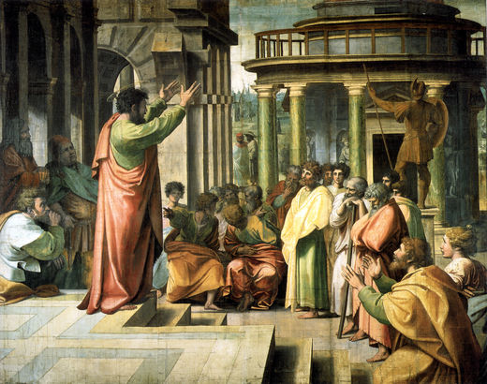
“My little children, of whom I travail in birth again until Christ be formed in you.” Gal. 4:19

Slide 17
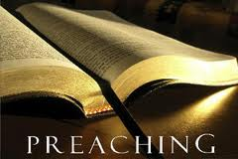
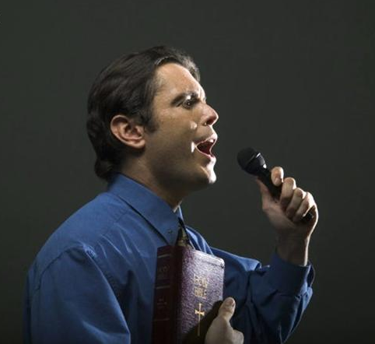
“Whom we preach, warning every man, and teaching every man in all wisdom; that we may present every man perfect in Christ Jesus.” Col. 1:28

Slide 18
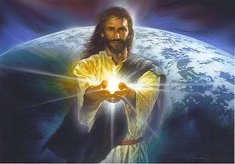
“And he gave some, apostles; and some, prophets; and some, evangelists; and some, pastors and teachers; For the perfecting of the saints, for the work of the ministry, for the edifying of the body of Christ:” Ephesians 4:11-12

Slide 19
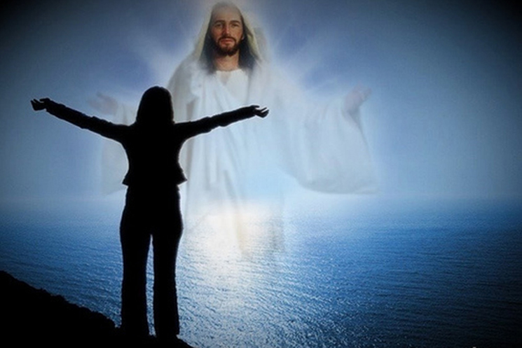
“Till we all come in the unity of the faith, and of the knowledge of the Son of God, unto a perfect man, unto the measure of the stature of the fulness of Christ.” Eph. 4:13

Slide 20
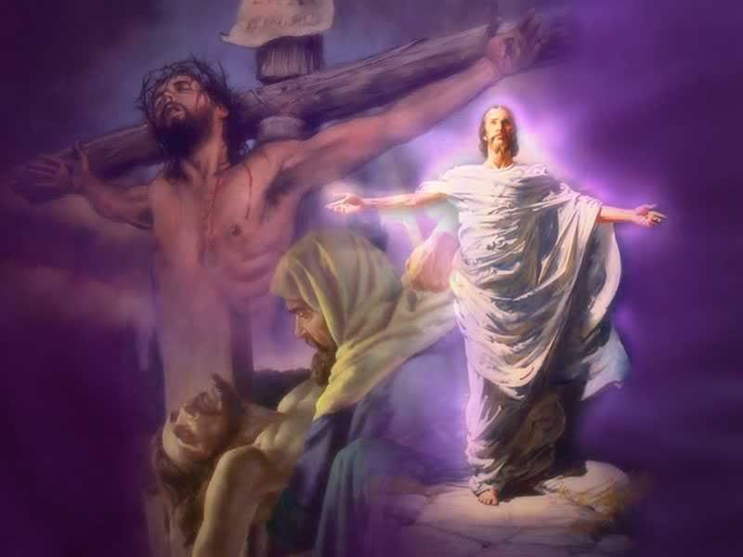
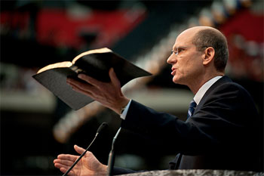
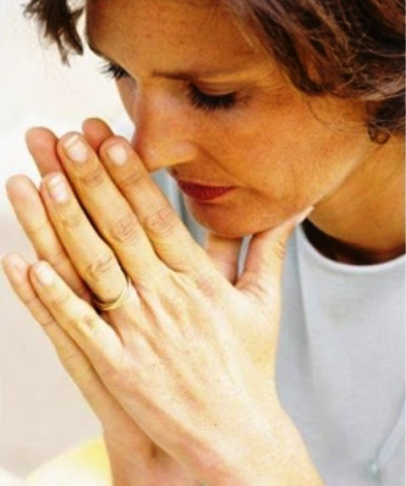
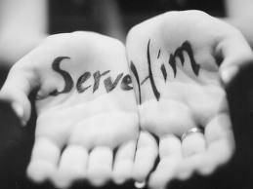
Glory of God
“The perfecting
of the saints…”

Slide 22
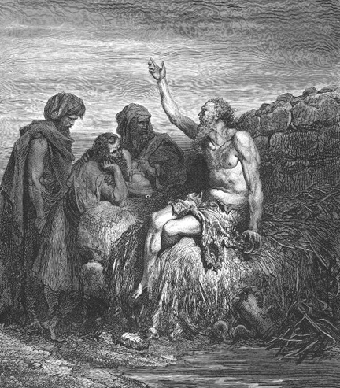
God is incomprehensible
“Canst thou by searching find out God? canst thou find out the Almighty unto perfection? It is as high as heaven; what canst thou do? deeper than hell; what canst thou know? The measure thereof is longer than the earth, and broader than the sea.” Job 11:7-9

Slide 23
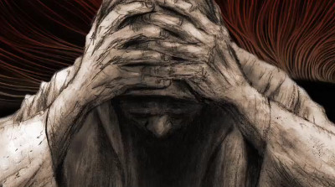
"I would seek unto God, and unto God would I commit my cause: Which doeth great things and unsearchable; marvellous
things without number.”
Job 5:7-9

Slide 24
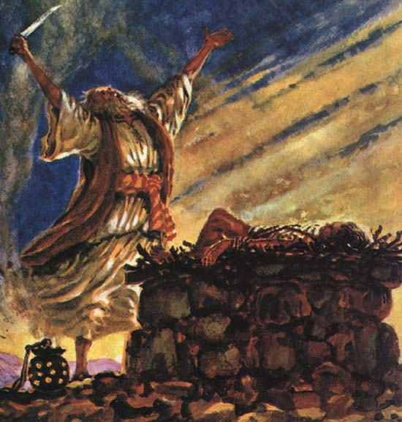
“Shall not the Judge of all
the earth do right?”
Gen. 18:25

Slide 25
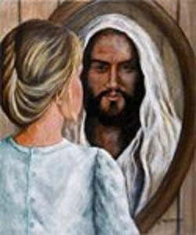
“And we know that all things work together for good to them that love God, to them who are the called according to his purpose. For whom he did foreknow, he also did predestinate to be conformed to the image of his Son.” Romans 8:28-29

Slide 26
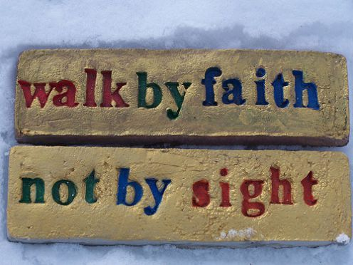
“For we walk by faith, not by sight.” II Cor. 5:7

Slide 27
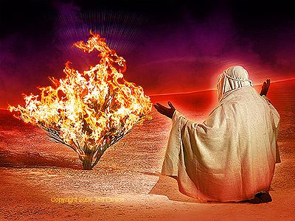
God is self-existent
"And Moses said unto God, Behold, when I come unto the children of Israel, and shall say unto them, The God of your fathers hath sent me, What is his name? What shall I say unto them? And God said unto Moses, I AM THAT I AM: and he said, Thus shalt thou say unto the children of Israel, I AM hath sent me unto you.”
Exodus 3:13-14

Slide 28
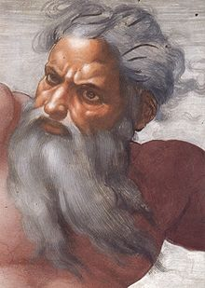
“God exists because He exists.”
“God is not dependent upon
anything or anyone”
His existence (Psalm 90:2)
His thoughts (Romans 11:33, 34)
His will (Romans 9:19; Eph. 1:5)
His power (Psalm 115:3)
His counsel (Psalm 33:10, 11)

Slide 29
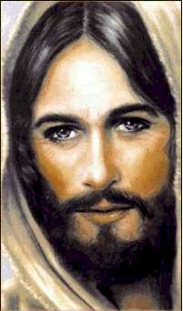
“I said therefore unto you, that ye shall die in your sins: for if ye believe not that I am he, ye shall die in your sins.” John 8:24

Slide 30
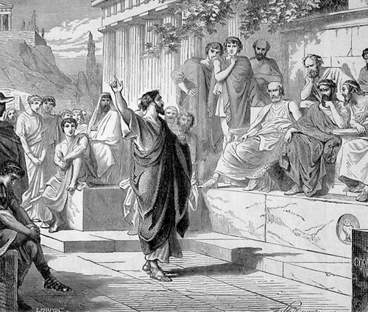
God is self-sufficient
“Neither is worshipped with men's hands, as though he needed any thing, seeing he giveth to all life, and breath, and all things.” Acts 17:25

Slide 31
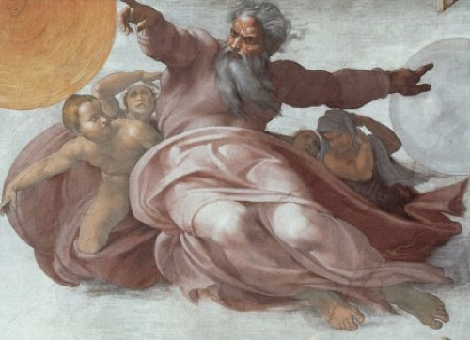
This attribute is closely connected to the attribute of self-existence, but carries it a step further.
This means God has never had in eternity past, nor can ever have in the ages to come, a single need for which his own divine nature has not already provided.

Slide 32
“But my God shall supply all your need according to his riches in glory by Christ Jesus.” Phil. 4:19

Slide 33
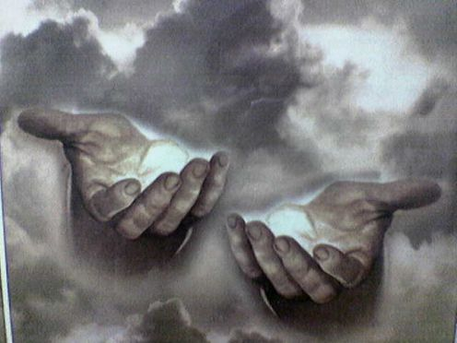
God is eternal
"The eternal God is thy refuge, and underneath are the everlasting arms: and he shall thrust out the enemy from before thee.” Deuteronomy 33:27

Slide 34
When we speak of God being eternal, we mean that He has no beginning or end. God has always existed. He is above all temporal limits of time. He possesses all His existence in one indivisible present. He sees the past and future as clearly as the present. He is neither conditioned, controlled or confined by time.

Slide 35
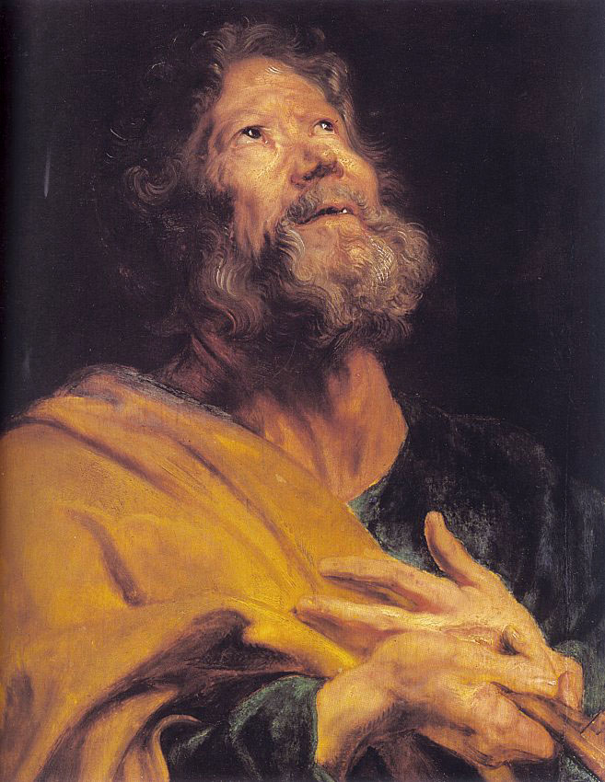
“But, beloved, be not ignorant of this one thing, that one day is with the Lord as a thousand years, and a thousand years as one day.” II Peter 3:8

Slide 36
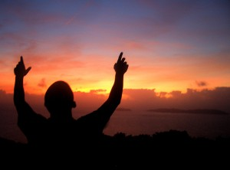
“For thus saith the high and lofty One that inhabiteth eternity, whose name is Holy; I dwell in the high and holy place, with him also that is of a contrite and humble spirit, to revive the spirit of the humble, and to revive the heart of the contrite ones.” Isa. 57:15

Slide 37
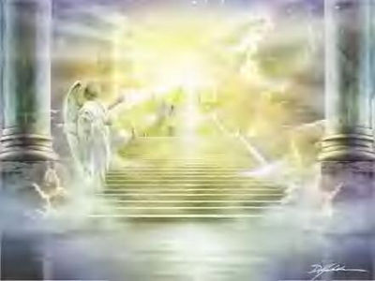
God is infinite
Unlimited, unmeasurable, unbounded and unlimited

Slide 38
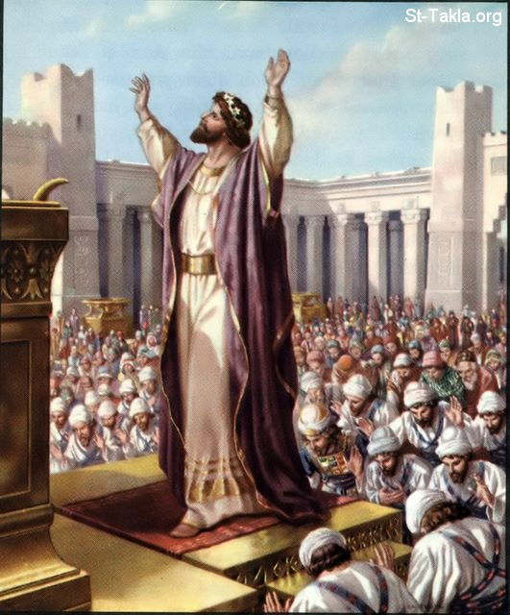
"And Solomon stood before the altar of the Lord in the presence of all the congregation of Israel, and spread forth his hands toward heaven: And he said…Behold, the heaven and heaven of heavens cannot contain thee; how much less this house that I have builded?”
I Kings 8:22, 23, 27

Slide 39
He is infinitely “perfect” – Job 11:7-9; Jer. 31:37
He is infinite in His "purity, holiness, and justice” – Job 4:17-18; Isa. 6:2-3
He is infinite in “goodness and mercy” – Psalm 16:2; 100:5; 108:4
His "greatness" it is "unsearchable” - Psalm 145:3
The height, depth, length and breadth of the love of God, infinitely immeasurable - Eph. 3:18

Slide 40
His "understanding" is infinite - Psalm 147:5
There is "no searching of his understanding" - Isa. 40:28
He is a God of all “knowledge and wisdom”
His infinite wisdom and knowledge are beyond man’s ability to comprehend - Rom. 11:33
The power of God is infinite – Heb. 1:3
With Him nothing is impossible – Luke 1:37
There is no end of His power – “eternal power”- Rom. 1:20

Slide 42
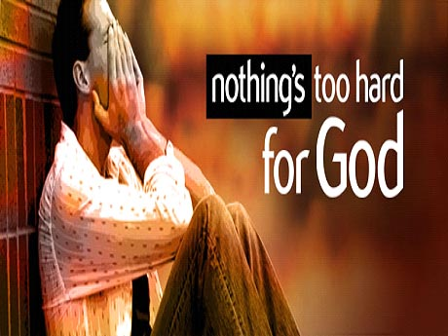
God is omnipotent
"Is any thing too hard for the Lord?” (Genesis 18:14)

Slide 43
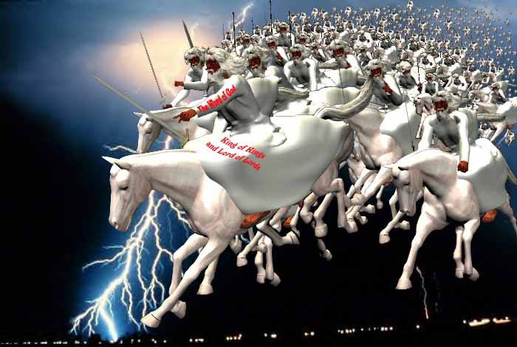
"And I heard as it were the voice of a great multitude, and as the voice of many waters, and as the voice of mighty thunderings, saying, Alleluia: for the Lord God omnipotent reigneth.” Revelation 19:6

Slide 44
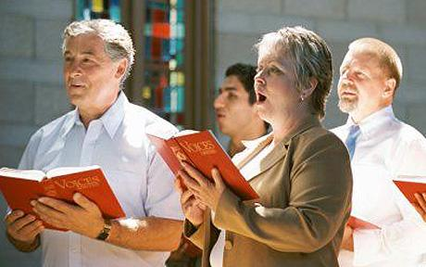
God can do anything but fail
God can do anything, anything, anything God can do anything but fail God can do anything, anything, anything God can do anything but fail
He can save, He can cleanse He can keep, and He will God can do anything but fail He can save, He can cleanse He can keep, and He will God can do anything but fail Chorus: He's the Alpha and Omega, the beginning and the end He's the fairest of ten thousand to my soul God can do anything, anything, anything God can do anything but fail

Slide 45
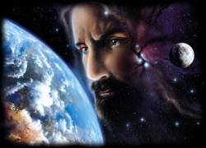
God is omnipresent
"Whither shall I go from thy spirit? or whither shall I flee from thy presence? If I ascend up into heaven, thou art there: if I make my bed in hell, behold, thou art there. If I take the wings of the morning, and dwell in the uttermost parts of the sea; even there shall thy hand lead me, and thy right hand shall hold me.”
Psalm 139:7-11

Slide 46
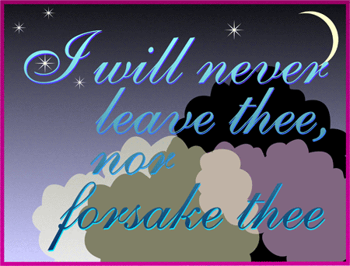

Slide 48
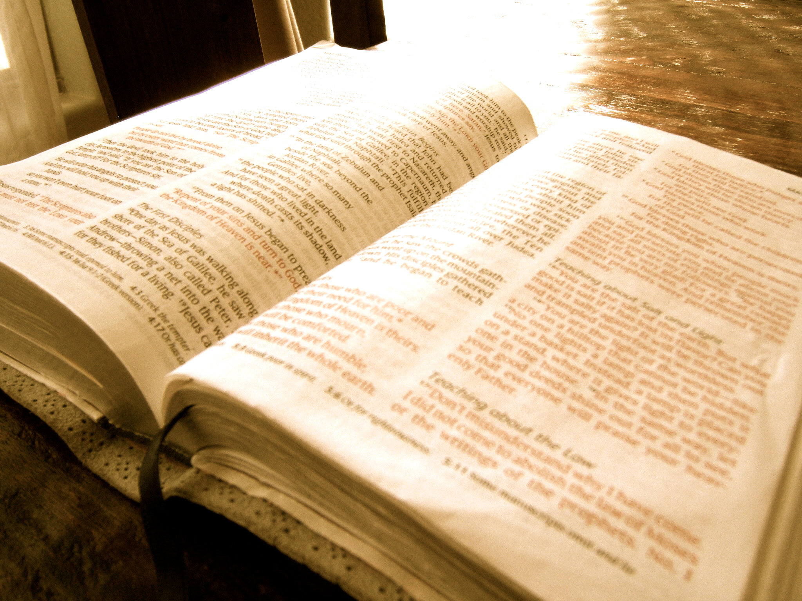
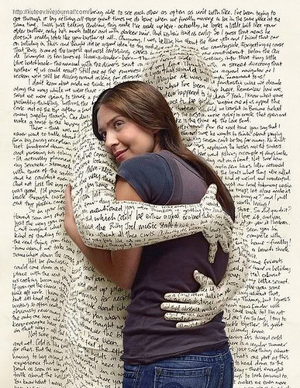
“That we through patience and comfort of the scriptures might have hope…”

Slide 49
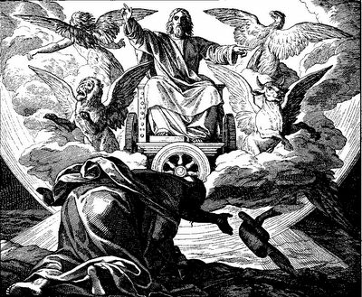
God is omniscient
"Great is our Lord, and of great power: his understanding is infinite.“ Psalm 147:5

Slide 50
God possesses (without prior discovery of facts) complete and universal knowledge of all things past, present, and future.
He sees all things
Proverbs 15:3 "The eyes of the Lord are in every place, beholding the evil and the good."
He knows all things (the big and small of His universe)
Hebrews 4:13 "Neither is there any creature that is not manifest in his sight: but all things are naked and opened unto the eyes of him with whom we have to do."

Slide 51
He knows our thoughts
Psalm 44:21 "Shall not God search this out? For he knoweth the secrets of the heart."
He knows our words
Psalm 139:4 "For there is not a word in my tongue, but, lo, O Lord, thou knowest it altogether."
He knows our deeds
Psalm 139:2"Thou knowest my downsitting and mine uprising."

Slide 52
He knows our sorrows
Exodus 3:7 “I know their sorrows…”
He knows our needs
Matthew 6:32 “…for your heavenly Father knoweth that ye have need of all these things.”
He knows our devotion
II Chronicles 16:9 “For the eyes of the Lord run to and fro throughout the whole earth, to shew himself strong in the behalf of them whose heart is perfect toward him.”

Slide 53
He knows our frailties
Psalm 103:14 “For he knoweth our frame; he remembereth that we are dust.”
He knows our foolishness
Psalm 69:5 “O God, thou knowest my foolishness; and my sins are not hid from thee.”
He knows His own
II Timothy 2:19 “Nevertheless the foundation of God standeth sure, having this seal, The Lord knoweth them that are his.”

Slide 54
He knows the past, present, and future
Acts 15:18 "Known unto God are all his works from the beginning of the world."
He knows what might or could have been
Matthew 11:23 "And thou, Capernaum, which art exalted unto heaven, shalt be brought down to hell: for if the mighty works, which have been done in thee, had been done in Sodom, it would have remained until this day."

Slide 55
“I will walk before the LORD in the land of the living.” Psalm 116:9

Slide 56
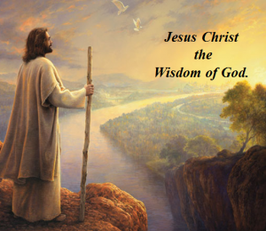
God is all wise
"To the only wise God our Saviour, be glory and majesty, dominion and power, both now and ever. Amen.” Jude 1:25

Slide 57
“That your faith should not stand in the wisdom of men, but in the power of God. Howbeit we speak wisdom among them that are perfect: yet not the wisdom of this world, nor of the princes of this world, that come to nought: But we speak the wisdom of God in a mystery, even the hidden wisdom, which God ordained before the world unto our glory: Which none of the princes of this world knew: for had they known it, they would not have crucified the Lord of glory. But as it is written, Eye hath not seen, nor ear heard, neither have entered into the heart of man, the things which God hath prepared for them that love him.

Slide 58
But God hath revealed them unto us by his Spirit: for the Spirit searcheth all things, yea, the deep things of God. For what man knoweth the things of a man, save the spirit of man which is in him? even so the things of God knoweth no man, but the Spirit of God. Now we have received, not the spirit of the world, but the spirit which is of God; that we might know the things that are freely given to us of God. Which things also we speak, not in the words which man's wisdom teacheth, but which the Holy Ghost teacheth; comparing spiritual things with spiritual. But the natural man receiveth not the things of the Spirit of God: for they are foolishness unto him: neither can he know them, because they are spiritually discerned.”

Slide 59
“If any of you lack wisdom, let him ask of God, that giveth to all men liberally, and upbraideth not; and it shall be given him.” James 1:5

Slide 60
God is immutable “For I am the Lord, I change not.” Malachi 3:6
Hebrews 6:17-18

Slide 61
God is sovereign
"Remember the former things of old: for I am God, and there is none else; I am God, and there is none like me, declaring the end from the beginning, and from ancient times the things that are not yet done, saying, My counsel shall stand, and I will do all my pleasure: yes, I have spoken it, I will also bring it to pass; I have purposed it, I will also do it.” Isaiah 46:9-11

Slide 62
God’s sovereignty simply means –
“God is in control.”

Slide 63
Because God is sovereign and He loves you, nothing will ever come into your life that He does not either decree or allow. Consequently, no matter what you face in life, you can take comfort in the fact that God is sovereign.

Slide 65
God is light

Slide 66
“And these things write we unto you, that your joy may be full. This then is the message which we have heard of him, and declare unto you, that God is light, and in him is no darkness at all. If we say that we have fellowship with him, and walk in darkness, we lie, and do not the truth: But if we walk in the light, as he is in the light, we have fellowship one with another, and the blood of Jesus Christ his Son cleanseth us from all sin. If we say that we have no sin, we deceive ourselves, and the truth is not in us. If we confess our sins, he is faithful and just to forgive us our sins, and to cleanse us from all unrighteousness.” I John 1:4-9

Slide 67
"But ye are a chosen generation, a royal priesthood, an holy nation, a peculiar people; that ye should shew forth the praises of him who hath called you out of darkness into his marvellous light." I Peter 2:9

Slide 68
God’s light “Revealed through the Word of God” (Psalm 119:105)

Slide 69
God is inscrutable
INCOMPREHENSIBLE
beyond our understanding
MAN CANNOT PLUMB THE DEPTS OR LIMITS OF GOD
“For my thoughts are not your thoughts, neither are your ways my ways, saith the LORD. For as the heavens are higher than the earth, so are my ways higher than your ways, and my thoughts than your thoughts.”
Isa. 55:8-9

Slide 70
God's will may not make sense to us but does to God.
We may not have all the answers but we serve the God who does.

Slide 71
God is faithful

Slide 72
“Thy mercy, O LORD, is in the heavens; and thy faithfulness reacheth unto the clouds.” Psalm 36:5

Slide 73
“Moreover it is required in stewards, that a man be found faithful.” I Cor. 4:2
“His lord said unto him, Well done, good and faithful servant; thou hast been faithful over a few things, I will make thee ruler over many things: enter thou into the joy of thy lord.” Matt. 25:23

Slide 74
God is holy
God
wise, immutable, sovereign, inscrutable, light, faithful, incomprehensible, self-existence, self-sufficient, eternal, infinite, omnipotent, omnipresent, omniscient, righteousness, just, true, good, merciful, gracious, love
Holiness

Slide 75
“Sanctify yourselves therefore, and be ye holy: for I am the LORD your God…
But as he which hath called you is holy, so be ye holy in all manner of conversation…
Because it is written, Be ye holy; for I am holy.”

Slide 76
“But the day of the Lord will come as a thief in the night; in the which the heavens shall pass away with a great noise, and the elements shall melt with fervent heat, the earth also and the works that are therein shall be burned up. Seeing then that all these things shall be dissolved, what manner of persons ought ye to be in all holy conversation and godliness.”
II Peter 3:10-11

Slide 77
God is just and righteous
“There is no God else beside me; a just God and a Saviour; there is none beside me.”
Isa. 45:21
“For the righteous God trieth the hearts and reins.”
Psalm 7:9

Slide 78
“Blessings are upon the head of the just.” Prov. 10:6
“For the eyes of the Lord are over the righteous, and his ears are open unto their prayers: but the face of the Lord is against them that do evil.”
I Peter 3:12

Slide 79
God is true
"And this is life eternal, that they might know thee the only true God, and Jesus Christ, whom thou hast sent.”
John 17:3
“Sanctify them through thy truth: thy word is truth.” John 17:17

Slide 80
“Moreover thou shalt provide out of all the people able men, such as fear God, men of truth, hating covetousness.”
Exod. 18:21
“For my mouth shall speak truth; and wickedness is an abomination to my lips.” Prov. 8:7

Slide 81
God is good
“Oh that men would praise the Lord for his goodness, and for his wonderful works to the children of men!” Psalm 107:8

Slide 82
"The Lord is good, a stronghold in the day of trouble, and He knoweth them that trust in Him" Nahum 1:7

Slide 83
“Let your light so shine before men, that they may see your good works, and glorify your Father which is
in heaven.”
Matt. 5:16

Slide 84
God is merciful
Psalm 136
“His mercy endureth forever…”

Slide 85
Mercy = God withholding from us what we rightly deserve!
“Have mercy upon us, O LORD, have mercy upon us: for we are exceedingly filled with contempt (base, worthless, disobedient, disrespectful, despised, shameful).” Psalm 123:3

Slide 86
Praise the LORD; for his mercy endureth for ever

Slide 87
“I beseech you therefore, brethren, by the mercies of God, that ye present your bodies a living sacrifice, holy, acceptable unto God, which is your reasonable service.” Rom. 12:1
“Put on therefore, as the elect of God, holy and beloved, bowels of mercies, kindness, humbleness of mind, meekness, longsuffering…” Col. 3:12

Slide 88
God is gracious
"Gracious is the Lord, and righteous; yea, our God is merciful.”
Psalm 116:5
“He hath made his wonderful works to be remembered: the Lord is gracious and full of compassion.” Psalm 111:4
“But the God of all grace, who hath called us unto his eternal glory by Christ Jesus, after that ye have suffered a while, make you perfect, stablish, strengthen, settle you.”
1 Peter 5:10
“If so be ye have tasted that the Lord is gracious.”
1 Peter 2:3

Slide 89
“For the grace of God that bringeth salvation hath appeared to
all men.”
Titus 2:11

Slide 90
Grace
Mercy
“Gracious is the Lord, and righteous; yea, our God is merciful.” Psalm 116:5

Slide 91
It is helpful at this point to
contrast mercy with grace
God’s mercy allows him to withhold merited punishment – Psalm 89:14
God’s grace allows Him to freely bestow unmerited favor – Ezra 9:8
Mercy is not getting what we deserve, namely, hell – Rev. 20:13-14
Grace is getting what we do not deserve, namely, heaven – Rev. 21:1-4

Slide 92
Mercy
Grace

Slide 93
“Be strong in the grace that is in Christ Jesus…”

Slide 94
“To the praise of the glory of His grace, wherein he hath made us accepted in the beloved.” Eph. 1:6

Slide 95
God is love
I John 4:8,16 “He that loveth not knoweth not God; for God is love…And we have known and believed the love that God hath to us. God is love.”

Slide 96
“In this was manifested the love of God toward us, because that God sent his only begotten Son into the world, that we might live through him. Herein is love, not that we loved God, but that he loved us, and sent his Son to be the propitiation for our sins.” I John 4:9-10

Slide 97
“Then one of them, which was a lawyer, asked him a question, tempting him, and saying, Master, which is the great commandment in the law? Jesus said unto him, Thou shalt love the Lord thy God with all thy heart, and with all thy soul, and with all thy mind. This is the first and great commandment. And the second is like unto it, Thou shalt love thy neighbour as thyself. On these two commandments hang all the law and the prophets.”
Matthew 22:35-40

Slide 99
“A new commandment I give unto you, That ye love one another; as I have loved you, that ye also love one another.”
John 13:34

Slide 100
“Though I speak with the tongues of men and of angels, and have not charity, I am become as sounding brass, or a tinkling cymbal. And though I have the gift of prophecy, and understand all mysteries, and all knowledge; and though I have all faith, so that I could remove mountains, and have not charity, I am nothing. And though I bestow all my goods to feed the poor, and though I give my body to be burned, and have not charity, it profiteth me nothing.” I Cor. 13

Slide 101
“For the love of Christ constraineth us; because we thus judge, that if one died for all, then were all dead: And that he died for all, that they which live should not henceforth live unto themselves, but unto him which died for them, and rose again.” II Corinthians 5:14-15

Slide 103
God is light
God is inscrutable
God is faithful
God is holy
God is just and righteous
God is true
God is good
God is merciful
God is gracious
God is love
God is incomprehensible
God is self-existence
God is self-sufficient
God is eternal
God is infinite
God is omnipotent
God is omnipresent
God is omniscient
God is all wise
God is immutable
God is sovereign

