Slide 1
The Fear of the Lord
Proverbs 1:1-33

Slide 2
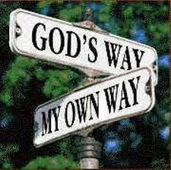
What is the fear of the Lord? – “Continual awareness that there is a Holy God that knows every thought that we think and everything we do and He is either blessing or cursing us accordingly…”

Slide 3
Being wise enough to chose the way of blessing -
“I call heaven and earth to record this day against you, that I have set before you life and death, blessing and cursing: therefore choose life, that both thou and thy seed may live.” Deut. 30:19
“And if it seem evil unto you to serve the LORD, choose you this day whom ye will serve; whether the gods which your fathers served that were on the other side of the flood, or the gods of the Amorites, in whose land ye dwell: but as for me and my house, we will serve the LORD.” Josh. 24:15

Slide 4
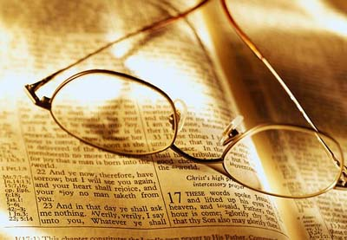
Wisdom = Seeing life from God’s perspective
Prov. 16:25 “There is a way that seemeth right unto a man, but the end thereof are the ways of death.”
Col. 1:28 “Whom we preach, warning every man, and teaching every man in all wisdom; that we may present every man perfect in Christ Jesus.”

Slide 5
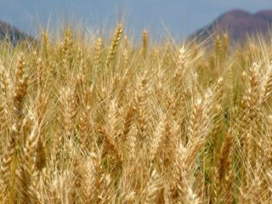
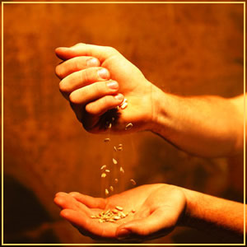
Understanding the consequences of sinful decisions and avoiding them –
Gal. 6:7 “Be not deceived; God is not mocked: for whatsoever a man soweth, that shall he also reap.”
Sow a thought and you reap an action; sow an act and you reap a habit; sow a habit and you reap a character; sow a character and you reap a destiny.

Slide 6
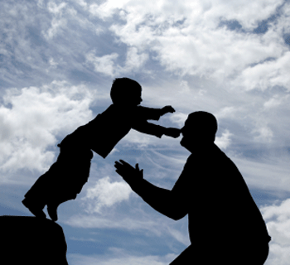

Slide 7
“For whom the Lord loveth he chasteneth, and scourgeth every son whom he receiveth. If ye endure chastening, God dealeth with you as with sons; for what son is he whom the father chasteneth not? But if ye be without chastisement, whereof all are partakers, then are ye bastards, and not sons. Furthermore we have had fathers of our flesh which corrected us, and we gave them reverence: shall we not much rather be in subjection unto the Father of spirits, and live? For they verily for a few days chastened us after their own pleasure; but he for our profit, that we might be partakers of his holiness. Now no chastening for the present seemeth to be joyous, but grievous: nevertheless afterward it yieldeth the peaceable fruit of righteousness unto them which are exercised thereby.” (Hebrews 12:6-11)

Slide 8
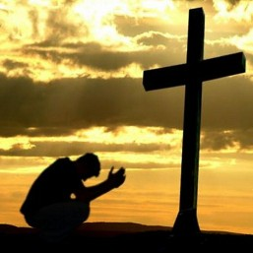
Fear of man
Fear of God
“And fear not them which kill the body, but are not able to kill the soul: but rather fear him which is able to destroy both soul and body in hell.” Matt. 10:28

Slide 10
To overcome sinful habits:
“By mercy and truth iniquity is purged: and by the fear of the Lord men depart from evil.” Proverbs 16:6
To begin learning knowledge:
“The fear of the Lord is the beginning of knowledge. . .” Proverbs 1:7
To start being wise:
“The fear of the Lord is the beginning of wisdom: and the knowledge of the holy is understanding.” Proverbs 9:10

Slide 11
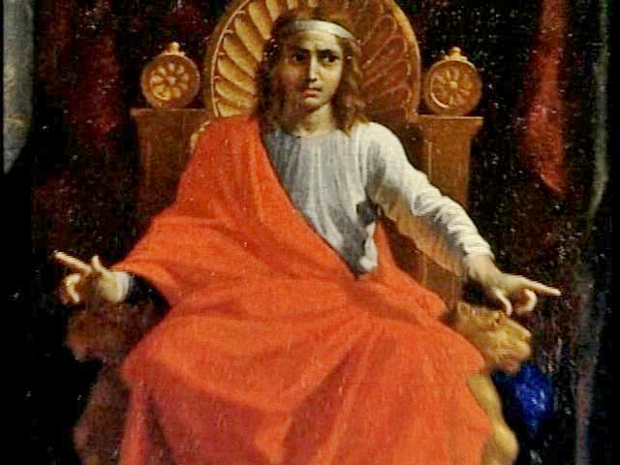
“Give me now wisdom and knowledge, that I may go out and come in before this people: for who can judge this thy people, that is so great?” IIChro. 1:10

Slide 12
Knowledge = Facts / Intelligence
I Cor. 8:1 “Knowledge puffeth up.”
Wisdom = Humble application knowledge
Prov. 4:7 “Wisdom is the principal thing; therefore get wisdom: and with all thy getting get understanding (discernment).”

Slide 13
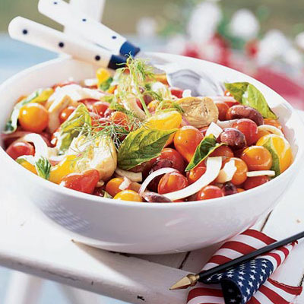
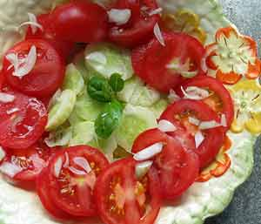

Slide 14
To grow in wisdom:
“The fear of the Lord is the instruction of wisdom; and before honour is humility.” Proverbs 15:33
To get riches, honor, and life:
“By humility and the fear of the Lord are riches, and honour, and life.” Proverbs 22:4
To experience true worship:
“But as for me, I will come into thy house in the multitude of thy mercy: and in thy fear will I worship toward thy holy temple.” Psalm 5:7

Slide 15
“O come, let us worship and bow down: let us kneel before the LORD our maker.
O worship the LORD in the beauty of holiness.” Psalm 95:6; 96:9

Slide 16
To have a longer life:
“The fear of the Lord prolongeth days: but the years of the wicked shall be shortened.” Proverbs 10:27
To learn contentment:
“Better is little with the fear of the Lord than great treasures and trouble therewith.” Proverbs 15:16
To discover the fountain of life:
“The fear of the Lord is a fountain (joy/happiness) of life, to depart from the snares of death.” Proverbs 14:27

Slide 17
“The thief cometh not, but for to steal, and to kill, and to destroy: I am come that they might have life, and that they might have it more abundantly.” John 10:10

Slide 18
“He that believeth on me, as the scripture hath said, out of his belly shall flow rivers of living water. But this spake he of the Spirit, which they that believe on him should receive.” John 7:38-39

Slide 19
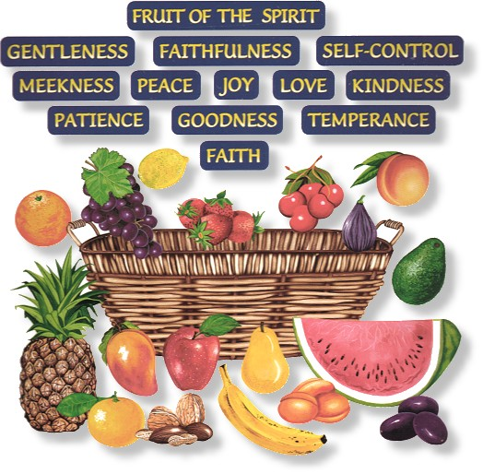
“But the fruit of the Spirit is love,
joy, peace….” Gal. 5:22

Slide 20
To be looked to for truthfulness:
“Thou hast given a banner to them that fear thee, that it may be displayed because of the truth.” Psalm 60:4
To receive a special heritage:
“For thou, O God, hast heard my vows; thou hast given me the heritage of those that fear thy name.” Psalm 61:5
To be given God’s mercy:
“For as the heaven is high above the earth, so great is his mercy toward them that fear him.” Psalm 103:11

Slide 21
To experience God’s salvation:
“Surely his salvation is nigh them that fear him; that glory may dwell in our land.” Psalm 85:9
To have no wants:
“O fear the Lord, ye his saints: for there is no want to them that fear him.” Psalm 34:9
To receive daily provision:
“He hath given meat unto them that fear him: he will ever be mindful of his covenant.” Psalm 111:5

Slide 22
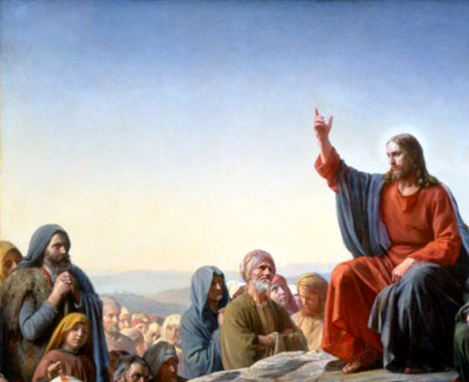
“Ask, and it shall be given you; seek, and ye shall find; knock, and it shall be opened unto you: For every one that asketh receiveth; and he that seeketh findeth; and to him that knocketh it shall be opened. Or what man is there of you, whom if his son ask bread, will he give him a stone? Or if he ask a fish, will he give him a serpent? If ye then, being evil, know how to give good gifts unto your children, how much more shall your Father which is in heaven give good things to them that ask him?”
Matthew 7:7-11

Slide 23
“But my God shall supply all your need according to
his riches in glory by
Christ Jesus.” Phil. 4:19

Slide 24
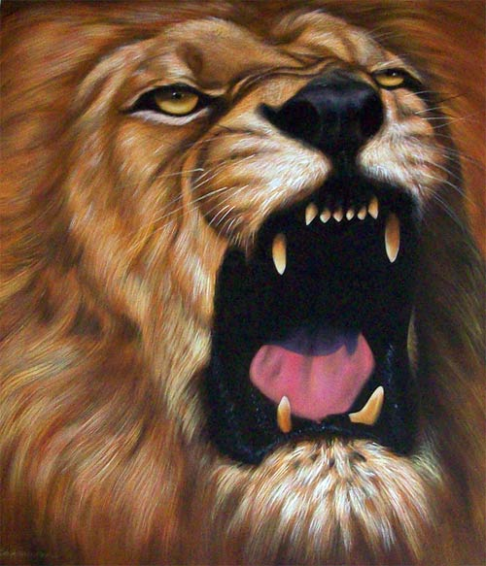
To experience strong confidence:
“In the fear of the Lord is strong confidence: and his children shall have a place of refuge.” Proverbs 14:26
“The eternal God is thy refuge, and underneath are the everlasting arms: and he shall thrust out the enemy from before thee; and shall say, Destroy them.” Deuteronomy 33:27

Slide 25
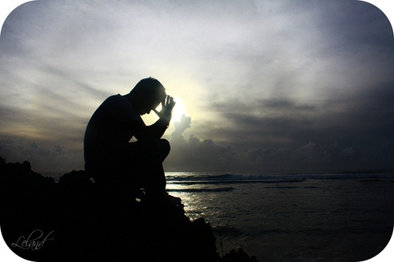
To experience fellowship with god:
“The secret (intimacy) of the Lord is with them that fear him; and he will shew them his covenant.” Psalm 25:14
“Jesus answered and said unto him, If a man love me, he will keep my words: and my Father will love him, and we will come unto him, and make our abode with him.” John 14:23

Slide 26
To experience God’s goodness:
“Oh how great is thy goodness, which thou hast laid up for them that fear thee; which thou hast wrought for them that trust in thee before the sons of men!” Psalm 31:19

Slide 27
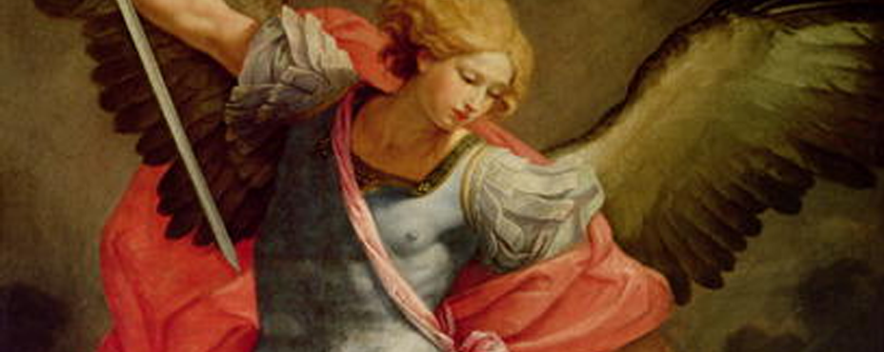
To have constant protection:
“Behold, the eye of the Lord is upon them that fear him, upon them that hope in his mercy; To deliver their soul from death, and to keep them alive in famine.” Psalm 33:18-19
To be delivered from trouble:
“The angel of the Lord encampeth round about them that fear him, and delivereth them.” Psalm 34:7

Slide 28
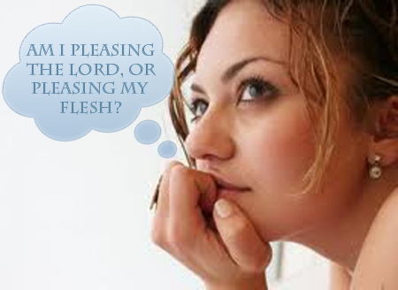
To have the Lord’s pity:
“Like as a father pitieth his children, so the Lord pitieth them that fear him.” Psalm 103:13
To bring delight to the Lord:
“The Lord taketh pleasure in them that fear him, in those that hope in his mercy.” Psalm 147:11

Slide 29
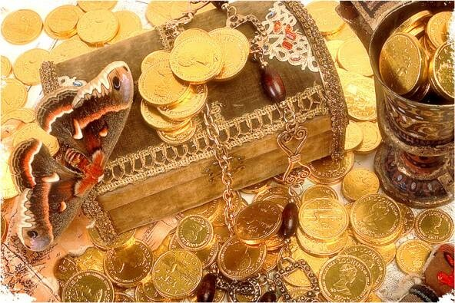
To become a special treasure of God: “Then they that feared the Lord spake often one to another; and the Lord hearkened, and heard it, and a book of remembrance was written before him for them that feared the Lord, and that thought upon his name. And they shall be mine, saith the Lord of hosts, in that day when I make up my jewels.” Malachi 3:16-17

Slide 31
THERE IS No receiving the
Salvation and blessing of the LOrd:
“He will fulfill the desire of them that fear him; he also will hear their cry, and will save them.” Psalm 145:19
THERE IS NO effective witnessing: “But sanctify the Lord God in your hearts: and be ready always to give an answer to every man that asketh you a reason of the hope that is in you with meekness and fear.” I Peter 3:15

Slide 32
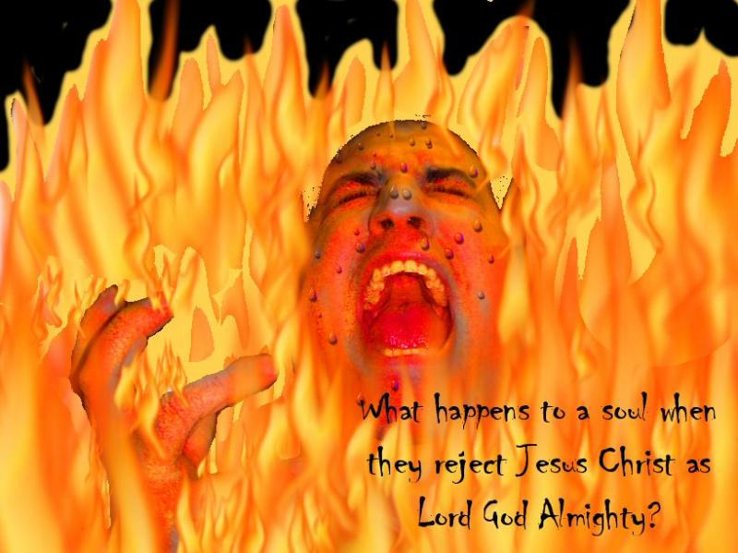
THERE IS NO effective soul-winning:
“And others save with fear, pulling them out of the fire; hating even the garment spotted by the flesh.” Jude 23

Slide 33
THERE IS NO ENTERING INTO GOD’S REST:
“Let us therefore fear, lest, a promise being left us of entering into his rest, any of you should seem to come short of it.” Hebrews 4:1

Slide 34
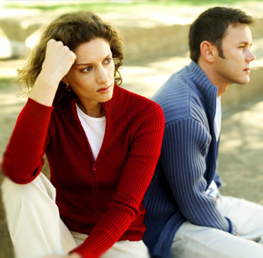
THERE IS NO influence on unsaved husbands:
“Likewise, ye wives, be in subjection to your own husbands; that, if any obey not the word, they also may without the word be won by the conversation of the wives; While they behold your chaste conversation coupled with fear.” I Peter 3:1-2

Slide 35
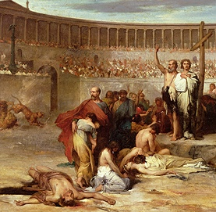
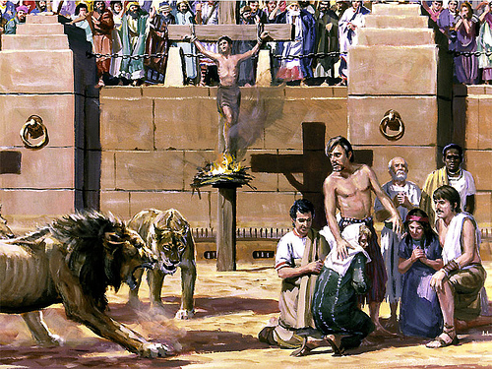
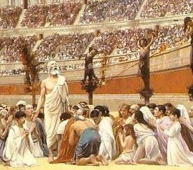
THERE IS NO courage to face suffering for righteousness sake:
“Fear none of those things which thou shalt suffer; behold, the devil shall cast some of you into prison, that ye may be tried; and ye shall have tribulation ten days; be thou faithful unto death, and I will give thee a crown of life.” Revelation 2:10

Slide 36
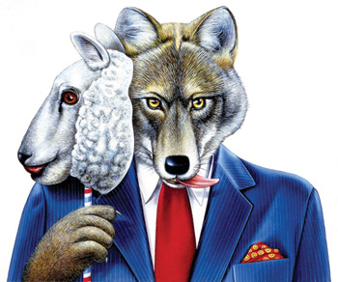
THERE IS NO guard against wrong church members:
“And great fear came upon all the church, and upon as many as heard these things. . . And of the rest durst no man join himself to them: but the people magnified them.”Acts 5:11-13

Slide 37
THERE IS NO effective church DISCIPLINE:
“And Ananias hearing these words fell down, and gave up the ghost: and great fear came on all them that heard these things.”Acts 5:5
“Them that sin rebuke before all, that others also may fear.” I Timothy 5:20
THERE IS NO scriptural submission:
“Submitting yourselves one to another in the fear of the God.” Ephesians 5:21

Slide 38
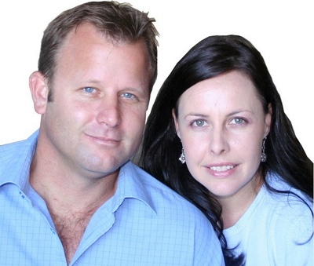
“Wives, submit yourselves unto your own husbands, as unto the Lord.” Eph. 5:22

Slide 39
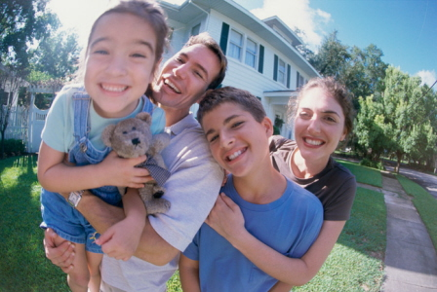
“Children, obey your parents in the Lord: for this is right. Honour thy father and mother; (which is the first commandment with promise;) That it may be well with thee, and thou mayest live long on the earth.” Eph. 6:1-2

Slide 40
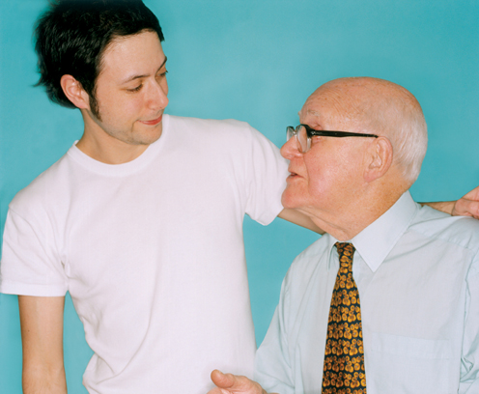
“Likewise, ye younger, submit yourselves unto the elder.” I Peter 5:5

Slide 41
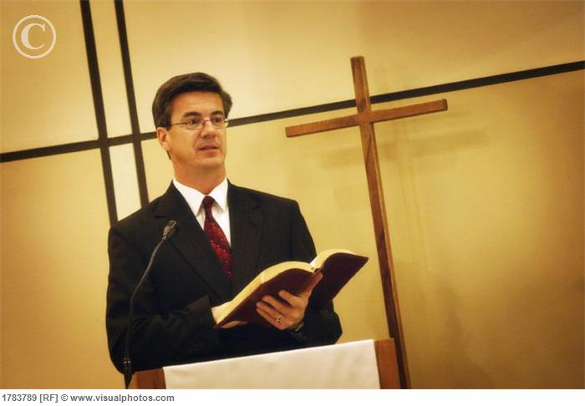
“Obey them that have the rule over you, and submit yourselves: for they watch for your souls, as they that must give account, that they may do it with joy, and not with grief: for that is unprofitable for you.”
Heb. 13:17

Slide 42
THERE IS NO restraint of evil:
“As it is written,There is none righteous, no, not one: There is none that understandeth, there is none that seeketh after God. They are all gone out of the way, they are together become unprofitable; there is none that doeth good, no, not one. Their throat is an open sepulcher; with their tongues they have used deceit; the poison of asps is under their lips: Whose mouth is full of cursing and bitterness: Their feet are swift to shed blood: Destruction and misery are in their ways: And the way of peace have they not known: There is no fear of God before their eyes.” Romans 3:10-18

Slide 43
(2 Timothy 3:1-17) “This know also, that in the last days perilous times shall come. For men shall be…”

Slide 44
THERE IS NO perfecting of holiness:
“Having therefore these promises, dearly beloved, let us cleanse ourselves from all filthiness of the flesh and spirit, perfecting holiness in the fear of God.” II Corinthians 7:1
THERE IS NO maturity in salvation:
“Work out your own salvation with fear and trembling. For it is God which worketh in you both to will and to do of his good pleasure.” Philippians 2:12-13

Slide 45
Who do you fear?

Slide 46
“And as it was in the days of Noah, so shall it be also in the days of the Son of man. They did eat, they drank, they married wives, they were given in marriage, until the day that Noah entered into the ark, and the flood came, and destroyed them all. Likewise also as it was in the days of Lot; they did eat, they drank, they bought, they sold, they planted, they builded; But the same day that Lot went out of Sodom it rained fire and brimstone from heaven, and destroyed them all. Even thus shall it be in the day when the Son of man is revealed.” Luke 17:26-30

Slide 47
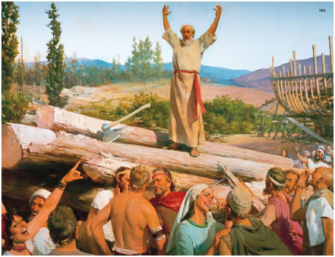
Noah lived in the Fear of God

Slide 48
“And GOD saw that the wickedness of man was great in the earth, and that every imagination of the thoughts of his heart was only evil continually. And it repented the LORD that he had made man on the earth, and it grieved him at his heart. And the LORD said, I will destroy man whom I have created from the face of the earth; both man, and beast, and the creeping thing, and the fowls of the air; for it repenteth me that I have made them. But Noah found grace in the eyes of the LORD… Noah was a just man and perfect in his generations, and Noah walked with God”

Slide 49
Why did Noah find grace in the eyes of the Lord?
Because Noah feared God and would not allow himself or his children to be influenced by the wickedness that was in the world at that time!!!
Note: The Fear of the Lord produced three things in the life of Noah which resulted in God’s grace coming upon him and his family –

Slide 50
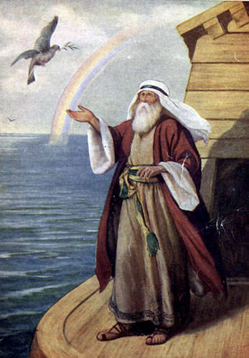
1# Produced personal holiness (just)
2# Produced the ability to resist temptation of sin (perfect in his generation)
3# Produced a close walk with God

Slide 51
The generation in which we live is a very wicked and adulterous generation – I personally believe that this is the last generation to exist before the coming of our Lord and the end of the world – “So likewise ye, when ye shall see all these things, know that it is near, even at the doors. verily I say unto you, This generation shall not pass, till all these things be fulfilled…but as the days of Noah were, so shall also the coming of the son of man be…”

Slide 52
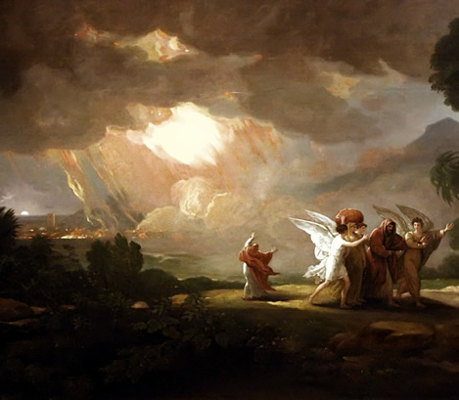
Lot lived in the fear of man
“For that righteous man dwelling among them, in seeing and hearing, vexed his righteous soul from day to day with their unlawful deeds.” IIPet. 2:8

