Slide 1
The Doctrine of the Holy Spirit (Part 1)

Slide 3
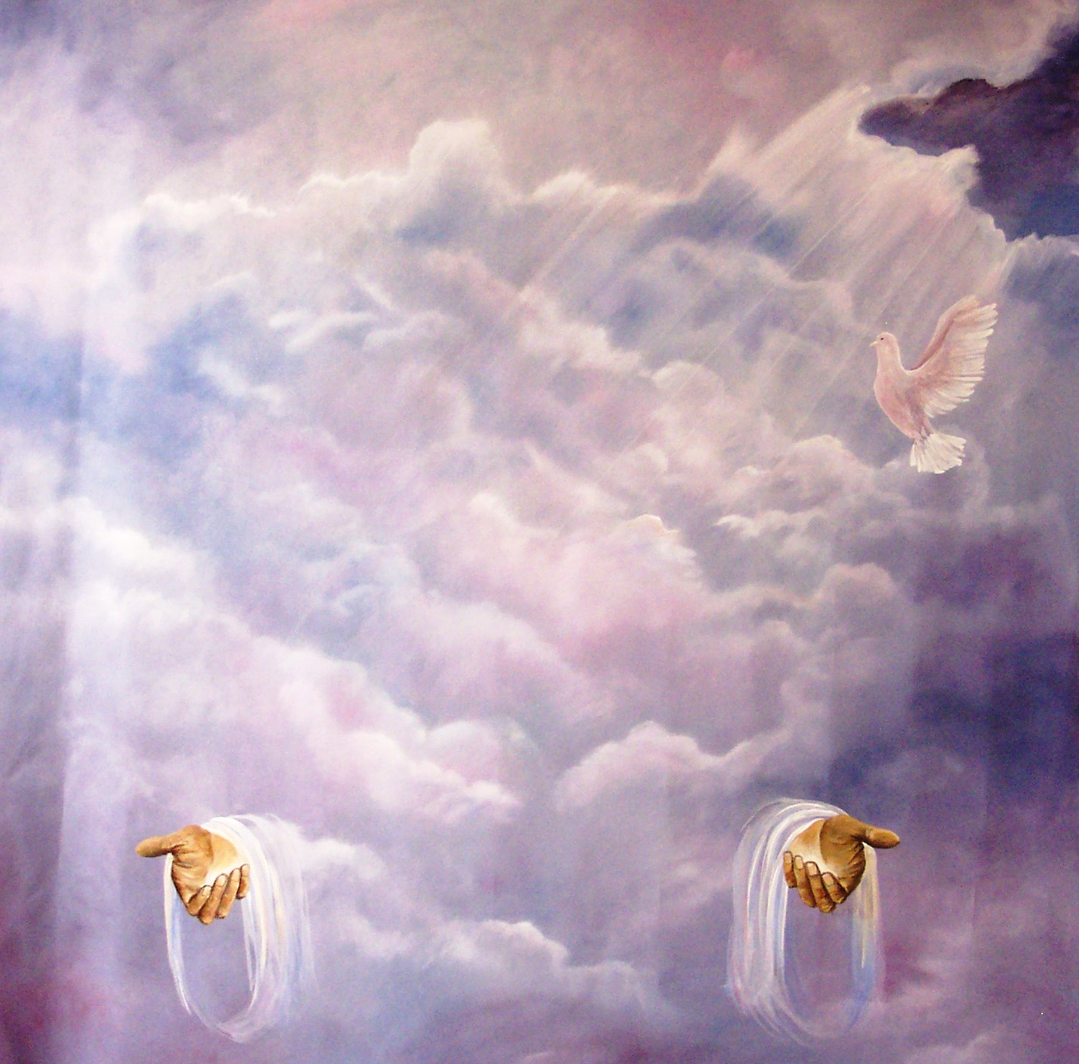
“Then Peter said unto them, Repent, and be baptized every one of you in the name of Jesus Christ for the remission of sins, and ye shall receive the gift of the Holy Ghost.” (Acts2:38)

Slide 4
In the New Testament alone there are some 261 passages which refer to the Holy Spirit. He is mentioned 56 times in the Gospels, 57 times in the book of Acts, 112 times in the Pauline epistles, and 36 times in the remaining New Testament. Total = 522

Slide 5
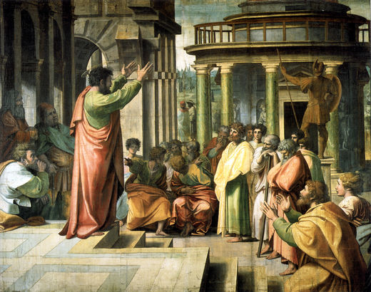
During one of his missionary trips, the Apostle Paul questioned a group of Ephesian believers (disciples of John the Baptist) about the doctrine of the Holy Spirit. Their answer must have shocked him somewhat, for they replied, "...We have not so much as heard whether there be any Holy Ghost" (Acts 19:2)

Slide 6
This statement by these Ephesian disciples, perhaps as no other in the Bible, illustrates the sorry and shameful treatment often given to the Holy Spirit. His very existence has been ignored and his ministry misunderstood.

Slide 7
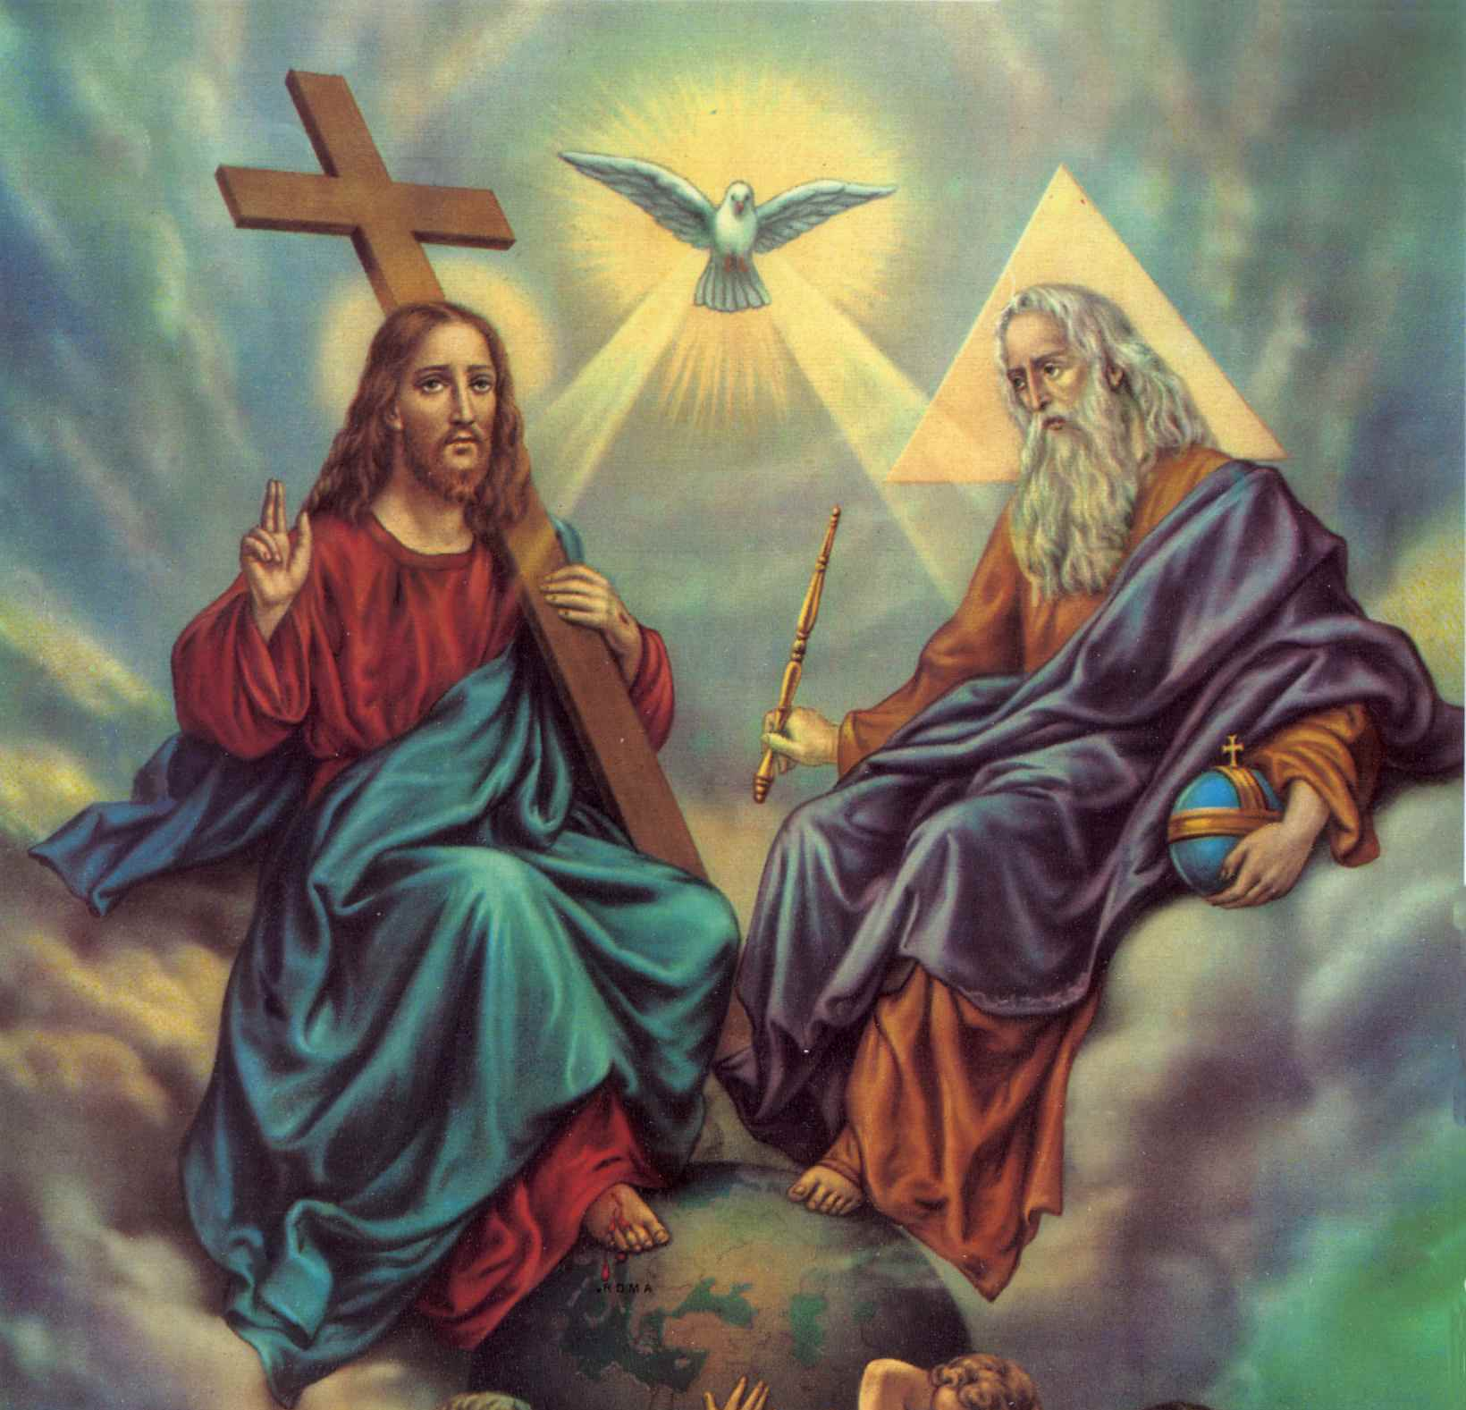
If Paul was shocked, surely the Godhead must be saddened as they view the ignorance within the Church today of the Person and Work (ministry) of the third Person in the Trinity.

Slide 8
Matthew 28:19 – “Go ye therefore, and teach all nations, baptizing them in the name of the Father, and of the Son, and of the Holy Ghost.”
I John 5:7 – “For there are three that bear record in heaven, the Father, the Word, and the Holy Ghost: and these three are one.”

Slide 9
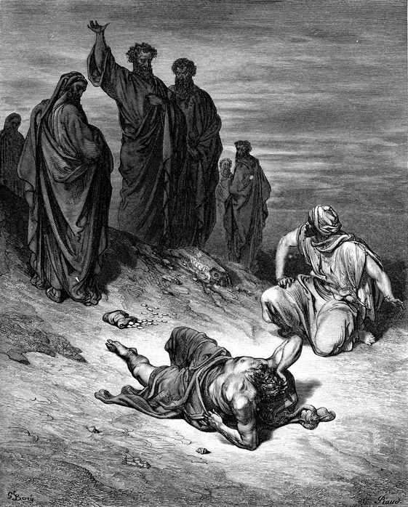
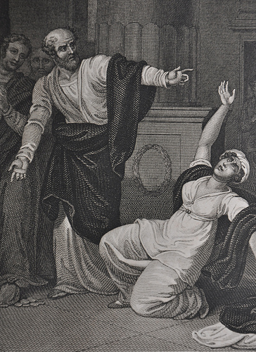
“But Peter said, Ananias, why hath Satan filled thine heart to lie to the Holy Ghost…thou hast not lied unto men, but unto God.” (Acts 5:3-4)

Slide 12
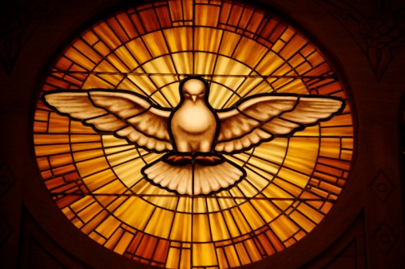
He has a mind
“Likewise the Spirit also helpeth our infirmities: for we know not what we should pray for as we ought: but the Spirit itself maketh intercession for us with groanings which cannot be uttered. And he that searcheth the hearts knoweth what is the mind of the Spirit, because he maketh intercession for the saints according to the will of God. And we know that all things work together for good to them that love God, to them who are the called according to his purpose.” (Romans 8:26-28)

Slide 13
"And he that searcheth the hearts knoweth what is the mind of the Spirit, because he maketh intercession for the saints according to the will of God" (Rom. 8:27)
The first "he" in this verse is a reference to the Son of God, as seen in verse 34, while the second "he" refers to the Holy Spirit himself.
What a fantastic truth is seen here, for the believer enjoys the intercessory ministry of both the Son and Holy Spirit.

Slide 14
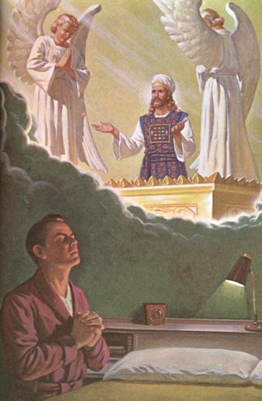
“Wherefore he is able also to save them to the uttermost that come unto God by him, seeing he ever liveth to make intercession for them.”
(Hebrews 7:25)

Slide 15
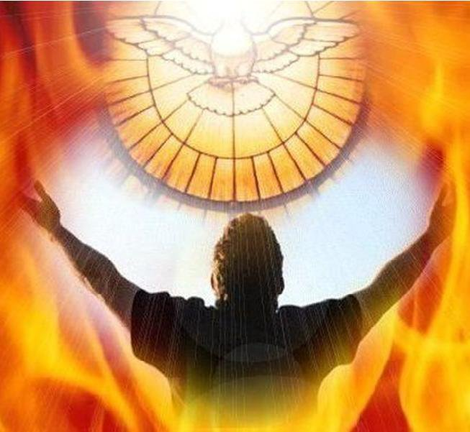
“Likewise the Spirit also helpeth our infirmities: for we know not what we should pray for as we ought: but the Spirit itself maketh intercession for us with groanings which cannot be uttered.” (Romans 8:26)

Slide 16
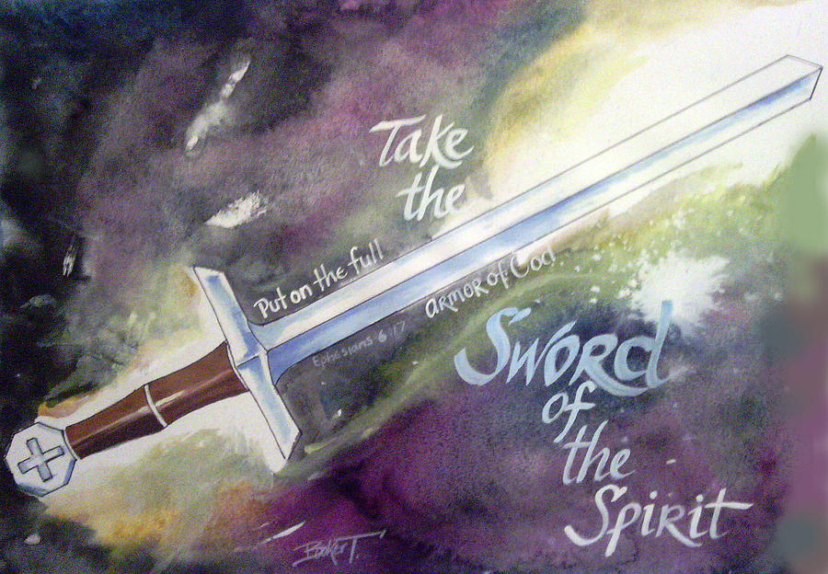
He has knowledge of God's mind

Slide 17
(I Corinthians 2:10-16) “But God hath revealed them unto us by his Spirit: for the Spirit searcheth all things, yea, the deep things of God. For what man knoweth the things of a man, save the spirit of man which is in him? even so the things of God knoweth no man, but the Spirit of God. Now we have received, not the spirit of the world, but the spirit which is of God; that we might know the things that are freely given to us of God. Which things also we speak, not in the words which man's wisdom teacheth,

Slide 18
but which the Holy Ghost teacheth; comparing spiritual things with spiritual. But the natural man receiveth not the things of the Spirit of God: for they are foolishness unto him: neither can he know them, because they are spiritually discerned. But he that is spiritual judgeth all things, yet he himself is judged of no man. For who hath known the mind of the Lord, that he may instruct him? But we have the mind of Christ.”

Slide 19
The truths of God’s Word are revealed through the Spirit. The Holy Spirit is the divine author of Scripture. He used many human agents, but the message is entirely His. The revelation is God's pure Word. To illustrate the Holy Spirit's unique qualification for revealing the Word, Paul compares the Spirit's knowledge of God's mind to a human being's knowledge of his own mind. No person can know another person as well as he knows himself. Even husbands and wives who have lived together for dozens of years, and have freely shared their thoughts and dreams and problems and joys,

Slide 20
never come to know their mates as intimately as they know themselves. Our innermost thoughts, the deep recesses of our hearts and minds, are known only to ourselves. In a similar way, only God's own Spirit can know Him intimately. And, wonder of wonders, it is the Spirit of God, the one who intimately knows the depths of God and the thoughts of God, whom God has sent to reveal His own wisdom to those who believe—to us.

Slide 21
Holy Spirit our Teacher

Slide 22
John 16:13 – “Howbeit when he, the Spirit of truth, is come, he will guide you into all truth: for he shall not speak of himself; but whatsoever he shall hear, shall he speak: and he will shew you things to come.”
I John 2:26-27 – “These things have I written unto you concerning them that seduce you. But the anointing which ye have received of him abideth in you, and ye need not that any man teach you: but as the same anointing teacheth you of all things, and is truth, and is no lie, and even as it hath taught you, ye shall abide in him.”

Slide 23
He has a will
"But all these worketh that one and the selfsame Spirit, dividing to every man severally as he will” (I Cor. 12:11)
This is a reference to the various spiritual gifts which the Holy Spirit imparts to believers as he determines.

Slide 24
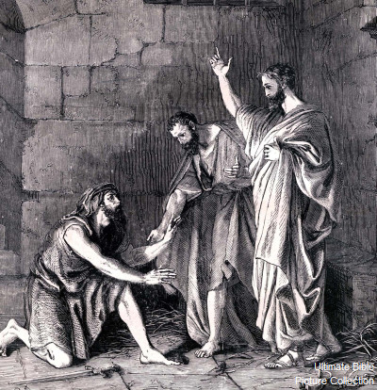
He forbids
"Now when they had gone throughout Phrygia and the region of Galatia, and were forbidden of the Holy Ghost to preach the word in Asia, after they were come to Mysia, they assayed to go into Bithynia: but the Spirit suffered them not" (Acts 16:6-7)
Paul, Silas, and Timothy were prohibited from going to two possible mission fields by the Spirit.

Slide 25
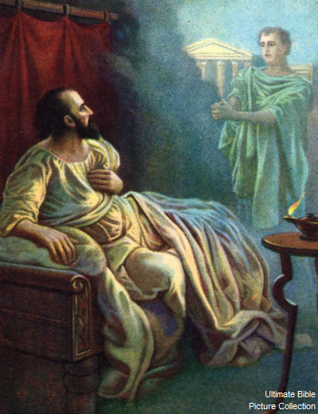
He permits
"And after he had seen the vision, immediately we endeavored to go into Macedonia, assuredly gathering that the Lord had called us for to preach the gospel unto them" (Acts 16:10)
This explains the reason for the previous prohibition.

Slide 26
He speaks

Slide 27
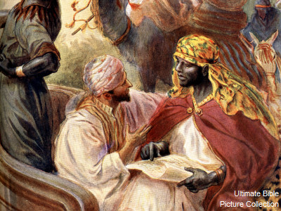
"Then the Spirit said unto Philip, Go near, and join thyself to this chariot" (Acts 8:29)

Slide 28
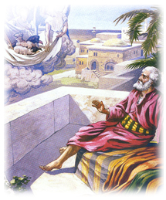
"While Peter thought on the vision, the Spirit said unto him, Behold, three men seek thee" (Acts 10:19)

Slide 29
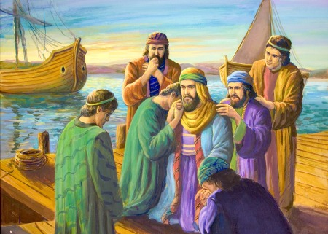
"As they ministered to the Lord, and fasted, the Holy Ghost said, Separate me Barnabas and Saul for the work whereunto I have called them" (Acts 13:2)

Slide 30
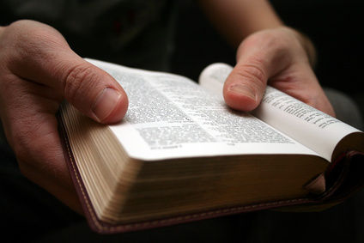
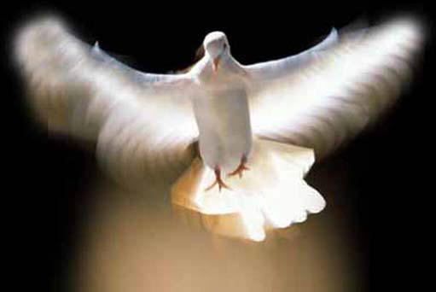
“For as many as are led by the Spirit of God, they are the sons of God.” (Romans 8:14)

Slide 31
“My conscience also bearing me witness
in the Holy Ghost.” (Rom. 9:1)
“Which shew the work of the law written in their hearts, their conscience also bearing witness, and their thoughts the mean while accusing or else excusing one another.” (Rom. 2:15)

Slide 32
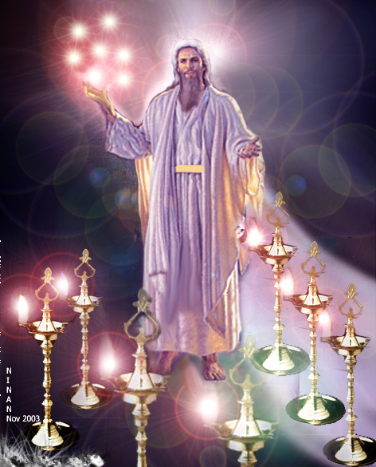
To seven churches in Asia Minor
On no less than seven occasions (one to each church) we read the words:
"He that hath an ear, let him hear what the Spirit saith unto the churches" (Rev. 2:7, 11, 17, 29; 3:6, 13, 22)

Slide 33
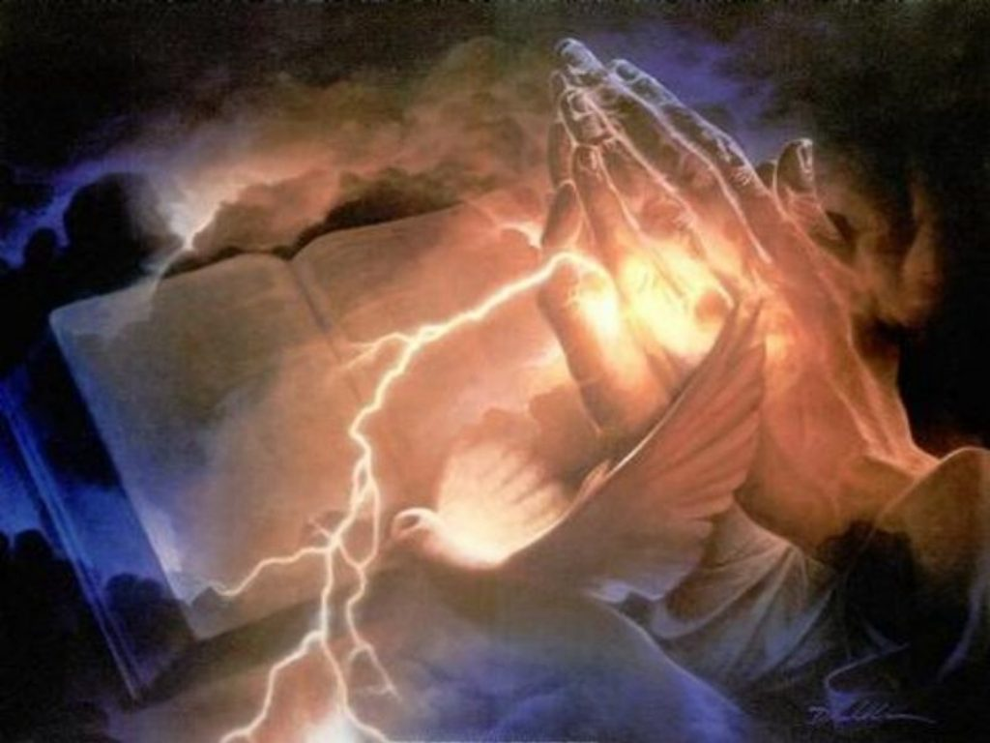
He loves
"Now I beseech you, brethren, for the Lord Jesus Christ’s sake, and for the love of the Spirit, that ye strive together with me in your prayers to God for me" (Romans 15:30)

Slide 34
It is wonderful to know that each believer is loved by
The Father - (John 14:21; 16:27; II Cor. 9:7)
The Son - (Gal. 2:20; Eph. 3:19; Rev. 1:5; 3:19)
The Holy Spirit - Romans 5:5 “The love of God is shed abroad in our hearts by the Holy Ghost which is given unto us.”

Slide 38
He grieves
"And grieve not the Holy Spirit of God, whereby ye are sealed unto the day of redemption" (Eph. 4:30)

Slide 39
This grieving attribute of the Holy Spirit is really an extension of his love, for while one may be angered by his enemies, he can only be grieved by those he loves.

Slide 40
The command here is, literally, "stop grieving the Holy Spirit of God."

Slide 41
He prays
"Likewise the Spirit also helpeth our infirmities: for we know not what we should pray for as we ought: but the Spirit itself maketh intercession for us with groanings which cannot be uttered" (Rom. 8:26)

Slide 42
Because the Holy Spirit is Person you can have a personal relationship with him
Romans 8:14 “For as many as are led by the Spirit of God, they are the sons of God.”

Slide 43
“Know ye not that ye are the temple of God, and that the Spirit of God dwelleth in you?” (I Cor. 3:16)

Slide 44
I Cor. 3:16 “Know ye not that ye are the temple of God, and that the Spirit of God dwelleth in you?”
I Thess. 4:8 “He therefore that despiseth, despiseth not man, but God, who hath also given unto us his holy Spirit.”
II Cor. 6:18-7:1

Slide 45
“For ye have not received the spirit of bondage again to fear; but ye have received the Spirit of adoption, whereby we cry, Abba, Father.” (Rom. 8:15) “And because ye are sons, God hath sent forth the Spirit of his Son into your hearts, crying, Abba, Father.” (Gal. 4:6)

Slide 46
Abba is an Aramaic word for father, used by Jesus (Mark 14:36) and Paul (Rom. 8:15) to address God in a relation of personal intimacy.

Slide 48
He Comforts

Slide 49
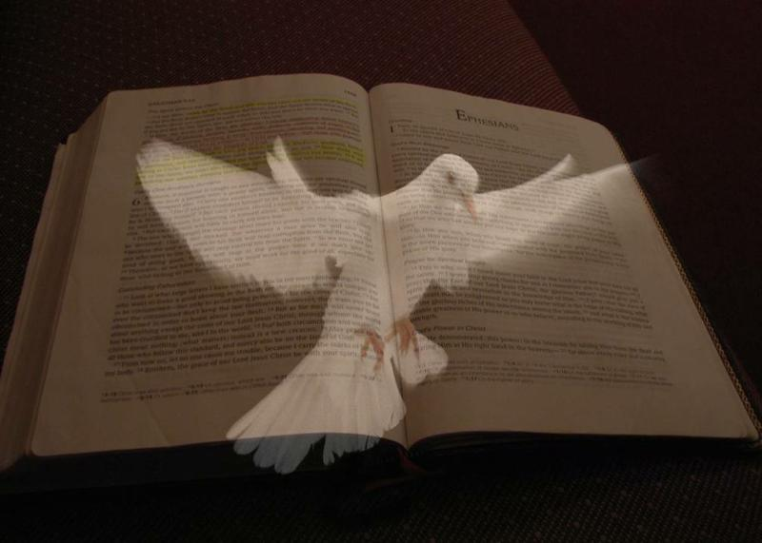
John 14:16 “And I will pray the Father, and he shall give you another Comforter, that he may abide with you for ever.”
John 14:26 “But the Comforter, which is the Holy Ghost, whom the Father will send in my name, he shall teach you all things, and bring all things to your remembrance, whatsoever I have said unto you.”
John 15:26 “But when the Comforter is come, whom I will send unto you from the Father, even the Spirit of truth, which proceedeth from the Father, he shall testify of me.”
John 16:7 “Nevertheless I tell you the truth; It is expedient for you that I go away: for if I go not away, the Comforter will not come unto you; but if I depart, I will send him unto you.”

Slide 51
“If we live in the Spirit, let us also walk
in the Spirit.” (Gal. 5:25)

Slide 52
