Slide 1
The Doctrine of the Holy Spirit
The Holy Spirits desire
for the Every Believer

Slide 3
In the New Testament alone there are some 261 passages which refer to the Holy Spirit. He is mentioned 56 times in the Gospels, 57 times in the book of Acts, 112 times in the Pauline epistles, and 36 times in the remaining New Testament. Total = 522

Slide 5
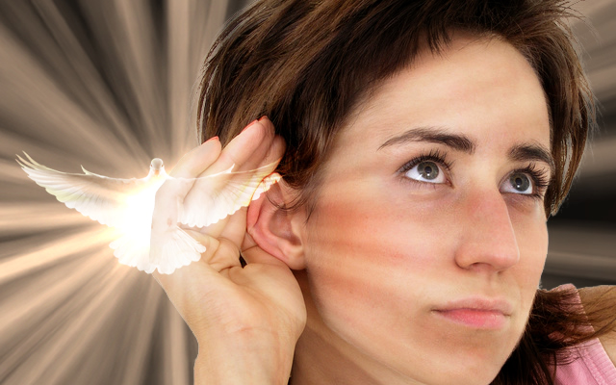
Because the Holy Spirit is Person you can have a personal relationship with him
Romans 8:14 “For as many as are led by the Spirit of God, they are the sons of God.”

Slide 7
I John 5:7-8 “For there are three that bear record in heaven, the Father, the Word, and the Holy Ghost: and these three are one. And there are three that bear witness in earth, the Spirit, and the water, and the blood: and these three agree in one.”

Slide 8
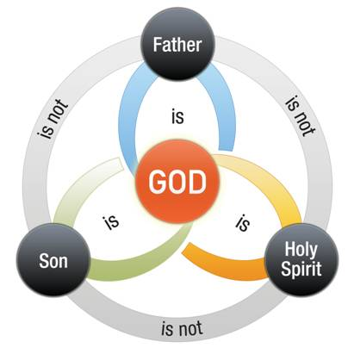

Slide 10
Spirit of God
Spirit of Christ
Eternal Spirit
Spirit of Truth
Spirit of Grace
Spirit of Glory
Spirit of Life
Spirit of Wisdom and Revelation
Spirit of Comfort
Spirit of Promise
Spirit of Holiness
Spirit of Adoption
Holy Ghost
Seven Spirits of God

Slide 11
The symbols of the Holy Spirit become essential to our gaining an understanding of who He is, what He’s like and His ministry in our lives, the Church
and the World.

Slide 12
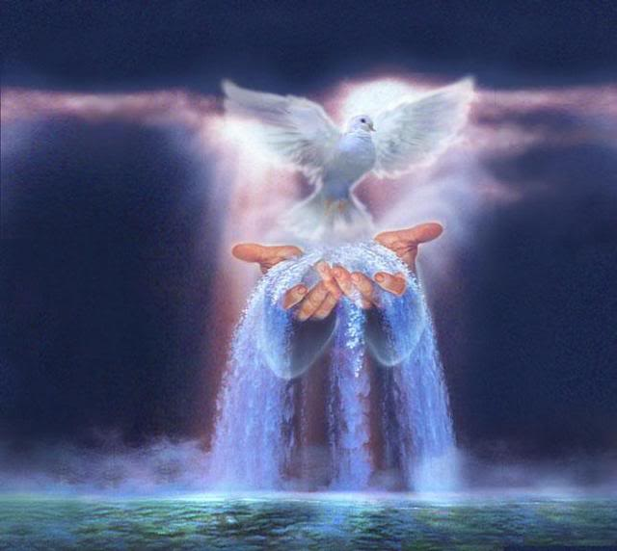
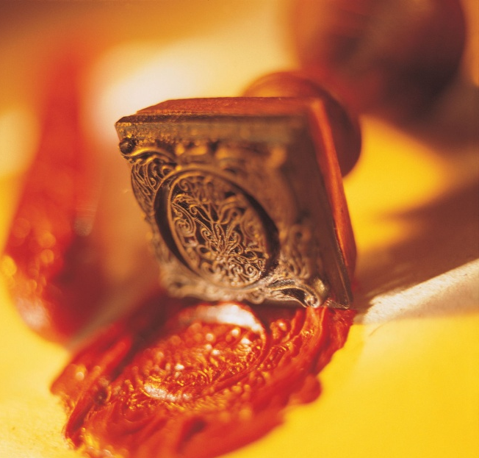
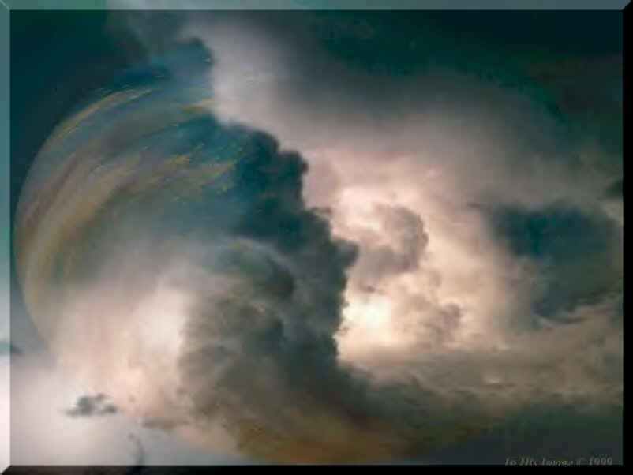
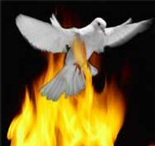

Slide 13
Ephesians 1:13-14
“In whom ye also trusted, after that ye heard the word of truth, the gospel of your salvation: in whom also after that ye believed, ye were sealed with that
Holy Spirit of promise. Which is the earnest of our inheritance…”

Slide 16
The Holy Spirits desire
for the Local Church

Slide 17
He desires to inspire and direct the worship and ministry in the Local Church - (Phil. 3:3)
He desires to direct the missionary outreach of the Local Church - (Acts 1:8)
He desires to aid the singing services in the Local Church - (I Cor. 14:15)
He desires to appoint the Local Churches pastor - (Acts 20:28)

Slide 18
He desires to empower the pastors preaching in the Local Church - (I Cor. 2:4)
He desires to warn the members of the Local Church - (I Tim. 4:1)
He desires to determine the decisions made by the Local Church - (Acts 15:28)
He desires to condemn or bless the efforts of the Local Church - (Psalm 109:17)

Slide 20
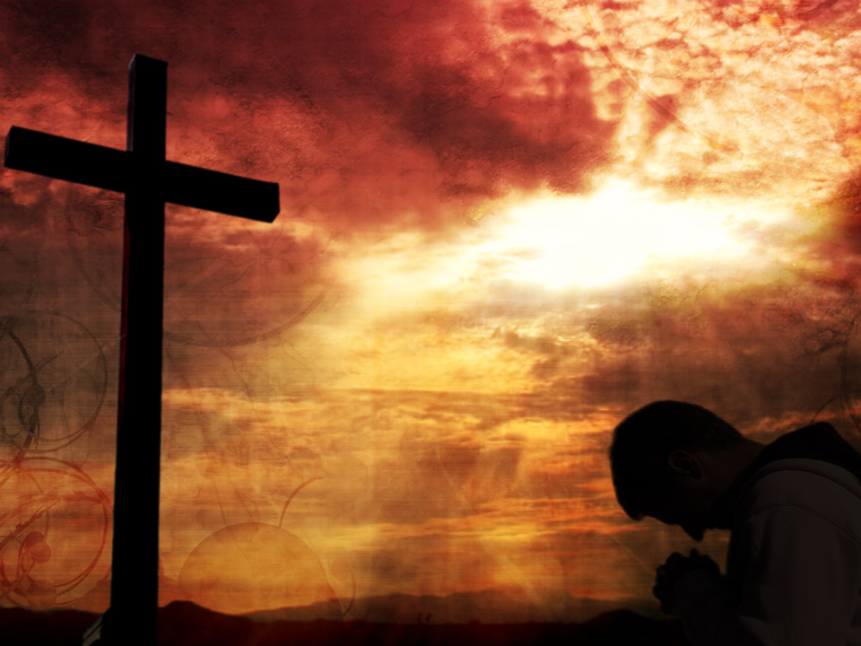
What is the Desire of the Holy Spirit for each and every Believer?

Slide 21
I Cor. 6:19 “What? know ye not that your body is the temple of the Holy Ghost which is in you, which ye have of God, and ye are not your own?”

Slide 22
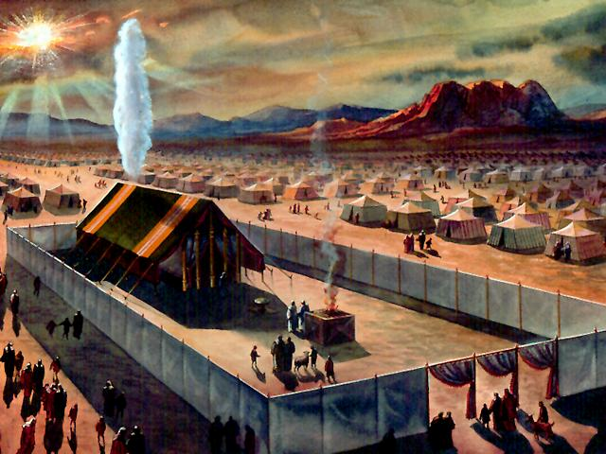
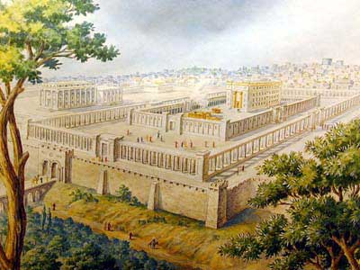

Slide 23
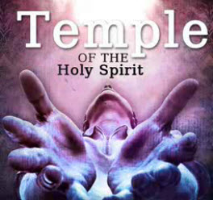
“And what agreement hath the temple of God with idols? for ye are the temple of the living God; as God hath said, I will dwell in them, and walk in them; and I will be their God, and they shall be my people.” II Cor. 6:16

Slide 26
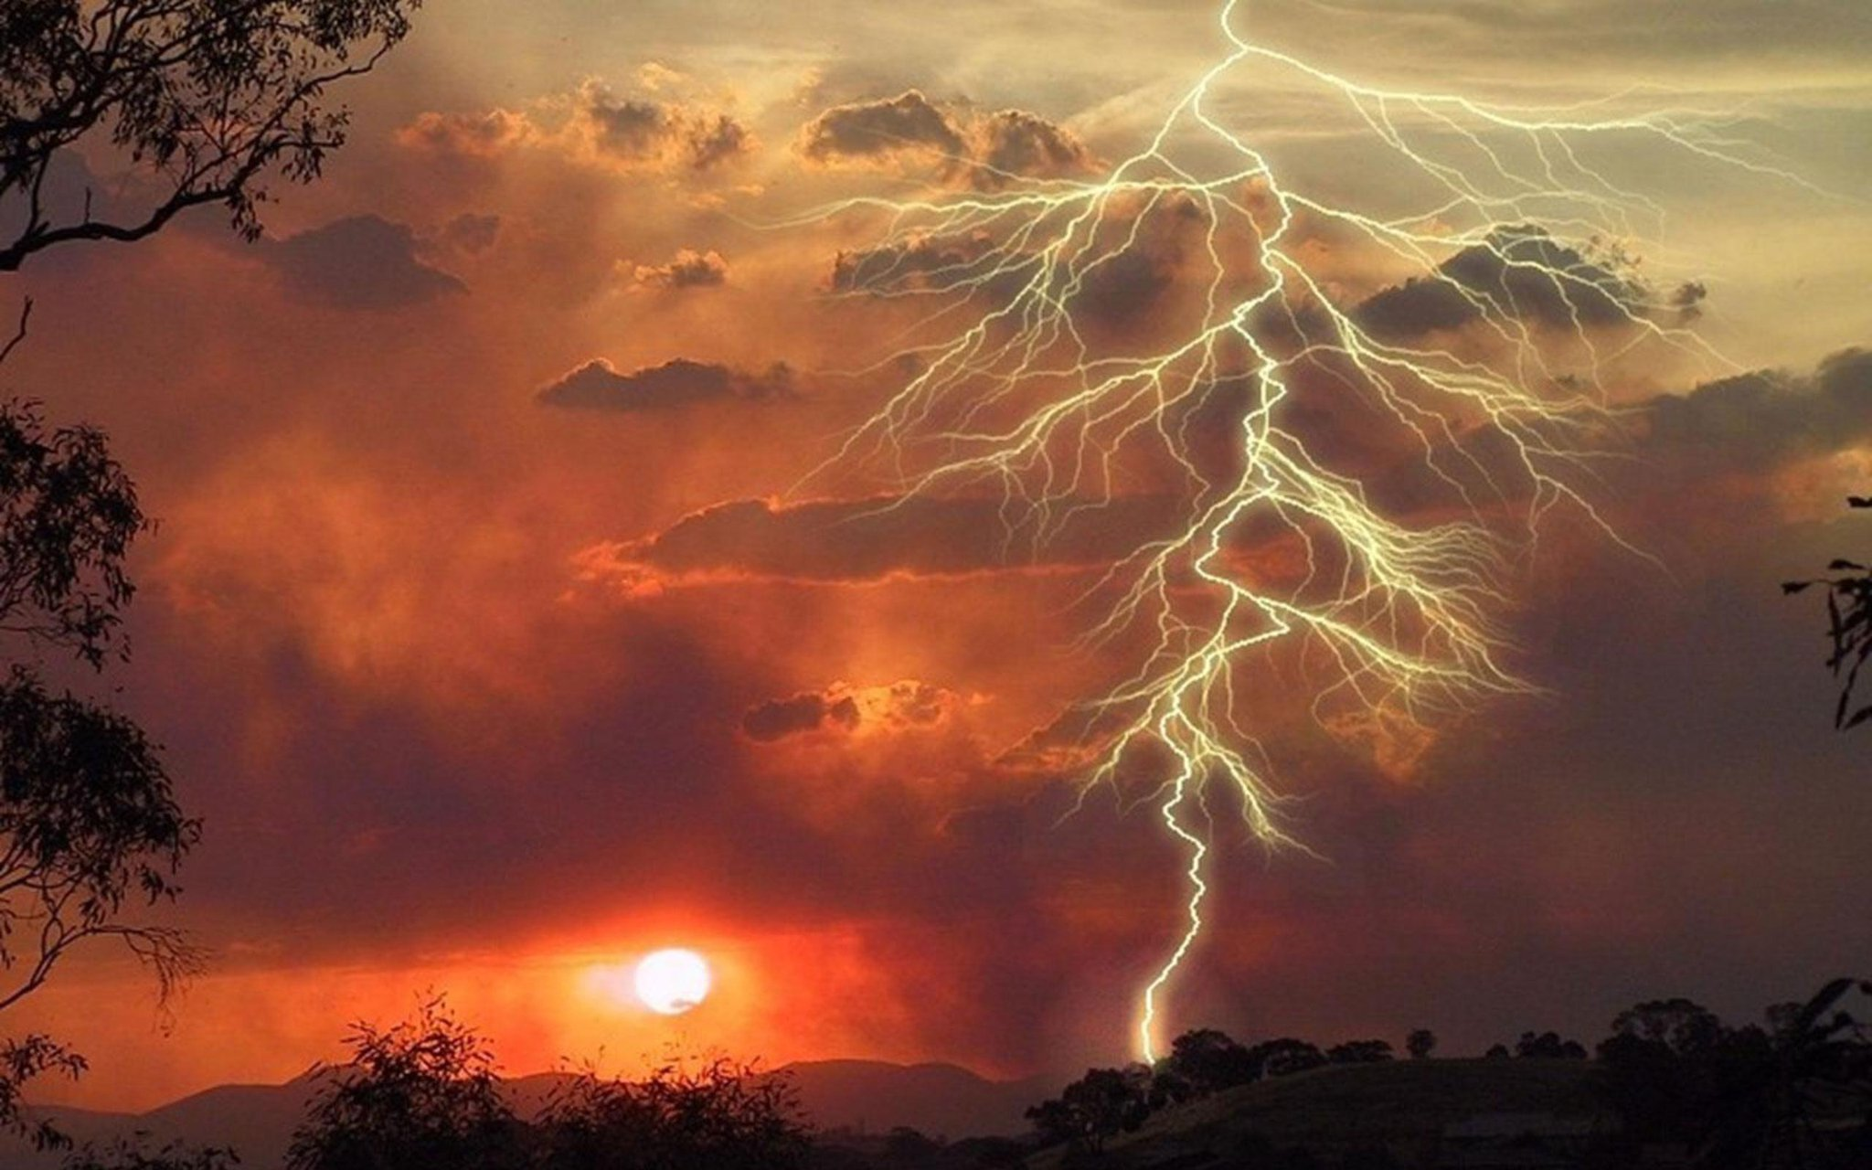
I Cor. 3:16-17
“Know ye not that ye are the temple of God, and that the Spirit of God dwelleth in you? If any man defile the temple of God, him shall God destroy; for the temple of God is holy, which temple ye are.”

Slide 27
“Destroy”
1. To ruin.
2. To tear down or break up.
3. To demolish.
4. To do away with.
5. To put an end to.
6. To subdue or defeat completely.
7. To render useless or ineffective.

Slide 28
“By mercy and truth iniquity is purged: and by the fear of the LORD men depart from evil.” Prov. 16:6

Slide 31
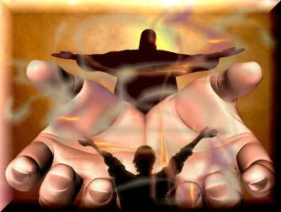

Slide 33
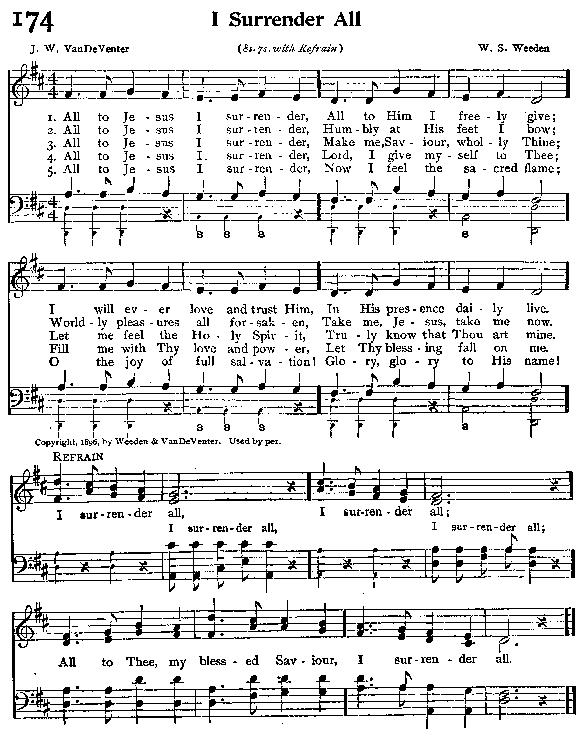

Slide 34
All to Jesus I surrender, All to Him I freely give; I will ever love and trust Him, In His presence daily live.
All to Jesus I surrender, Humbly at His feet I bow, Worldly pleasures all forsaken; Take me, Jesus, take me now.

Slide 35
All to Jesus I surrender, Make me, Savior, wholly Thine; Let me feel Thy Holy Spirit, Truly know that Thou art mine. All to Jesus I surrender, Lord, I give myself to Thee; Fill me with Thy love and power, Let Thy blessing fall on me.

Slide 36
All to Jesus I surrender, Now I feel the sacred flame. Oh, the joy of full salvation! Glory, glory to His name! I surrender all, I surrender all. All to Thee, my blessed Savior, I surrender all.

Slide 37
Holy Spirit Desires to Fill us

Slide 38
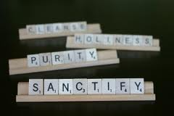
The Holy Spirit Desires to Sanctify us

Slide 40
“And the very God of peace sanctify you wholly; and I pray God your whole spirit and soul and body be preserved blameless unto the coming of our Lord Jesus Christ.”

Slide 41
The Holy Spirit Desires to Lead us

Slide 42
The Holy Spirit Desires to Teach us (give us spiritual perception)

Slide 43
The Holy Spirit Desires to Convict us

Slide 44
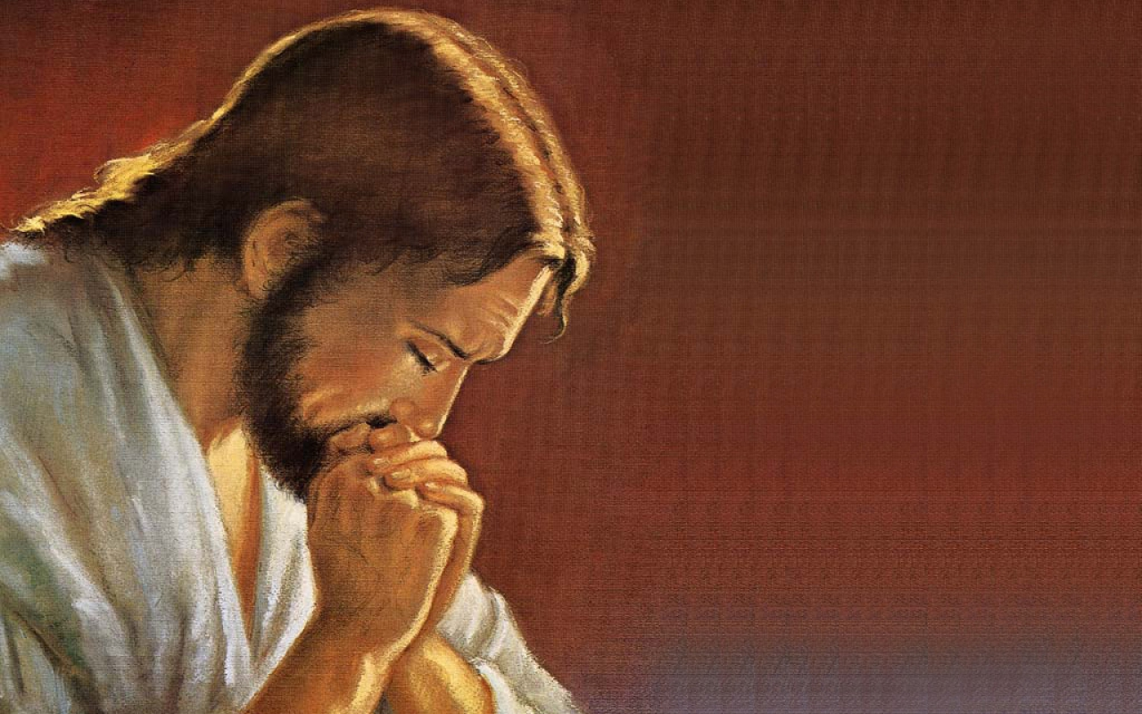
The Holy Spirit Desires to Comfort us
“And I will pray the Father, and he shall give you another Comforter, that he may abide with you for ever.” John 14:16

Slide 45
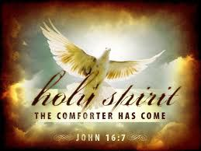

Slide 46
The Holy Spirit Desires to be our Helper

Slide 47
John 16:7 “Nevertheless I tell you the truth; It is expedient for you that I go away: for if I go not away, the Comforter (Helper) will not come unto you; but if I depart, I will send him unto you.”

Slide 48
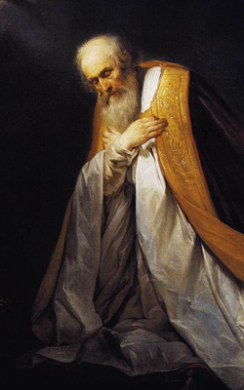
Psalm 30:10 “Hear, O LORD, and have mercy upon me: LORD, be thou my helper.”

Slide 49
Holy Spirit Desires to Guide (direct) us
“Howbeit when he, the Spirit of truth, is come, he will guide you into all truth: for he shall not speak of himself; but whatsoever he shall hear, that shall he speak: and he will shew you things to come.”
John 16:13

Slide 50
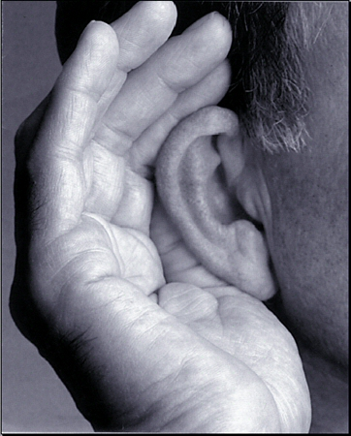
The Holy Spirit Desires to Prompt us
“He that hath an ear, let him hear what the Spirit saith unto the churches.”
Rev. 3:13

Slide 51
The Holy Spirit Desires to Empower us for Service
Acts 1:8 “But ye shall receive power, after that the Holy Ghost is come upon you.”
Rom. 15:13 “Now the God of hope fill you with all joy and peace in believing, that ye may abound in hope, through the power of the Holy Ghost.”

Slide 52
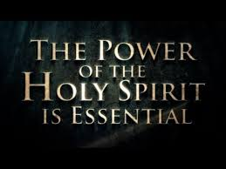
“Not by might, nor by power, but by my spirit, saith the LORD of hosts.” Zec. 4:6

Slide 53
The Holy Spirit Desires to Conform us to the Image of Christ
II Cor. 3:18
“But we all, with open face beholding as in a glass the glory of the Lord, are changed into the same image from glory to glory, even as by the Spirit of the Lord.”

Slide 55
The Holy Spirit Desires to Transform us
“And be not conformed to this world: but be ye transformed by the renewing of your mind, that ye may prove what is that good, and acceptable, and perfect, will of God.” Rom. 12:2

Slide 56
The Holy Spirit Desires to Bear His Fruit in and through us

Slide 57
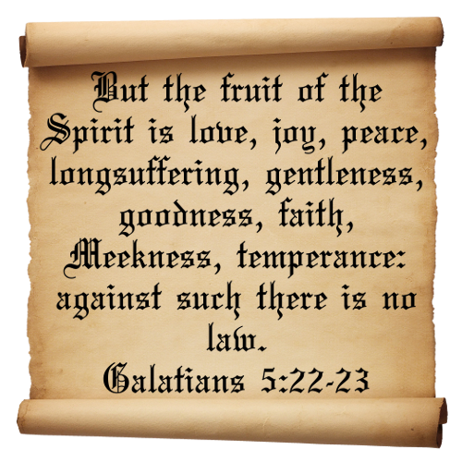

Slide 58
The Holy Spirit Desires that we use our Spiritual Gift

Slide 59
I Timothy 4:14-15 “Neglect not the gift that is in thee, which was given thee…Meditate upon these things; give thyself wholly to them; that thy profiting may appear to all.”

Slide 60
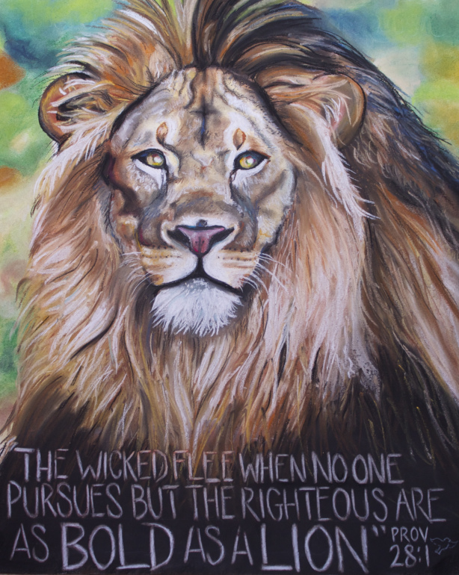
The Holy Spirit Desires to give us Boldness
“And they were all filled with the Holy Ghost, and they spake the word of God
with boldness.”
Acts 4:31

Slide 61
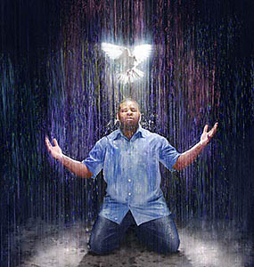
The Holy Spirit Desires to Bear witness with our Spirit
“The Spirit itself beareth witness with our spirit, that we are the children of God.”
Rom. 8:16

Slide 62
The Holy Spirit Desires to Cautions us
“He therefore that despiseth, despiseth not man, but God, who hath also given unto us his holy Spirit…Quench not the Spirit. ”
I Thess. 4:8, 5:19

Slide 63
The Holy Spirit Desires to Create with in us a Love for God and Others
“The love of God is shed abroad in our hearts by the Holy Ghost which is given unto us.”
Rom. 5:5
“But as touching brotherly love ye need not that I write unto you: for ye yourselves are taught of God to love one another.” I Thess. 4:8

Slide 65
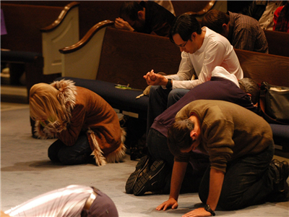
The Holy Spirit Desires to Produce within us a Hunger for the Things of God and His Word

Slide 66
“That the righteousness of the law might be fulfilled in us, who walk not after the flesh, but after the Spirit. For they that are after the flesh do mind the things of the flesh; but they that are after the Spirit the things of the Spirit. For to be carnally minded is death; but to be spiritually minded is life and peace. Because the carnal mind is enmity against God: for it is not subject to the law of God, neither indeed can be. So then they that are in the flesh cannot please God. But ye are not in the flesh, but in the Spirit, if so be that the Spirit of God dwell in you. Now if any man have not the Spirit of Christ, he is none of his.” Romans 8:4-9

Slide 67
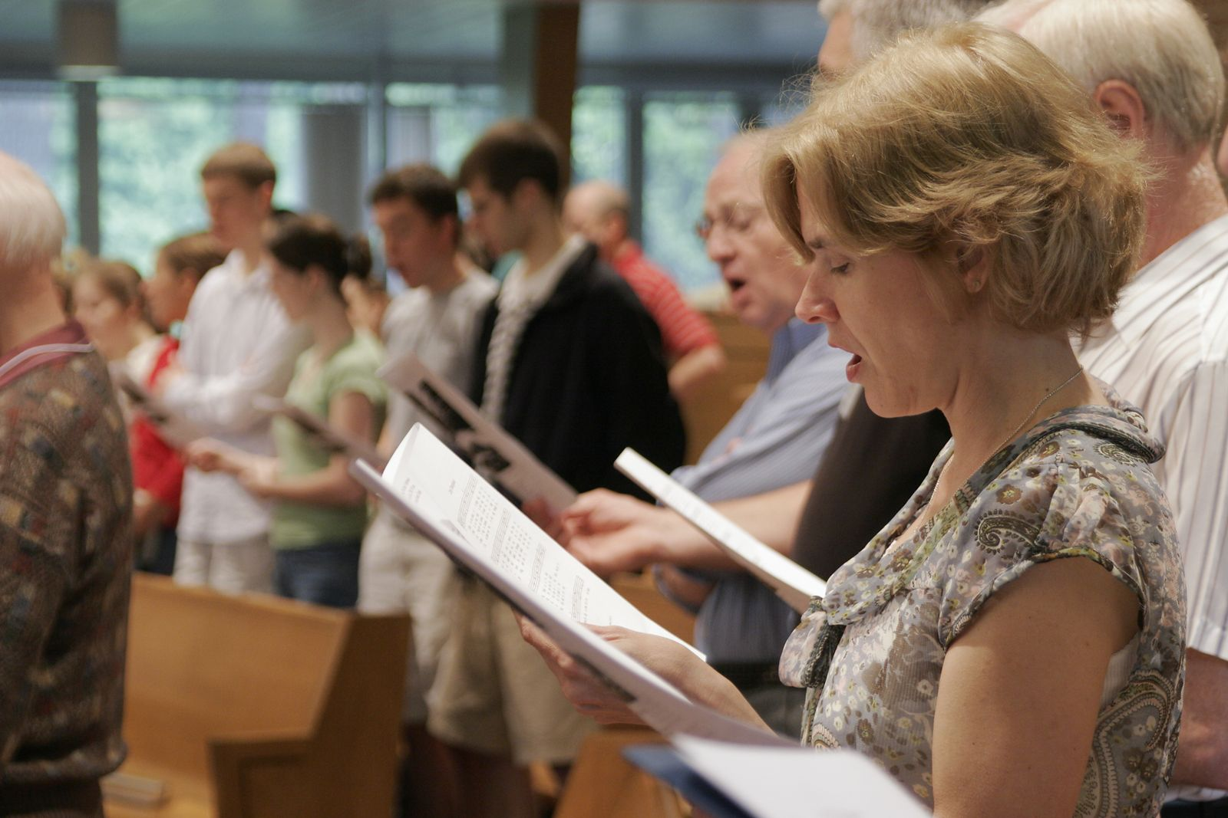
The Holy Spirit Desires to Inspire our Worship
“For we are the circumcision, which worship God in the Spirit, and rejoice in Christ Jesus, and have no confidence in the flesh.” Phil. 3:3

Slide 68
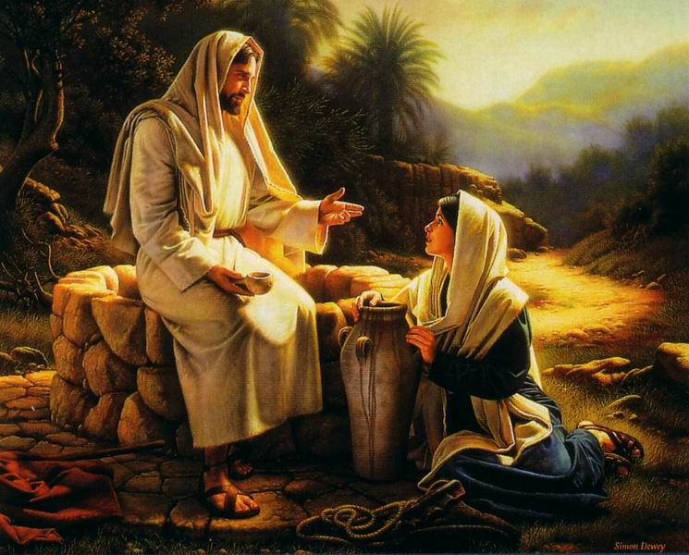
John 4:24 “God is a Spirit: and they that worship him must worship him in Spirit and in truth.”

Slide 69
The Holy Spirit Desires to Produce Unity in the Church

Slide 70
Eph. 4:3 “Endeavouring (making every effort) to keep the unity of the Spirit in the bond of peace.”

Slide 71
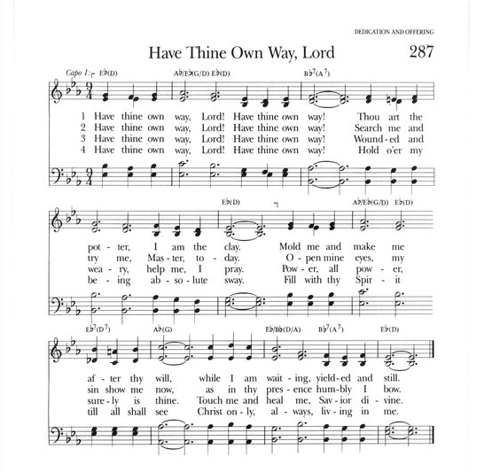

Slide 72
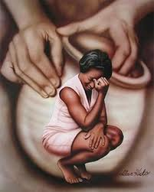
Have Thine own way, Lord! Have Thine own way! Thou art the Potter, I am the clay. Mold me and make me after Thy will, While I am waiting, yielded and still.

Slide 73
Have Thine own way, Lord! Have Thine own way! Hold o’er my being absolute sway! Fill with Thy Spirit till all shall see Christ only, always, living in me.

