Slide 1
The Doctrine of the Holy Spirit (Part 5)
(The Symbols of the Holy Spirit)
Part 2

Slide 3
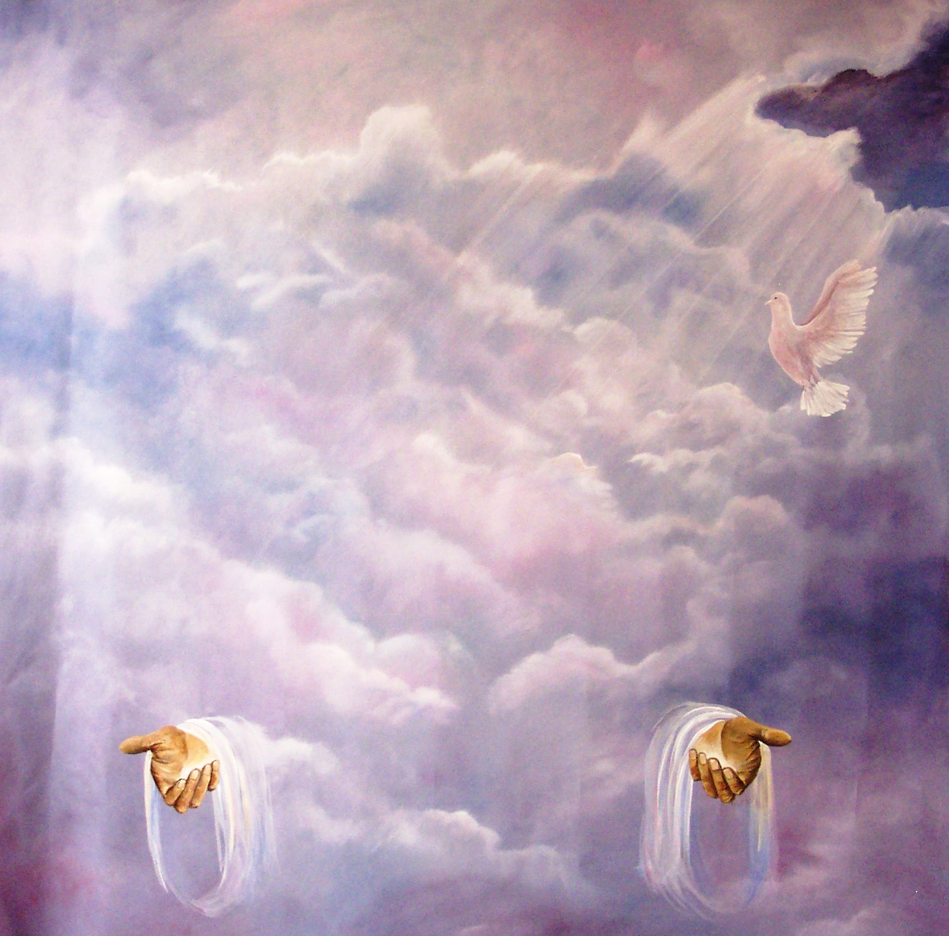
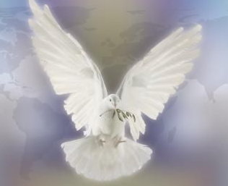
“Then Peter said unto them, Repent, and be baptized every one of you in the name of Jesus Christ for the remission of sins, and ye shall receive the gift of the Holy Ghost.” (Acts2:38)

Slide 4
In the New Testament alone there are some 261 passages which refer to the Holy Spirit. He is mentioned 56 times in the Gospels, 57 times in the book of Acts, 112 times in the Pauline epistles, and 36 times in the remaining New Testament. Total = 522

Slide 6
Because the Holy Spirit is Person you can have a personal relationship with him
Romans 8:14 “For as many as are led by the Spirit of God, they are the sons of God.”

Slide 8
I John 5:7-8 “For there are three that bear record in heaven, the Father, the Word, and the Holy Ghost: and these three are one. And there are three that bear witness in earth, the Spirit, and the water, and the blood: and these three agree in one.”

Slide 9
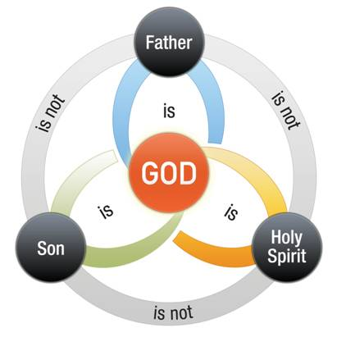

Slide 11
Spirit of God
Spirit of Christ
Eternal Spirit
Spirit of Truth
Spirit of Grace
Spirit of Glory
Spirit of Life
Spirit of Wisdom and Revelation
Spirit of Comfort
Spirit of Promise
Spirit of Holiness
Spirit of Adoption
Holy Ghost
Seven Spirits of God

Slide 12
The symbols of the Holy Spirit become essential to our gaining an understanding of who He is, what He’s like and His ministry in our lives, the Church
and the World.

Slide 13
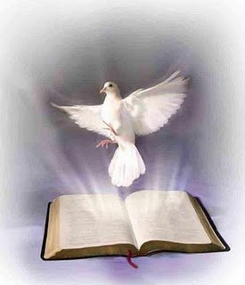
The seven designated symbols of the Holy Spirit, like the fourteen names and titles, throw light upon both his nature and mission.

Slide 14
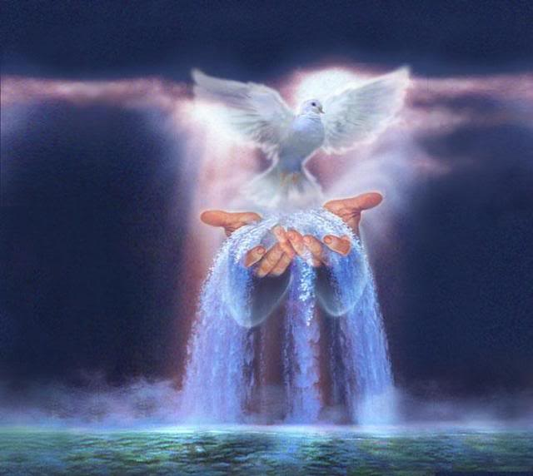
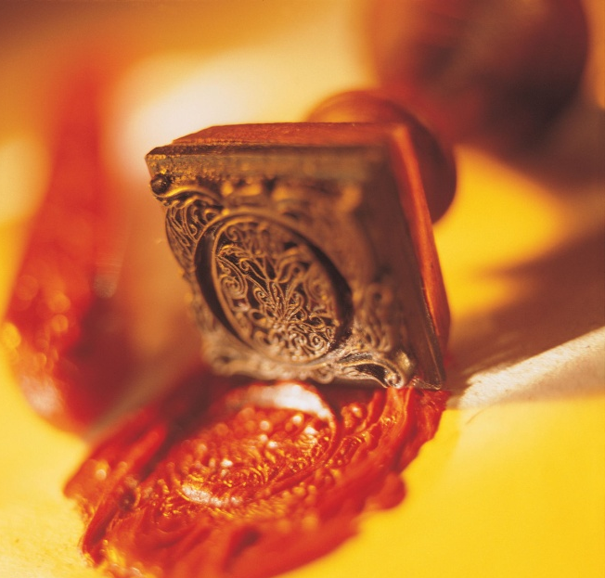
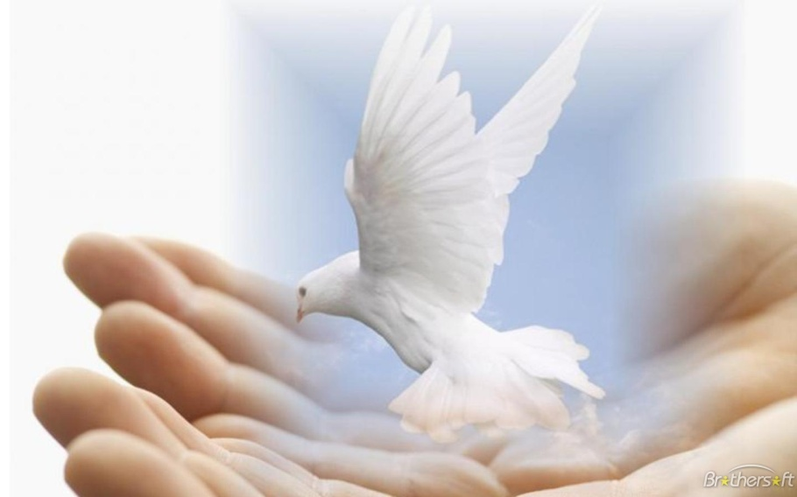
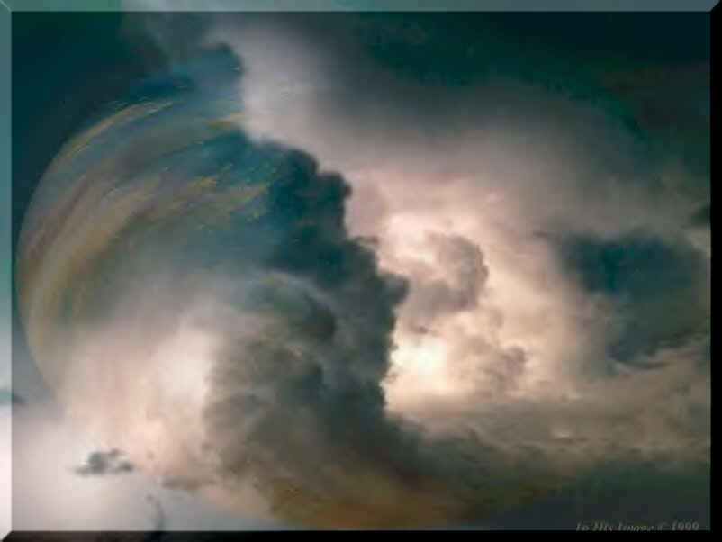
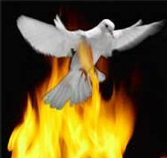

Slide 15
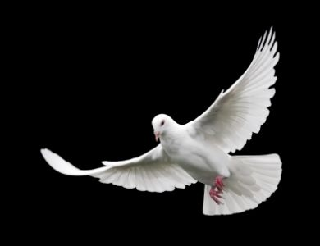
The Holy Spirit as a Dove

Slide 16
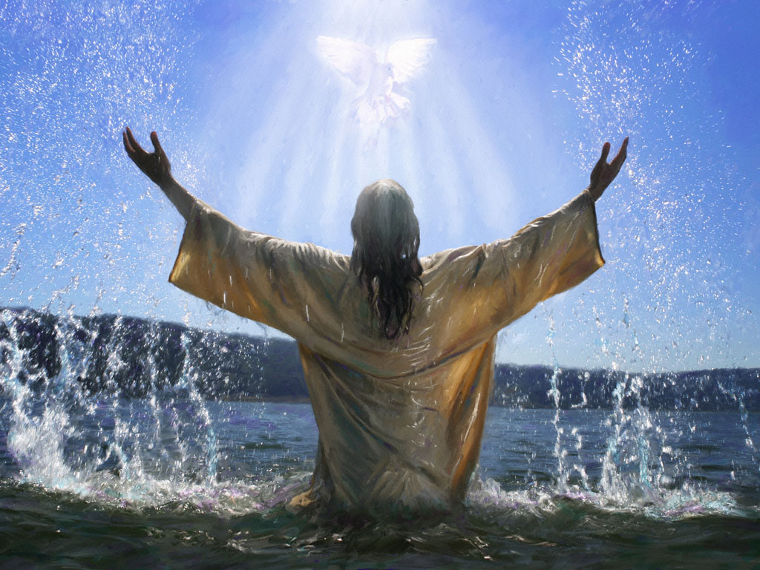
“And the Holy Ghost descended in a bodily shape like a dove upon him, and a voice came from heaven, which said, Thou art my beloved Son; in thee I am well pleased.” (Luke 3:22)

Slide 17
The Holy Spirit as Oil

Slide 19
Tonight’s Message
The Holy Spirit as Water

Slide 20
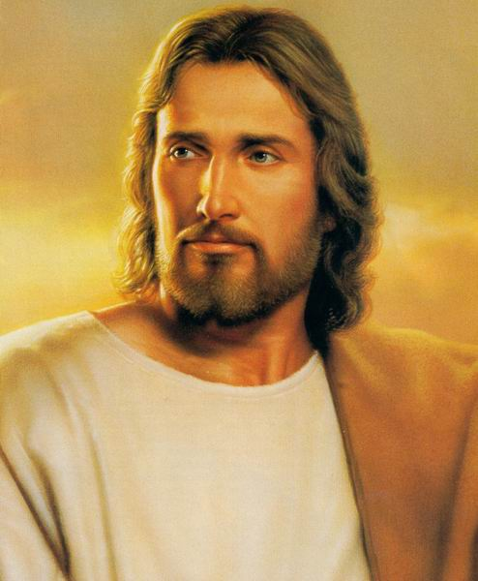
"In the last day, that great day of the feast, Jesus stood and cried, saying, If any man thirst, let him come unto me, and drink. He that believeth on me, as the Scripture hath said, out of his belly shall flow rivers of living water. But this spake he of the Spirit, which they that believe on him should receive: for the Holy Ghost was not yet given; because that Jesus was not yet glorified."
(John 7:37-39)

Slide 21
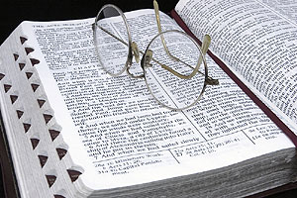
Throughout the Word of God, water is a symbol, a “type,” of the Spirit of God
{figurative language}

Slide 22
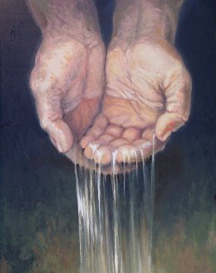
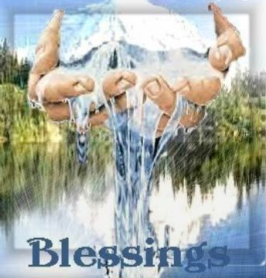
(Isaiah 44:3-4)
“For I will pour water upon him that is thirsty, and floods upon the dry ground: I will pour my spirit upon thy seed, and my blessing upon thine offspring: And they shall spring up as among the grass, as willows by
the water.”

Slide 23
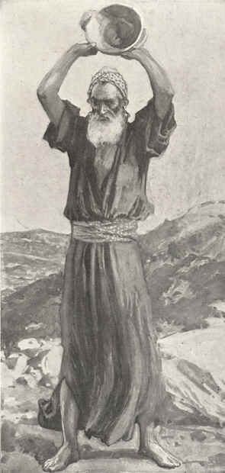
(Jeremiah 2:13)
“For my people have committed two evils; they have forsaken me the fountain of living waters, and hewed them out cisterns, broken cisterns, that can hold no water.”

Slide 24
Think about water and what it means to you.

Slide 25
Water is essential to life “we die without it”

Slide 26
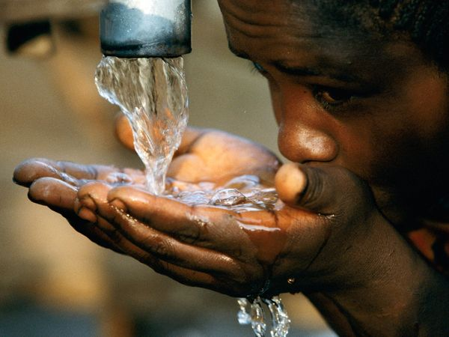
The average person can go about 60 days without food before he starves to death, but one can go only about three days without water, because it is so vital.

Slide 27
In fact, the human body is mostly water

Slide 28
Whenever someone forsakes God, the spring of living water, he has done what Jeremiah 2:13 says, He hews out his own broken cistern, which simply “won’t hold water.”
Just as actual water sustains physically life, so spiritual water (The Holy Spirit) sustains our life spiritually.
Eph. 5:26 “That he might sanctify and cleanse it with the washing of water by the word.”

Slide 29
“Turn you at my reproof: behold, I will pour out my spirit unto you, I will make known my words unto you.” (Prov. 1:23)

Slide 30
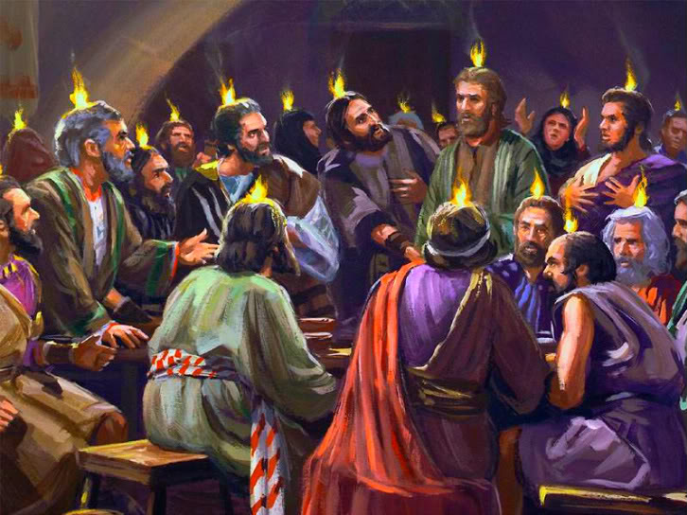
“Therefore being by the right hand of God exalted, and having received of the Father the promise of the Holy Ghost, he hath shed forth [poured out like water] this, which ye now see and hear.” (Acts 2:33)

Slide 31
“And hope maketh not ashamed; because the love of God is shed abroad [poured out] in our hearts by the Holy Ghost which is given unto us.” (Rom 5:5)

Slide 32
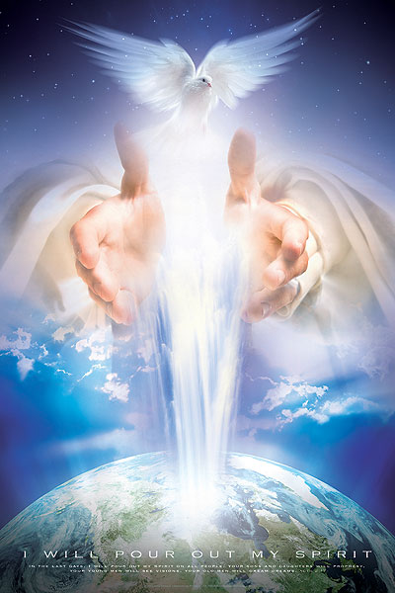
“And it shall come to pass afterward, that I will pour out my spirit upon all flesh; and your sons and your daughters shall prophesy, your old men shall dream dreams, your young men shall see visions: And also upon the servants and upon the handmaids in those days will I pour out my spirit.”
(Joel 2:28-29)

Slide 33
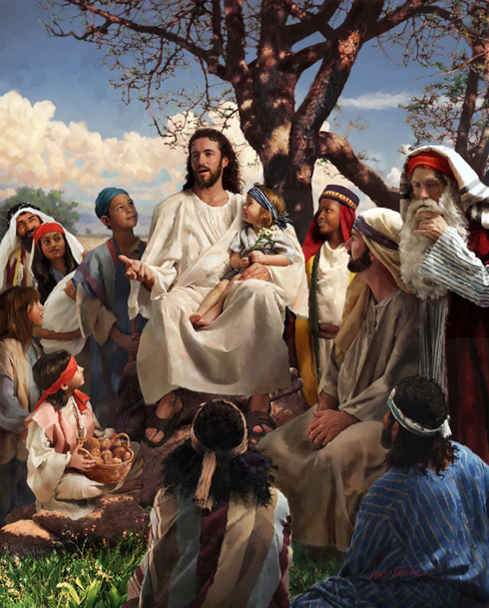
“Blessed are they which do hunger and thirst after righteousness: for they shall be filled.” (Matt. 5:6)

Slide 34
“I stretch forth my hands unto thee: my soul thirsteth after thee, as a thirsty land.” (Palm 143:6)

Slide 35
Read your Bible daily
Study your Bible
Attend every service of the Church
Attend Bible Studies
Read Christian books
Memorize Scripture
Meditate on Scripture
Take Sermon notes
Listen to Sermons on line
Have a daily prayer time

Slide 36
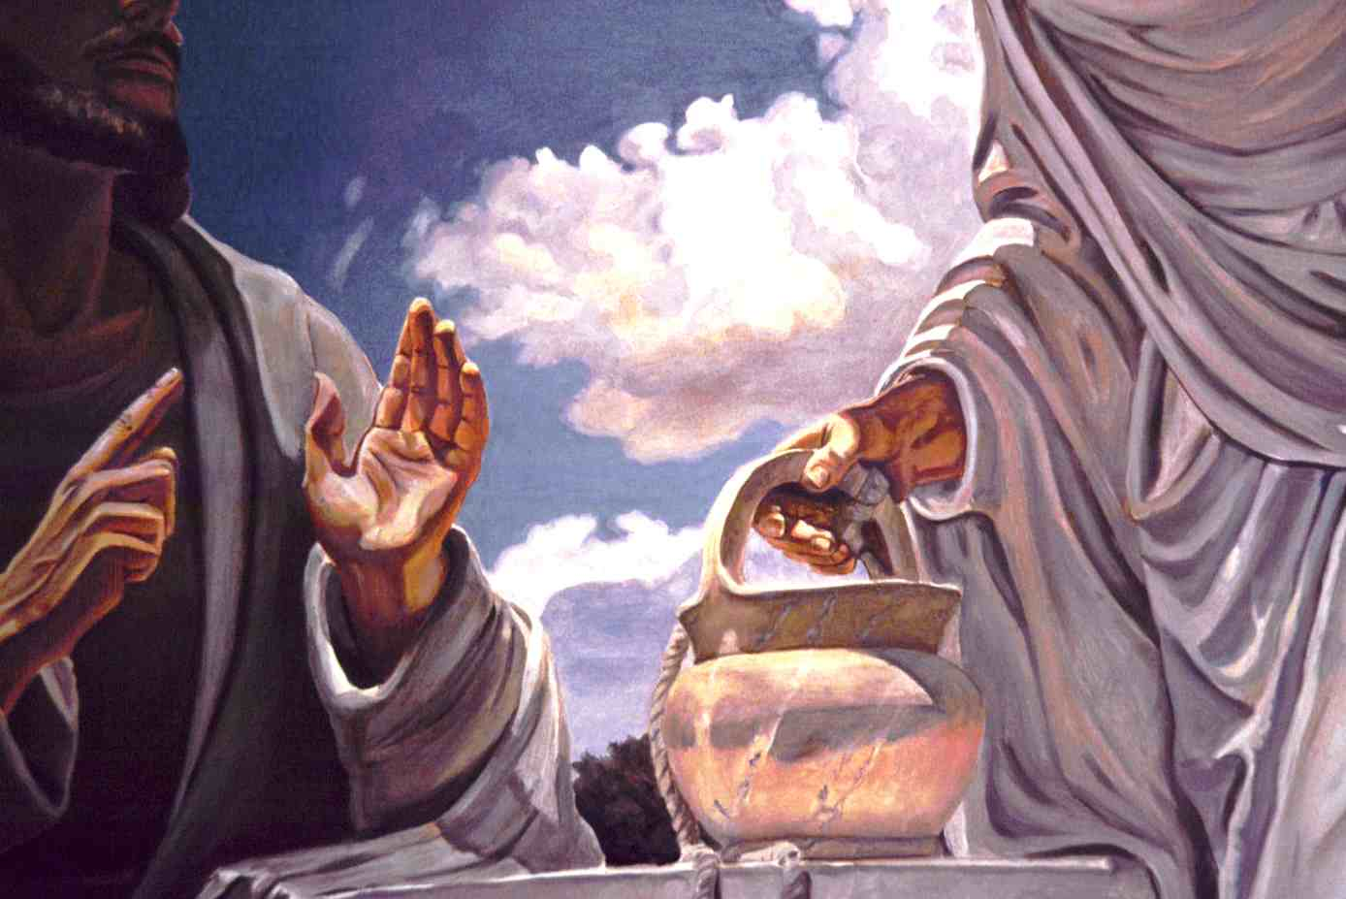
“Jesus answered and said unto her, Whosoever drinketh of this water shall thirst again: But whosoever drinketh of the water that I shall give him shall never thirst; but the water that I shall give him shall be in him a well of water springing up into everlasting life.”

Slide 37
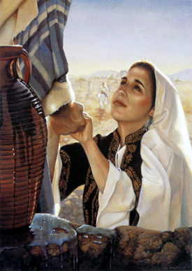
“The woman saith unto him, Sir, give me this water, that I thirst not, neither come hither to draw.”

Slide 38
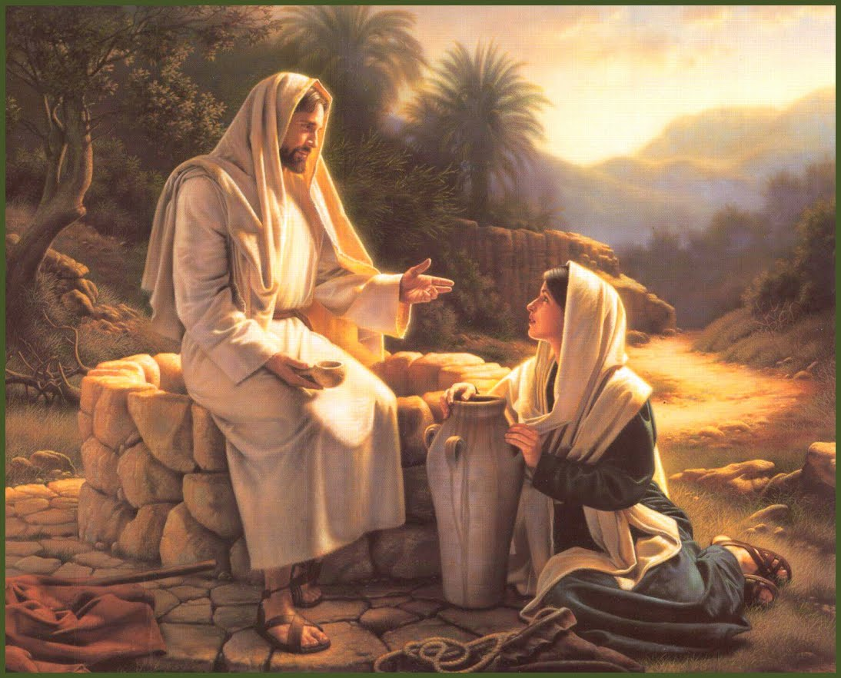
“The woman saith unto him, I know that Messias cometh, which is called Christ: when he is come, he will tell us all things. Jesus saith unto her, I that speak unto thee am he.”

Slide 39
(John 6:32-35)
“Then Jesus said unto them, Verily, verily, I say unto you, Moses gave you not that bread from heaven; but my Father giveth you the true bread from heaven. For the bread of God is he which cometh down from heaven, and giveth life unto the world. Then said they unto him, Lord, evermore give us this bread. And Jesus said unto them, I am the bread of life: he that cometh to me shall never hunger; and he that believeth on me shall never thirst.”

Slide 40
Never thirst again = Salvation
Blessed are those that thirst = Fellowship

Slide 41
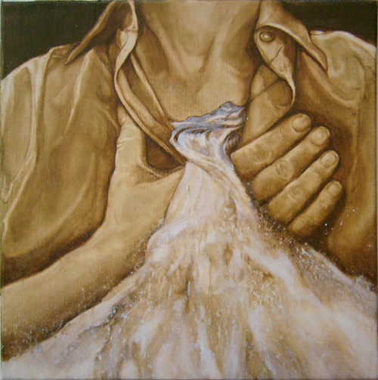
“Jesus stood and cried, saying, If any man thirst, let him come unto me, and drink. He that believeth on me, as the scripture hath said, out of his belly shall flow rivers of living water.” (John 7:37-38)

Slide 42
The Water of the Spirit Indicates
Life – “Living Water”
Cleansing – “Now are ye clean”
Refreshment – “When the times of refreshing shall come from the presence of the Lord.”
Nourishment – “Blessed are they which do hunger and thirst after righteousness: for they shall be filled.”

Slide 44
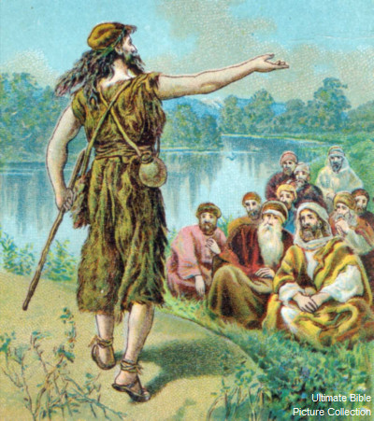
“And John was clothed with camel's hair, and with a girdle of a skin about his loins; and he did eat locusts and wild honey; And preached, saying, There cometh one mightier than I after me, the latchet of whose shoes I am not worthy to stoop down and unloose.
I indeed have baptized you with water: but he
shall baptize you with
the Holy Ghost.”
(Mark 1:5-8)

Slide 45
The Baptism of the Holy Spirit is one of the most misunderstood ministries of the Holy Spirit.
I Cor. 12:13 “For by one Spirit are we all baptized into one body, whether we be Jews or Gentiles, whether we be bond or free; and have been all made to drink into one Spirit.”
Gal. 3:27 “For as many of you as have been baptized into Christ have put on Christ.”

Slide 46
Question: "What is the baptism of the Holy Spirit?" Answer: The baptism of the Holy Spirit may be defined as that work whereby the Spirit of God places the believer into union with Christ and into union with other believers in the body of Christ at the moment of salvation.

Slide 47
Why are the Assemblies of God so committed to the doctrine of the baptism in the Holy Spirit along with the speaking in tongues? Quote: The Baptism in the Holy Spirit is a vital experience of the Christian life. It is a special work of the Spirit beyond salvation. On the Day of Pentecost, disciples who had already made a decision to follow Jesus "were filled with the Holy Spirit and began to speak in other tongues" (Acts 2:4).

Slide 48
The Filling of the Holy Spirit and Baptism of the Holy Spirit are two different ministries of the Holy Spirit
We are never commanded to be Baptized by the Holy Spirit, but we are commanded to be filled with the Holy Spirit – Eph. 5:18
Every believer is Baptized into the body of Christ by the Holy Spirit at the time of Salvation – I Cor. 12:13
Not all believers are filled with the Holy Spirit after salvation – Eph. 5:18

Slide 49
“One Lord, one faith, one baptism, One God and Father of all, who is above all, and through all, and in you all.” (Ephesians 4:5-6)
The Baptism of the Holy Spirit is a once and for all event in the Believers life.
The Filling of the Holy Spirit is a repeated experience through out the Believers life.

Slide 50
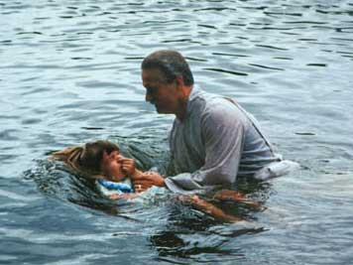
(Romans 6:1-4) Water Baptism pictures not only the death, burial and resurrection of Christ. It also pictures the “Baptism of the Holy Spirit.”

Slide 52
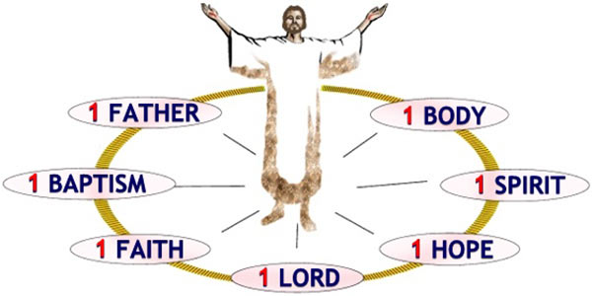
(Ephesians 4:4-6) “There is one body, and one Spirit, even as ye are called in one hope of your calling; One Lord, one faith, one baptism, One God and Father of all, who is above all, and through all, and in you all.”

