Slide 1
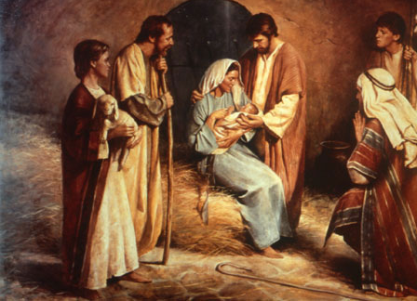
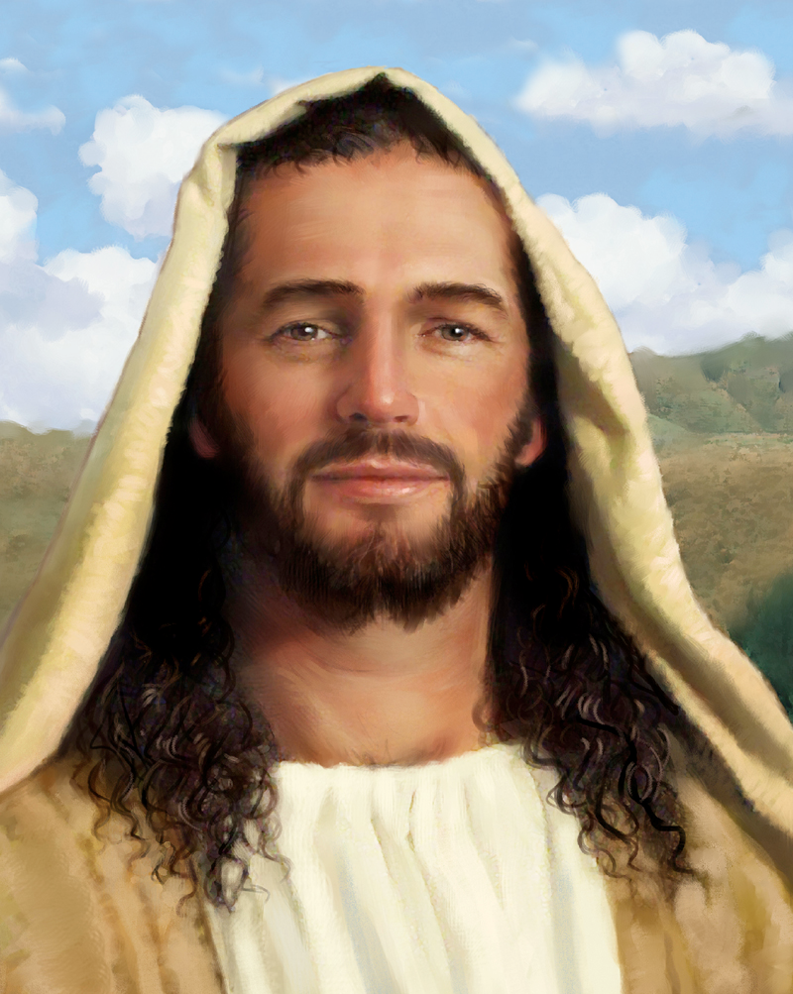
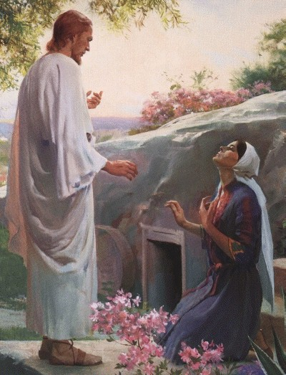
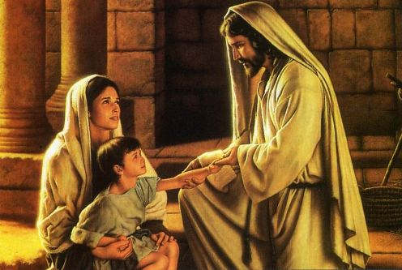
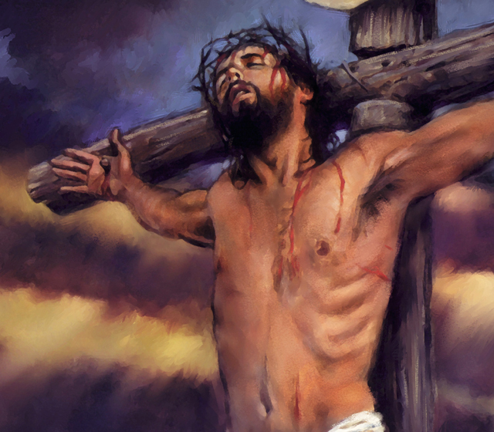
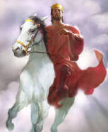
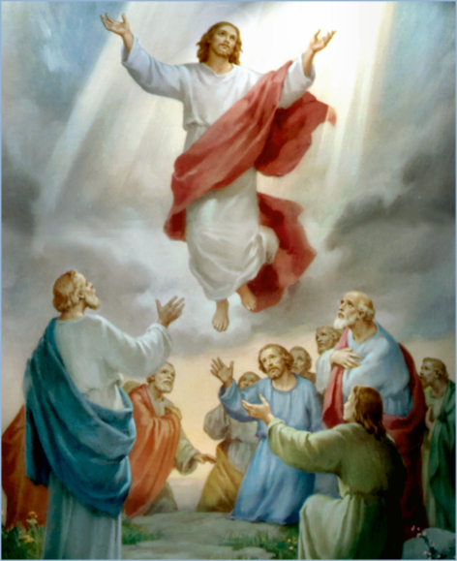
The Doctrine of Jesus Christ (Part 18)
The Death of Jesus Christ
“Christ decent into the heart of the earth”

Slide 2
Review

Slide 4
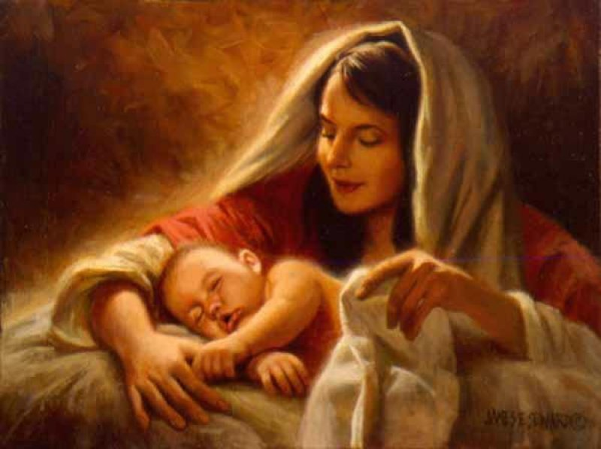
The Virgin Birth
“Behold, a virgin shall be with child, and shall bring forth a son, and they shall call his name Emmanuel, which being interpreted is, God with us.”
Matt. 1:23

Slide 5
The Incarnation of Christ
(John 1:1-14)
God the Son took upon himself the full nature of man and yet retain the full nature of God.

Slide 6
Names and Titles of Jesus Christ

Slide 7
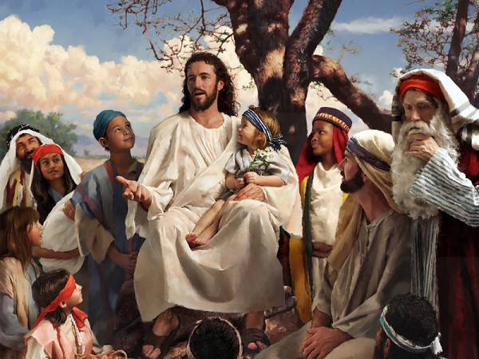
The Humanity of Jesus Christ

Slide 8
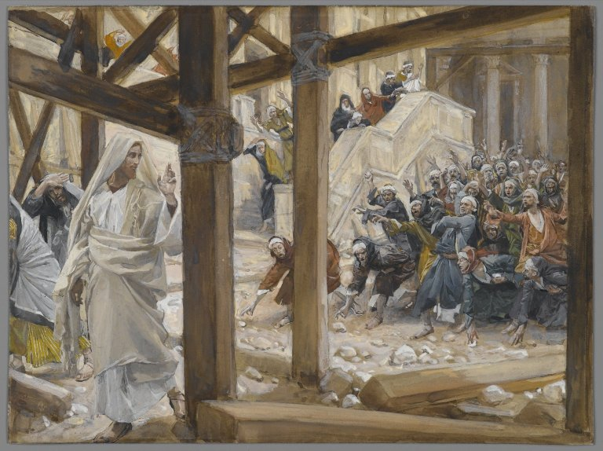
The Deity of Jesus Christ
(John 10:30-33)

Slide 9
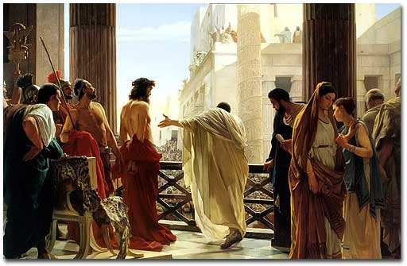
The Impeccability of Jesus Christ (John 18:38)

Slide 10
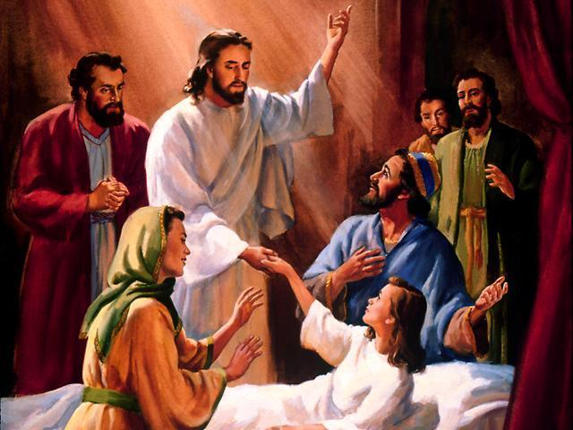
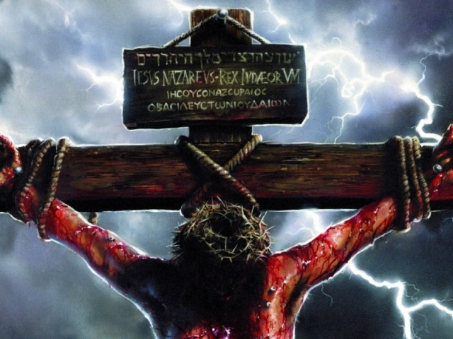
“For even the Son of man came not to be ministered unto, but to minister, and to give his life a ransom for many.” Mark 10:45
The Earthly Ministry of Jesus Christ

Slide 11
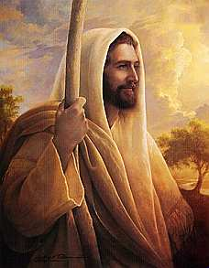
The Character of Jesus Christ
What kind of man was our Lord?
What were some of his characteristics?

Slide 12
The character of Christ
His zeal
His compassion
His meekness and gentleness
His boldness and courage
His love

Slide 13
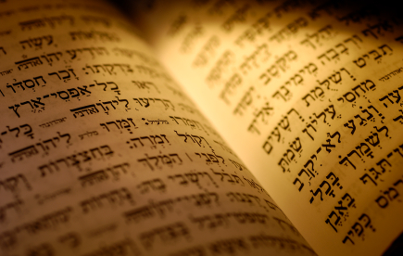
In the Old Testament three great offices were created by God to meet the spiritual and material needs of his chosen people.

Slide 14
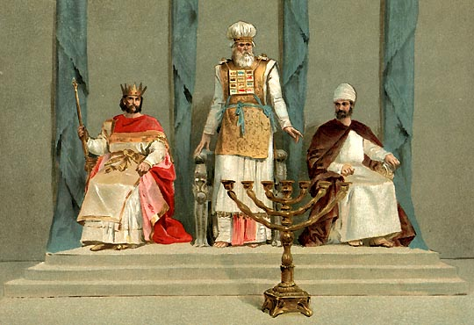
Jesus holds all three offices

Slide 15
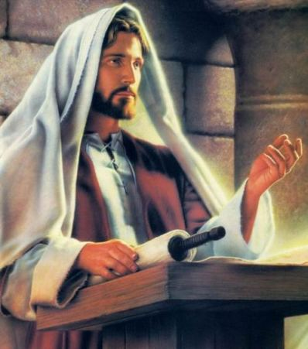

Slide 16
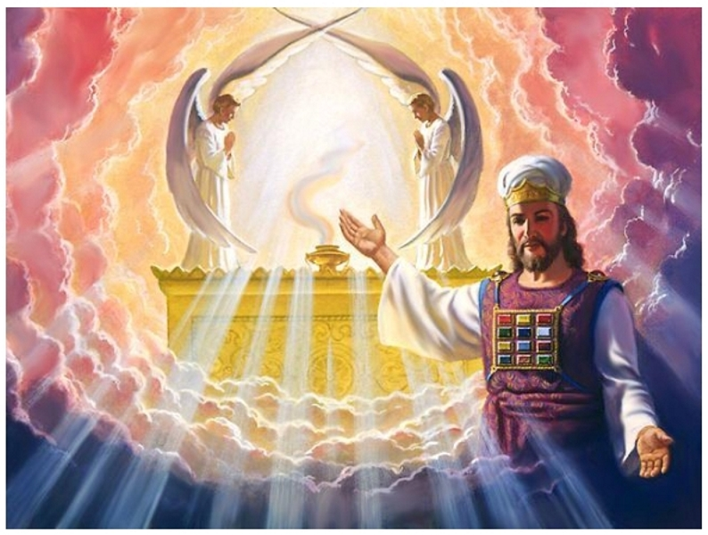

Slide 17
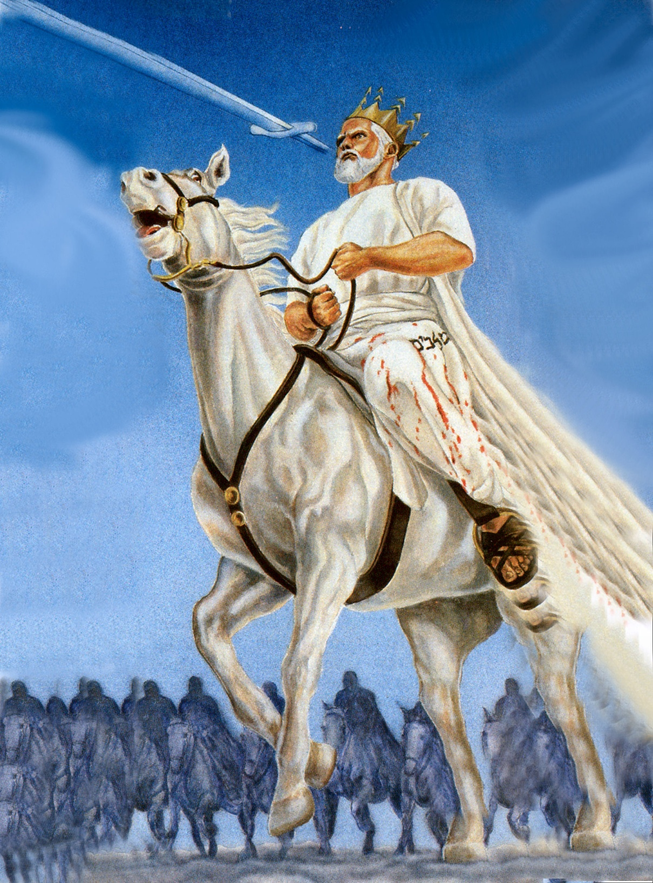

Slide 18
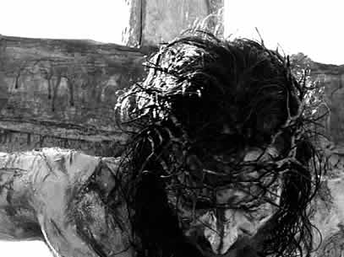
The Death of Jesus Christ

Slide 19
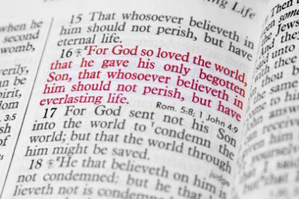

Slide 20
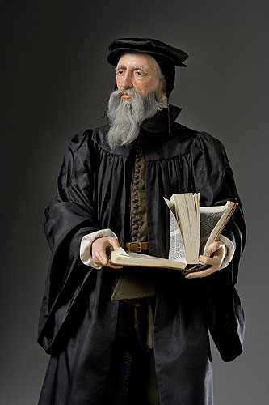
“Exposing the false Doctrine of Calvinism”
“I marvel that ye are so soon removed from him that called you into the grace of Christ unto another gospel …but there be some that trouble you, and would pervert the gospel of Christ. But though we, or an angel from heaven, preach any other gospel unto you than that which we have preached unto you, let him be accursed.” (Gal. 1:6-8)

Slide 21
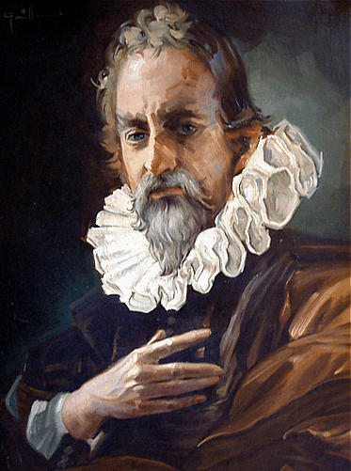
"We call predestination God’s eternal decree, by which He determined what He willed to become of each man. For all are not created in equal condition; rather, eternal life is ordained for some, eternal damnation for others."

Slide 22
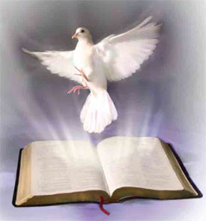
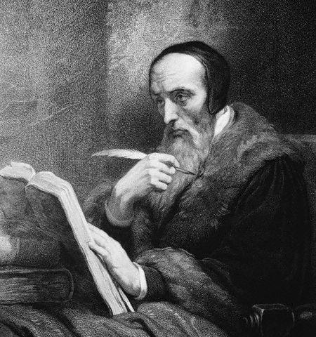
Calvinism teaches that some men are predestinated to Heaven and others are predestinated to Hell. It is strictly God’s choice and man can not change it.

Slide 23
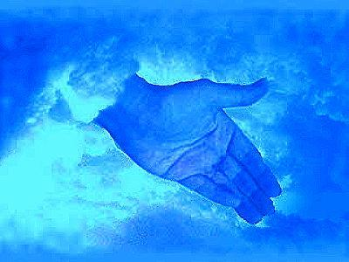
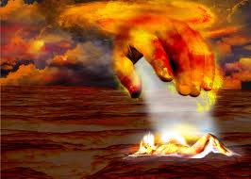
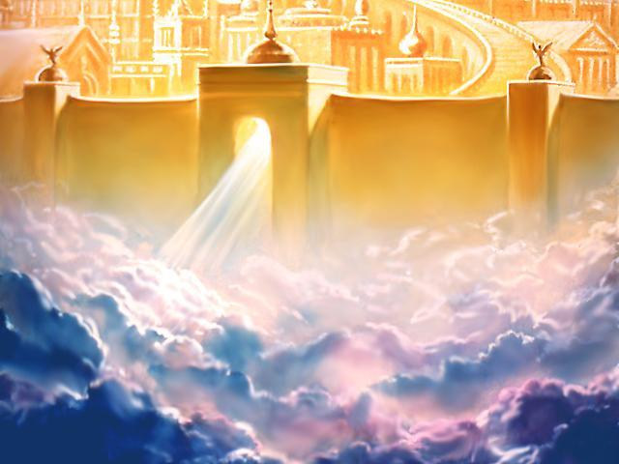
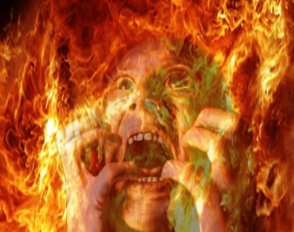

Slide 24
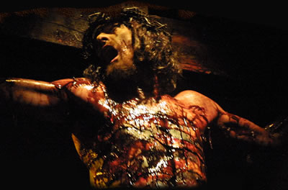
The Vicarious Atonement

Slide 25
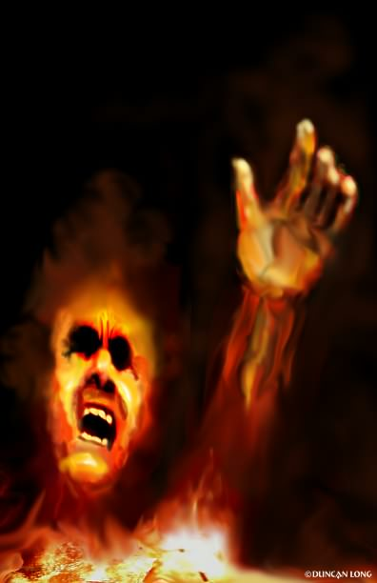
The word "vicarious" means substitute. Christ was a substitute for others in that He took their place and suffered their punishment.
Without Christ “vicarious death”, we are all going to die and spend an eternity in hell as payment for our sins (Rev. 20:14).

Slide 26
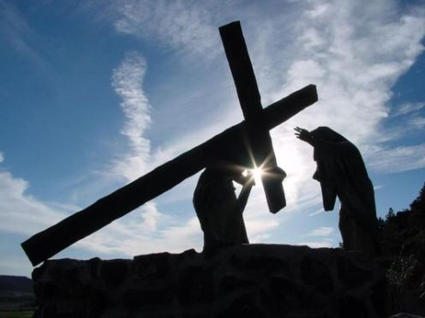
“Who his own self bare our sins in his own body on the tree.”
I Peter 2:24

Slide 27
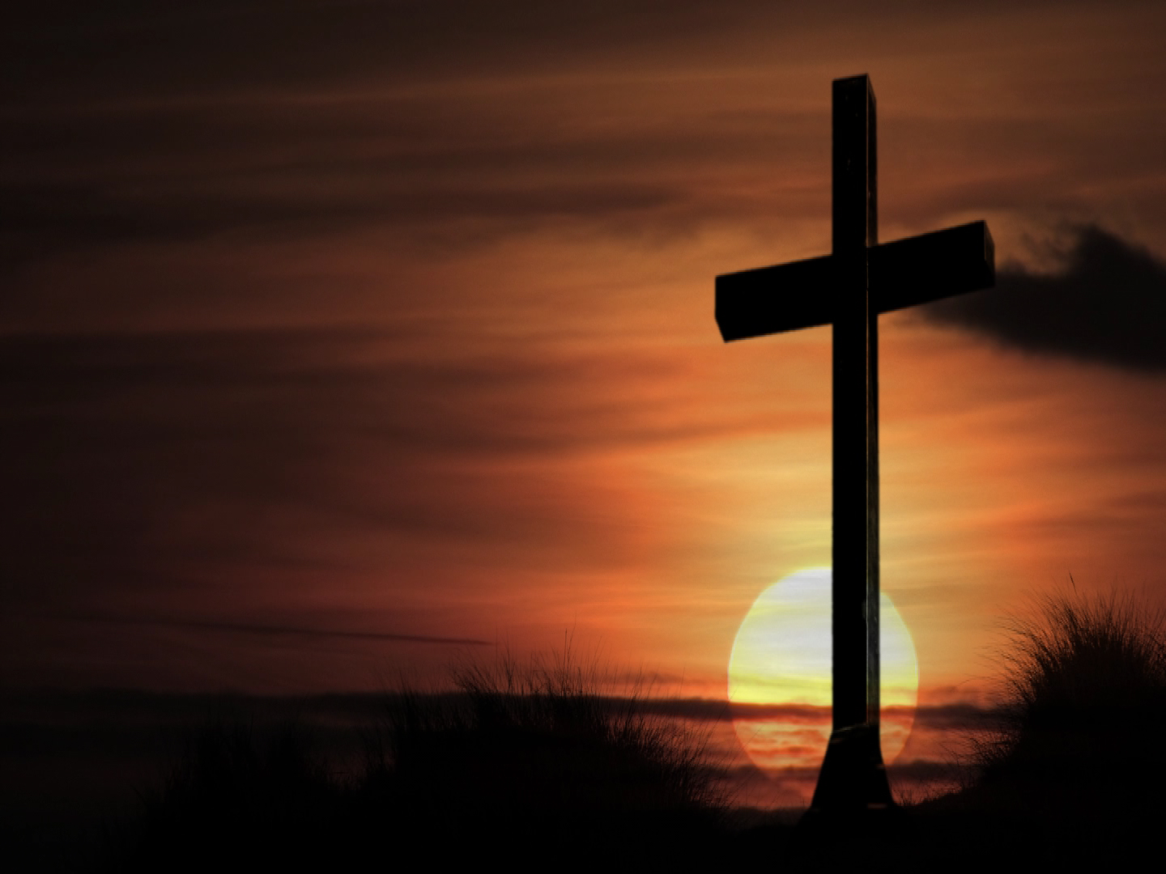
The results of the vicarious atonement
Redemption
Reconciliation
Justification
Sanctification
Glorification
Regeneration
Remission
Imputation
Propitiation
Forgiveness
Adoption
Ransom
Pardon
Eternal Salvation

Slide 28
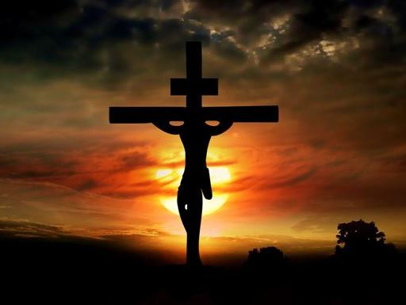
The seven last statements of Christ

Slide 29
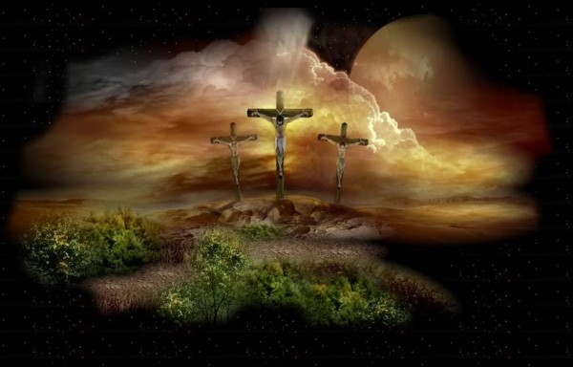
“Father, forgive them; for they know not what they do.”
“Today shalt thou be with me in paradise.”
“Woman, behold thy son! Then saith he to the disciple, Behold thy mother!”
“My God, my God, why hast thou forsaken me?”
“I thirst.”
“It is finished.”
“Father, into thy hands I commend my spirit.”

Slide 30
Christ decent into the heart of the earth
"For as Jonas was three days and three nights in the whale’s belly; so shall the Son of man be three days and three nights in the heart of the earth"
(Matt. 12:40)

Slide 31
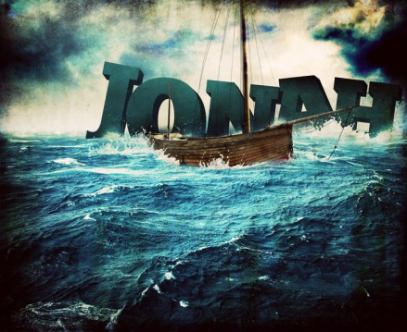

Slide 32
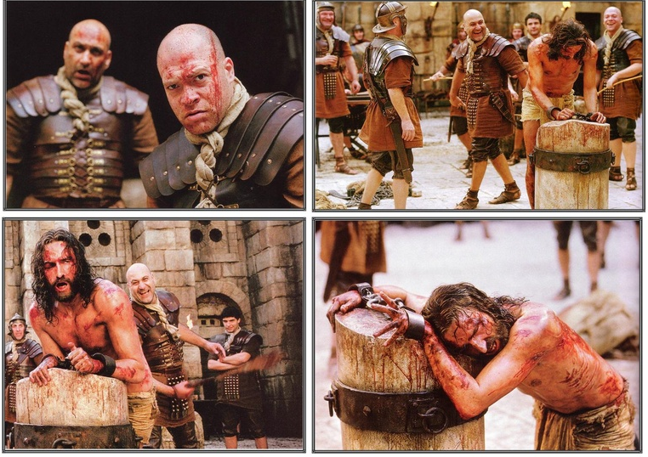
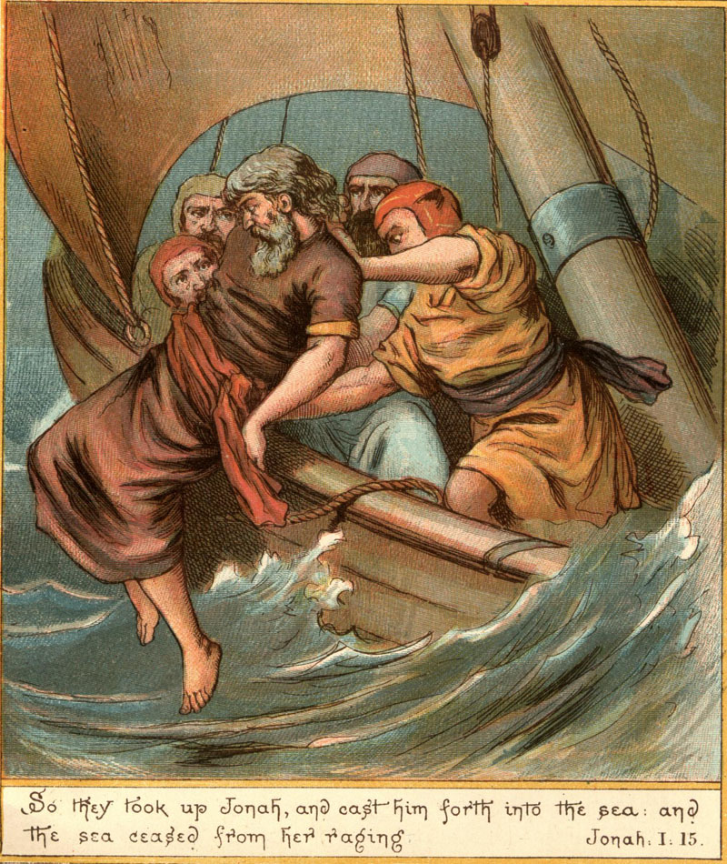

Slide 33
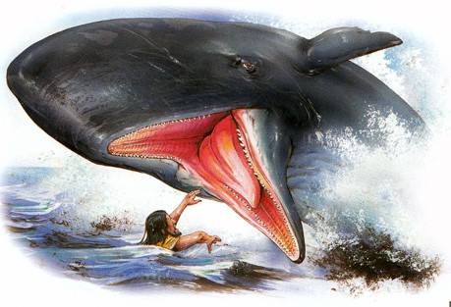
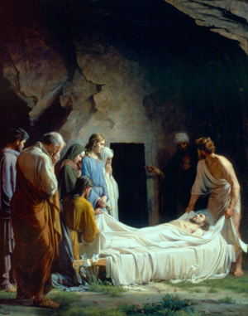

Slide 34
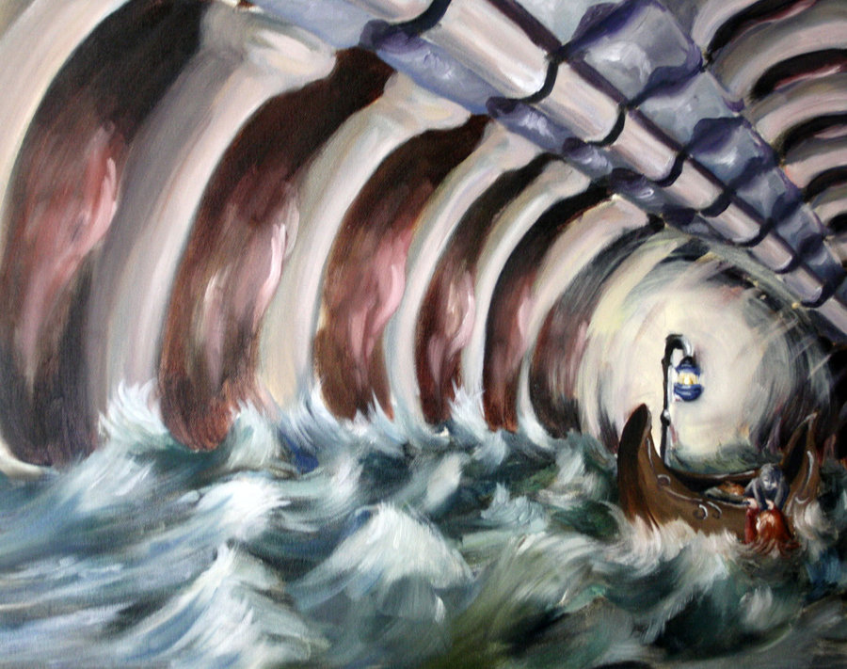
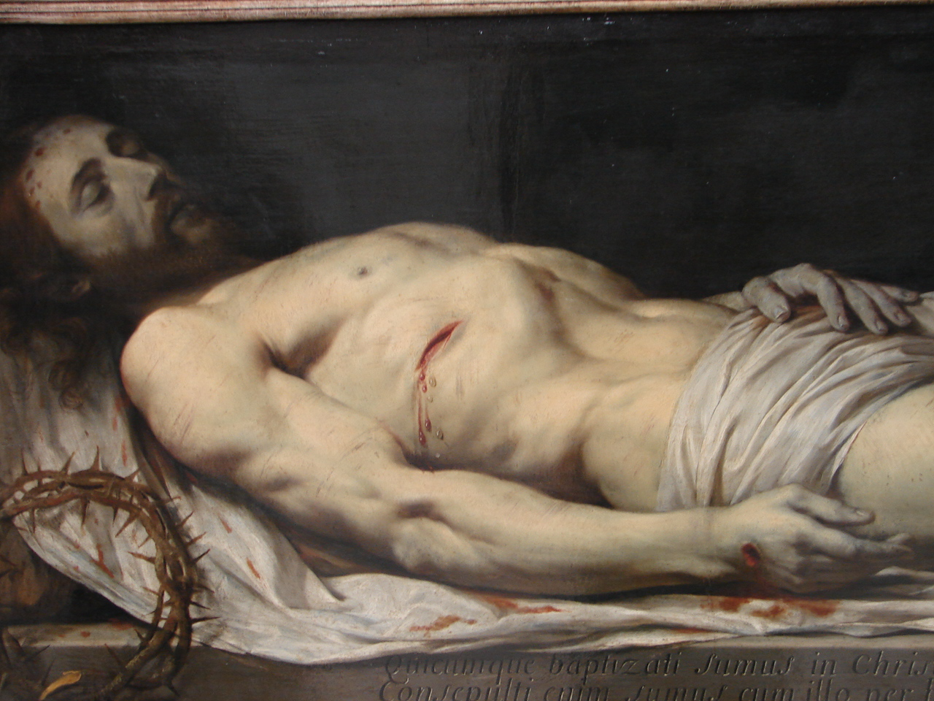
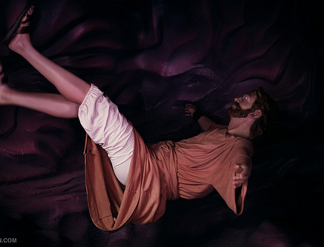

Slide 35
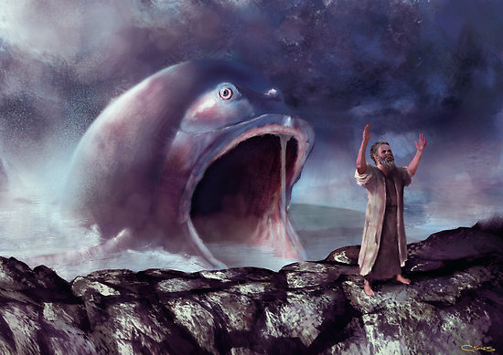
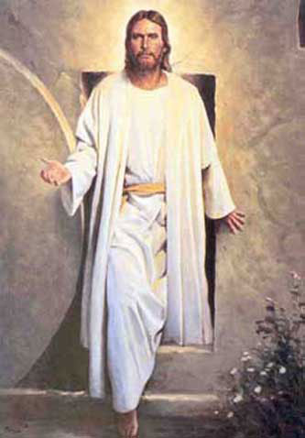

Slide 36
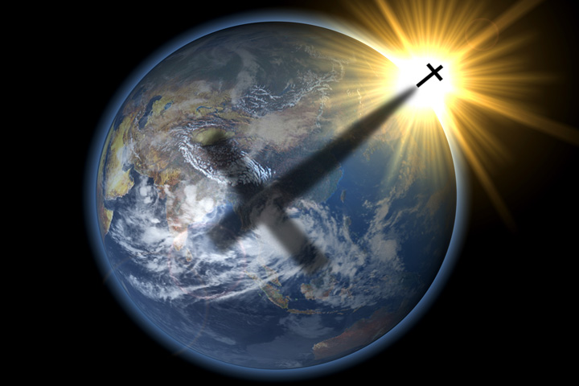
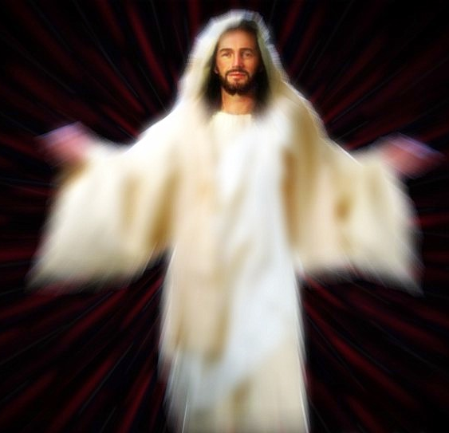

Slide 37
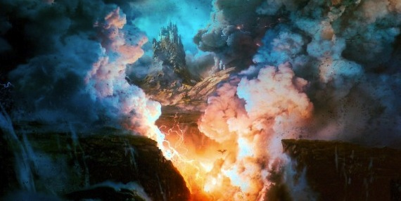
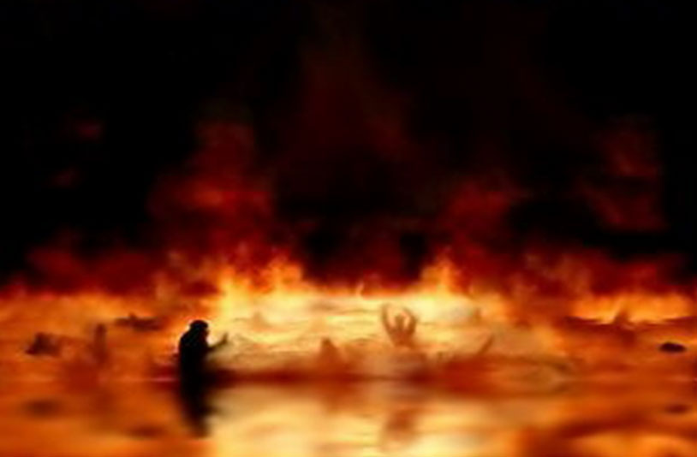
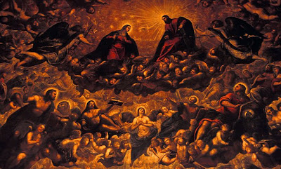
Hebrew word Sheol and the Greek word Hades
“Place of the departed dead”

Slide 38
Before Christ's death and resurrection those who died went to Sheol = "abode of the dead" "the world of the dead" - both the righteous and the unrighteous went to this place called Sheol –
Sheol had two compartments –
Paradise (Abraham's bosom)
Torments (hell)
Luke 23:39-43 - The malefactor on the cross
Luke 16:23-26 - Rich man and Lazarus

Slide 39
“And Jesus said unto him, Verily I say unto thee, To day shalt thou be with me in paradise.”

Slide 40
“And in hell he lift up his eyes, being in torments, and seeth Abraham afar off, and Lazarus in his bosom.” Luke 16:23

Slide 41
“And he cried and said, Father Abraham, have mercy on me, and send Lazarus, that he may dip the tip of his finger in water, and cool my tongue; for I am tormented in this flame.” (Luke 16:24)

Slide 42
“And beside all this, between us and you there is a great gulf fixed: so that they which would pass from hence to you cannot; neither can they pass to us, that would come from thence.” Luke 16:26

Slide 43
Torments
Paradise (Abraham's bosom)

Slide 44
“For Christ also hath once suffered for sins, the just for the unjust, that he might bring us to God, being put to death in the flesh, but quickened by the Spirit: By which also he went and preached unto the spirits in prison; Which sometime were disobedient, when once the longsuffering of God waited in the days of Noah, while the ark was a preparing, wherein few, that is, eight souls were saved by water.” (I Peter 3:18-20)

Slide 45
Jesus victoriously proclaimed His triumph over sin and death to the spirits which were in prison (v.19-20)
"By which also he (Jesus) went and preached unto the spirits (of the dead) in prison (hell); which sometime (formerly) were disobedient..."

Slide 46
Question: What does this mean? It means that right after Christ died, between the cross and His resurrection, He went before the spirits in prison and proclaimed that God's promise of salvation was fulfilled in Him, that He is the Savior of the world.

Slide 47
Jesus descends into Sheol and preaches to the "spirits in prison"

Slide 48
“And they shall be gathered together, as prisoners are gathered in the pit, and shall be shut up in the prison…” (Isa. 24:22)

Slide 49
Who are the spirits to whom Jesus preached?
They were those who were disobedient - Just like the disobedient who lived upon earth while Noah was preparing
the Ark.

Slide 50
They were disobedient even though God was longsuffering towards them - "And GOD saw that the wickedness of man was great in the earth, and that every imagination of the thoughts of his heart was only evil continually. And it repented the LORD that he had made man on the earth, and it grieved him at his heart. And the LORD said, I will destroy man whom I have created from the face of the earth; both man, and beast, and the creeping thing, and the fowls of the air; for it repenteth me that I have made them...And the LORD said, My spirit shall not always strive with man, for that he also is flesh: yet his days shall be an hundred and twenty years." (Gen. 6)

Slide 51
They were disobedient and rejected the preaching of Noah (message of salvation) - “And as it was in the days of Noah, so shall it be also in the days of the Son of man. They did eat, they drank, they married wives, they were given in marriage, until the day that Noah entered into the ark, and the flood came, and destroyed them all. Likewise also as it was in the days of Lot; they did eat, they drank, they bought, they sold, they planted, they builded; But the same day that Lot went out of Sodom it rained fire and brimstone from heaven, and destroyed them all. Even thus shall it be in the day when the Son of man is revealed.” Luke 17:26-30

Slide 53
What was Noah's message "Repentance and Salvation"
II Pet. 2:5 "And spared not the old world, but saved Noah, a preacher of righteousness, bringing in the flood upon the world of the ungodly."
These people mocked the preacher of righteousness and rejected his message until it begin to rain and then it was too late!
"They were disobedient" and their disobedience resulted in their eternal imprisonment and damnation in Hell.

Slide 57
What message did Jesus preach?
Did he give them a second chance to be saved? –
NO! There is no second chance - "Behold now is the accepted time, behold now is that day of salvation."
We do not know what Jesus preached - The only thing we do know is that he proclaimed his victory / triumph (over sin, death and hell)!
Perhaps he told them what their future would be - Great White Throne to come – Rev. 20:12-15

Slide 58
“And death and hell were cast into the lake of fire. This is the second death. And whosoever was not found written in the book of life was cast into the lake of fire.”

Slide 59
Everlasting punishment – Matt. 25:46
Everlasting fire – Matt. 25:41
Everlasting burning – Isa. 33:14
A furnace of fire – Matt. 13:42, 50
Lake of fire – Rev. 20:15
Unquenchable fire – Matt. 3:12
Devouring fire – Isa. 33:14
Lake burning with fire and brimstone – Rev. 19:20
Place of torment – Luke 16:43
Outer darkness – Matt. 8:12
Weeping and gnashing of teeth – Matt. 24:51
It is the lowest and deepest pit on earth – Ps. 88:6
The pit burns with fire and brimstone – Rev. 21:8
The pit is the place of great torment – Luke 16:28
It has bars – Job 17:16
It has gates – Isa. 38:10
It has chains – II Pet. 2:4
Prisoners are tormented by demon creatures - "They shall be burnt with hunger, and devoured with burning heat, and with bitter destruction: I will also send the teeth of beasts upon them, with the poison of serpents…”

Slide 61
“Wherefore he saith, When he ascended up on high, he led captivity captive, and gave gifts unto men. Now that he ascended, what is it but that he also descended first into the lower parts of the earth? He that descended is the same also that ascended up far above all heavens, that he might fill all things.” (Ephesians 4:8-9)

Slide 63
“For it is not possible that the blood of bulls and of goats should take away sins.”
(Hebrews 10:4)

Slide 64
“Neither by the blood of goats and calves, but by his own blood he entered in once into the holy place, having obtained eternal redemption for us.” (Hebrews 9:12)

Slide 68
“And He (Christ) gave gifts unto men…for the perfecting of the saints, for the work of the ministry, for the edifying of the body of Christ.” (Ephesians 4:8-13)

Slide 69
What is a spiritual gift?
A spiritual gift is the “Manifold grace of God” (I Peter 4:10)
It is given to Christians enabling them to serve their church, the world and Christ through the divine enablement of the Holy Spirit – (I Corinthians 12:1-27)

Slide 70
Who is given a spiritual gift? (Romans 12:1-8; I Corinthians 12-14; Ephesians 4:7-16; I Peter 4:10-11)
Every believer is given a spiritual gift.
Spiritual gifts are received at the time of salvation.
When we are born, we possess certain natural abilities.
When we are born spiritually, God takes these natural abilities and along with our spiritual gift turns them into the means by which He can work through us supernaturally.

Slide 71
Seven Motivational Gifts (Romans 12:3-8)
Prophet
Server
Teacher
Exhorter
Giver
Organizer
Mercy

