Slide 1
The Doctrine of Man (Part 2)
His Nature

Slide 4
Job 7:17 “What is man, that thou shouldest magnify him? and that thou shouldest set thine heart upon him?”
Job 15:14 “What is man, that he should be clean? and he which is born of a woman, that he should be righteous?”
Ps. 8:4 “What is man, that thou art mindful of him? and the son of man, that thou visitest him?”
Ps. 144:3 “LORD, what is man, that thou takest knowledge of him! or the son of man, that thou makest account of him!”
Heb. 2:6 “But one in a certain place testified, saying, What is man, that thou art mindful of him? or the son of man, that thou visitest him?”

Slide 6
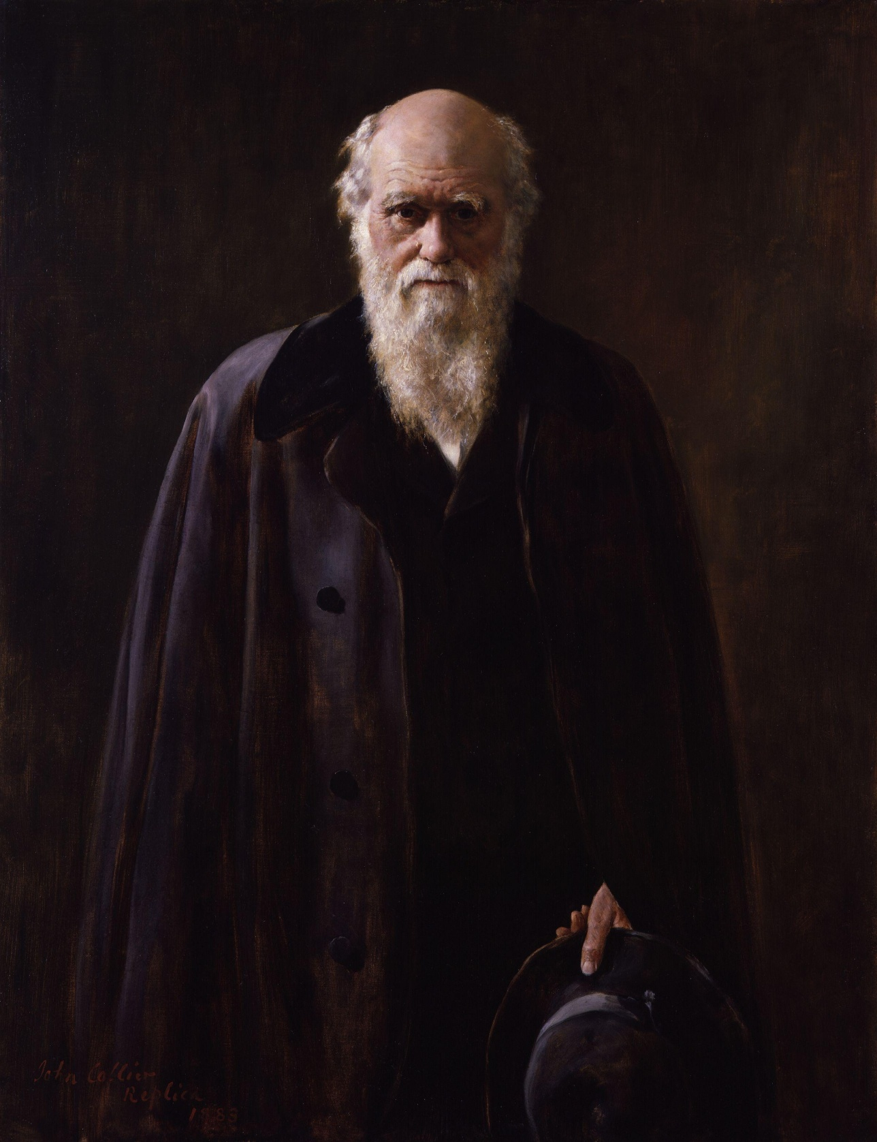

Slide 7
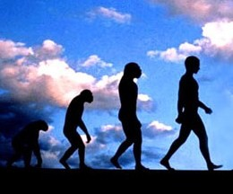

Slide 9
Col. 2:8
“Beware lest any man spoil you through philosophy and vain deceit, after the tradition of men, after the rudiments of the world, and not after Christ.”

Slide 10
John 1:1-4
“In the beginning was the Word, and the Word was with God, and the Word was God. The same was in the beginning with God. All things were made by him; and without him was not any thing made that was made. In him was life; and the life was the light of men.”

Slide 11
Rom. 1:21-24 “Because that, when they knew God, they glorified him not as God, neither were thankful; but became vain in their imaginations, and their foolish heart was darkened. Professing themselves to be wise, they became fools, And changed the glory of the uncorruptible God into an image made like to corruptible man, and to birds, and fourfooted beasts, and creeping things. Wherefore God also gave them up to uncleanness through the lusts of their own hearts, to dishonour their own bodies between themselves.”

Slide 12
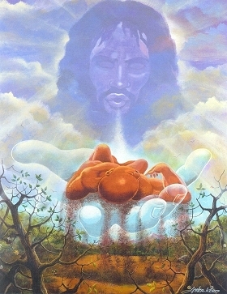
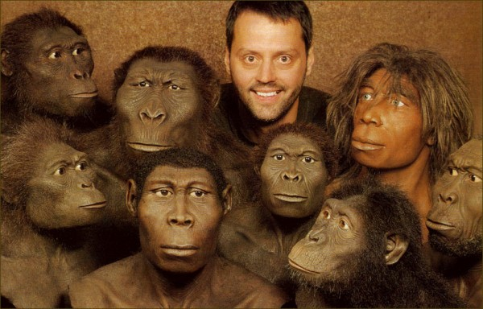

Slide 13
I Cor. 3:19 “For the wisdom of this world is foolishness with God. For it is written, He taketh the wise in their own craftiness.”

Slide 14
Psalm 53:1 “The fool hath said in his heart, There is no God. Corrupt are they, and have done abominable iniquity: there is none that doeth good.”

Slide 15
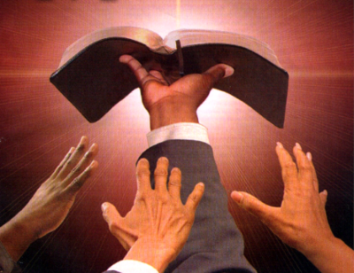
“Thy Word is Truth…”

Slide 17
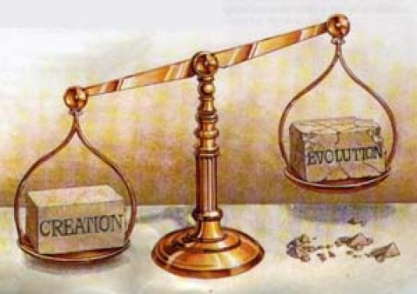

Slide 19
"And God said, Let us make man in our image, after our likeness; and let them have dominion over the fish of the sea, and the fowl of the air, and over the cattle, and over all the earth, and over every creeping thing that creepeth upon the earth. So God created man in his own image, in the image of God created he him; male and female created he them" (Gen. 1:26, 27)

Slide 20
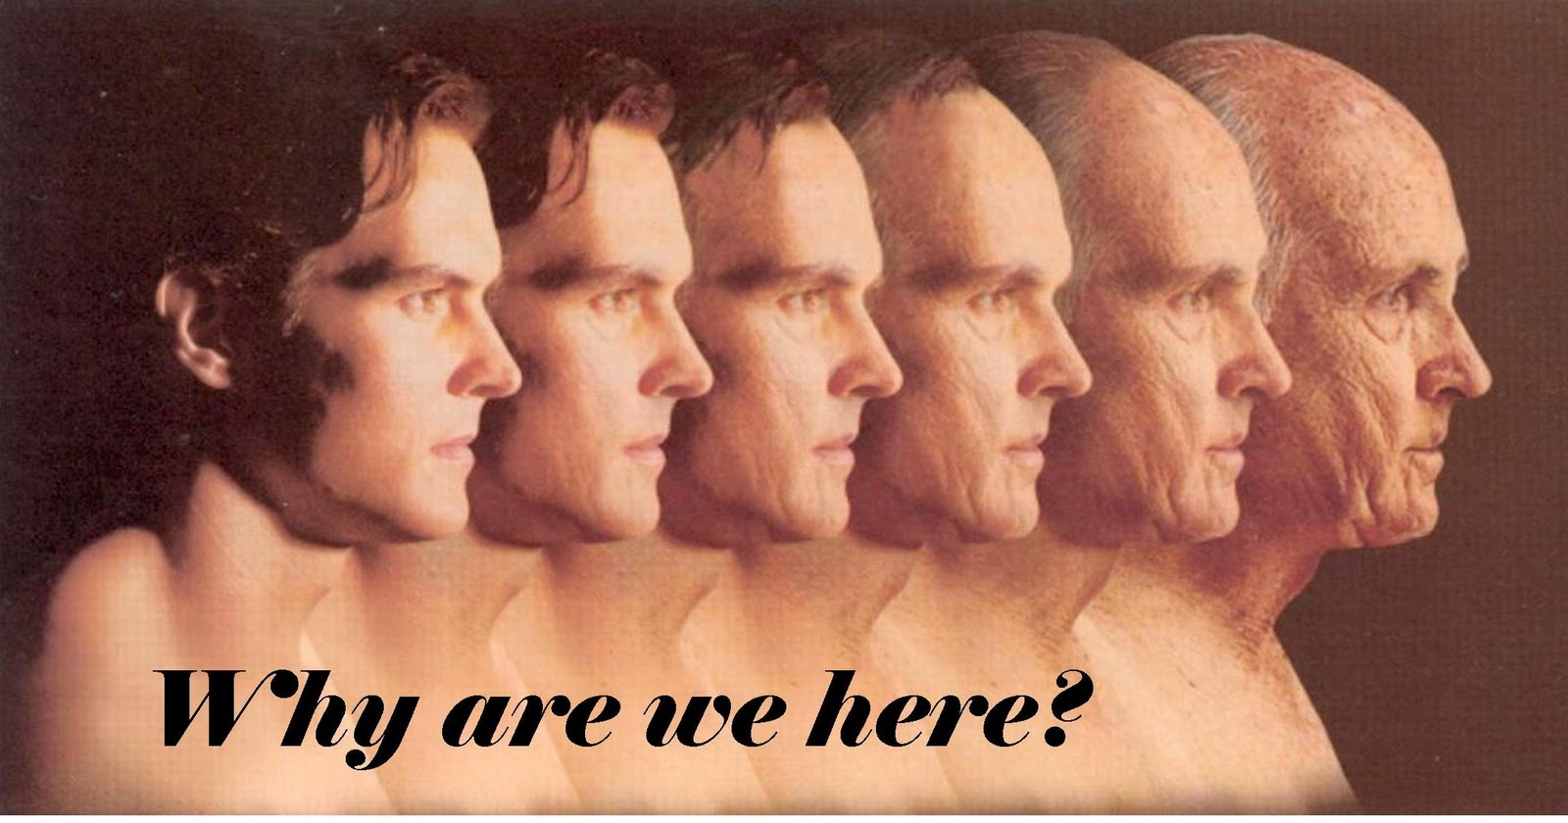

Slide 21
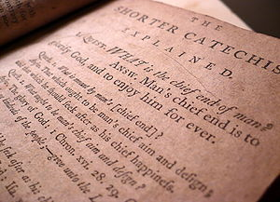

Slide 23
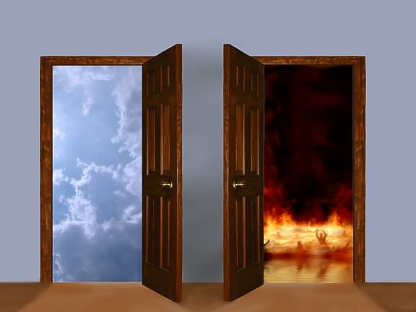

Slide 24
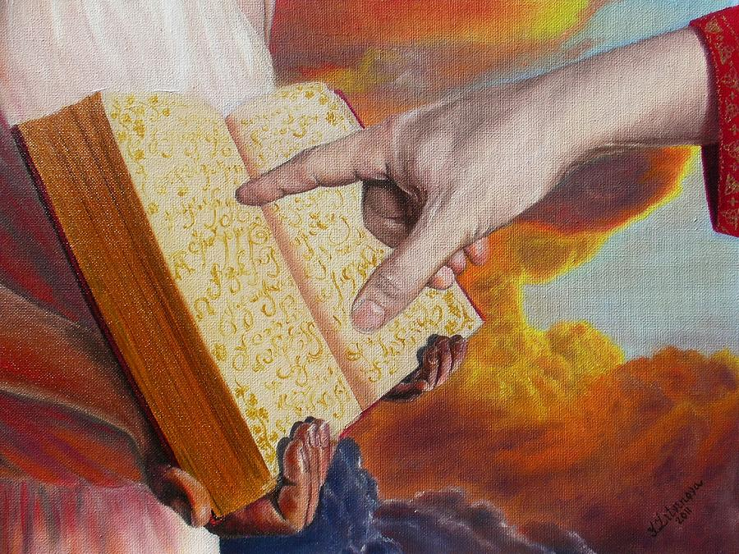
Rev. 20:15
“And whosoever was not found written in the book of life was cast into the lake of fire.”

Slide 25
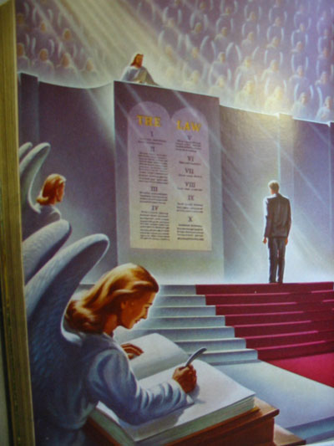
Heb 9:27
“And as it is appointed unto men once to die, but after this the judgment.”

Slide 26
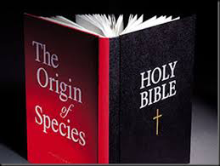

Slide 27
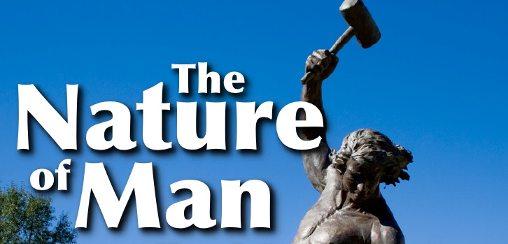

Slide 28
In dealing with man’s nature, we must attempt to answer four basic questions.
How is man made in the image and likeness of God?
Is man a trichotomous (three-part) being? That is, does he consist of body, soul and spirit?
What are the basic characteristics of the soul?
What is the difference between the soul and the spirit?

Slide 29
1# How is man made in the image and likeness of God?
Gen. 1:26-27 "And God said, Let us make man in our image, after our likeness; and let them have dominion over the fish of the sea, and the fowl of the air, and over the cattle, and over all the earth, and over every creeping thing that creepeth upon the earth. So God created man in his own image, in the image of God created he him; male and female created he them"
Gen. 9:6 “Whoso sheddeth man's blood, by man shall his blood be shed: for in the image of God made he man.”

Slide 30
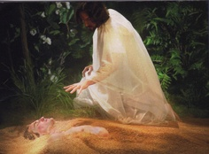
I Cor. 11:7 “For a man indeed ought not to cover his head, forasmuch as he is the image and glory of God: but the woman is the glory of the man.”
Col. 3:10 “And have put on the new man, which is renewed in knowledge after the image of him that created him.”
James 3:9 “Therewith bless we God, even the Father; and therewith curse we men, which are made after the similitude of God.”

Slide 31
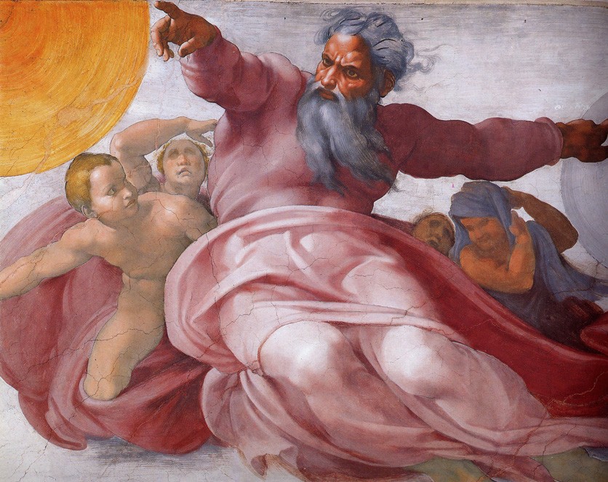
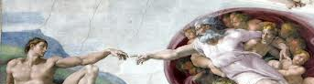
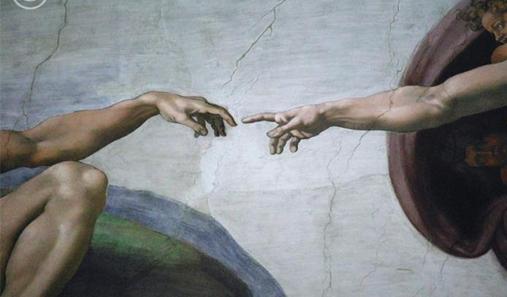
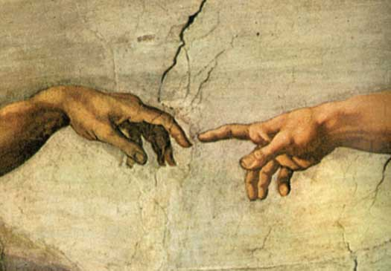
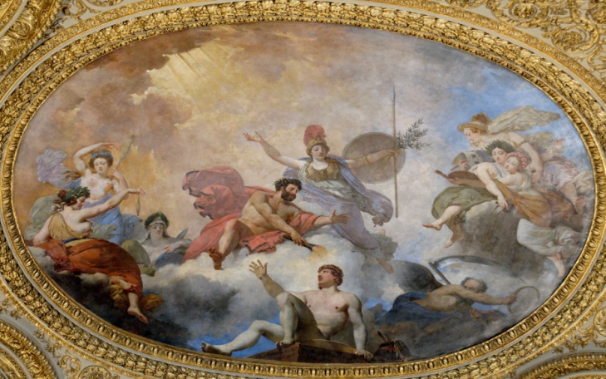
When God created man in His own image, He purposed that mankind would resemble Himself in certain ways.

Slide 32
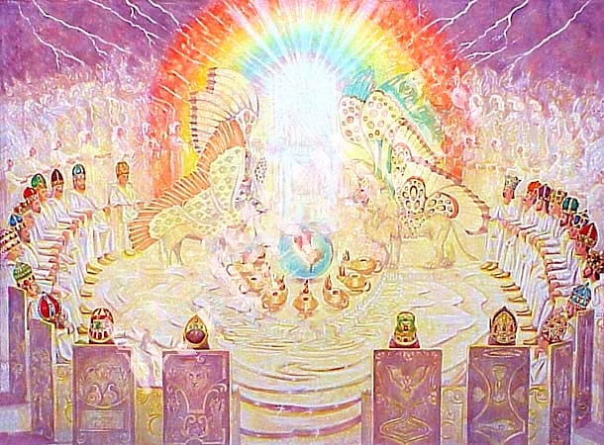
How are we to understand these words? “Let us make man in our image, after our likeness…”
The expression "image of God" does not refer to physical likeness because "God is a spirit" (John 4:24) and He is invisible (Col.1:15; I Tim.1:17).
“God is light and in Him is no darkness at all…” I John 1:5

Slide 33
John 4:24 “God is a Spirit: and they that worship him must worship him in spirit and in truth.”
Psalm 139:7-8 “Whither shall I go from thy Spirit? or whither shall I flee from thy presence? If I ascend up into heaven, thou art there: if I make my bed in hell, behold, thou art there. If I take the wings of the morning, and dwell in the uttermost parts of the sea; Even there shall thy hand lead me, and thy right hand shall hold me.”
Jeremiah 23:24 “Can any hide himself in secret places that I shall not see him? saith the LORD. Do not I fill heaven and earth? saith the LORD.”

Slide 34
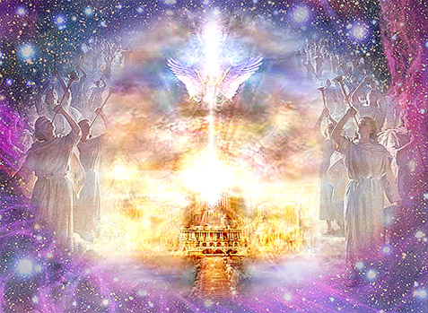
I Kings 8:27 “…behold, the heaven and heaven of heavens cannot contain thee.”
II Chronicles 2:6 “But who is able to build him an house, seeing the heaven and heaven of heavens cannot contain him? who am I then, that I should build him an house.”

Slide 35
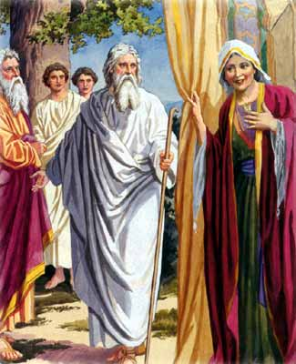
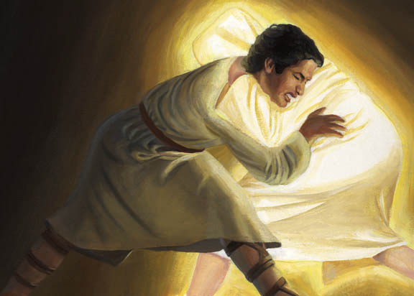
Although God is spirit (John 4:24) and does not have a body like a man, when He appeared visibly to men, He did so in the form of a human body (Genesis 18:1-2; 32:24-30).

Slide 36
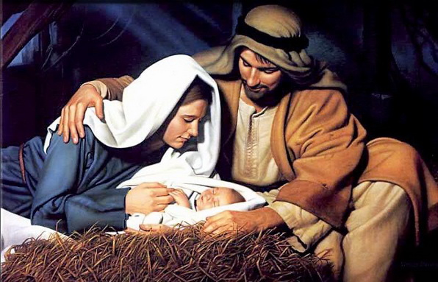
The incarnation of Jesus Christ - John 1:14 “And the Word became flesh, and dwelt among us, and we saw His glory, glory as of the only begotten from the Father, full of grace and truth.”
Heb. 10:5 “Wherefore when he cometh into the world, he saith, Sacrifice and offering thou wouldest not, but a body hast thou prepared me.”

Slide 37
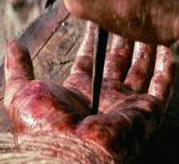
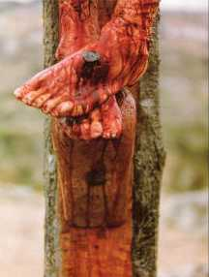
(Luke 24:39-40) “Behold my hands and my feet, that it is I myself: handle me, and see; for a spirit hath not flesh and bones, as ye see me have. And when he had thus spoken, he shewed them his hands and his feet.”

Slide 38
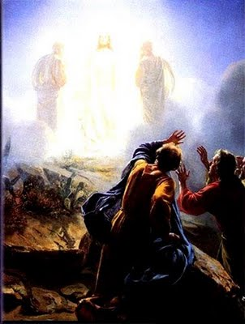
Transfiguration of Christ
“And was transfigured before them: and his face did shine as the sun, and his raiment was white as the light.”
(Matt. 17:2)

Slide 39
“No man hath seen God at any time.” ( I John 4:12)

Slide 40
“In whom we have redemption through his blood, even the forgiveness of sins: Who is the image of the invisible God, the firstborn of every creature: For by him were all things created, that are in heaven, and that are in earth, visible and invisible, whether they be thrones, or dominions, or principalities, or powers: all things were created by him, and for him.”
(Col. 1:14 -16)

Slide 41
I Tim. 1:17 “Now unto the King eternal, immortal, invisible, the only wise God, be honour and glory for ever and ever. Amen.”
Heb. 11:27 “By faith he forsook Egypt, not fearing the wrath of the king: for he endured, as seeing him who is invisible.”

Slide 42
Eleven Visions of God

Slide 43
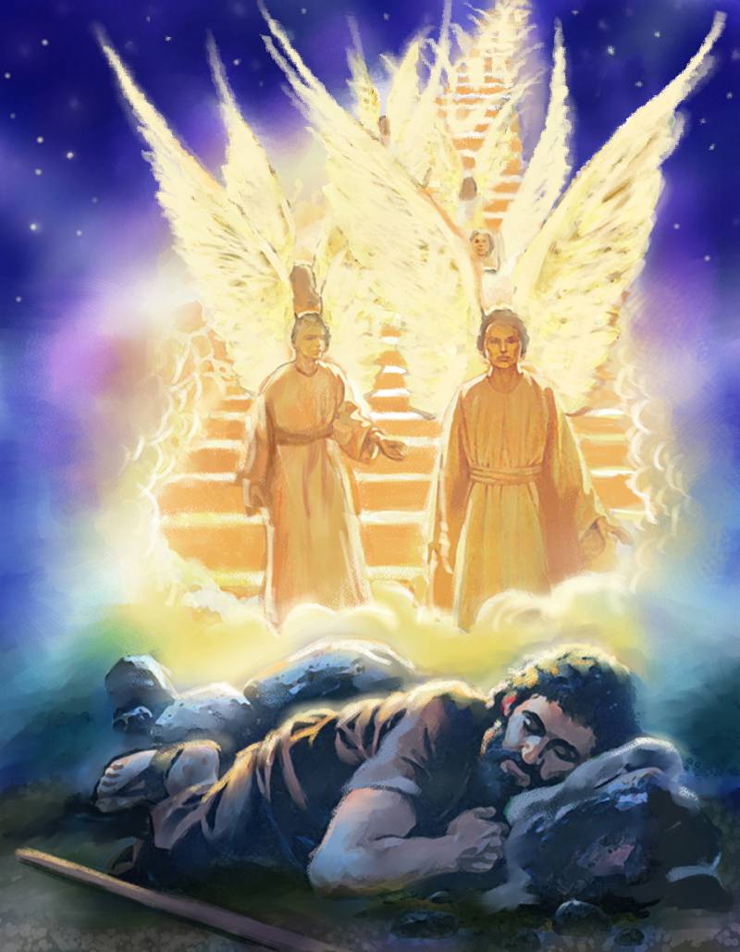
Jacob dreamed of “a ladder set up on the earth, and the top of it reached to heaven....And, behold, the Lord stood above it” (Gen. 28:12-13)

Slide 44
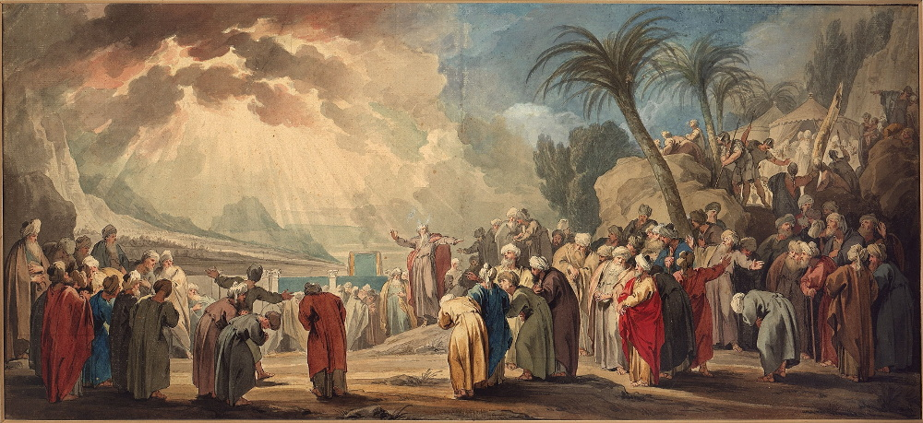
Moses, and Aaron, Nadab, and Abihu, and seventy of the elders of Israel...saw the God of Israel (Exod. 24:9-10)

Slide 45
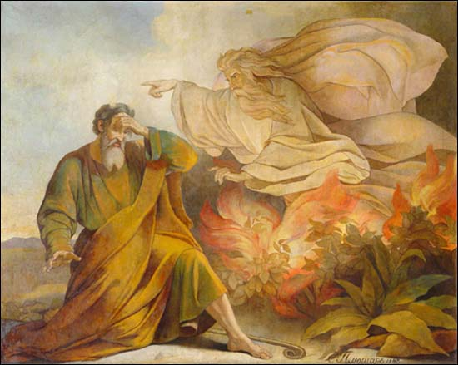
Moses saw the back of God (Exod. 33:23)

Slide 46
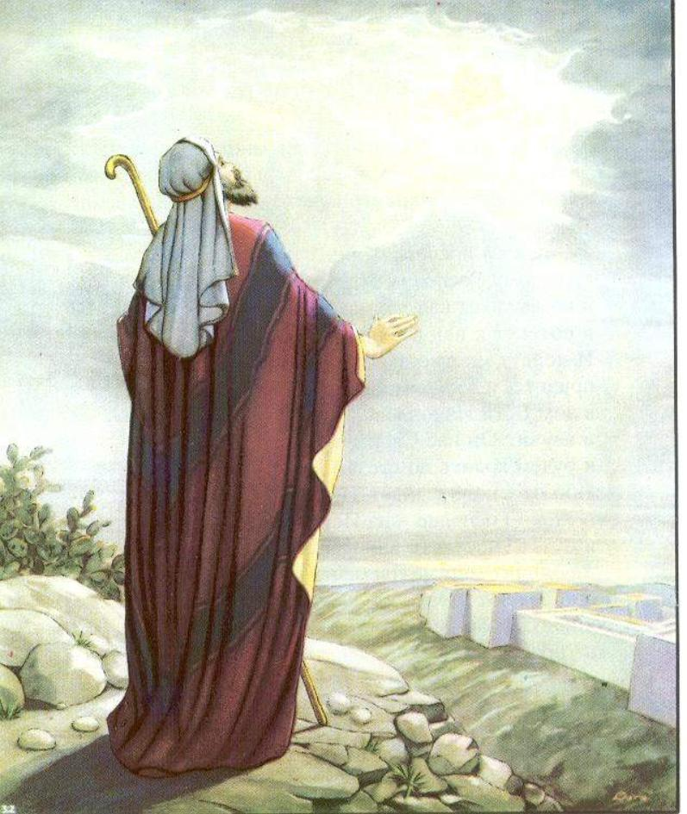
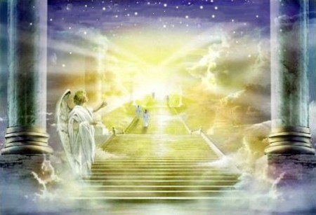
Micaiah “saw the Lord sitting upon his throne” (II Chron. 18:18)

Slide 47
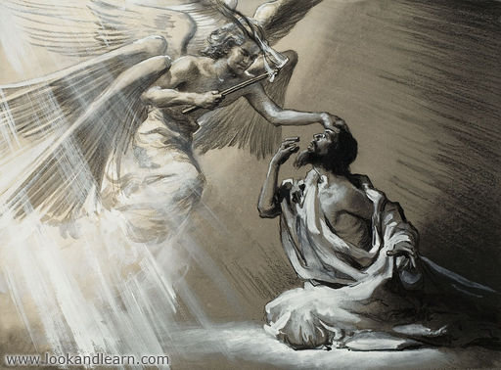
Isaiah “saw also the Lord sitting upon a throne, high and lifted up, and his train filled the temple” (Isa.6:1)

Slide 48
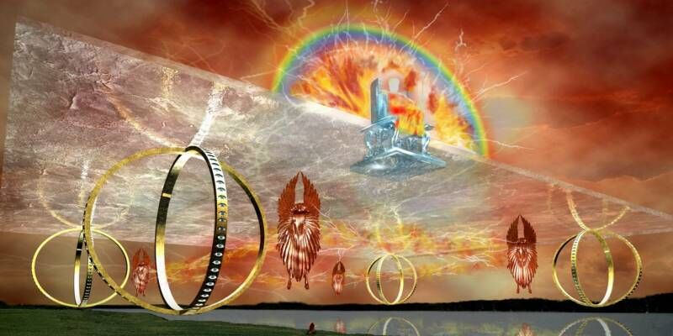
Ezekiel saw “the vision of the glory of God sitting on his throne…” (Ezek. 1:1-28)

Slide 49
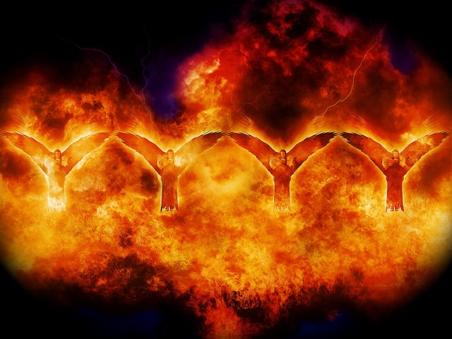
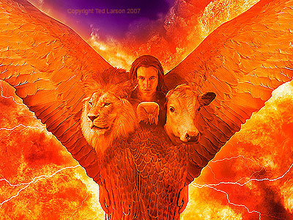
Ezekiel again had a similar vision (Ezek. 10:1-22)

Slide 50
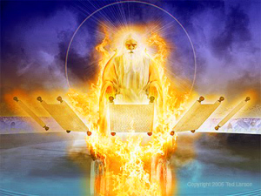
Daniel “beheld till the thrones were cast down, and the Ancient of days did sit” (Dan. 7:9)

Slide 51
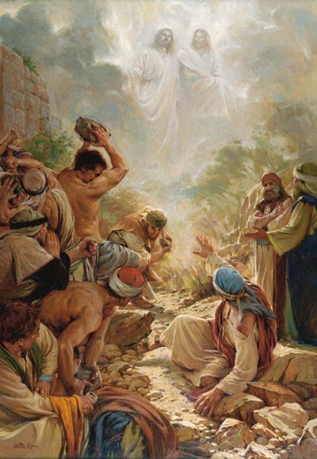
Stephen “looked up stedfastly into heaven, and saw the glory of God, and Jesus standing on the right hand of God” (Acts 7:55)

Slide 52
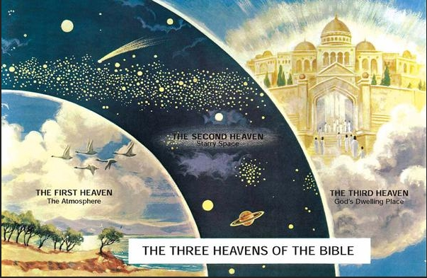
Paul wrote that he “knew a man” (likely himself), who was “caught up to the third heaven” (II Cor. 12:2)

Slide 53
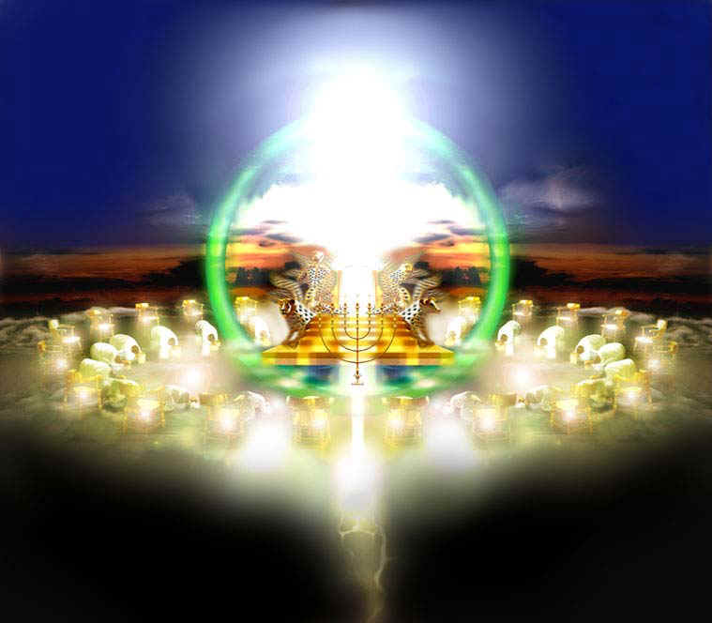
John “was in the spirit; and behold, a throne was set in heaven, and one sat on the throne” (Rev. 4:2).

Slide 54
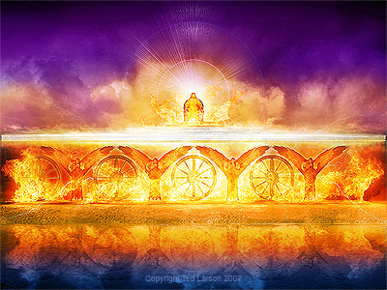
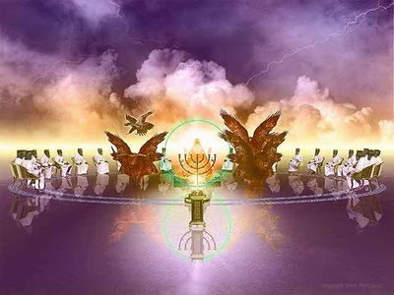
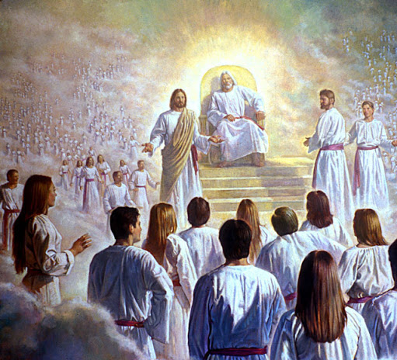
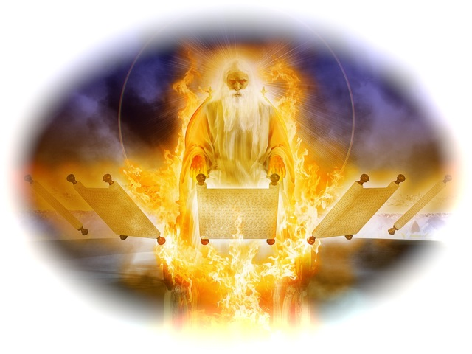
Visions of God are not God

Slide 55
Why does the Bible say that God has bodily parts?
Zec. 4:10 “…the eyes of the LORD, which run to and fro through the whole earth.”
I Pet. 3:12 “For the eyes of the Lord are over the righteous, and his ears are open unto their prayers.”
Judges 2:15 “Whithersoever they went out, the hand of the LORD was against them…”
Psalm 99:5 “Exalt ye the LORD our God, and worship at his footstool; for he is holy.”
Psalm 34:16 “The face of the LORD is against them that do evil, to cut off the remembrance of them from the earth.”

Slide 56
Though God is without a body, his acts for his people are said to be by "his mighty arm" (Exodus 15:16).
God is also pictured as having a face, hands, fingers and a back (Psalm 27:8; 10:12; 88:5; Deuteronomy 9:10; Exodus 33:23).
As well, God is described as talking, walking, laughing, and weeping (Gen. 17:3; Gen. 3:8; Psalm 2:4; John 11:35)

Slide 57
(Rom. 1:20)
“For the invisible things of him from the creation of the world are clearly seen, being understood by the things that are made, even his eternal power and Godhead...”

Slide 58
God is described in bodily form to aid us in our understanding of the of God “And we know that the Son of God is come, and hath given us an understanding, that we may know him that is true, and we are in him that is true, even in his Son Jesus Christ. This is the true God, and eternal life.” (I John 5:20)

Slide 59
If man does not bear the physical likeness and image of God, what likeness and image does he bear?

Slide 60
We all know we are not gods—though if we're honest, we know we often think we are the god of our own lives, even if we'd never admit it.
The truth is, we are not God. But you are godlike.
The Hebrew wood for image means – shadow.
In what ways are we “godlike”?

Slide 61
First, the truth about you is that you are creative because God is creative: "In the beginning God created the heavens and the earth" (Genesis 1:1).
The second truth about you is that you are spiritual because God is Spirit: "The Spirit of God was hovering over the waters" (Genesis 1:2).
Every human is a spiritual being.
We are more than the sum of our physical parts.
Our spiritual nature, though unseen, is as real as our physical nature.

Slide 62
(Romans 1:19, 2:14-15) “Because that which may be known of God is manifest in them; for God hath shewed it unto them…For when the Gentiles, which have not the law, do by nature the things contained in the law, these, having not the law, are a law unto themselves: Which shew the work of the law written in their hearts, their conscience also bearing witness, and their thoughts the mean while accusing or else excusing one another.”

Slide 63
A third truth about you is that you communicate because God communicates: "God said…” (Genesis 1:3).
Anthropologists agree that the emergence of language—first spoken, then written—represents the sharpest break between animals and humans.
The human ability to think and reason, to use language, symbols and art, far surpasses the abilities of any animals.
This gift was bestowed when God imprinted in mankind his communicative nature.

Slide 64
A fourth truth about you is that you are intelligent because God is intelligent – Jude 1:25
God's intelligent image has been imprinted on our lives, though we all possess different levels of intelligence.
We are to develop our mental capacities to their fullest – “For unto whomsoever much is given, of him shall be much required.” Luke 12:48

Slide 65
A fifth truth about you is that you are relational because God is relational: “Let us make man in our image, in our likeness...It is not good for man to be alone…And they heard the voice of the LORD God walking in the garden in the cool of the day: and Adam and his wife hid themselves from the presence of the LORD God amongst the trees of the garden.”

Slide 66
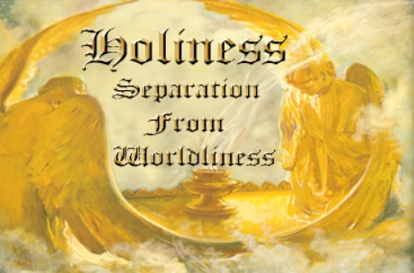
A sixth truth about you is that you are morally responsible because God is a moral being (He is a Holy God) – Isa. 5:16 “But the LORD of hosts shall be exalted in judgment, and God that is holy shall be sanctified in righteousness.”
“Be ye holy for I am holy…” Because God is a moral being, we are to reflect his holy nature in our lives.

Slide 67
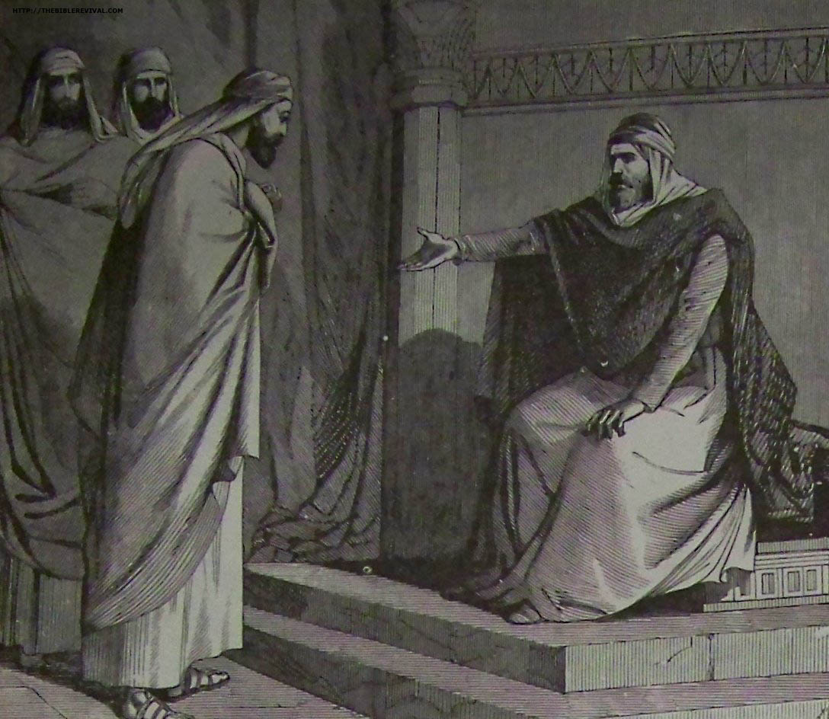

Slide 69
Use your creativity for the Glory of God – “Do all to the glory of God.”
Use your spiritual nature to seek the Lord – “If from thence thou shalt seek the LORD thy God, thou shalt find him, if thou seek him with all thy heart and with all thy soul.”
Use your communicative abilities to witness for the Lord – “Ye shall be witnesses of me…”
Use intelligence to serve the Lord – “So then with the mind I myself serve the law of God.”
Use your relationships to exalt the Lord – “Let us exalt his name together…”

Slide 70
6. Use your moral nature to seek after holiness - II Cor. 7:1 “Having therefore these promises, dearly beloved, let us cleanse ourselves from all filthiness of the flesh and spirit, perfecting holiness in the fear of God.

Slide 71
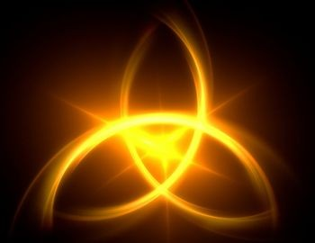
2# Is man a trichotomous (three-part) being? That is, does he consist of body, soul and spirit?

Slide 72
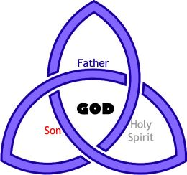
Three persons of the Godhead

Slide 73
The three elements of personality are
Intellect
Emotion
Will

Slide 74
Will
(Luke 22:42)
Intellect
(I Cor. 2:16)
God
Emotion
(Psalm 7:11)

Slide 75
3# What are the basic characteristics of the soul? (Word soul is found 473 times KJV)
Eph. 3:16 “That he would grant you, according to the riches of his glory, to be strengthened with might by his Spirit in the inner man.”
I Pet. 2:11 “Dearly beloved, I beseech you as strangers and pilgrims, abstain from fleshly lusts, which war against the soul.”

Slide 76
Will
(Hebrews 10:26)
Intellect
(Romans 8:7)
Man/Soul
(Hebrews 4:12)
Emotion
(II Corinthians 6:11-13)

Slide 78
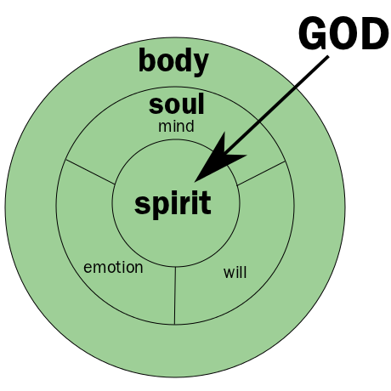
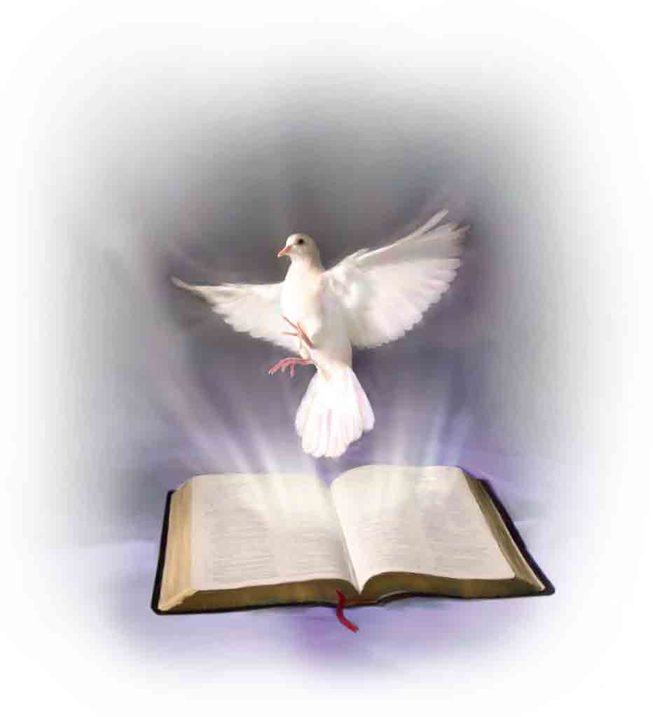

Slide 80
4# What is the difference between the body, soul and spirit?

Slide 81
The Body and its five senses -

Slide 82
The Soul and its three parts -

Slide 83
The Spirit and God –
I Cor. 15:22 “For as in Adam all die, even so in Christ shall all be made alive.”
Eph 2:1 “And you hath he quickened, who were dead in trespasses and sins.”
Eph 2:5 “Even when we were dead in sins, hath quickened us together with Christ.”
Col 2:13 “And you, being dead in your sins and the uncircumcision of your flesh, hath he quickened together with him, having forgiven you all trespasses.”

Slide 85
Romans 6-8

