Slide 1
The Doctrine of Man (Part 5)
The Consequences of the Fall

Slide 4
Job 7:17 “What is man, that thou shouldest magnify him? and that thou shouldest set thine heart upon him?”
Job 15:14 “What is man, that he should be clean? and he which is born of a woman, that he should be righteous?”
Ps. 8:4 “What is man, that thou art mindful of him? and the son of man, that thou visitest him?”
Ps. 144:3 “LORD, what is man, that thou takest knowledge of him! or the son of man, that thou makest account of him!”
Heb. 2:6 “But one in a certain place testified, saying, What is man, that thou art mindful of him? or the son of man, that thou visitest him?”

Slide 6
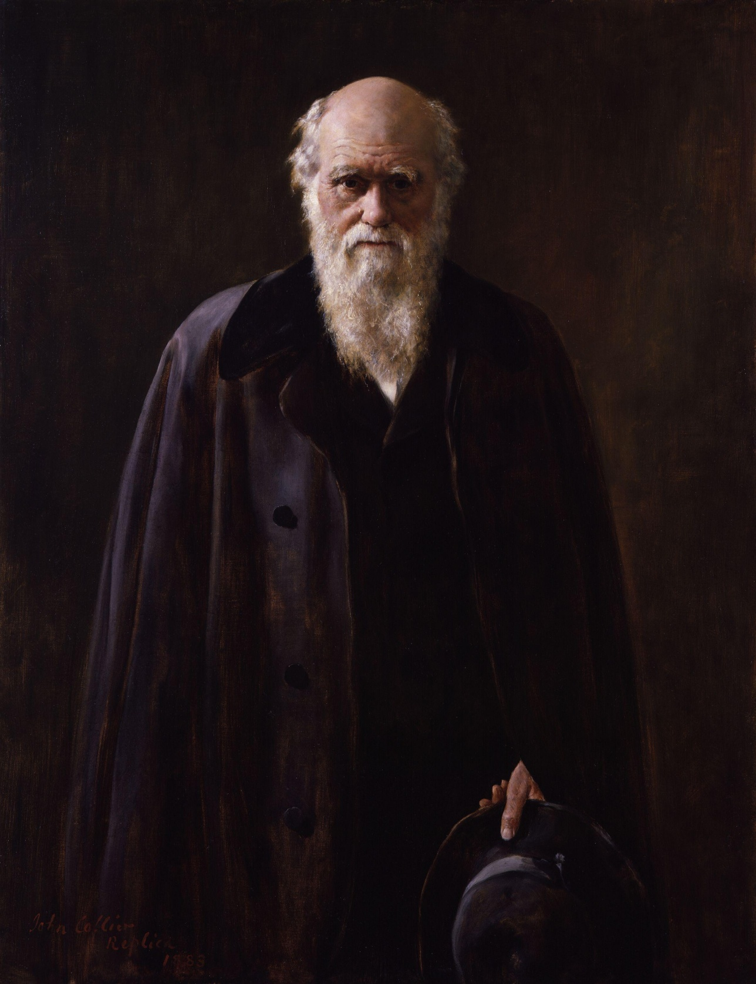

Slide 8
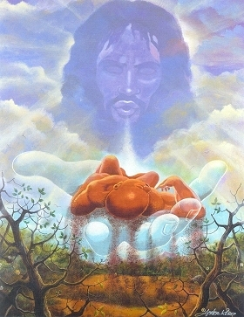
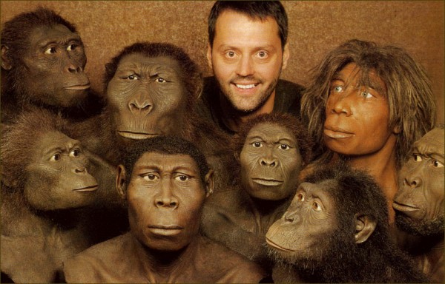

Slide 9
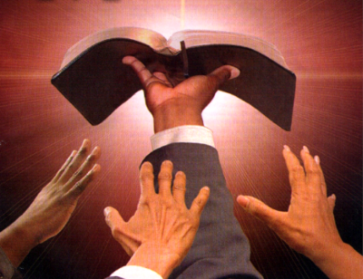
“Thy Word is Truth…”

Slide 11
"And God said, Let us make man in our image, after our likeness; and let them have dominion over the fish of the sea, and the fowl of the air, and over the cattle, and over all the earth, and over every creeping thing that creepeth upon the earth. So God created man in his own image, in the image of God created he him; male and female created he them" (Gen. 1:26, 27)

Slide 12
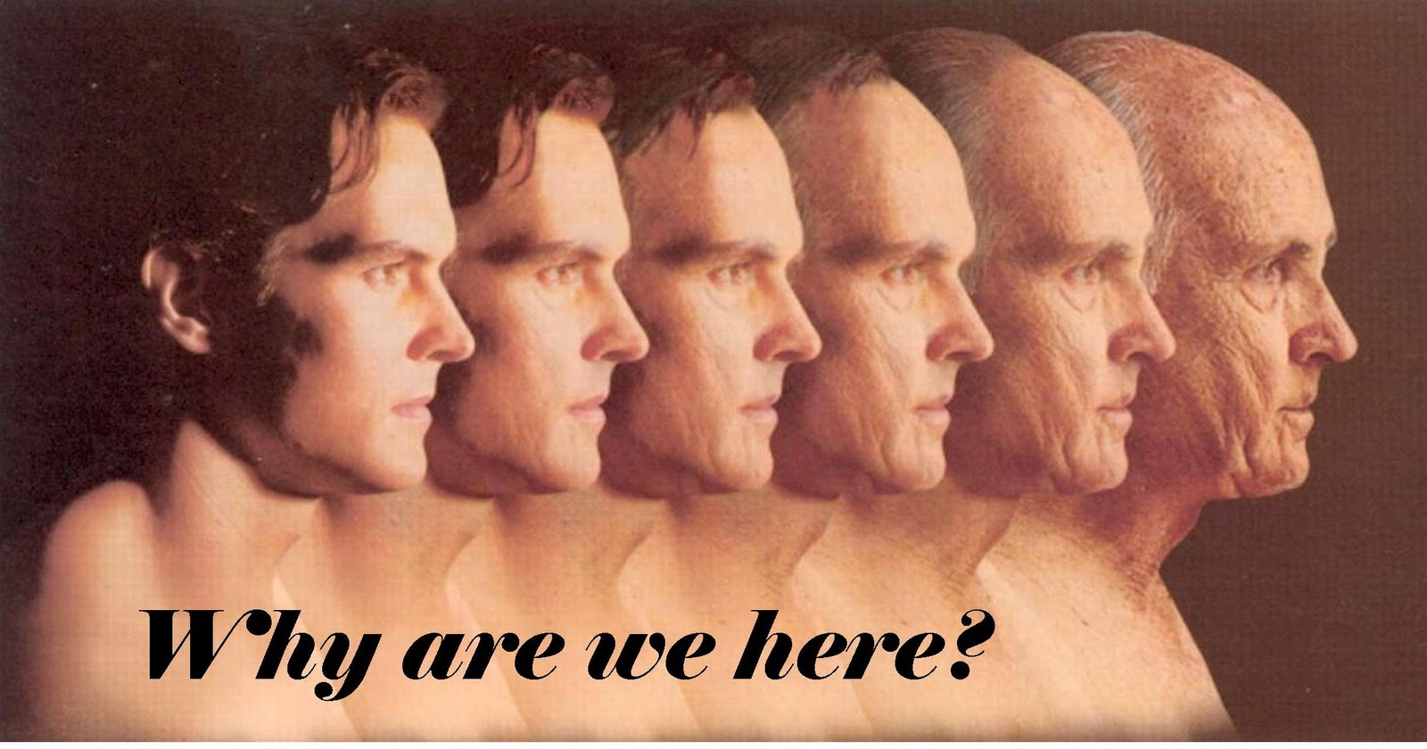

Slide 13
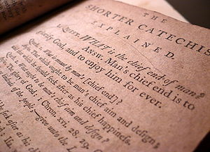

Slide 16
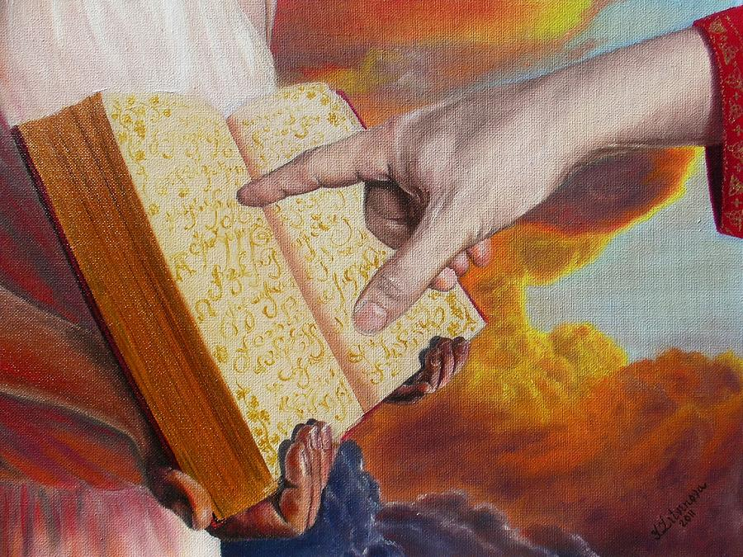
Rev. 20:15
“And whosoever was not found written in the book of life was cast into the lake of fire.”

Slide 18
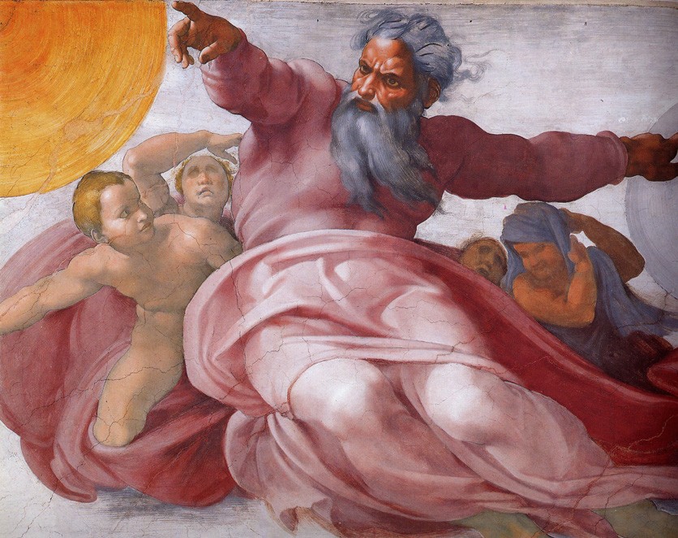
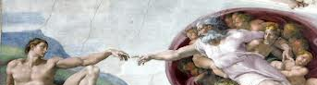
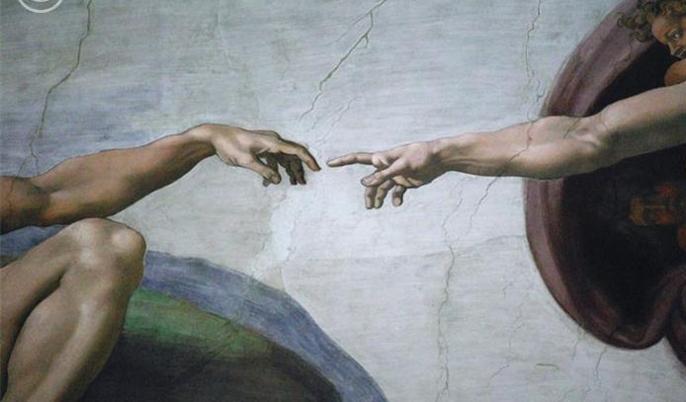
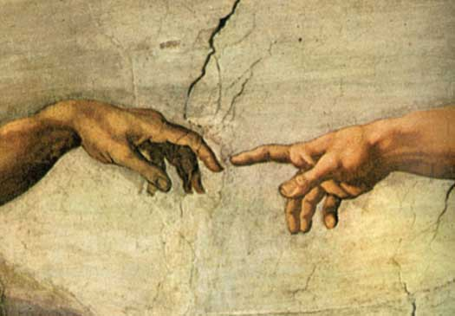
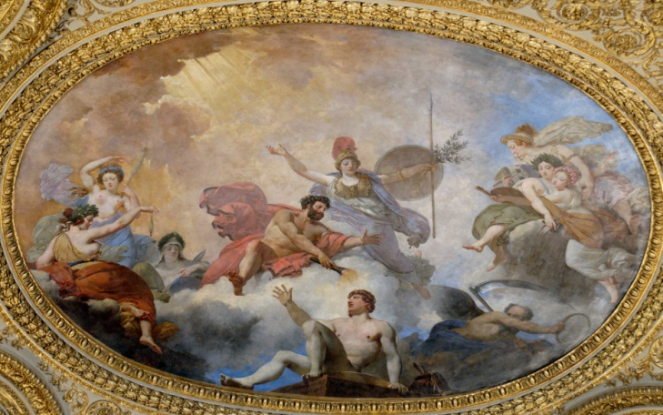
"And God said, Let us make man in our image, after our likeness; and let them have dominion over the fish of the sea, and the fowl of the air, and over the cattle, and over all the earth, and over every creeping thing that creepeth upon the earth. So God created man in his own image, in the image of God created he him; male and female created he them.” Gen. 1:26-27

Slide 20
Creative
Spiritual
Communicative
Intelligent
Relational
Moral

Slide 21
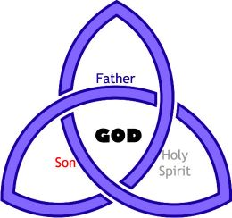
Three persons of the Godhead

Slide 22
Man is a trichotomous (three-part) being. That is, does he consist of body, soul and spirit?

Slide 23
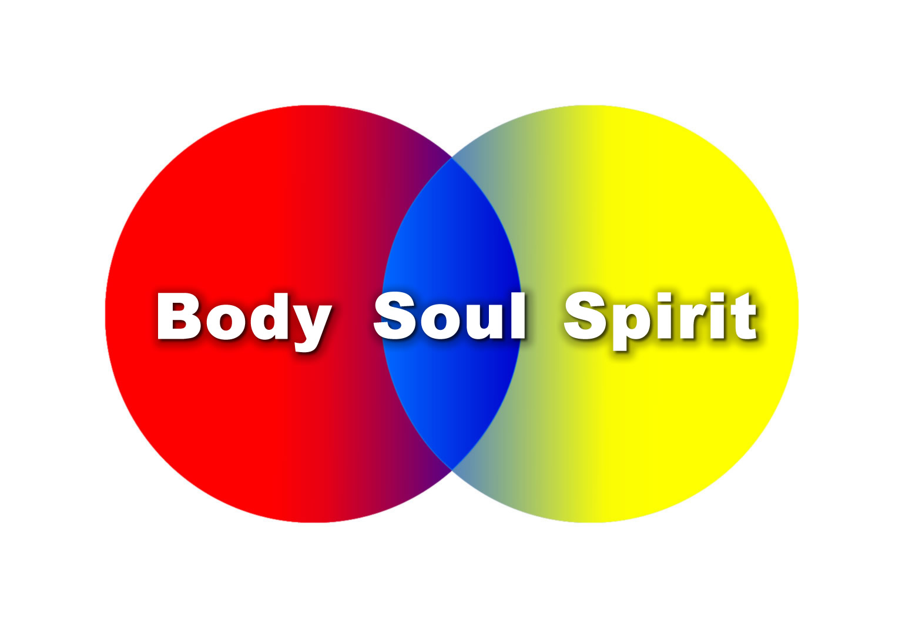

Slide 24
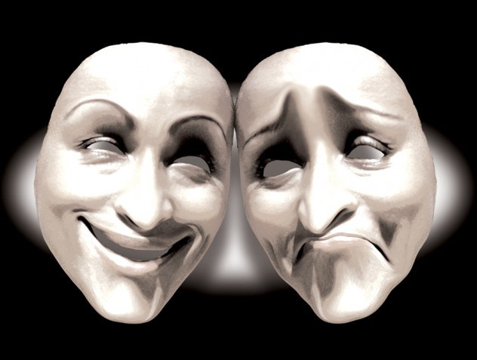
The three elements of personality are
Intellect
Emotion
Will

Slide 25
Man’s Original Duties and Responsibilities

Slide 26
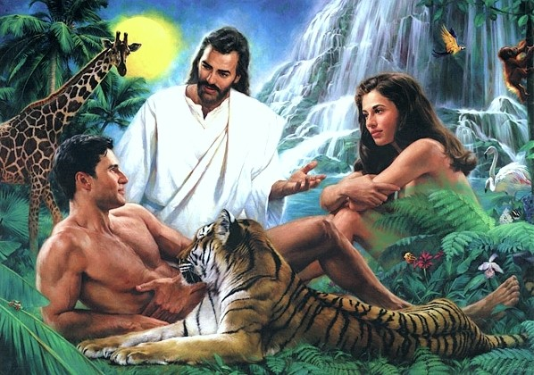
Why did God create man?

Slide 27
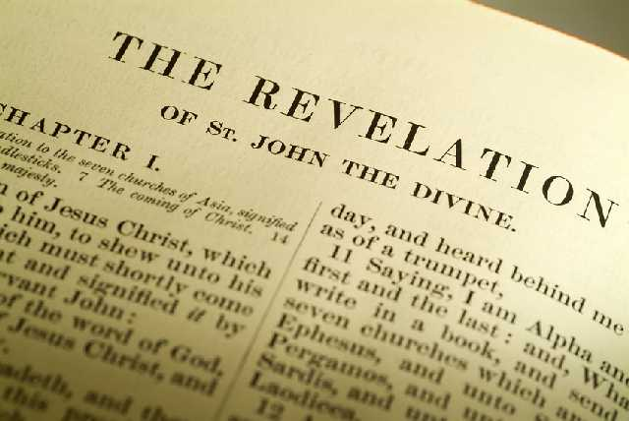
“Thou art worthy, O Lord, to receive glory and honour and power: for thou hast created all things, and for thy pleasure they are and were created.” (Rev. 4:11)

Slide 28
“Furthermore then we beseech you, brethren, and exhort you by the Lord Jesus, that as ye have received of us how ye ought to walk and to please God, so ye would abound more and more.” (I Thess. 4:1)

Slide 29
“So then they that are in the flesh cannot please God.” (Romans 8:8)

Slide 30
(II Corinthians 5:7-10)
“For we walk by faith, not by sight: We are confident, I say, and willing rather to be absent from the body, and to be present with the Lord. Wherefore we labour, that, whether present or absent, we may be accepted of him. For we must all appear before the judgment seat of Christ; that every one may receive the things done in his body, according to that he hath done, whether it be good or bad.”

Slide 31
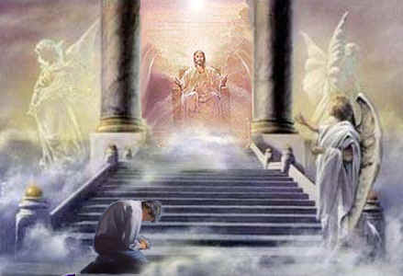

Slide 32
How do we bring pleasure to God?

Slide 33
The only way to bring pleasure to God is by fulfilling our God given duties and responsibilities.

Slide 34
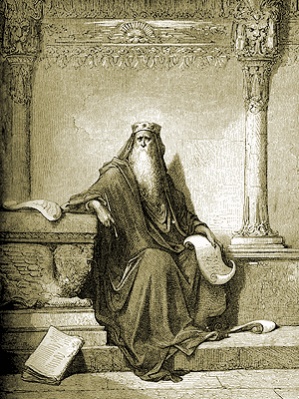
“Let us hear the conclusion of the whole matter: Fear God, and keep his commandments: for this is the whole duty of man.” (Eccl. 12:13)

Slide 35
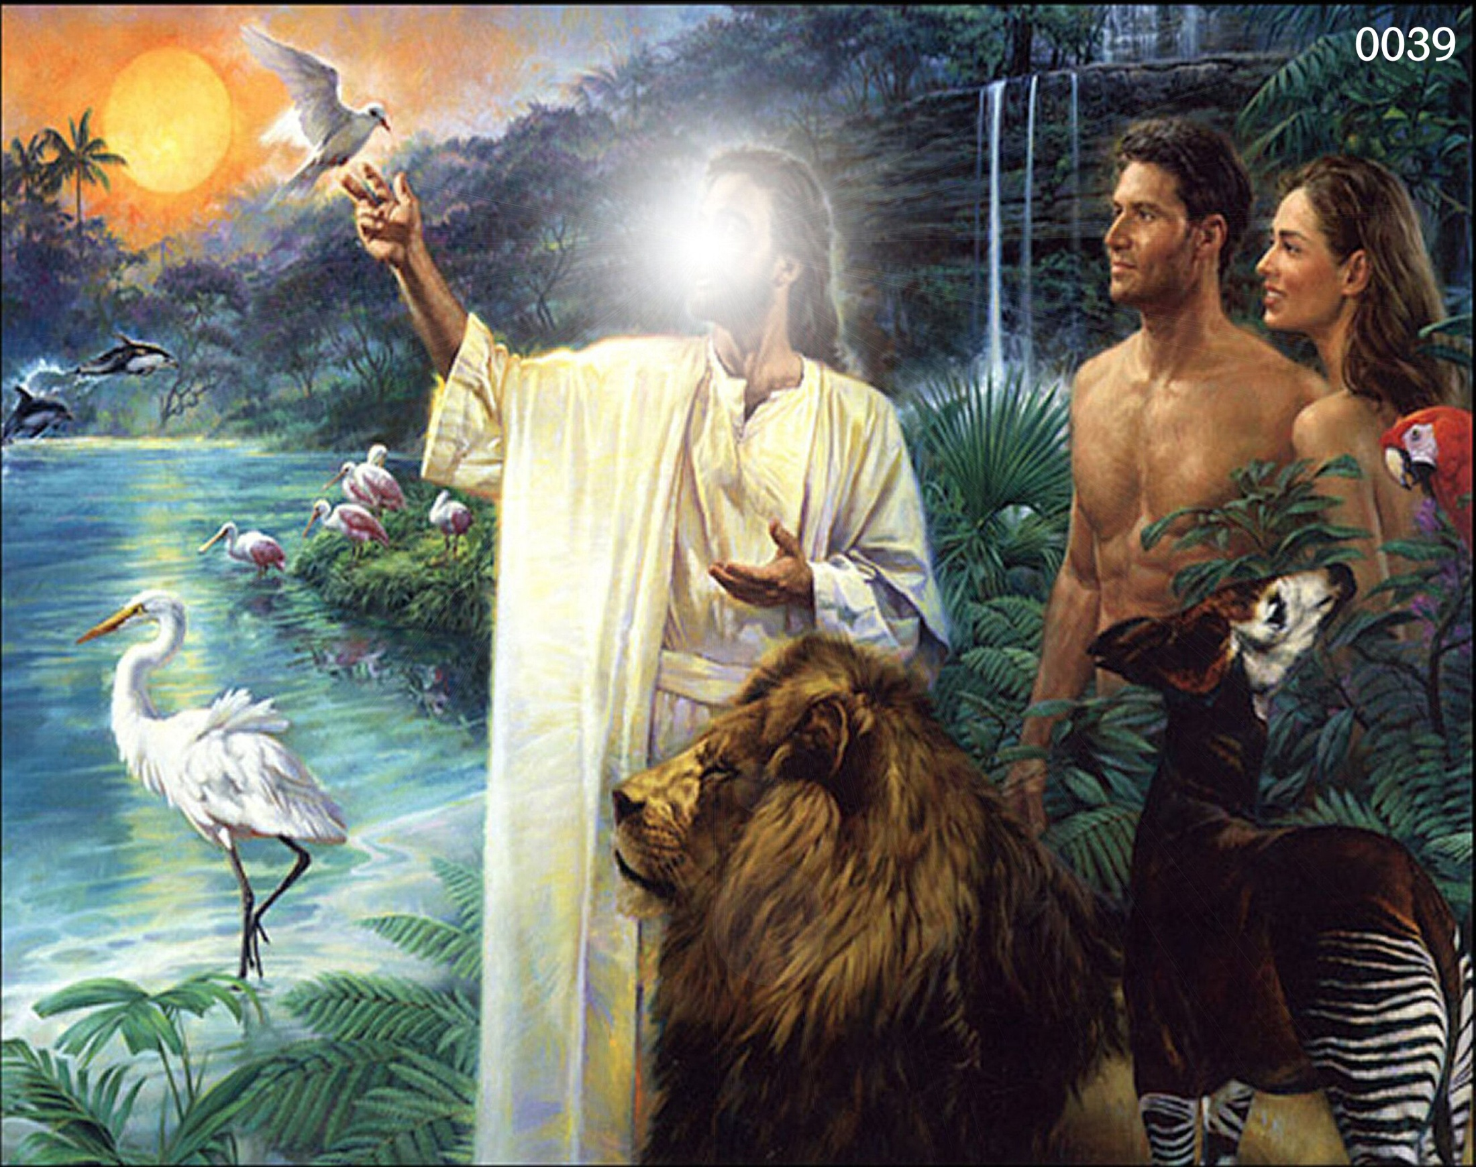

Slide 36
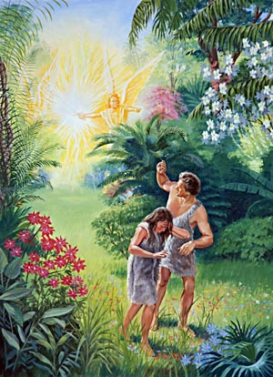
His Tragic Sin and Fall

Slide 37
"Now the serpent was more subtile than any beast of the field which the Lord God had made. And he said unto the woman, Yea, hath God said, Ye shall not eat of every tree of the garden?" (Gen. 3:1).

Slide 38
Satan’s approach to Eve
He begins by slyly doubting God’s Word.
But soon is brazenly denying the Word of God.
“And he said unto the woman, Yea, hath God said, Ye shall not eat of every tree of the garden?”
"And the serpent said unto the woman, Ye shall not surely die" (Gen. 3:4)

Slide 39
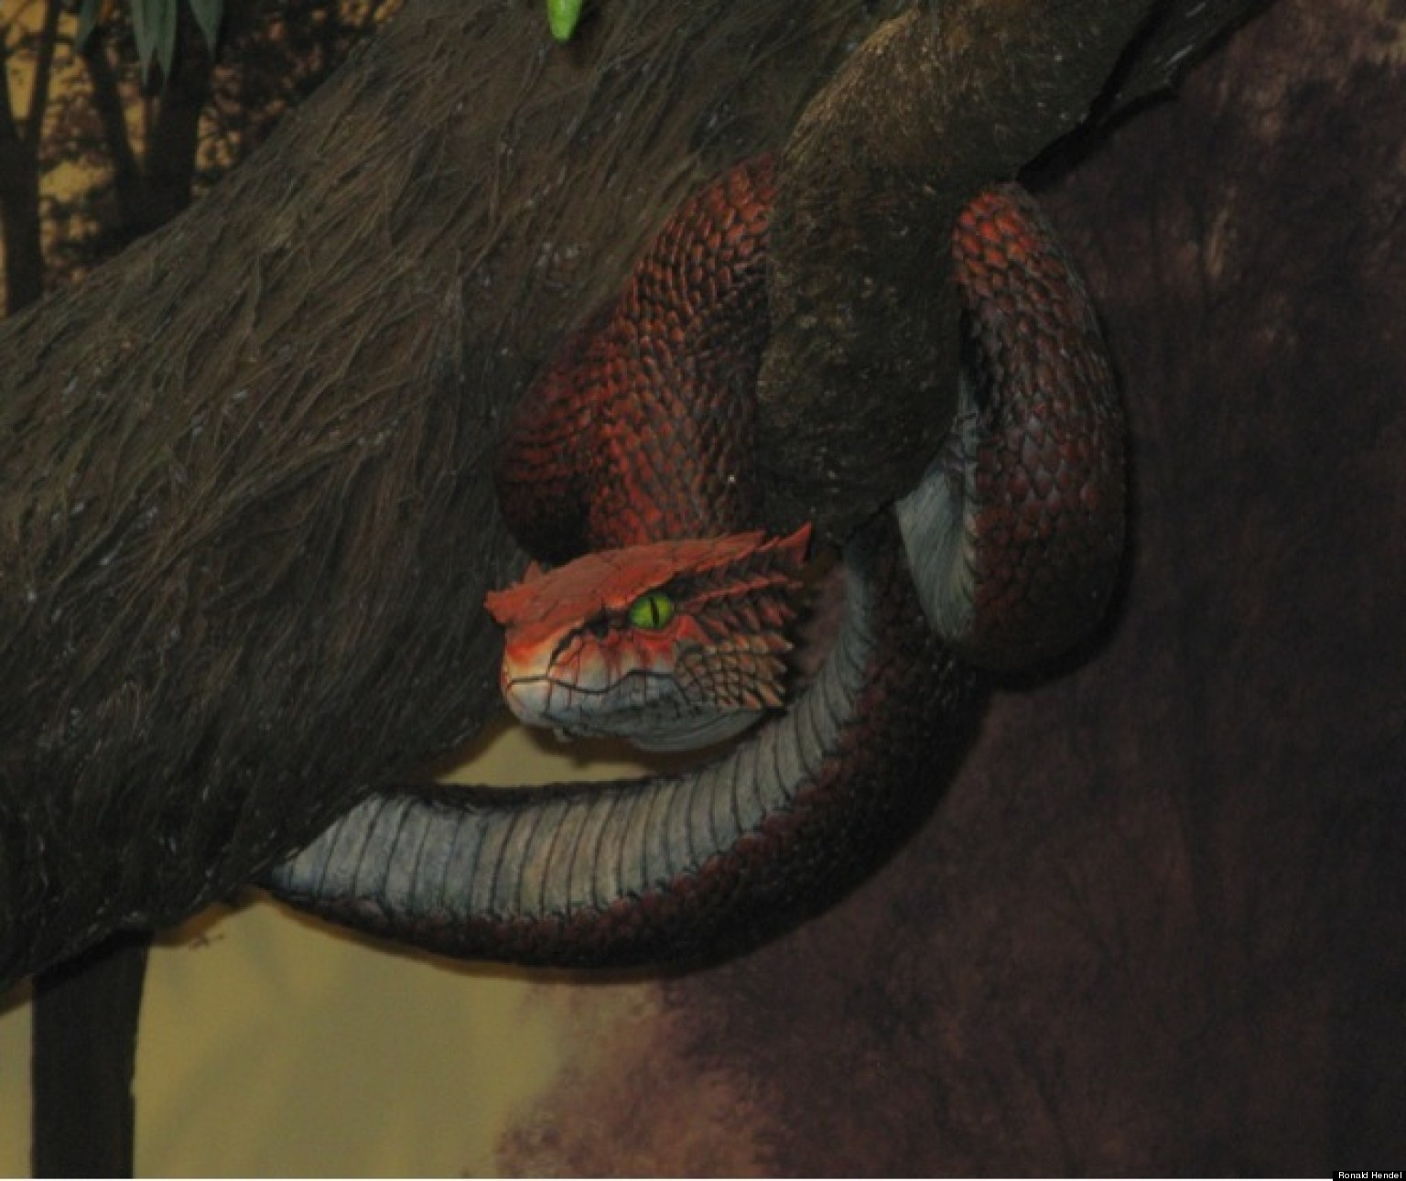
Don’t ever doubt the Word of God!

Slide 40
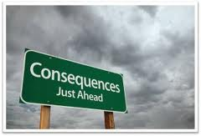
Doubt leads to Denial
Denial leads to Rejection
Rejection leads to Disobedience
Disobedience leads to Consequences

Slide 41
(Galatians 6:7-8) “Be not deceived; God is not mocked: for whatsoever a man soweth, that shall he also reap. For he that soweth to his flesh shall of the flesh reap corruption; but he that soweth to the Spirit shall of the Spirit reap life everlasting.”

Slide 42
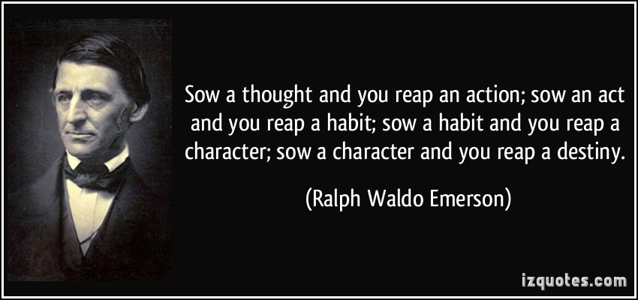

Slide 43
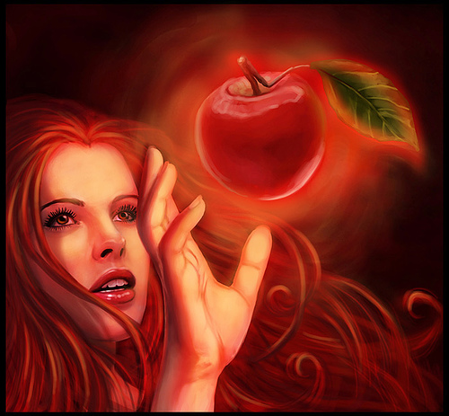
"And when the woman saw that the tree was good for food, and that it was pleasant to the eyes, and a tree to be desired to make one wise, she took of the fruit thereof and did eat…”

Slide 44
Satan’s Threefold Temptation
Lust of the flesh – “…saw that the tree was good for food…”
Lust of the eyes – “…and that it was pleasant to the eyes…”
Pride of life – “…and a tree to be desired to make one wise…”
“She took of the fruit thereof, and did eat…”

Slide 45
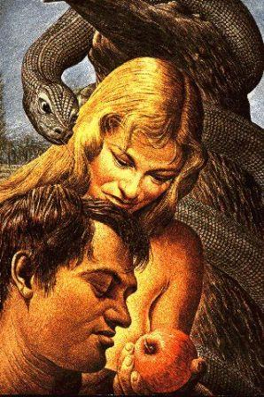
“…and gave also unto her husband with her; and he did eat."
(Gen. 3:6)

Slide 46
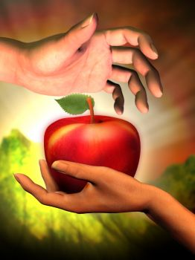
(I Tim. 2:14) “And Adam was not deceived, but the woman being deceived was in the transgression.”

Slide 47
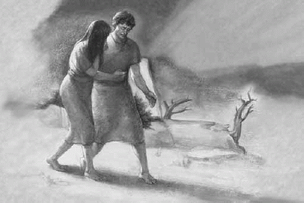
“The Consequences of the Fall”

Slide 48
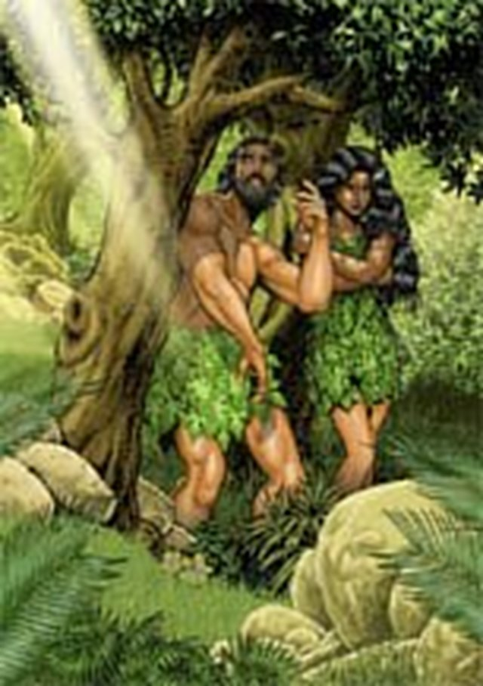
“And the eyes of them both were opened, and they knew that they were naked; and they sewed fig leaves together, and made themselves aprons.”

Slide 49
The trial that followed the fall
Adam the sinner, after a brief and futile attempt
to hide, now confesses to his crime.

Slide 50
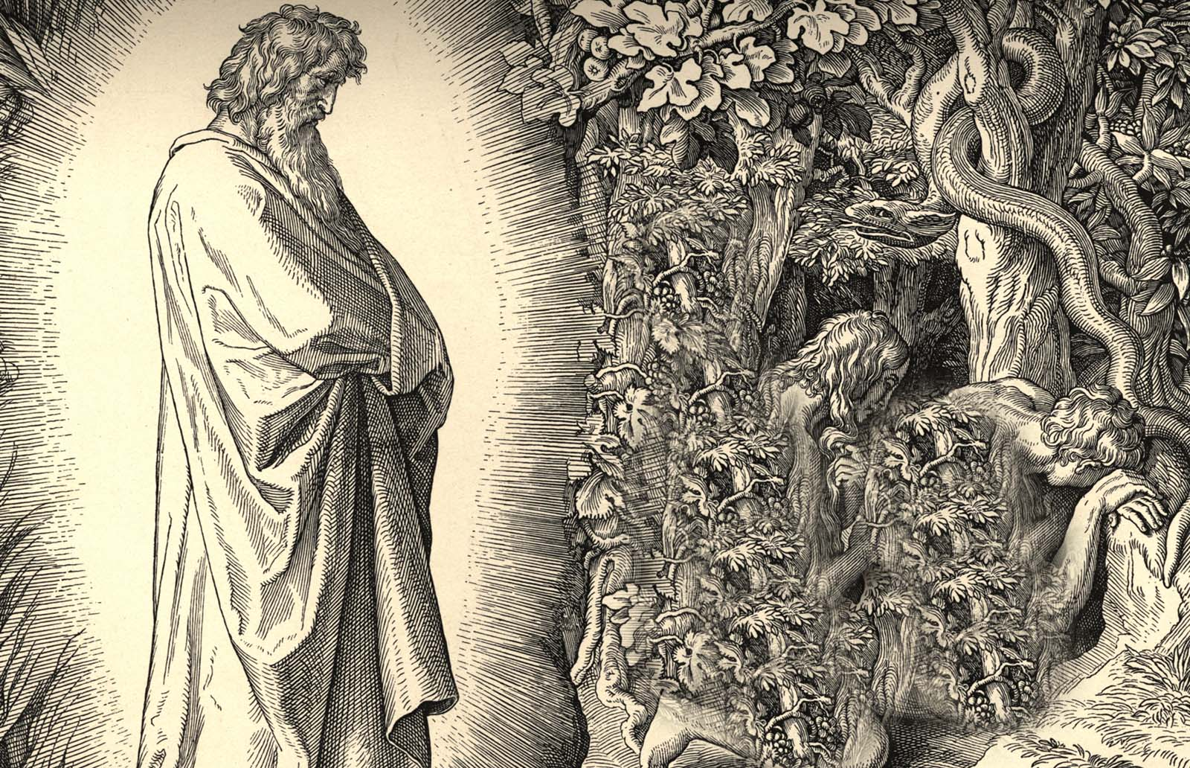
At this point the Righteous Judge sets up His court in Eden and the trial begins

Slide 51
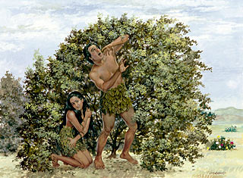
(Genesis 3:8-13) “And they heard the voice of the LORD God walking in the garden in the cool of the day: and Adam and his wife hid themselves from the presence of the LORD God amongst the trees of the garden. And the LORD God called unto Adam, and said unto him, Where art thou?

Slide 52
And he said, I heard thy voice in the garden, and I was afraid, because I was naked; and I hid myself. And he said, Who told thee that thou wast naked? Hast thou eaten of the tree, whereof I commanded thee that thou shouldest not eat? And the man said, The woman whom thou gavest to be with me, she gave me of the tree, and I did eat. And the LORD God said unto the woman, What is this that thou hast done? And the woman said, The serpent beguiled me, and I did eat.”

Slide 53
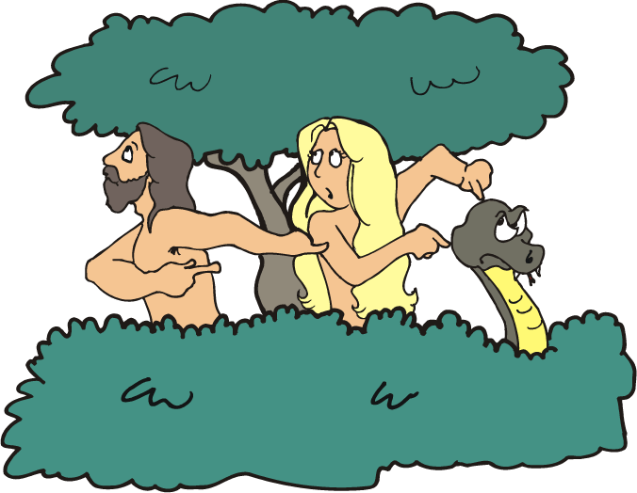

Slide 55
“So then every one of us shall give
account of himself to God.” Rom. 14:12

Slide 56
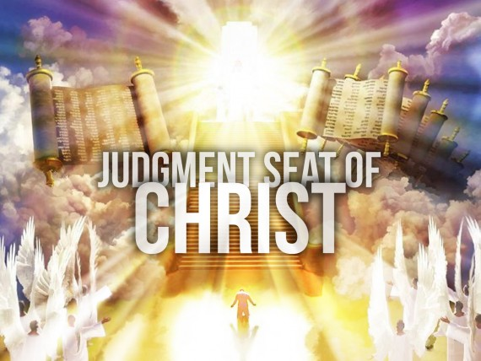
“For we must all appear before the judgment seat of Christ; that every one may receive the things done in his body, according to that he hath done, whether it be good or bad.” II Cor. 5:10

Slide 57
A threefold sentence passed

Slide 58
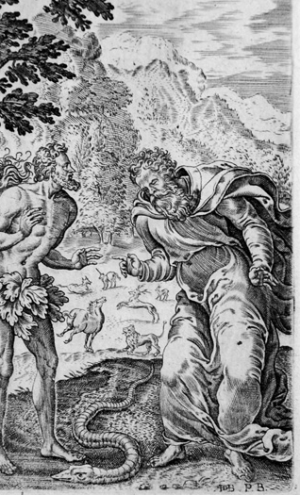
Judgment upon the Serpent

Slide 59
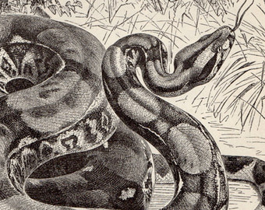
"And the Lord God said unto the serpent, Because thou hast done this, thou art cursed above all cattle, and above every beast of the field; upon thy belly shalt thou go, and dust shalt thou eat all the days of thy life." (Gen. 3:14)

Slide 60
Isaiah indicates that this judgment will continue to be binding upon the serpent even during the millennium.
"The wolf and the lamb shall feed together, and the lion shall eat straw like the bullock: and dust shall be the serpent’s meat. They shall not hurt nor destroy in all my holy mountain, saith the Lord" (Isa. 65:25)

Slide 61
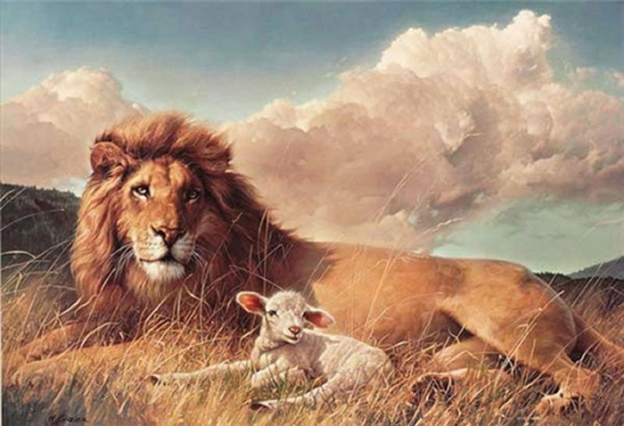
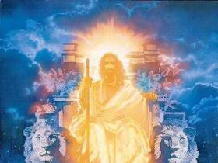
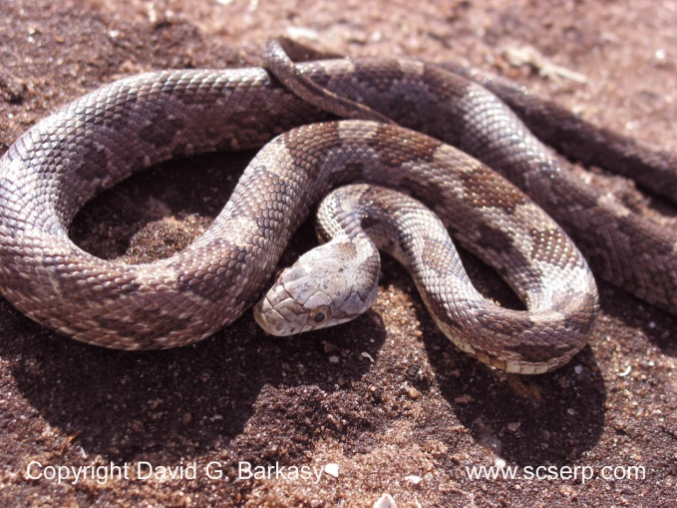

Slide 62
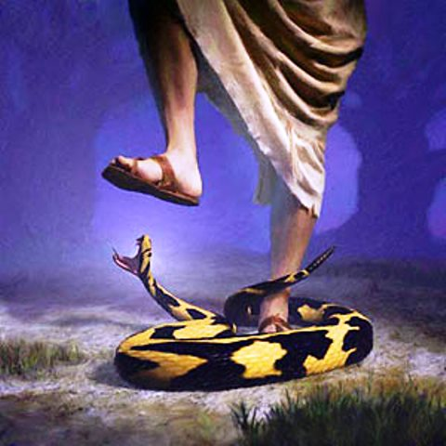
Judgment upon Satan

Slide 63
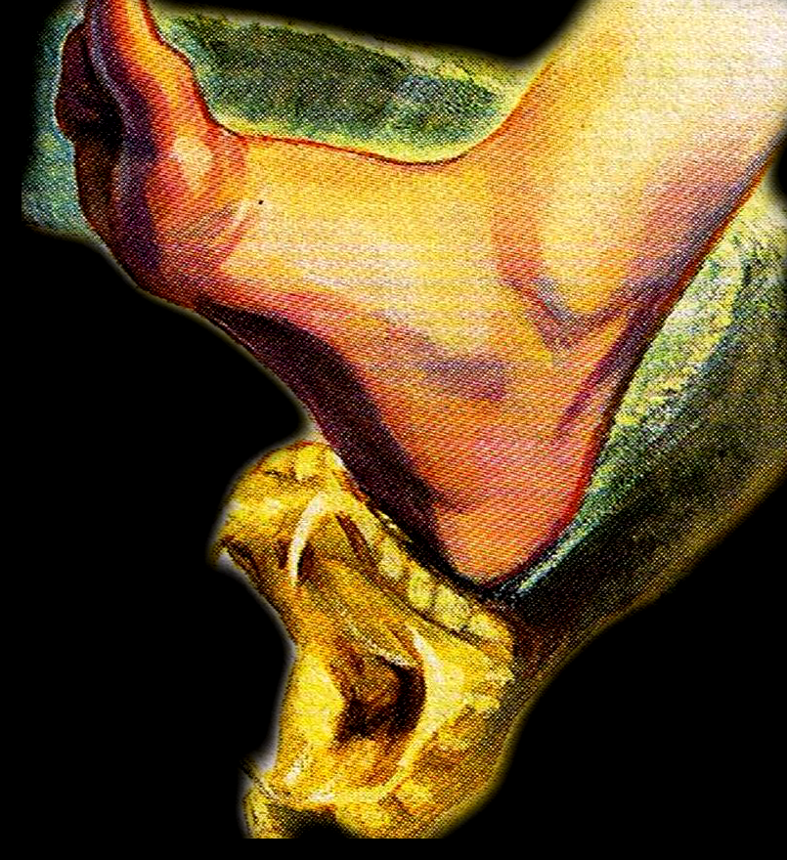
"And I will put enmity between thee and the woman, and between thy seed and her seed; it shall bruise thy head, and thou shalt bruise his heel" (Gen. 3:15)

Slide 64
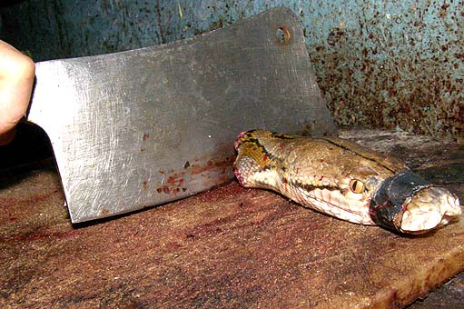
At first glance this verse would merely seem to predict the natural hatred of man for snakes.

Slide 65
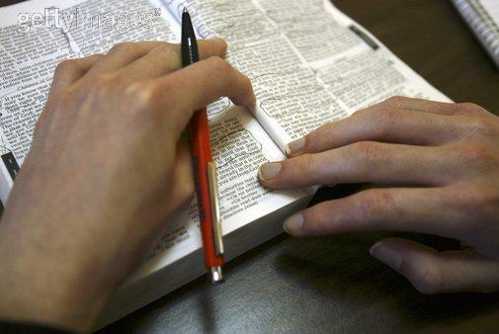
Students of the Bible however see a far more precious and profound truth underlying these words.

Slide 66
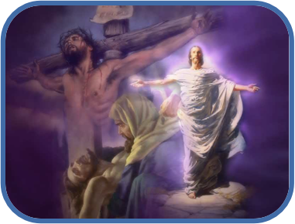
For in this verse we see no less than a thrilling prediction of the cross and the resurrection of the Savior’s and His great victory over Satan.

Slide 67
There will be an intense hatred between Satan and Christ. Eventually Christ shall crush the head of Satan, while suffering a heel wound in the process.

Slide 68
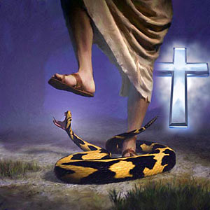

Slide 69
I Corinthians 15:57 “But thanks be to God, which giveth us the victory through our Lord Jesus Christ.”
II Corinthians 2:14 “Now thanks be unto God, which always causeth us to triumph in Christ, and maketh manifest the savour of his knowledge by us in every place.”
Romans 8:37 “Nay, in all these things we are more than conquerors through him that loved us.”
I John 5:1 “Whatsoever is born of God overcometh the world: and this is the victory that overcometh the world, even our faith. Who is he that overcometh the world, but he that believeth that Jesus is the Son of God.”

Slide 70
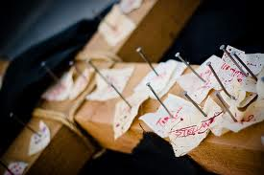
Colossians 2:13-15 “And you, being dead in your sins and the uncircumcision of your flesh, hath he quickened together with him, having forgiven you all trespasses; Blotting out the handwriting of ordinances that was against us, which was contrary to us, and took it out of the way, nailing it to his cross; And having spoiled principalities and powers, he made a shew of them openly, triumphing over them in it.”

Slide 71
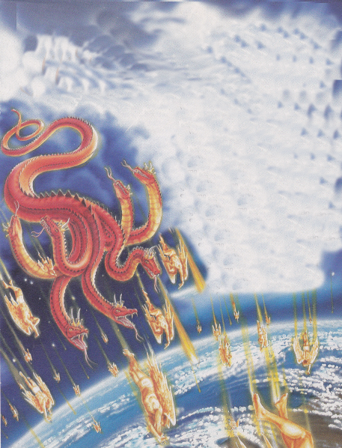
“And the great dragon was cast out, that old serpent, called the Devil, and Satan, which deceiveth the whole world: he was cast out into the earth, and his angels were cast out with him. And I heard a loud voice saying in heaven, Now is come salvation, and strength, and the kingdom of our God, and the power of his Christ: for the accuser of our brethren is cast down, which accused them before our God day and night. And they overcame him by the blood of the Lamb, and by the word of their testimony; and they loved not their lives unto the death.” (Revelation 12:9-11)

Slide 72
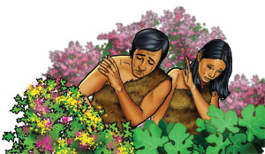
Judgment upon Adam and Eve (sevenfold sentence because of their sin)

Slide 73
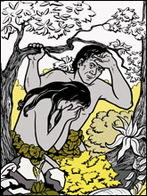
1# Guilt and Shame
"And the eyes of them both were opened, and they knew that they were naked; and they sewed fig leaves together, and made themselves aprons" (Gen. 3:7)

Slide 74
I John 2:28 “And now, little children, abide in him; that, when he shall appear, we may have confidence, and not be ashamed before him at his coming.” Rom. 3:19 “Now we know that what things soever the law saith, it saith to them who are under the law: that every mouth may be stopped, and all the world may become guilty before God.”

Slide 76
The difference between guilt and shame is that guilt is the feeling we get when we have done something wrong and know it. Shame is when our actions result in branding ourselves in the eyes of others as a bad person.

Slide 77
2# Fear
“And they heard the voice of the Lord God walking in the garden in the cool of the day: and Adam and his wife hid themselves from the presence of the Lord God amongst the trees of the garden. And the Lord God called unto Adam, and said unto him, Where art thou? And he said, I heard thy voice in the garden, and I was afraid, because I was naked; and I hid myself" (Gen. 3:8-10)

Slide 78
“Neither is there any creature that is not manifest in his sight: but all things are naked and opened unto the eyes of him with whom we have to do.” (Heb. 4:13)

Slide 79
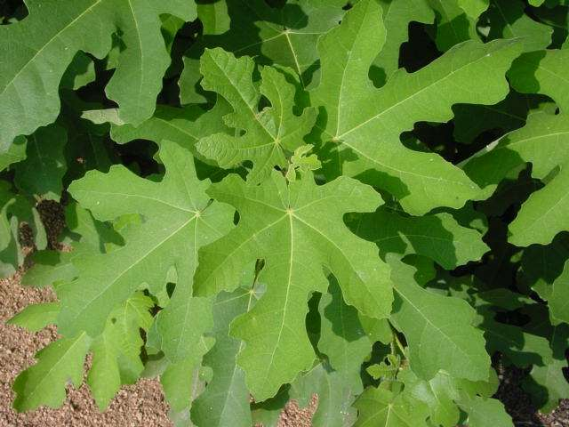
(Proverbs 28:13) “He that covereth his sins shall not prosper: but whoso confesseth and forsaketh them shall have mercy.”

Slide 80
What’s your fig leaf? What are you hiding behind?
Minimizing your sin
Denying your guilt
Blaming others
Justifying your actions
Religion
Good works
Position
Family reputation

Slide 81
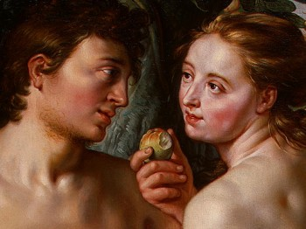
3# Discord
"And the man said, The woman whom thou gavest to be with me, she gave me of the tree, and I did eat.”"
(Gen. 3:12)

Slide 82
(Proverbs 6:16-19) “These six things doth the LORD hate: yea, seven are an abomination unto him: A proud look, a lying tongue, and hands that shed innocent blood, An heart that deviseth wicked imaginations, feet that be swift in running to mischief, A false witness that speaketh lies, and he that soweth discord among brethren.”

Slide 83
Psalm 133:1 “Behold, how good and how pleasant it is for brethren to dwell together in unity.”
Eph. 4:3 “Endeavoring to keep the unity of the Spirit in the bond of peace.”
Phil. 2:2 “Fulfill ye my joy, that ye be likeminded, having the same love, being of one accord, of one mind.”

Slide 84
4# Death

Slide 85
Physical death
"And all the days that Adam lived were nine hundred and thirty years: and he died" (Gen. 5:5)
"The days of our years are threescore years (60) and ten (70); and if by reason of strength they be fourscore years (80), yet is their strength labour and sorrow; for it is soon cut off, and we fly away." (Psalm 90:10)

Slide 86
Spiritual death
"And then will I profess unto them, I never knew you: depart from me, ye that work iniquity" (Matt. 7:23)
"Then shall he say also unto them on the left hand, Depart from me, ye cursed, into everlasting fire, prepared for the devil and his angels" (Matt. 25:41)
"He that hath an ear, let him hear what the Spirit saith unto the churches; He that overcometh shall not be hurt of the second death" (Rev. 2:11)

Slide 87
"Blessed and holy is he that hath part in the first resurrection; on such the second death hath no power" (Rev. 20:6)
"And death and hell were cast into the lake of fire. This is the second death" (Rev. 20:14)
"But the fearful, and unbelieving, and the abominable, and murderers, and whoremongers, and sorcerers, and idolaters, and all liars, shall have their part in the lake which burneth with fire and brimstone: which is the second death" (Rev. 21:8)

Slide 89
Romans 6:23 “For the wages of sin is death…”

Slide 92
5# Suffering
"Unto the woman he said, I will greatly multiply thy sorrow and thy conception; in sorrow thou shalt bring forth children; and thy desire shall be to thy husband, and he shall rule over thee" (Gen. 3:16)

Slide 93
Isa. 26:17 “Like as a woman with child, that draweth near the time of her delivery, is in pain, and crieth out in her pangs, so have we been in thy sight, O LORD.”
Col. 3:18 “Wives, submit yourselves unto your own husbands, as it is fit in the Lord.”

Slide 94
6# Weariness in labor

Slide 95
"And unto Adam he said, Because thou hast hearkened unto the voice of thy wife, and hast eaten of the tree, of which I commanded thee, saying, Thou shalt not eat of it; cursed is the ground for thy sake; in sorrow shalt thou eat of it all the days of thy life; thorns also and thistles shall it bring forth to thee; and thou shalt eat the herb of the field; In the sweat of thy face shalt thou eat bread, till thou return unto the ground; for out of it wast thou taken; for dust thou art, and unto dust shalt thou return" (Gen. 3:17-19)

Slide 97
“For even when we were with you, this we commanded you, that if any would not work, neither should he eat.” (II Thess. 3:10)

Slide 98
7# Separation from God

Slide 99
"And the Lord God said, Behold, the man is become as one of us, to know good and evil: and now, lest he put forth his hand, and take also of the tree of life, and eat, and live for ever: therefore the Lord God sent him forth from the garden of Eden, to till the ground from whence he was taken. So he drove out the man; and he placed at the east of the garden of Eden Cherubims and a flaming sword which turned every way, to keep the way of the tree of life" (Gen. 3:22-24)

Slide 100
Revelation 22:2

Slide 101
“But your iniquities have separated between you and your God, and your sins have hid his face from you, that he will not hear.” Isa 59:2

Slide 102
“And all things are of God, who hath reconciled us to himself by Jesus Christ, and hath given to us the ministry of reconciliation.” (II Cor. 5:18)

