Slide 1
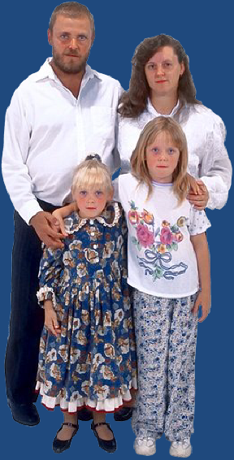
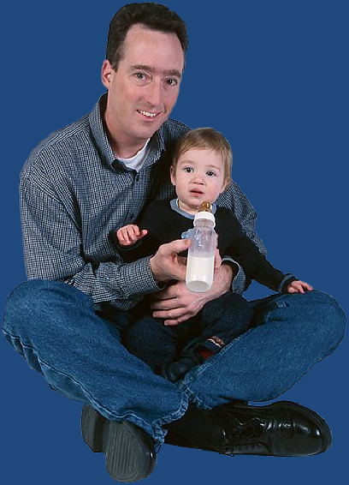
How to Provide Protection for your Daughters “Fathers, provoke not your children to wrath: but bring them up in the nurture and admonition of the Lord.”

Slide 2
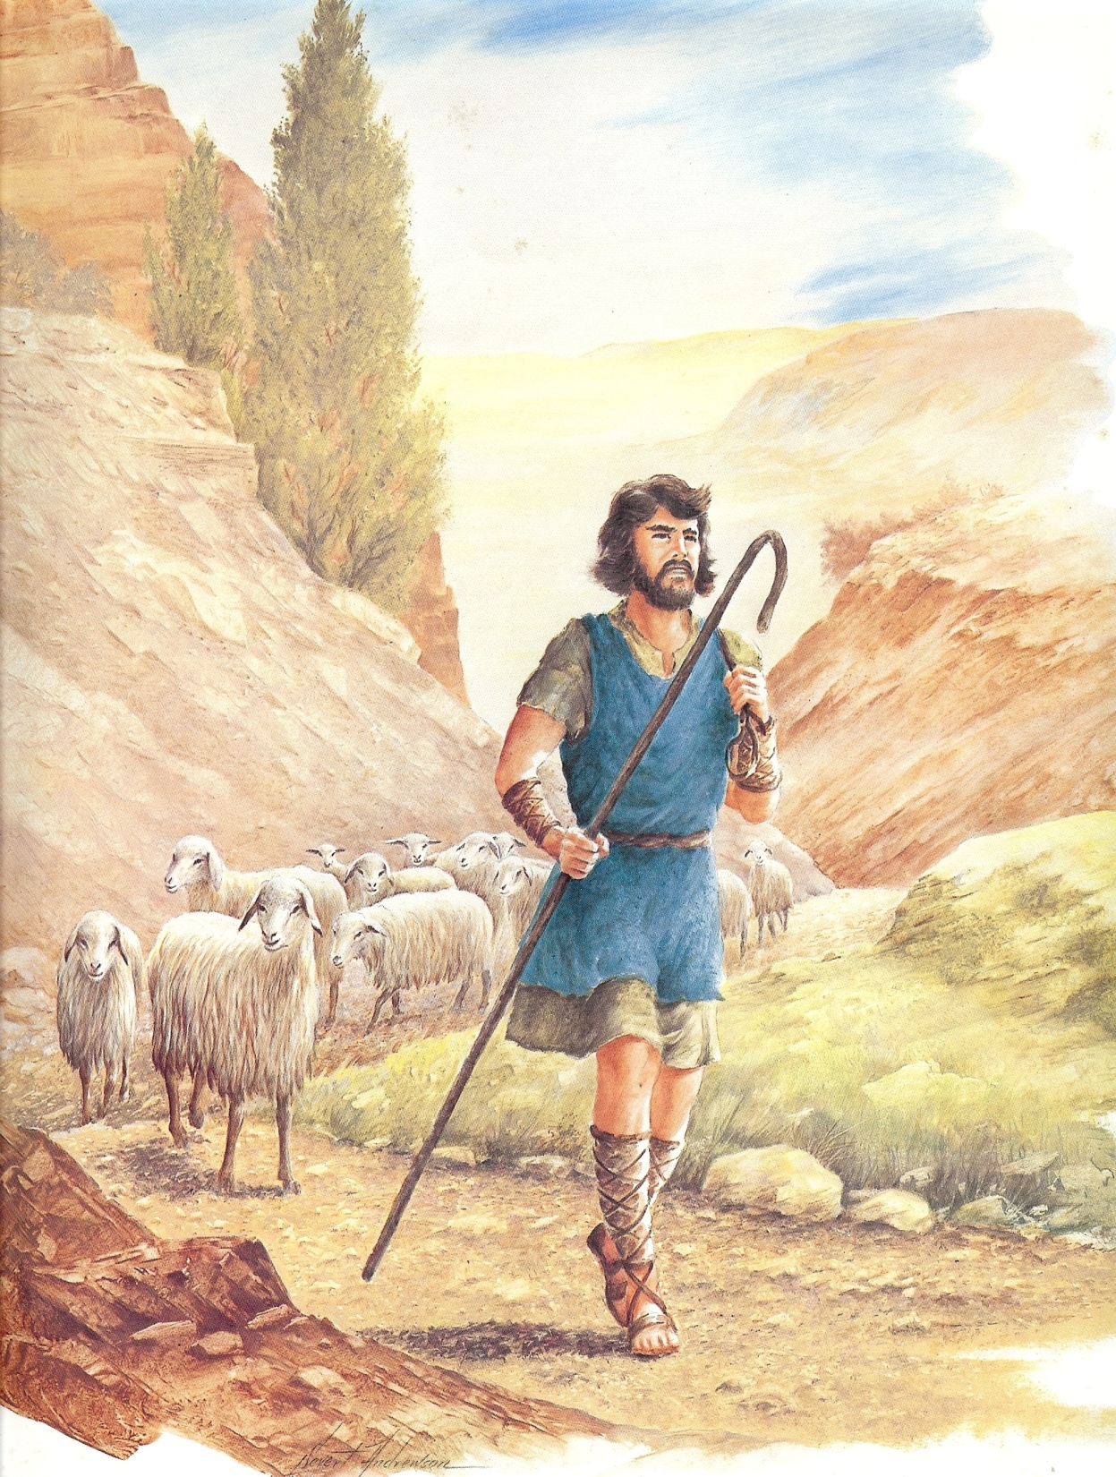
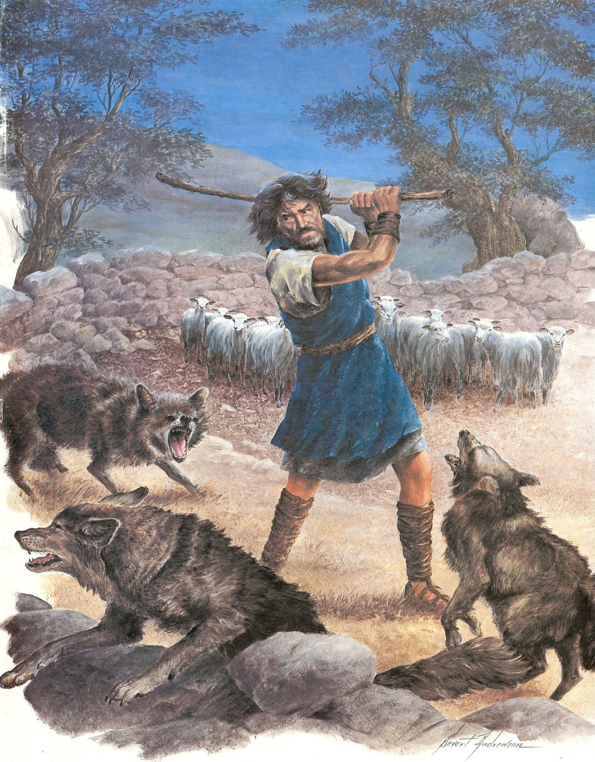
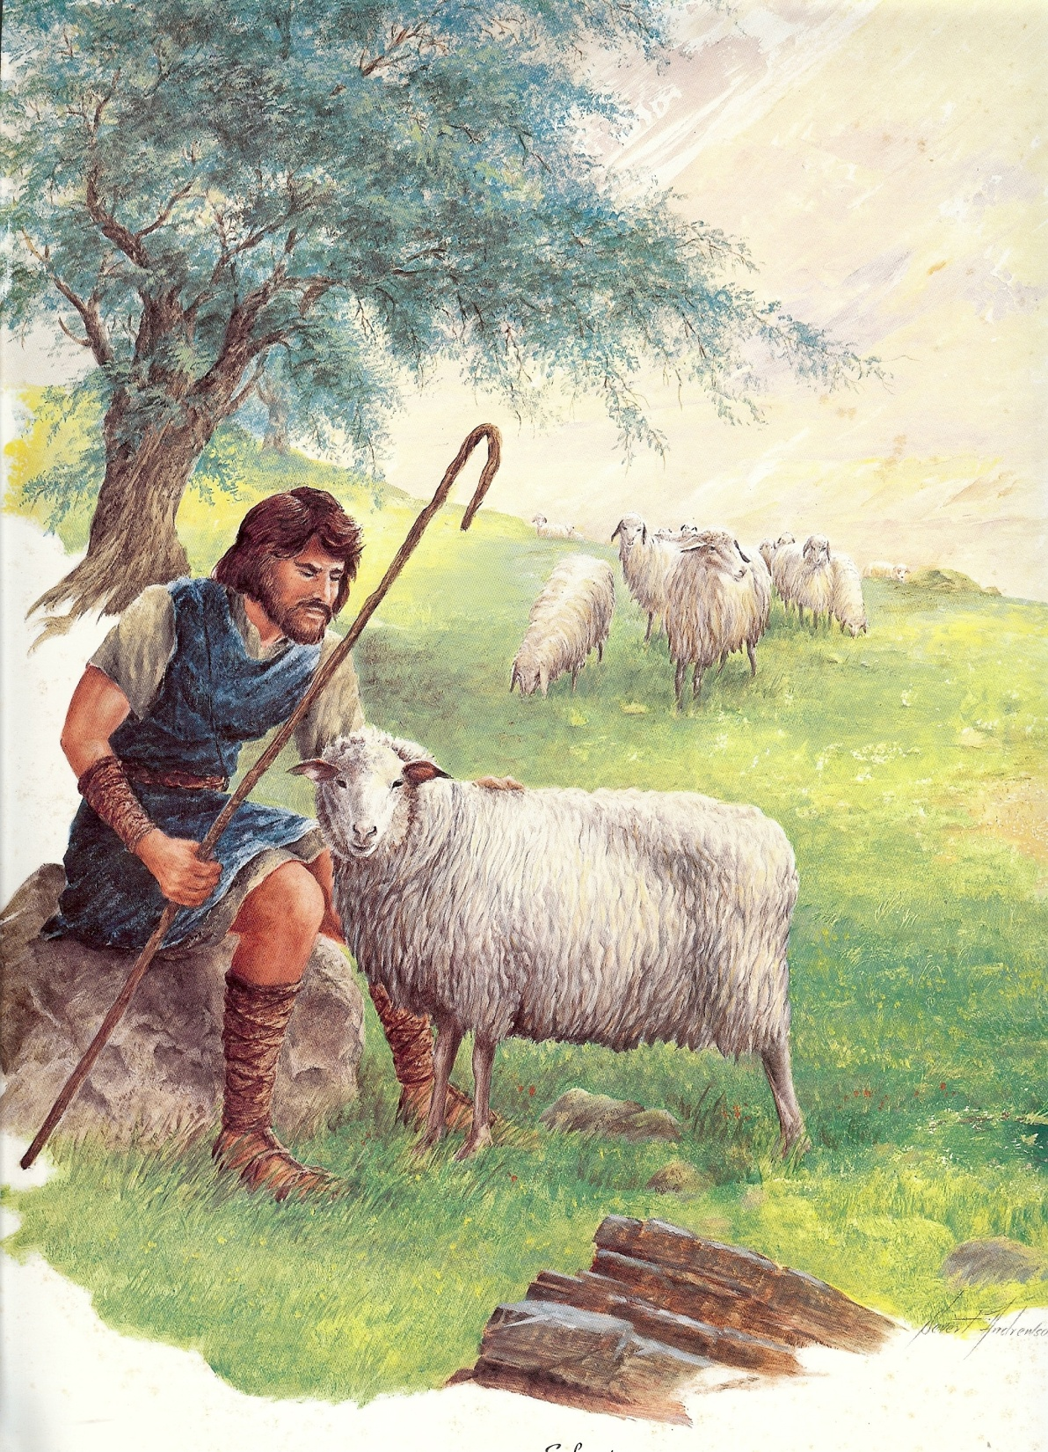

Slide 4
Ways a Father can Protect and Keep the Heart of his Daughter
Love your wife – Col. 3:18
Honor and praise her for godly character – Prov. 31
Provide a wise daily schedule – Col. 3:24-4:1
Protect them from outside jobs –
Independent spirit – Eph. 6:1-4
Wrong music – Col. 3:15-16
Wrong friends – I Cor. 15:33
Immoral men – Phil. 3:15-19

Slide 5
5. Teach them the importance of modest dress – I Tim. 2:9-11
6. Teach them the importance of feminine dress – Deut. 22:5
7. Protect them from unclean things – II Cor. 6:14-7:1
Computer / Internet
Face book
E-mail
Immoral reading material
Wrong friends
Worldly music and activities
Cell phones

Slide 6
8. Point out the godly character of good female role models in the church – I Tim. 5:14
9. Build respect by controlling anger and lust – Prov. 2, 5-7
10. Keep daily accountability with your daughter –
Deut. 22:13-19
11. Always be available and give your daughter your
full attentiveness – Eph. 5:16-17
12. Discipline your daughter in love – Proverbs
13. Assume the responsibility of spiritual leadership –
I Cor. 11:1-4

Slide 7
14. Be faithful in attending your local church –
Heb. 10:24-25
15. Be excited to attend church services –
Acts 2:42-45
Always be willing to admit when you are wrong and ask forgiveness – “I was wrong for _________ would you please forgive me?”
Ask your daughter to share with you your personal blind spots – Prov. 15:33
Guide her in the development of Biblical convictions – I Cor. 15:58

Slide 8
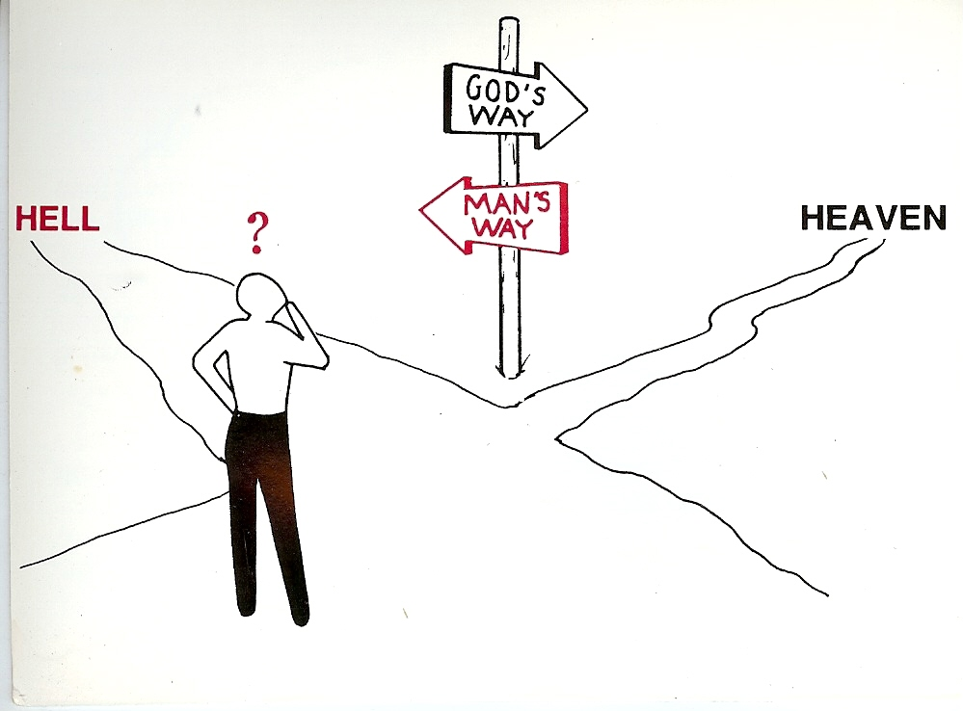
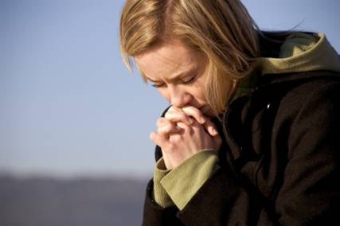
Unrighteousness
Righteousness

Slide 9
19. Date your daughter – Prov. 5-7
20. Teach her the Biblical principles of courtship
and how to deal with the affections of a young
man - Prov. 18:22

Slide 10
Applying Biblical teaching to the area of dating and courtship
I reject the worldly philosophy of dating – Romans 12:1-2
I purpose not to defile my self – II Corinthians 6:14-7:1
I will guard my heat with all diligence keeping it for the one God has for me – Proverbs 4:32
I am committed to serve the Lord – I Corinthians 7:32

Slide 11
I will avoid on line dating, chat rooms, e-mail, face book, cell phone, my-space, texting, etc. – I John 2:15

Slide 12
I will seek God’s will for my life –
Ephesians 5:17
I will surrender my right to choose
my life’s partner to God – Proverbs
6:20:20-24
I will receive the permission and blessing of my parents before courting – Ephesians 6:1-4

Slide 13
Preparation for Courtship
Must be old enough – I Corinthians 14:11
Must be mature enough – I Kings 2:2
Must be spiritually minded enough – Romans 8:6
Must be under authority - I Peter 5:5

Slide 14
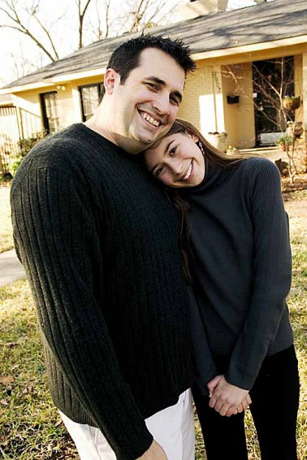

Slide 15
21. Respond to rebellious attitudes at once –
I Sam. 15:33
22. Teach her how to resist the Devil –
Jam. 1:13-14, 4:6-11
Note: This requires an understand of “Strongholds” II Cor. 10:3-6
How Satan get a stronghold in our lives
How to have freedom over strongholds
How to keep Satan from establishing strongholds – “resist the devil…”

Slide 16
II Corinthians 10:3-6
Stronghold
“False Ideas”
(John 8:44)
Ground
Surrendered
(Eph. 4:27)
Pride of Life
Immorality
(I Thess. 4:1-8)
Bitterness
(Heb. 12:15)
Temporal Values
(I Tim. 6:10)

Slide 17
Three Ways “Ground” is Surrendered to Satan
Immorality
Temporal Values
Bitterness

Slide 18
Steps to Regain Surrendered Ground
Confess each sin of surrendered ground that God brings to your mind – Prov. 28:13
Claim the blood of Christ for cleansing and victory over those sins – I John 1:9; Rev. 12:9
Ask God to take back the ground surrendered to Satan – Ps. 23:3; Rom. 6
Tear down strongholds (false ideas) with the truth of Scripture – II Cor. 10:4-5; John 17:17

Slide 19
5. Transform your mind with the truth of God’s Word – Rom. 12:1-2
6. Fully forgive your offenders – Matt. 6:10-15
7. Revenge all disobedience – II Cor. 10:6-7
Clear your conscience – Acts 24:16
Make restitution – Luke 19:1-10
Ask forgiveness – “Forgive me this wrong…” (II Cor. 12:13)

Slide 20
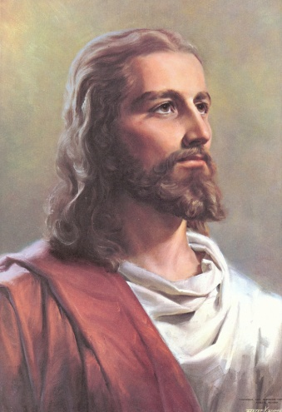
Stronghold
“Truth of Scripture”
(John 17:17)
Romans 6-8
Ground
Surrendered
(Rom. 6:16-19)
Humility
Holiness
(I Thess. 4:1-8)
Forgiveness
(Matt. 6:14)
Sacrificial Giving
(Luke 6:38)

Slide 21
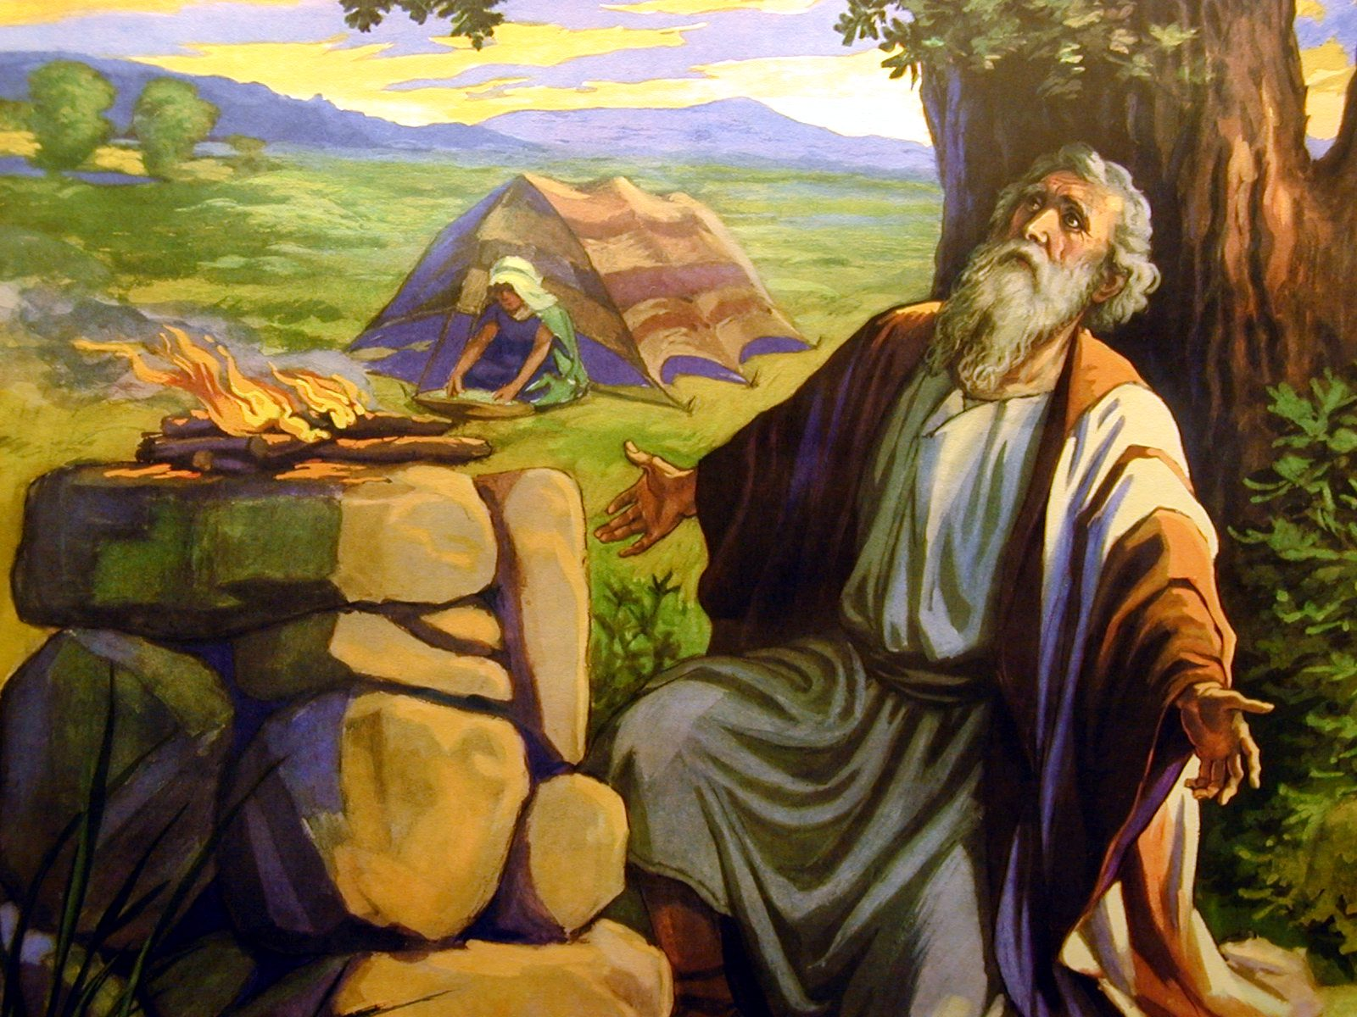
23. Pray a hedge of protection around your
daughter –
“Job sanctified them, and rose up early in the morning, and offered burnt offerings according to the number of them all: Thus did Job continually...Hast not thou made an hedge about him, and about his house, and about all that he hath on every side? Thou hast blessed the work of his hands, and his substance is increased in the land.” (Job 1:5, 10)

Slide 22
Three Parts to the Prayer for a Hedge
Ask God to bind and rebuke the power of Satan in the life of each one in your family – Mark 3:27
Pray in the name and through the blood of the Lord Jesus Christ – John 14:13
Claim the Scripture that related to the kind of protection that is needed –
Protection from temptation – I Cor. 10:13
Protection from fear of man – Matt. 10:26
Protection from pride – I Peter 5:1-8

Slide 23
Protection from anger – James 3:1-18
Protection from bitterness – Heb. 12:15
Protection from immorality – I Thess. 4:1-8
Protection from discouragement - Heb. 13:5
“Sin shall not have dominion over you…” Rom. 6:14

Slide 24
24. Know when to remove her from danger –
James 1:27
25. Seek to make brother and sisters best
friends – John 15:13
26. Teach brothers to watch over their sisters –
Gen. 4:9
27. Postpone getting her a car until she is wise
and mature enough to handle it –
I Tim. 6:11
28. Protect her from sleepovers – I Thess. 3:5

Slide 25
29. Instill in her the rewards of fearing the Lord –
Prov. 8:13
To overcome sinful habits:
“By mercy and truth iniquity is purged: and by the fear of the Lord men depart from evil.” Proverbs 16:6
To begin learning knowledge:
“The fear of the Lord is the beginning of knowledge. . .” Proverbs 1:7
To start being wise:
“The fear of the Lord is the beginning of wisdom: and the knowledge of the holy is understanding.” Proverbs 9:10
To have a longer life:
“The fear of the Lord prolongeth days: but the years of the wicked shall be shortened.” Proverbs 10:27

Slide 26
To discover the fountain of life:
“The fear of the Lord is a fountain of life, to depart from the snares of death.” Proverbs 14:27
To learn contentment:
“Better is little with the fear of the Lord than great treasures and trouble therewith.” Proverbs 15:16
To grow in wisdom:
“The fear of the Lord is the instruction of wisdom; and before honour is humility.” Proverbs 15:33
To get riches, honour, and life:
“By humility and the fear of the Lord are riches, and honour, and life.” Proverbs 22:4

Slide 27
To experience true worship:
“But as for me, I will come into thy house in the multitude of thy mercy: and in thy fear will I worship toward thy holy temple.” Psalm 5:7
To have no wants:
“O fear the Lord, ye his saints: for there is no want to them that fear him.” Psalm 34:9
To experience God’s salvation:
“Surely his salvation is nigh them that fear him; that glory may dwell in our land.” Psalm 85:9
To receive daily provision:
“He hath given meat unto them that fear him: he will ever be mindful of his covenant.” Psalm 111:5

Slide 28
To experience strong confidence:
“In the fear of the Lord is strong confidence: and his children shall have a place of refuge.” Proverbs 14:26
To have a satisfying life:
“The secret of the Lord is with them that fear him; and he will shew them his covenant.” Psalm 25:14
To experience God’s goodness:
“Oh how great is thy goodness, which thou hast laid up for them that fear thee; which thou hast wrought for them that trust in thee before the sons of men!” Psalm 31:19

Slide 29
To have constant protection:
“Behold, the eye of the Lord is upon them that fear him, upon them that hope in his mercy; To deliver their soul from death, and to keep them alive in famine.” Psalm 33:18-19
To be delivered from trouble:
“The angel of the Lord encampeth round about them that fear him, and delivereth them.” Psalm 34:7
To be looked to for truthfulness:
“Thou hast given a banner to them that fear thee, that it may be displayed because of the truth.” Psalm 60:4
To receive a special heritage:
“For thou, O God, hast heard my vows; thou hast given me the heritage of those that fear thy name.” Psalm 61:5

Slide 30
To be given God’s mercy:
“For as the heaven is high above the earth, so great is his mercy toward them that fear him.” Psalm 103:11
To have the Lord’s pity:
“Like as a father pitieth his children, so the Lord pitieth them that fear him.” Psalm 103:13
To bring delight to the Lord:
“The Lord taketh pleasure in them that fear him, in those that hope in his mercy.” Psalm 147:11

Slide 31
To become a special treasure of God:
“Then they that feared the Lord spake often one to another; and the Lord hearkened, and heard it, and a book of remembrance was written before him for them that feared the Lord, and that thought upon his name. And they shall be mine, saith the Lord of hosts, in that day when I make up my jewels. . .” Malachi 3:16-17

Slide 32
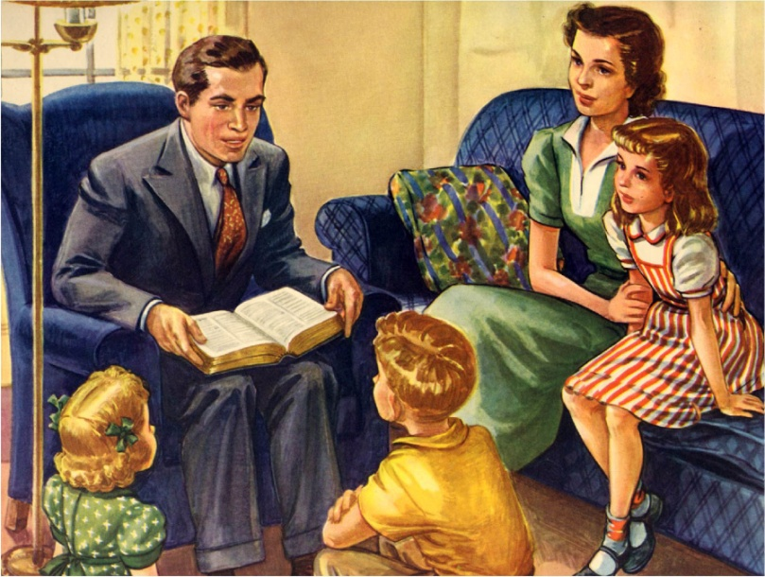
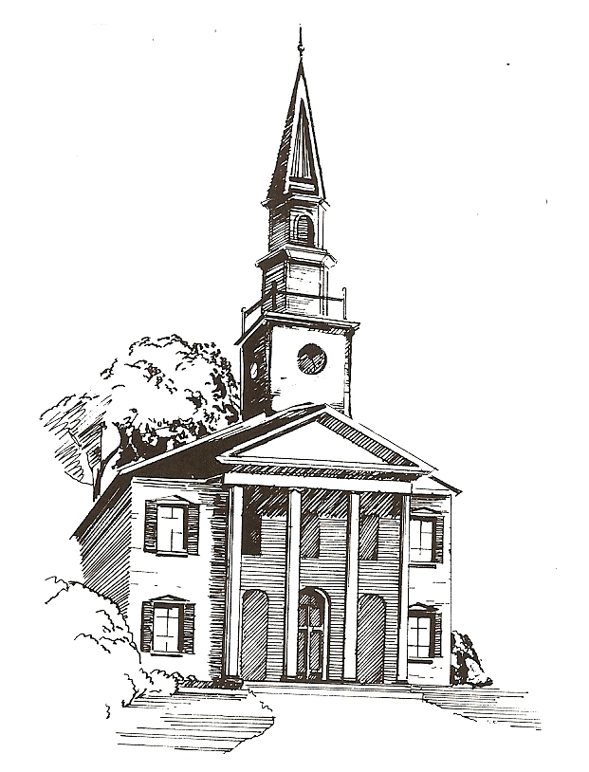
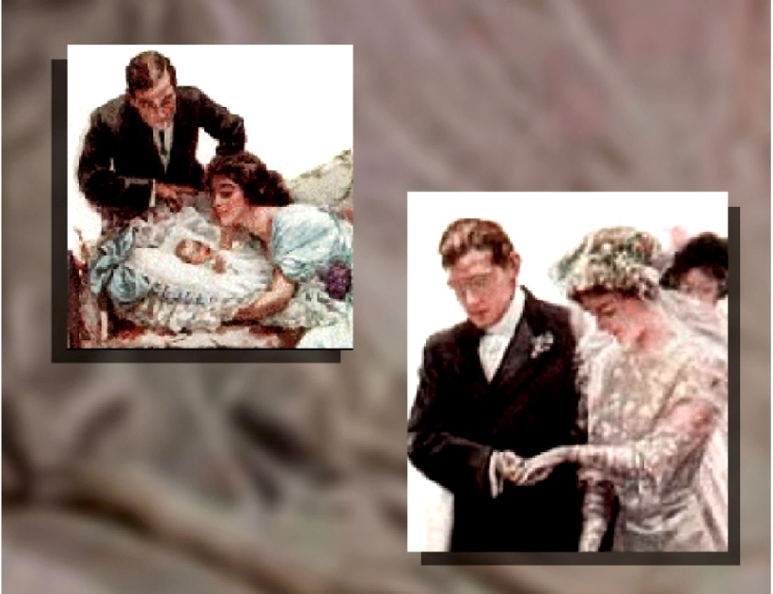
30. Lead her to personal salvation – II Tim. 3:15
31. Challenge her to total dedication – Rom. 12:1-2

