Slide 1
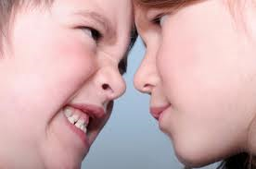
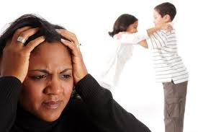
Getting Anger Out of Your Home
Psalms 37:8
Proverbs 22:24-25
Ephesians 4:31
James 1:20

Slide 2
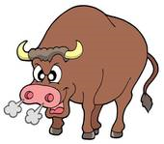
The Definition of Anger
Hebrew (Old Testament) - To blow hard in the nostrils, indignation, to be warm, to fume.
Greek (New Testament) - Violent passion, indignation, vengeance, to take revenge, a strong feeling excited by a real or supposed injury or offense.
NOTE: Vines Expository Dictionary - Wrath (thumos) is distinguished from Anger (orge) in this respect - thumos is an outburst of wrath which comes from the inward indignation of orge (anger).

Slide 3
Recognize the Symptoms of Anger
IMPATIENCE
RAISING VOICE
ANGRY LOOK
SILENCE
HARSHNESS
NAME CALLLING
VIOLENCE
FLUSHED FACE
SARCASM
CURSING
THREATENING
DILATED PUPILS
SCOWL
MOCKING
RIDICULE
TIGHT JAW
REJECTION

Slide 4
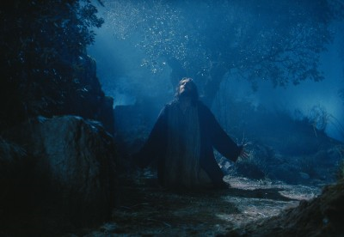
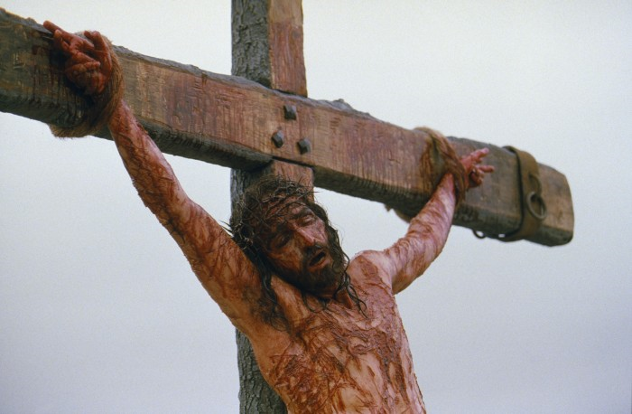
Overcoming anger by Yielding Personal Rights
Jesus Christ is our example concerning personal rights and how to yield those rights.

Slide 5
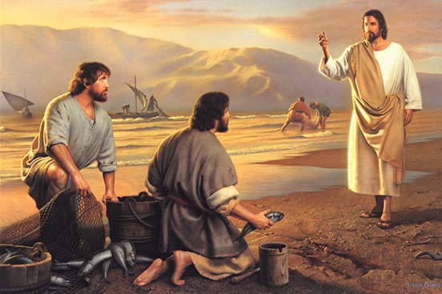
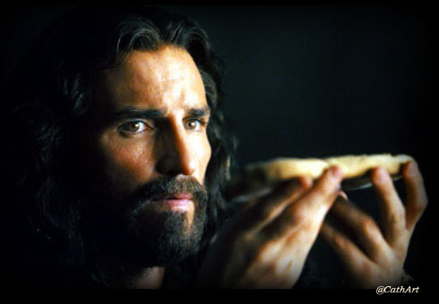
We are to follow Christ’s example - I Peter 2:21-23
We are to have Christ’s attitude - Philippians 2:5-8

Slide 6
Christ yielded His right to wealth - I Corinthians 2:9; Revelation 21:10-11, 18-19, 23; 22:1-2
Christ yielded His right to a Good Reputation - Mark 3:1-6; Luke, 7:38-50, John 1:46; 8:41
Christ yielded His right to be served - John 13:3-5, 12-15
Christ yielded His right to Physical Comforts - Matthew 8:20; Mark 1:32-35
Christ yielded His right to make His own Decisions - John 6:38; Luke 22:42 “. . . I came. . . not to do my own will, but the will of Him that sent me . . . not my will, but thine be done. . .”

Slide 7
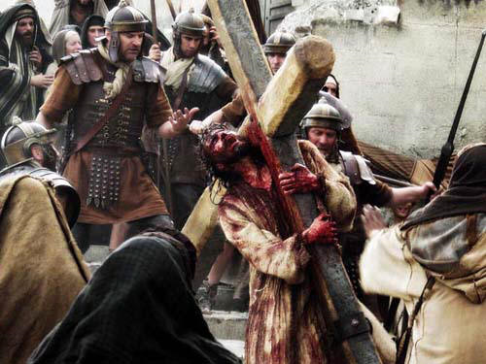
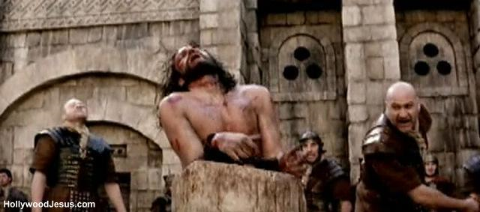
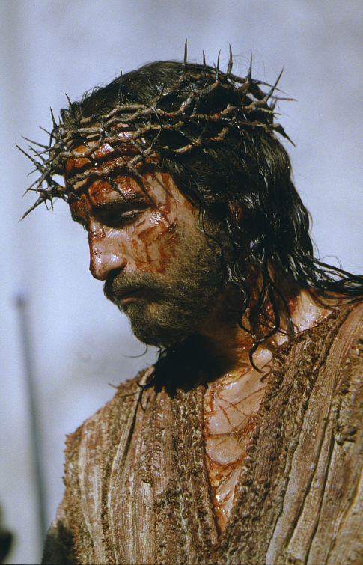
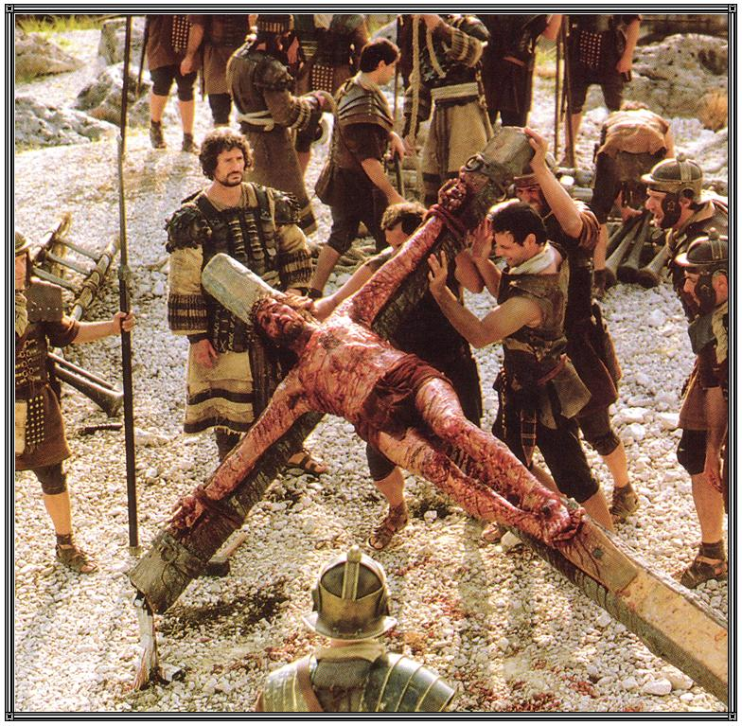
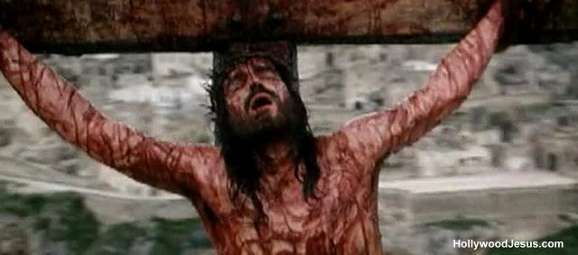
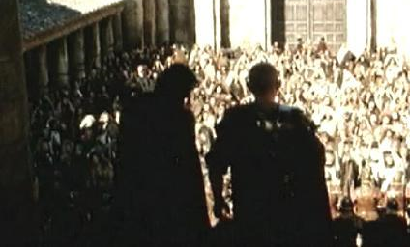
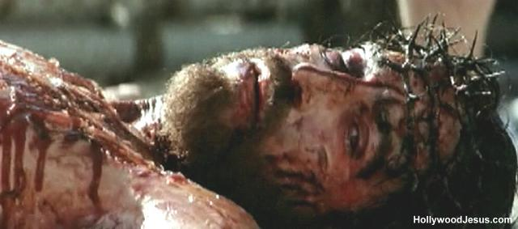
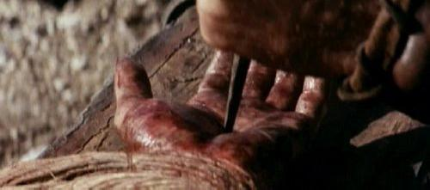

Slide 8
Transferring Ownership of all we have to the Lordship of Jesus Christ
Christ’s ownership of His entire creation - Colossians 1:16-17
God’s ownership over our lives - I Corinthians 6:19-20
A fundamental truth of Scripture is the principle of Stewardship - I Corinthians 4:1-2
> A steward is one who manages the property of another
> As God’s stewards we own nothing - He Does!!!

Slide 9
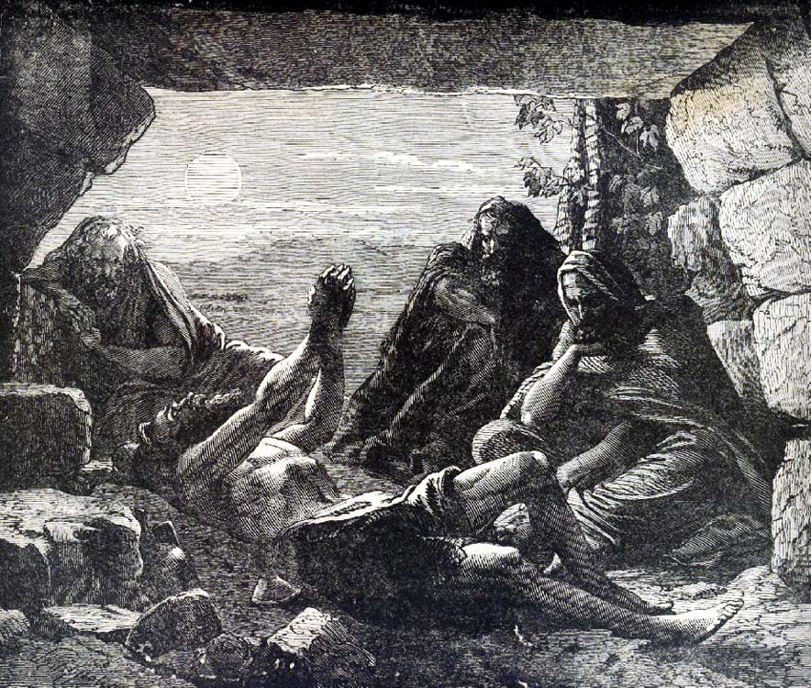
The proper view of the Christian Life is that which Job had (Job 1:20-22)
“Then Job arose, and rent his mantle, and shaved his head, and fell down upon the ground, and worshipped. And said, Naked came I out of my mother's womb, and naked shall I return thither: the LORD gave, and the LORD hath taken away; blessed be the name of the LORD. In all this Job sinned not, nor charged God foolishly.”

Slide 10
Steps to Conquer Anger

Slide 11
ACCEPT RESPONSIBILITY FOR YOUR ANGER - Colossians 3:8
See your anger through your victim’s eyes - Galatians 5:15
View anger as unresolved guilt from the past - Ephesians 4:26
act quickly to correct past offenses - Matthew 5:23-25
acknowledge anger of forefathers - Exodus 20:5
Regain ground given over to Satan in the area of anger - Ephesians 4:24
fully forgive your offenders - Matthew 18:21-35
Realize benefits - Romans 8:28-30
establish daily accountability - Proverbs 27:17
Yield personal rights - I Corinthians 6:19-20

Slide 12
Anger Indicates that there is some right, expectation or possession that you have not yet yielded to God.

Slide 13
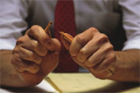
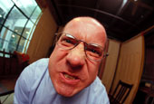
RESPONDING WRONGLY TO SOURCES OF IRRITATION

Slide 14
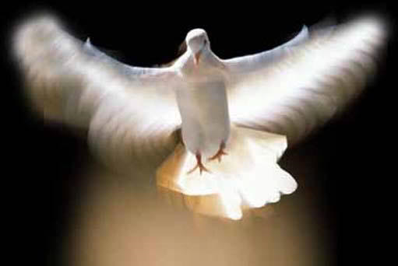
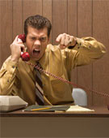
Resisting God’s Grace
(James 4:6-10)
God’s Grace
Defend Self
(Romans 14:10-12)
Blame Others
(Genesis 3:12-13)
Hold it in
(Bitterness) Hebrews 12:15

Slide 15
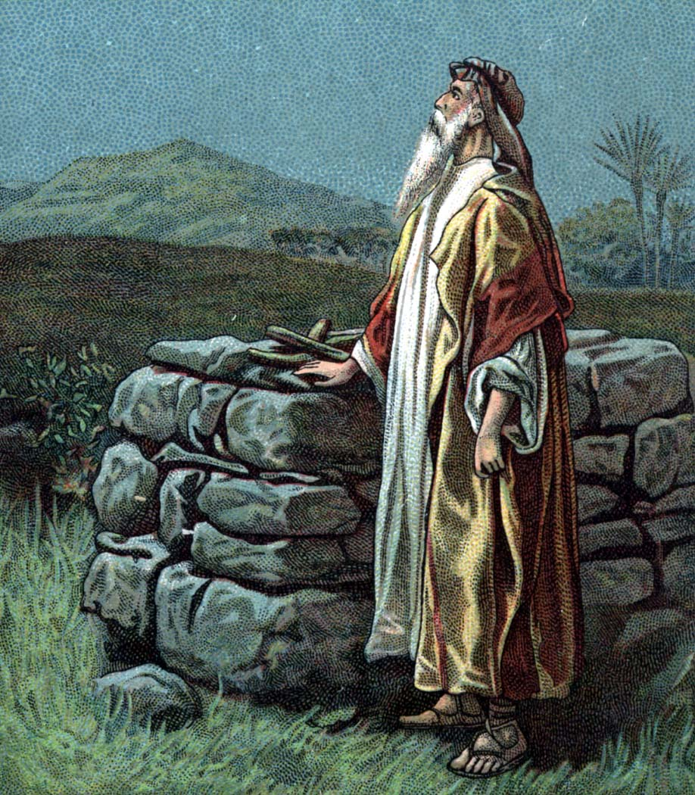
A prayer for yielding personal rights

Slide 16
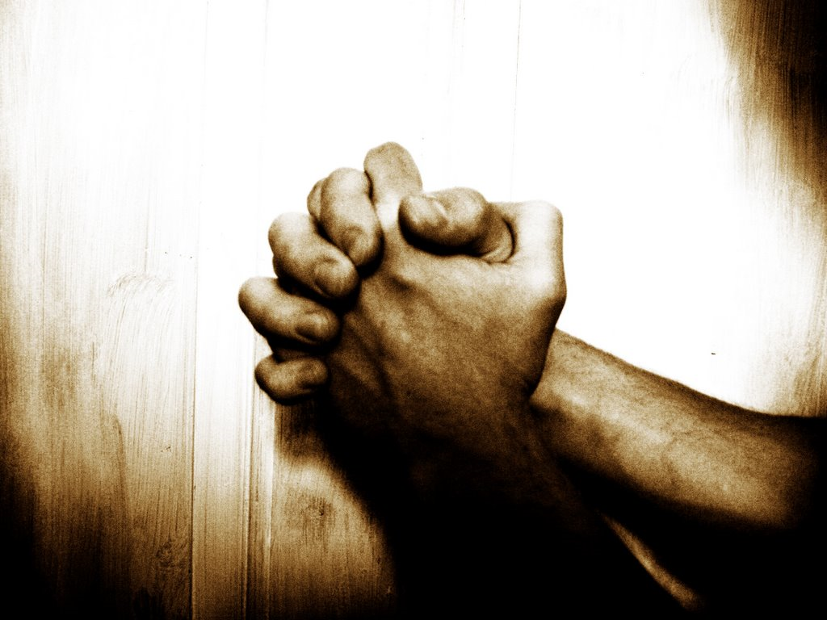

Slide 17
Gracious Heavenly Father, I love you and want to live my live for you today Galatians 2:20. Please allow me to pray in the Spirit Romans 8:26-27 because you know what I will face today and where to emphasize my prayers Ephesians 6:18.
I choose today to die to self Luke 9:23, to put off concerning the former life-style of the old man, which is corrupt according to the deceitful lust; and to be renewed in the spirit of my mind; and to put on the new man, which after God is created in righteousness and true holiness Ephesians 4:22-34.

Slide 18
I choose to do this because I know that refusal to die to self gives Satan ground in my life - Ephesians 4:27: therefore I reckon myself to be dead indeed unto sin, but alive unto God through Jesus Christ my Lord. I choose not to allow sin to reign in my mortal body, that I should obey it in the lust thereof. I yield the members of my body as instruments of righteousness unto God Romans 6:11-13.
Fill me with your Holy Spirit Ephesians 5:18 and please give me the grace I need this day to live in such a way that my life will glorify you Philippians 2:12-14.

Slide 19
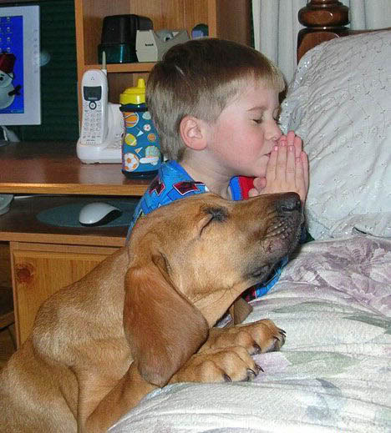
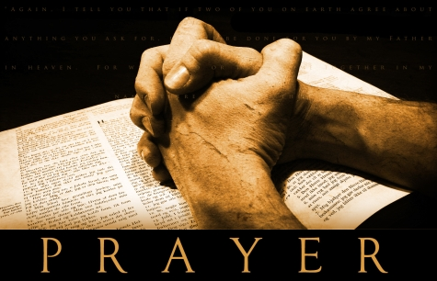
I now yield you my hands, feet, eyes, ears, mouth, mind, will, emotions, spirit, soul, and body. I surrender my life to you as a living sacrifice for your service today. Romans 6:11-18; 12:1-2; II Corinthians 6:14-7:1; I Thessalonians 4:1-8

Slide 20
I yield my rights to:
DEFEND MYSELF - Luke 23:9
BE NEEDED - II Timothy 4:16-17
GOOD HEALTH - II Cor. 11:23-28; 12:7-10
FINANCIAL SECURITY - I Cor. 9:16-18
MY SCHEDULE - I Thessalonians 2:18
FRIENDS - Psalms 38:11; 41:9; Proverbs 18:24
BE APPRECIATED - Luke 17:11-19
BE RIGHT - I Cor. 6:7-8; II Peter 2:19-20; 3:14,17
BE HEARD - I Peter 2:23; 3:1-10
NURSE MY HURTS - Matthew 18:21-22
PRIVACY - Luke 9:12
LEISURE - Mark 6:30-33

Slide 21
SUCCESS IN MINISTRY - II Corinthians 4:7-11
BE FORGIVEN - Matthew 6:12; 5:23-26
BE UNDERSTOOD - Mark 8:14-21
BE ACCEPTED - John 1:11
PLEASURE - Philippians 2:3-4
INDEPENDENCE - I Cor. 6:19-20; Heb. 10:24-25
BE RESPECTED - II Cor. 12:11-16
MY FUTURE PLANS - II Tim. 4:6; Heb. 11:36-40
THINGS - Matthew 6:21; Luke 12:31-34, II Pet. 3:10-14
MY EXPECTATIONS - Psalms 62:5
CONTROL - Mark 8:33; Ephesians 5:18
REPUTATION - Philippians 2:7

Slide 22
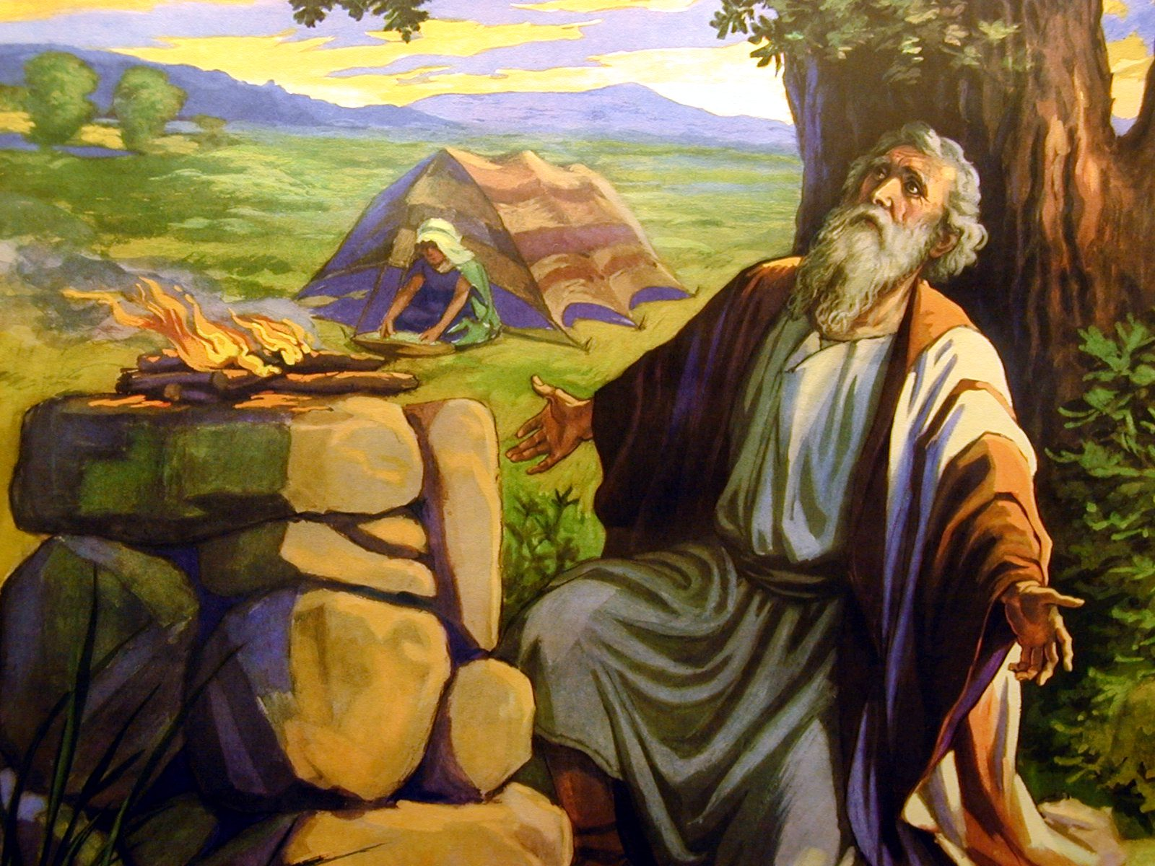
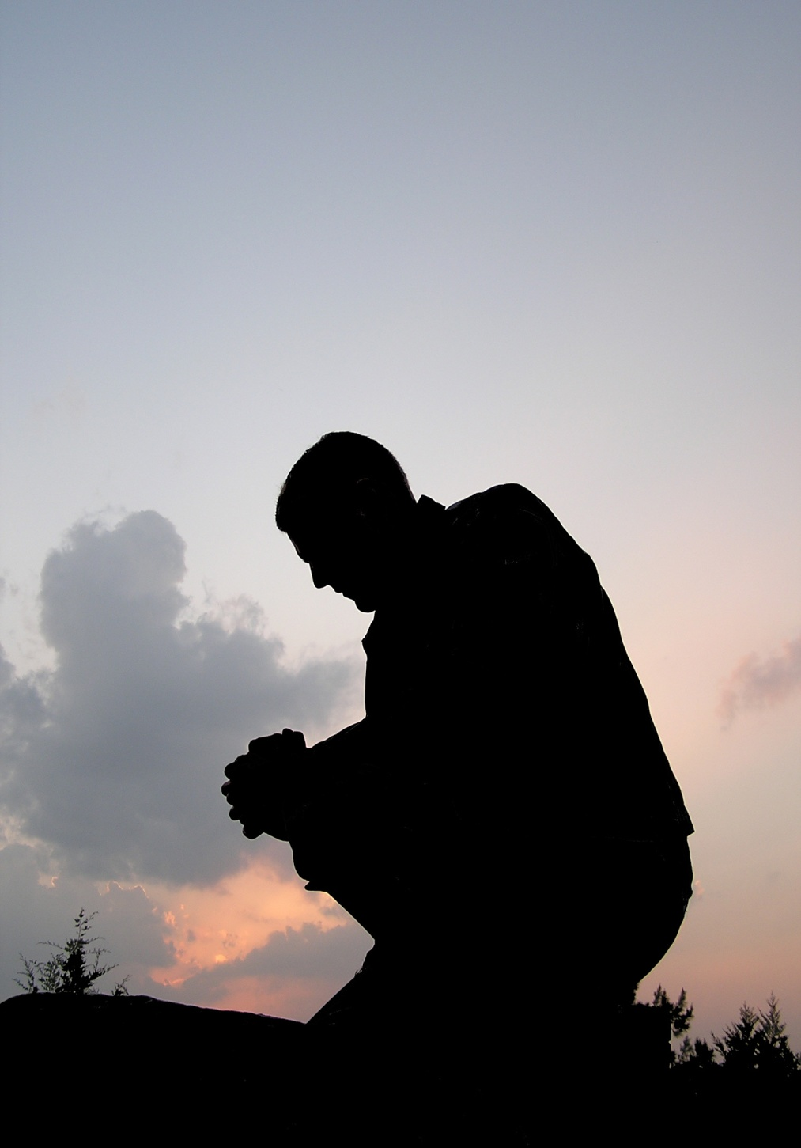
Romans 12:1-2

