Slide 1
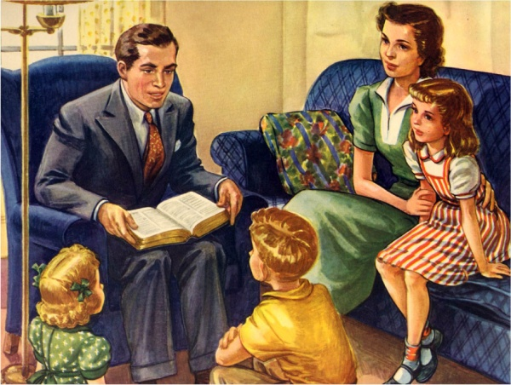
Spiritual Leadership
“But I would have you know, that the head of every man is Christ; and the head of the woman is the man; and the head of Christ is God.” (I Cor. 11:3)

Slide 2
1. submission to the lordship of Jesus Christ - (Romans 10:9-13)
Prayer of Salvation
“Thank you, God, for loving me, a sinner, and for sending Your Son to pay the penalty of my sin. Right now I put my trust in His death and resurrection for my salvation and receive the eternal life that You offer me through Him. Thank you for hearing this prayer, cleansing me of all my sin through Christ’s blood, and accepting me now as your child. Teach me and direct me through Your Word and Your Spirit to discover Your purpose for my life. Amen.”

Slide 3
Sanctification – Rom. 12:1-2; I Thess. 4:1-8
Conforming us to the image of Christ – II Cor. 3:18
Guiding – John 16:13
Teaching – I John 2:27
Leading – Rom. 8:14
Empowering for service – Acts 1:8
Comforting – John 14:16
Convicting and prompting – Rom. 8:12-17
Strengthen our inner man – Eph. 3:16
Filling – Eph. 5:18

Slide 4
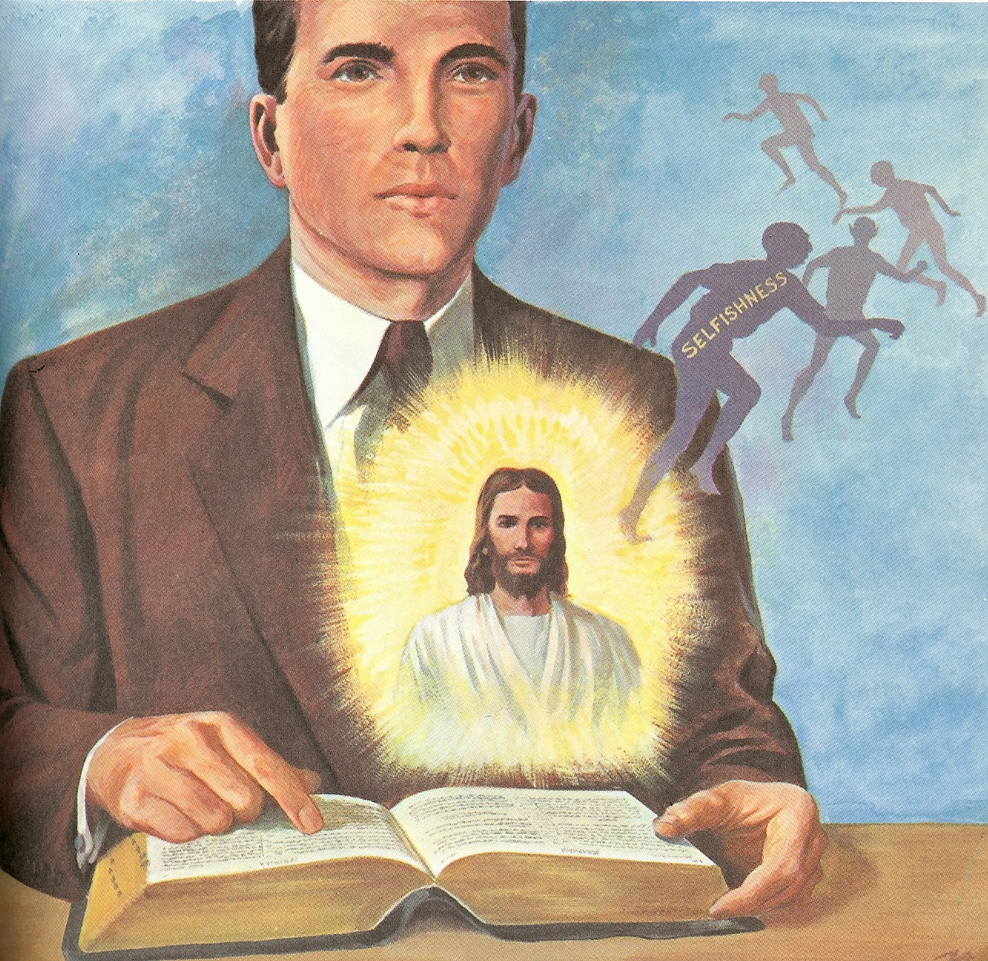
How to be Filled with the Holy Spirit

Slide 5
1. Purpose to live a holy life – I Thess. 4:1-8
2. Yield yourself to the Lord – Rom. 6,
12:1-2
3. Renew your mind daily – Eph. 4:23-24
4. Make no provision for the flesh – Rom.
13:14
5. Flee temptation – II Tim. 2:22
6. Resist Satan by continual submission to
God – Jam. 4:6-10
7. Do not give place to the devil – Eph. 4:27-30
(bitterness, immorality, covetousness)

Slide 6
8. Keep your thoughts centered on things above – Phil. 4:6-8
9. Set your affections on things above – Col. 3:1-4
Keep your sin confessed – Prov. 28: 13-14
Keep your conscience clear – Acts 24:16
Obey the promptings of the Holy Spirit – Rom. 8:14

Slide 7
13. Avoid quenching and grieving the
Holy spirit – I Thess. 5:19, Eph. 4:25-31
14. Ask God to fill you with the Holy Spirit –
Luke 11:15
The Holy Spirit is called the “Spirit of Grace” Heb. 10:29
“God gives grace to the humble…”

Slide 8
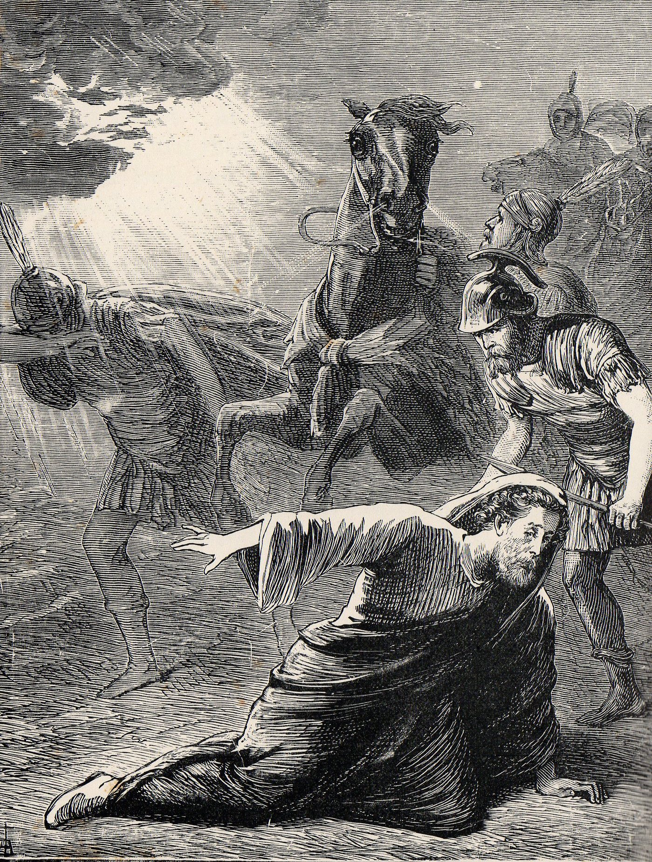
“And he trembling and astonished said, Lord, what wilt thou have me to do? And the Lord said unto him, Arise, and go into the city, and it shall be told thee what thou must do.”
(Acts 9:6)

Slide 9
2. Assuming the spiritual leadership role - (Ephesians 5:23-33)
When it comes to spiritual leadership, most husbands feel inadequate and unqualified.
Many feel that their wives are better readers and students of the Bible than they are.
It requires a major commitment for most men to initiate a spiritual activity in the family -

Slide 10
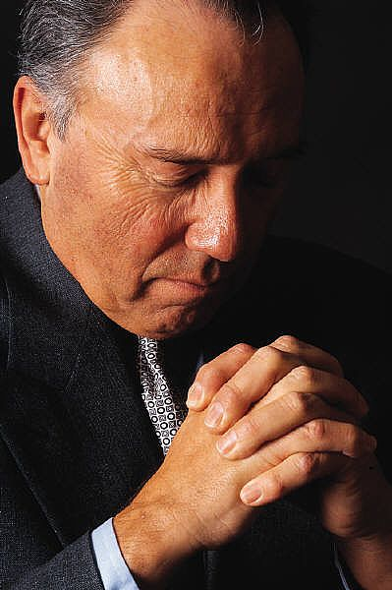
Praying
Reading the Scriptures
Family Devotions
Giving the Family Direction
Cleansing the Home
Establishing Biblical Standards
Enforcing Biblical Standards
Family Ministries
Discipleship of the Children
Meeting the Spiritual needs of the Wife
Faithful Church Attendance

Slide 11
3. providing direction without being domineering - I Peter 5:1-4
4. providing leadership through personal example – Heb. 13:7, 17
5. providing protection without being possessive - I Thess. 2:7-11; II Tim. 2:24-26
6. providing basic needs without being materialistic – Matt. 7:7-11; I Tim. 5:8; 6:6-8
7. providing leadership through humility - Prov. 22:4; I Peter 5:6

Slide 12
NOTE: It should be the goal of every husband to be the spiritual leader of his wife and family so that they can look with confidence to him for direction in life.
“Let your women keep silence in the churches: for it is not permitted unto them to speak; but they are commanded to be under obedience,
as also saith the law. And if they will learn anything, let them ask their husbands at home: for it is a shame for women to speak in the church.” (I Cor. 14:34-35)

Slide 13
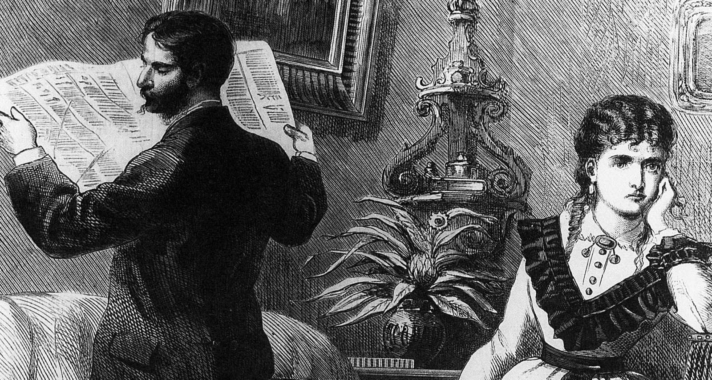
Reasons wives use for not seeking their husbands spiritual leadership:
He is not a Christian
He will not know the answer
He is too busy
He is not concerned about spiritual things

Slide 14
8. providing leadership through loving convictions - I Cor. 15:58; Eph. 4:14-15
What is a conviction - I Cor. 15:58; Eph. 4:14-15; 6:10-12; I Tim. 1:18-20; 3:9; 4:6-13; 6:12, 20; II Tim. 4:6-7; I John 2:12-17
Note: A conviction is a basic scriptural principle / teaching which a person purposes to follow, whatever the cost! - Rev. 2:13
What is a preference -
Note: A preference is the first choice a person would make in a given situation / not the only choice

Slide 15
The difference between a conviction and a preference -
Conviction does not change
Preference does
Conviction will be seen in daily living
Preference may not
Conviction will be consistent
Preference may vary
The five commands necessary for every man to build biblical convictions into his life - I Cor. 16:13-14

Slide 16
1. Be alert to spiritual danger - Rom. 13:11-14; Titus 2:11-12; I Peter 5:8
2. Be true to God’s standards - II Cor. 6:14-7:1; Col. 1:9-11; I Peter 1:13-16
3. Be a man - Josh. 1:9-11; I Kings 2:1-3; Psalms 1; Jer. 1:6-10
4. Be strong - Eph. 6:10-12; II Tim. 2:1-2; Heb. 5:11-14; I Peter 2:1-3; I John 2:14
5. Be kind and loving in all you do - John 13:34-35; Rom. 13:8-10; I Cor. 13:1-8

