Slide 1
Thirteen Things that Separate a Father from His Children
37% of our families are single parent families
The divorce rate in America for first marriage is 41%
The divorce rate in America for second marriage is 60%
The divorce rate in America for third marriage is 73%
Average father in America spends less them 5 min. with his children each day
One of the most observable facts of this generation is the fathers are cut off from their children.

Slide 2
“There is a generation that curseth their father, and doth not bless their mother. There is a generation that are pure in their own eyes, and yet is not washed from their filthiness. There is a generation, O how lofty are their eyes! and their eyelids are lifted up. There is a generation, whose teeth are as swords, and their jaw teeth as knives.” (Proverbs 30:11-14)

Slide 3
“There is a generation that curseth their father, and doth not bless their mother.”
“There is a generation that are pure in their own eyes, and yet is not washed from their filthiness.”
“There is a generation, O how lofty are their eyes! and their eyelids are lifted up.”
“There is a generation, whose teeth are as swords, and their jaw teeth as knives.”

Slide 4
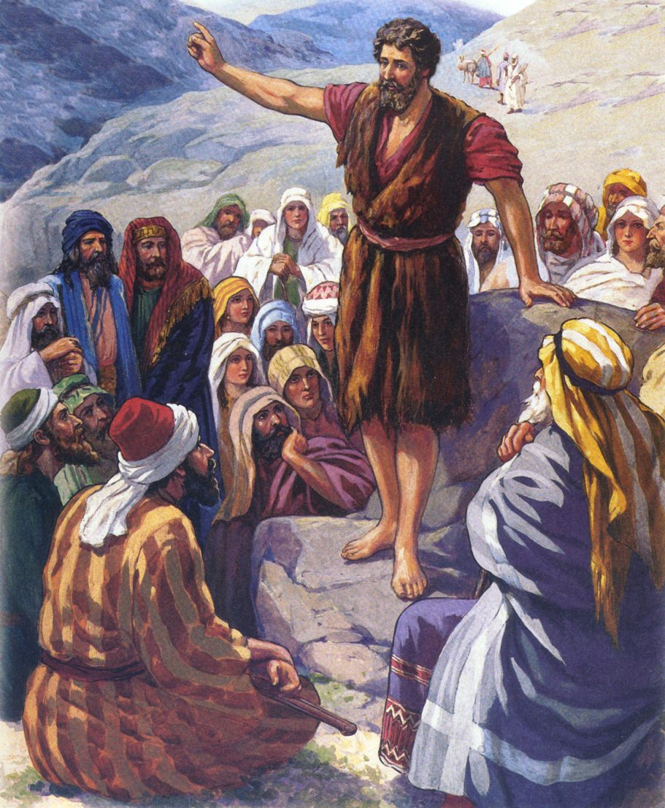
Ministry of John the Baptist
“And he shall go before him in the spirit and power of Elias, to turn the hearts of the fathers to the children, and the disobedient to the wisdom of the just; to make ready a people prepared for the Lord.” (Luke 1:17)

Slide 5
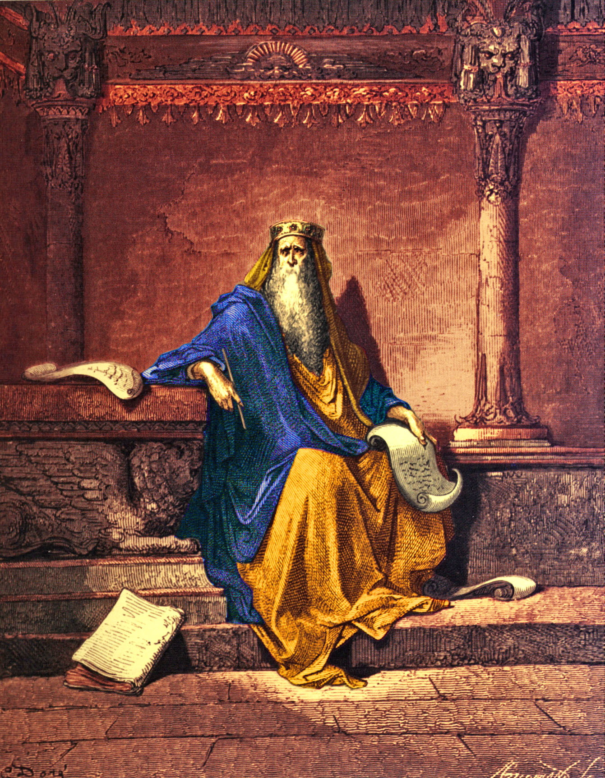
Solomon on the Importance of the Father / Child Relationship (Proverbs)

Slide 6
“My son, hear the instruction of thy father, and forsake not the law of thy mother.”
“Hear, ye children, the instruction of a father, and attend to know understanding.”
“My son, keep thy father's commandment, and forsake not the law of thy mother.”
“The proverbs of Solomon. A wise son maketh a glad father: but a foolish son is the heaviness of his mother.”
“A wise son heareth his father's instruction: but a scorner heareth not rebuke.”
“A fool despiseth his father's instruction: but he that regardeth reproof is prudent.”

Slide 7
“A wise son maketh a glad father: but a foolish man despiseth his mother.”
“He that begetteth a fool doeth it to his sorrow: and the father of a fool hath no joy.”
“A foolish son is a grief to his father, and bitterness to her that bare him.”
“A foolish son is the calamity of his father.”
“He that wasteth his father, and chaseth away his mother, is a son that causeth shame, and bringeth reproach.”
“Whoso curseth his father or his mother, his lamp shall be put out in obscure darkness.”

Slide 8
“Hearken unto thy father that begat thee, and despise not thy mother when she is old.”
“The father of the righteous shall greatly rejoice: and he that begetteth a wise child shall have joy of him. Thy father and thy mother shall be glad, and she that bare thee shall rejoice.”
“Thine own friend, and thy father's friend, forsake not; neither go into thy brother's house in the day of thy calamity: for better is a neighbour that is near than a brother far off.”
“Whoso keepeth the law is a wise son: but he that is a companion of riotous men shameth his father.”

Slide 9
“Whoso robbeth his father or his mother, and saith, It is no transgression; the same is the companion of a destroyer.”
“Whoso loveth wisdom rejoiceth his father: but he that keepeth company with harlots spendeth his substance.”
“There is a generation that curseth their father, and doth not bless their mother.”
“The eye that mocketh at his father, and despiseth to obey his mother, the ravens of the valley shall pick it out, and the young eagles shall eat it.”

Slide 10
“Fathers, provoke not your children to anger, lest they be discouraged.” (Col. 3:21)

Slide 11
1. Absentee Father
Wrong Priorities
Putting work or personal interest ahead of church attendance, serving the Lord, needs of your family, etc.
Eph. 5:16 “Redeeming the time, because the days are evil.”
Matt. 6:33 “But seek ye first the kingdom of God, and his righteousness; and all these things shall be added unto you.”

Slide 12
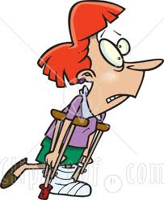
2. Unfaithful Father
Prov. 25:19 “Confidence in an unfaithful man in time of trouble is like a broken tooth, and a foot out of joint.”

Slide 13
Num. 12:7 “My servant Moses is not so, who is faithful in all mine house.”
Prov. 20:6 “Most men will proclaim every one his own goodness: but a faithful man who can find?”
Prov. 28:20 “A faithful man shall abound with blessings.”
Matt. 24:45 “Who then is a faithful and wise servant, whom his lord hath made ruler over his household, to give them meat in due season?”
Matt. 25:21 “His lord said unto him, Well done, thou good and faithful servant: thou hast been faithful over a few things, I will make thee ruler over many things: enter thou into the joy of thy lord.”

Slide 14
Luke 16:10-12 “He that is faithful in that which is least is faithful also in much…If therefore ye have not been faithful in the unrighteous mammon, who will commit to your trust the true riches...And if ye have not been faithful in that which is another man's, who shall give you that which is your own?”
I Cor. 4:2 “Moreover it is required in stewards, that a man be found faithful.”
I Cor. 4:17 “For this cause have I sent unto you Timotheus, who is my beloved son, and faithful in the Lord.”

Slide 15
Eph. 1:1 “Paul, an apostle of Jesus Christ by the will of God, to the saints which are at Ephesus, and to the faithful in Christ Jesus.”
Eph. 6:21 “Tychicus, a beloved brother and faithful minister in the Lord.”
Col. 4:9 “Onesimus, a faithful and beloved brother.”
I Pet. 5:12 “Silvanus, a faithful brother.”
I Tim. 1:12 “And I thank Christ Jesus our Lord, who hath enabled me, for that he counted me faithful, putting me into the ministry.”
Rev. 2:13 “I know thy works, and where thou dwellest, even where Satan's seat is: and thou holdest fast my name, and hast not denied my faith, even in those days wherein Antipas was my faithful martyr, who was slain among you, where Satan dwelleth.”

Slide 16
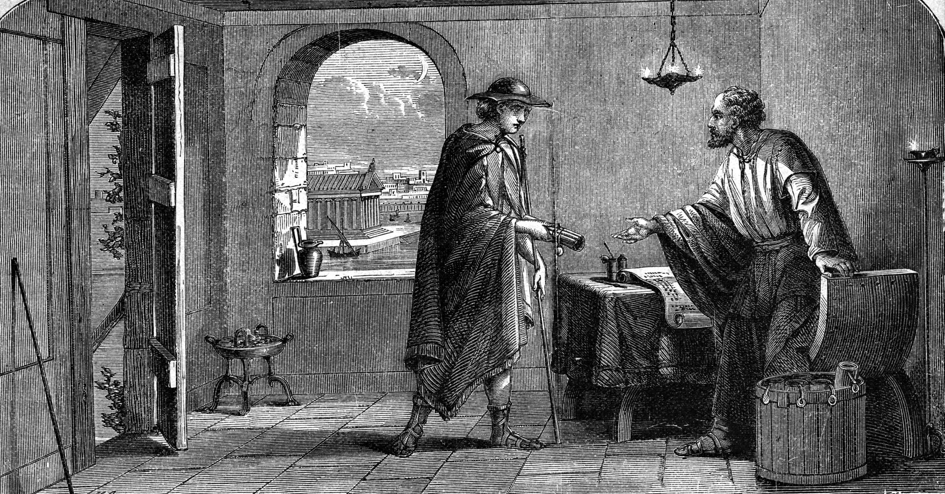
II Tim. 2:2 “And the things that thou hast heard of me among many witnesses, the same commit thou to faithful men, who shall be able to teach
others also.”

Slide 17
3. Fathers Who Make Rules without Principles to Undergird Them
“And thou shalt teach them diligently unto thy children, and shalt talk of them when thou sittest in thine house, and when thou walkest by the way, and when thou liest down, and when thou risest up.” (Deut. 6:7)

Slide 18
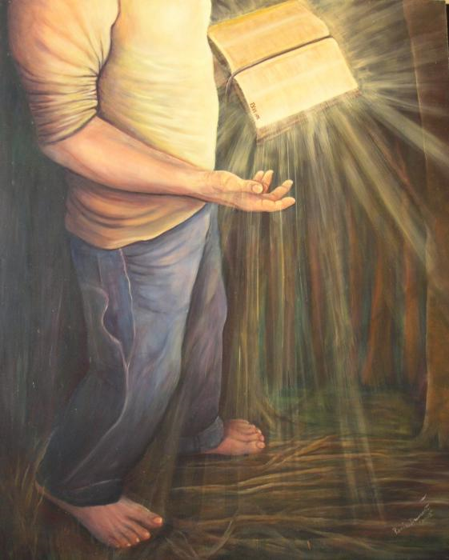
“Thy word is a lamp unto my feet, and a light unto my path.” (Ps. 119:105)

Slide 19
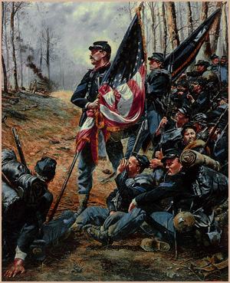
4. Fathers Who Have Double Standards
I Cor. 15:58 “Therefore, my beloved brethren, be ye stedfast, unmoveable…”
Matt .7:5 “Thou hypocrite, first cast out the beam out of thine own eye; and then shalt thou see clearly to cast out the mote out of thy brother's eye…”

Slide 20
Isa 59:19 “So shall they fear the name of the LORD from the west, and his glory from the rising of the sun. When the enemy shall come in like a flood, the Spirit of the LORD shall lift up a standard against him.”
Isa 62:10 “Go through, go through the gates; prepare ye the way of the people; cast up, cast up the highway; gather out the stones; lift up a standard for the people.”
Jer. 50:2 “Declare ye among the nations, and publish, and set up a standard; publish, and conceal not.”

Slide 21
5. Fathers Who Are Unwilling to Discipline
“For whom the Lord loveth he chasteneth, and scourgeth every son whom he receiveth…Furthermore we have had fathers of our flesh which corrected us, and we gave them reverence: shall we not much rather be in subjection unto the Father of spirits, and live?”
(Heb. 12:6,9)

Slide 22
Proverbs on Discipline “Chasten thy son while there is hope.” (Proverbs 19:18)
Prov. 3:11-13
Prov. 6:23
Prov. 12:1
Prov. 12:13
Prov. 13:18
Prov. 13:24
Prov. 15:5
Prov. 15:10
Prov. 19:18
Prov. 22:15
Prov. 23:13-14
Prov. 29:17

Slide 23
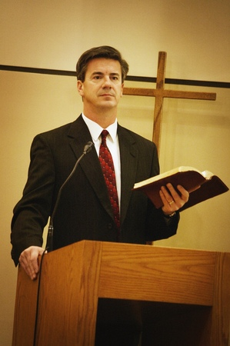
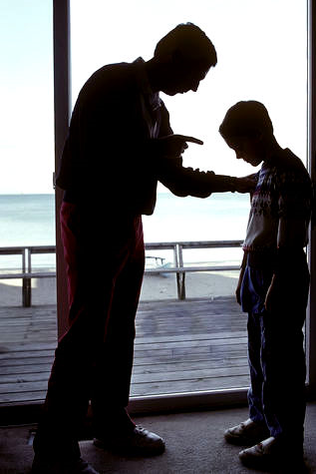
6. Fathers Who Consistently Display Anger
Tit. 1:7 “For a bishop must be blameless, as the steward of God; not selfwilled, not soon angry, not given to wine, no striker, not given to filthy lucre.”
Eph. 4:26 “Be ye angry, and sin not: let not the sun go down upon your wrath…”

Slide 24
Jam. 1:20 “For the wrath of man worketh not the righteousness of God.”
Col 3:8, 21 “But now ye also put off all these; anger, wrath, malice, blasphemy, filthy communication out of your mouth…Fathers, provoke not your children to anger.”

Slide 25
7. Fathers and Mothers Who Continually Quarrel
“Husbands, love your wives, even as Christ also loved
the church.”
(Eph. 5:25)
“Husbands, love your wives, and be not bitter
against them.”
(Col. 3:19)

Slide 26
8. Fathers Lack of Interest in the Activities of Their Child
Prov. 23:26 “My son, give me thine heart.”
Deut. 6:7 “…teach them diligently unto thy children, and shalt talk of them when thou sittest in thine house, and when thou walkest by the way, and when thou liest down, and when thou risest up.”

Slide 27
9. Fathers Who Place Unhealthy Pressure on Children to Succeed

Slide 28
Philippians 2:1-4 “If there be therefore any consolation in Christ, if any comfort of love, if any fellowship of the Spirit, if any bowels and mercies, Fulfil ye my joy, that ye be likeminded, having the same love, being of one accord, of one mind. Let nothing be done through strife or vainglory; but in lowliness of mind let each esteem other better than themselves. Look not every man on his own things, but every man also on the things of others.”

Slide 29
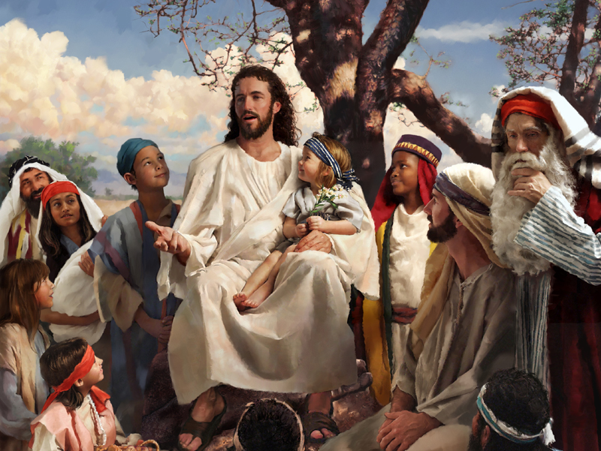
“And as ye would that men should do to you, do ye also to them likewise.” Luke 6:31

Slide 30
10. Fathers Who Relinquish Responsibility to the Mother, the School, or the Church
Eph. 6:4 “And, ye fathers, provoke not your children to wrath: but bring them up in the nurture and admonition of the Lord.”
Eph. 5:23 “For the husband is the head of the wife, even as Christ is the head of the church: and he is the saviour of the body.”
Rom. 14:12 “So then every one of us shall give account of himself to God.”

Slide 31
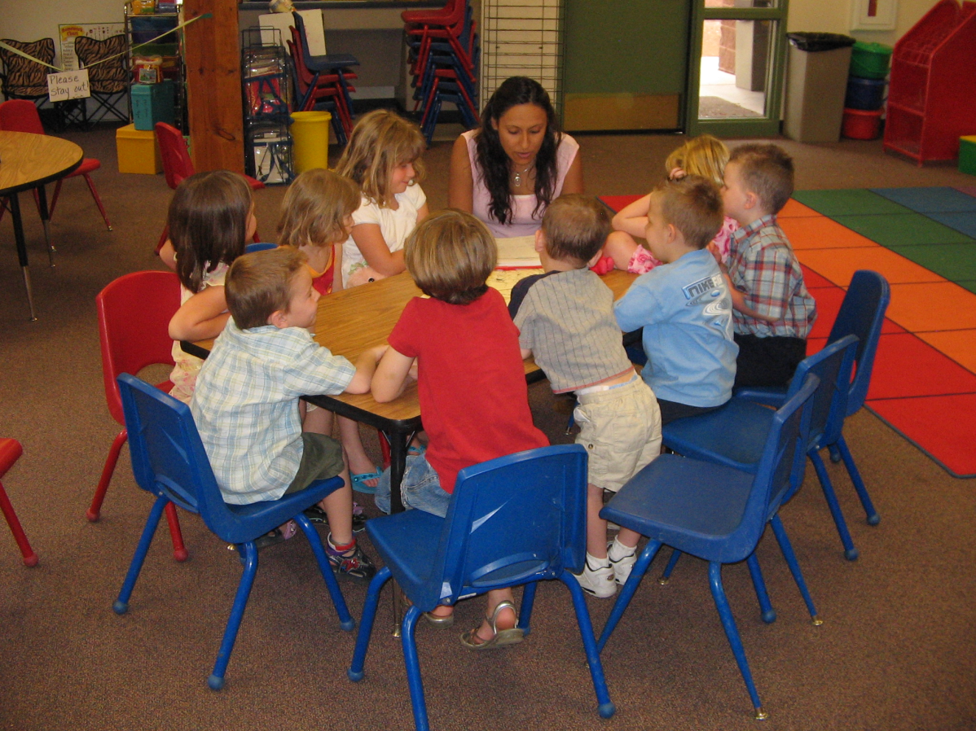

Slide 32
11. Father Who Are Unpredictable
Jam. 1:6, 8 “For he that wavereth is like a wave of the sea driven with the wind and tossed…A double minded man is unstable in all his ways.”
Eph. 4:14 “That we henceforth be no more children, tossed to and fro, and carried about with every wind of doctrine, by the sleight of men, and cunning craftiness, whereby they lie in wait to deceive.”

Slide 34
12. Fathers Who Will Not Listen to Their Children
Prov. 21:13 “Whoso stoppeth his ears at the cry of the poor, he also shall cry himself, but shall not be heard.”

Slide 35
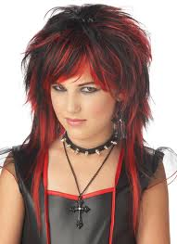

Slide 36
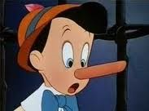
13. Fathers Who Don’t Keep Their Word
Matt. 5:37 “But let your communication be, Yea, yea; Nay, nay: for whatsoever is more than these cometh of evil.”
Jam. 5:12 “But let your yea be yea; and your nay, nay; lest ye fall into condemnation.”
Eccl. 5:5 “Better is it that thou shouldest not vow, than that thou shouldest vow and not pay.”

Slide 37
“Go to now, ye that say, Today or tomorrow we will go into such a city, and continue there a year, and buy and sell, and get gain: Whereas ye know not what shall be on the morrow. For what is your life? It is even a vapour, that appeareth for a little time, and then vanisheth away. For that ye ought to say, If the Lord will, we shall live, and do this, or that. But now ye rejoice in your boastings: all such rejoicing is evil.” (James 4:13-16)

Slide 38
Thirteen Things that Separate a Father from His Children
1. Absentee
2. Unfaithful
3. Rules with out Principles
4. Double Standards
5. Unwilling to Discipline
6. Anger
7. Continually Quarreling
8. Lack of Interest
9. Unhealthy Pressure
10. Relinquish Responsibility
11. Unpredictable
12. Will Not Listen
13. Does not Keep His Word

Slide 39
