Slide 1
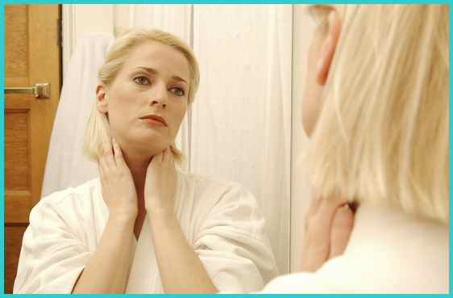
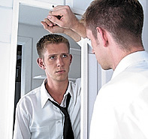
How to Deal With Self-Rejection

Slide 2
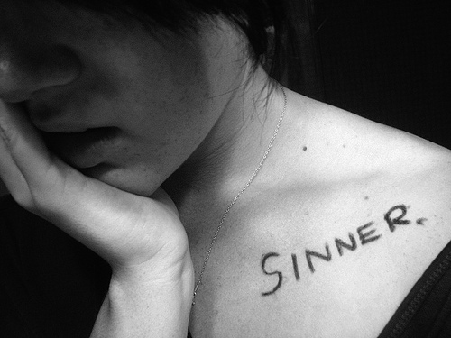
Self-rejection
Low self-worth
Lack of self-esteem
Poor self-image
Insecurity
Inferiority

Slide 3
Signs of Low Self-Esteem
Self-criticism
Self-blame
Blaming others
Guilt
Shame
Constantly putting others down
Faultfinding
Over or under achieving
Overeating
Anorexic
Workaholic
Playing the victim
Failure to take responsibility for your own life
Constant negativity
Being a showoff
Fearful

Slide 4
Turning power over to another to make decisions for you, then feeling victimized if the results are not to your liking
Inability to make decisions
Insecure
Sensual dress
Immoral behavior
Overbearing
Substance abuse
Constantly comparing yourself to others
Feeling inferior
Always trying to get attention through bad behavior
Possessive
Panic
Easily offended
Over sensitive
Anger

Slide 5
“Nay but, O man, who art thou that repliest against God? Shall the thing formed say to him that formed it, Why hast thou made me thus? Hath not the potter power over the clay, of the same lump to make one vessel unto honour, and another unto dishonour?” (Romans 9:20-21)
Self-rejection is a by-product of thinking that God is not actively involved in designing and molding our unchangeable features.

Slide 6
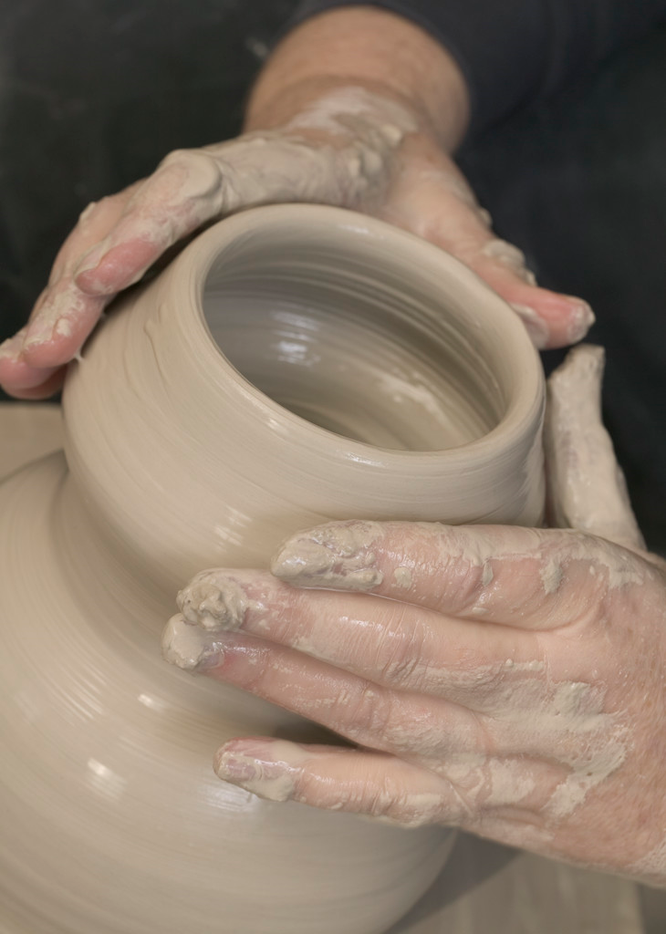
God’s analogy of the potter’s wheel
“But now, O LORD, thou art our father; we are the clay, and thou our potter; and we all are the work of thy hand.”
(Isaiah 64:8)

Slide 7
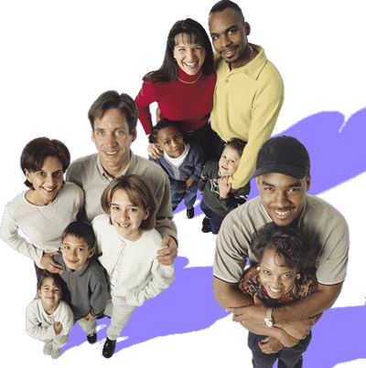
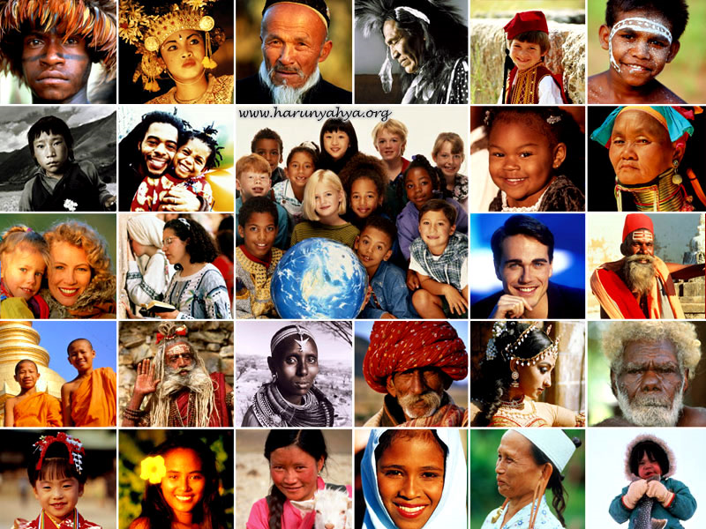
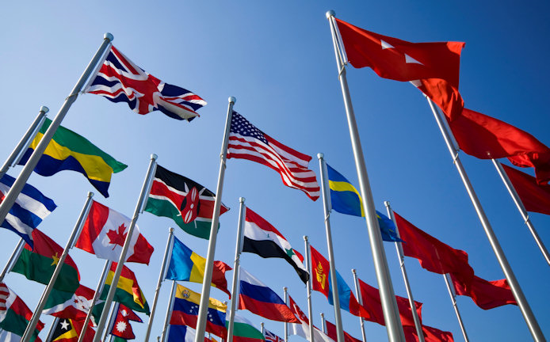
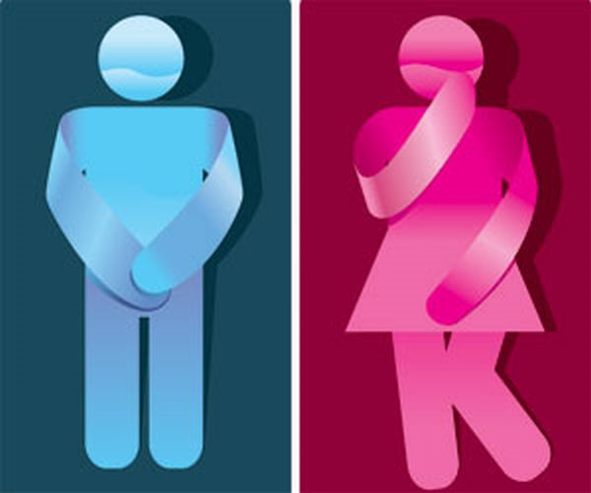
What are God’s Unchangeable Features?
Parents
Time in history
Racial background
National heritage
Gender

Slide 8
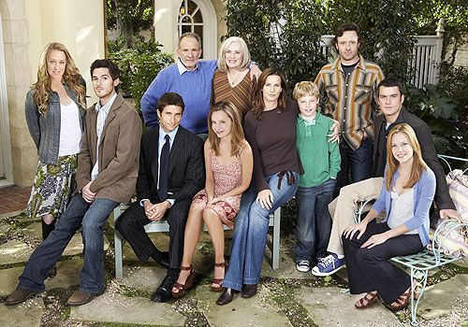
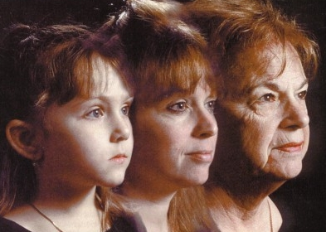
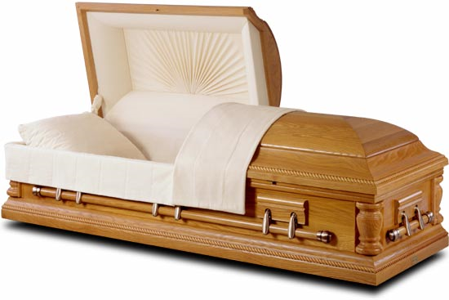
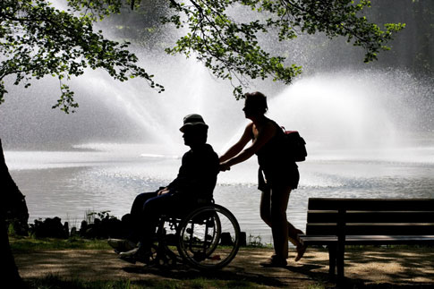
Birth order
Brothers and Sisters
Ageing
Death
Birth defects and deformities

Slide 9
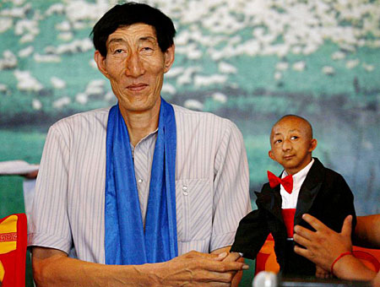
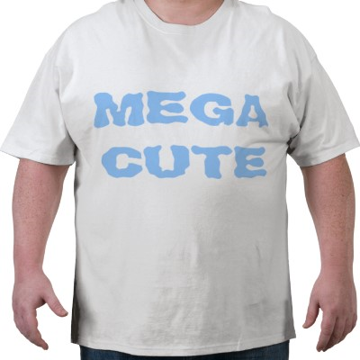
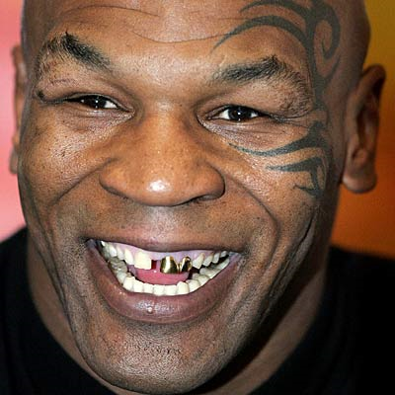
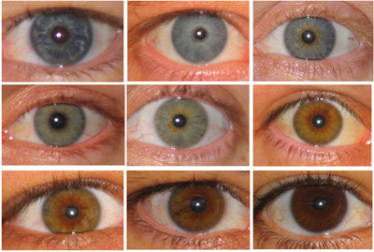
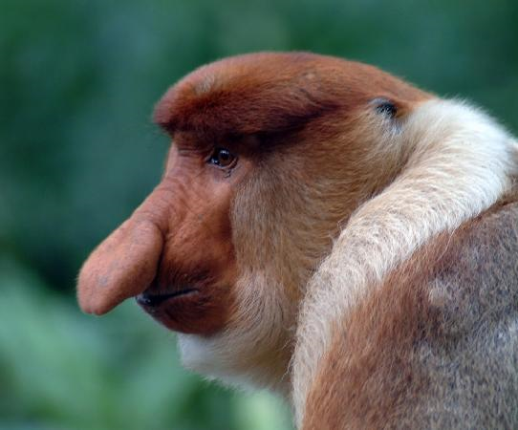
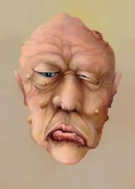
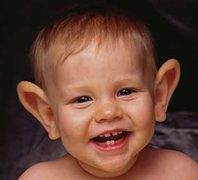
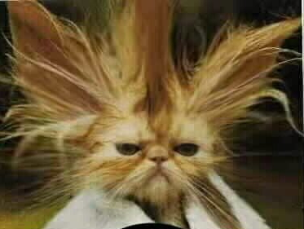
Physical features
Height
Bone size
Eyes
Nose
Ears
Complexion
Teeth
Hair

Slide 10
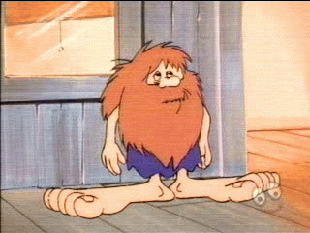
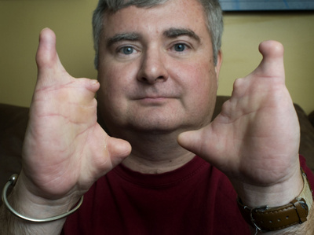
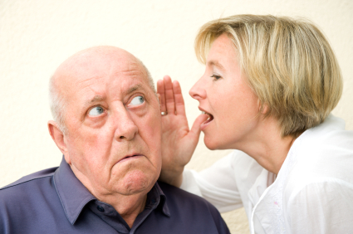
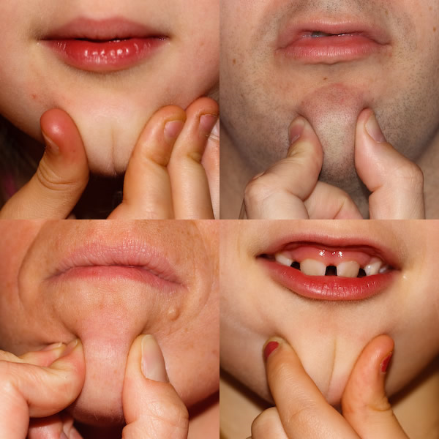
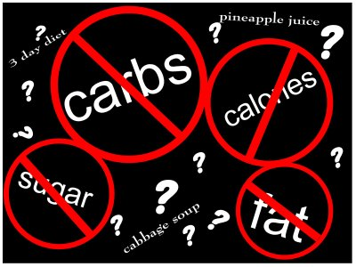
Feet
Hands
Sight
Hearing
Voice
Chin
Body build

Slide 11
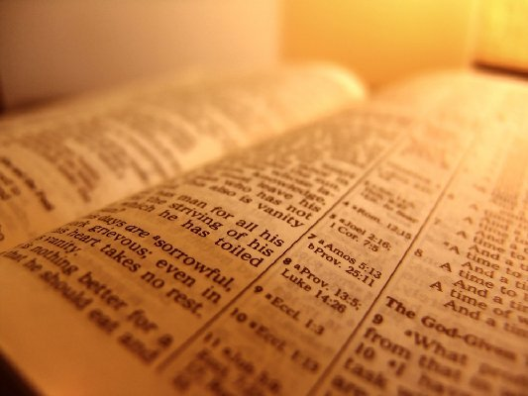
Meditate on Psalms 139 to gain Self-acceptance

Slide 12
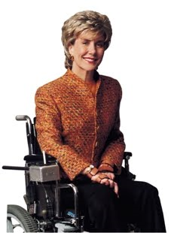
Accepting yourself the way God Designed you
God is the creator and designer of all things – I Peter 4:19
God has a purpose for your design – Romans 8:28
Once you accept His design, you can discover His purpose for your life - Ephesians 1:6-12

Slide 13
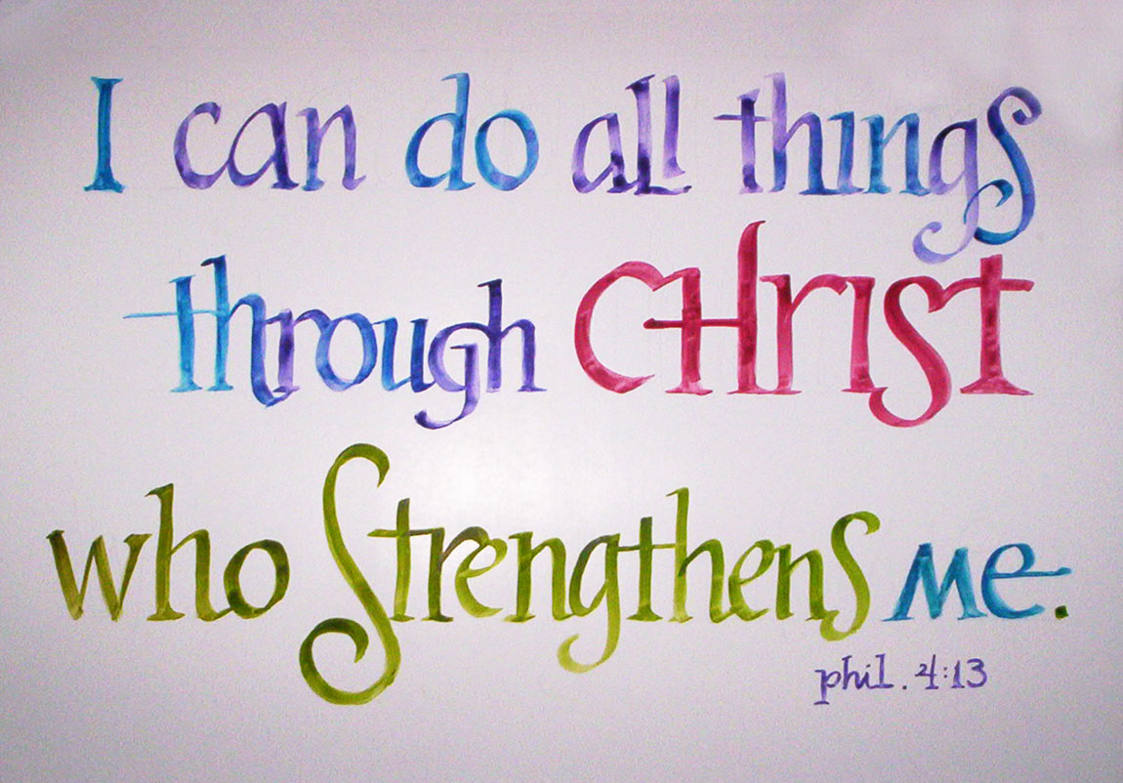
The Key to Self-acceptance is thinking right about yourself
“. . . as a man thinketh in his heart, so is he. . .” (Proverbs 23:7)

Slide 14
Understand Who We Are “IN CHRIST” (II Corinthians 5:17)
I am the salt of the earth - Matthew 5:13
I am the light of the world - matthew 5:14
I am a child of God; God is my Father - John 1:12; Romans 8:14-15; Galatians 3:26; 4:6
I am part of the true vine, a channel of Christ’s life - John 15:16
I am Christ’s friend - John 15:15
I am chosen and appointed by Christ to bear His fruit - John 15:16

Slide 15
I am a slave of righteousness - Romans 6:18
I am enslaved to God - Romans 6:22
I am a joint heir with Christ, sharing His inheritance with Him - Romans 8:17
I am a temple, a dwelling place of God, His Holy Spirit and His life dwells in me - I Corinthians 3:16; 6:19-20
I am united to the Lord and am one spirit with Him - I Corinthians 6:17

Slide 16
I am a member of Christ’s body - I Corinthians 12:27; Ephesians 5:30
I am a new creation - II Corinthians 5:17
I am reconciled to God and a minister of reconciliation - II Corinthians 5:18-19
I am one in Christ - Galatians 3:26-28
I am an heir of God since I am a son of God - Galatians 4:6-7
I am a saint - I Corinthians 1:2; Ephesians 1:1; Philippians 1:1; Colossians 1:2

Slide 17
I am God’s workmanship (handiwork) born anew in Christ to do His work - Ephesians 2:10
I am a fellow citizen with the rest of God’s family - Ephesians 2:19
I am a prisoner of Christ - Ephesians 4:1
I am righteous and holy - Ephesians 4:24
I am seated with Christ in heaven right now - Ephesians 2:6; Philippians 3:20
I am hidden with Christ in God - Colossians 3:3

Slide 18
I am an expression of the life of Christ because He is my life - Colossians 3:4
I am chosen of God, holy and dearly loved - Colossians 3:12; I Thessalonians 1:4
I am a son of light and not of darkness - I Thessalonians 5:5
I am a holy partaker of a heavenly calling - Hebrews 3:1
I am a partaker of Christ, I share in His life - Hebrews 3:14

Slide 19
I am one of God’s living stones, being built up in Christ as a spiritual house - I Peter 2:5
I am a member of a chosen race, a royal priesthood, a holy nation, a people for God’s own possession - I Peter 2:9-10
I am the bride of Christ - Ephesians 5:21-31
I am an alien and stranger to this world in which I temporarily live - I Peter 2:11
I am an enemy of the devil - I Peter 5:8
I am a child of God and will be like Christ when He returns - I John 3:1-4

Slide 20
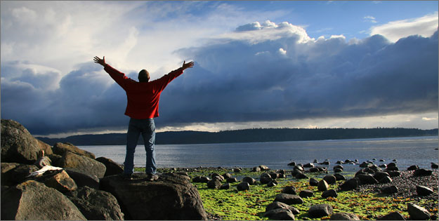
I am born of God, and the evil one cannot touch me - I John 5:18
I am an “Overcommer” - I John 5:3-4
I am not the great “I am” - John 8:24, 28, 58 - “But by the grace of God I am what I am. . .” - I Corinthians 15:10

Slide 21
Overcoming Satan’s Deception
Satan is trying to deceive you into believing that you are worthless, and that God does not care about you - John 8:32, 44
“And ye shall know the truth, and the truth shall make you free…Ye are of your father the devil, and the lusts of your father ye will do. He was a murderer from the beginning, and abode not in the truth, because there is no truth in him. When he speaketh a lie, he speaketh of his own: for he is a liar, and the father of it.”

Slide 22
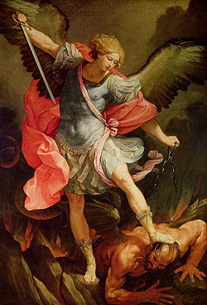
How is Satan Overcome?

Slide 23
Revelation 12:10-11 “And I heard a loud voice saying in heaven, Now is come salvation, and strength, and the kingdom of our God, and the power of his Christ: for the accuser of our brethren is cast down, which accused them before our God day and night. And they overcame him by the blood of the Lamb, and by the word of their testimony; and they loved not their lives unto the death.”

Slide 24
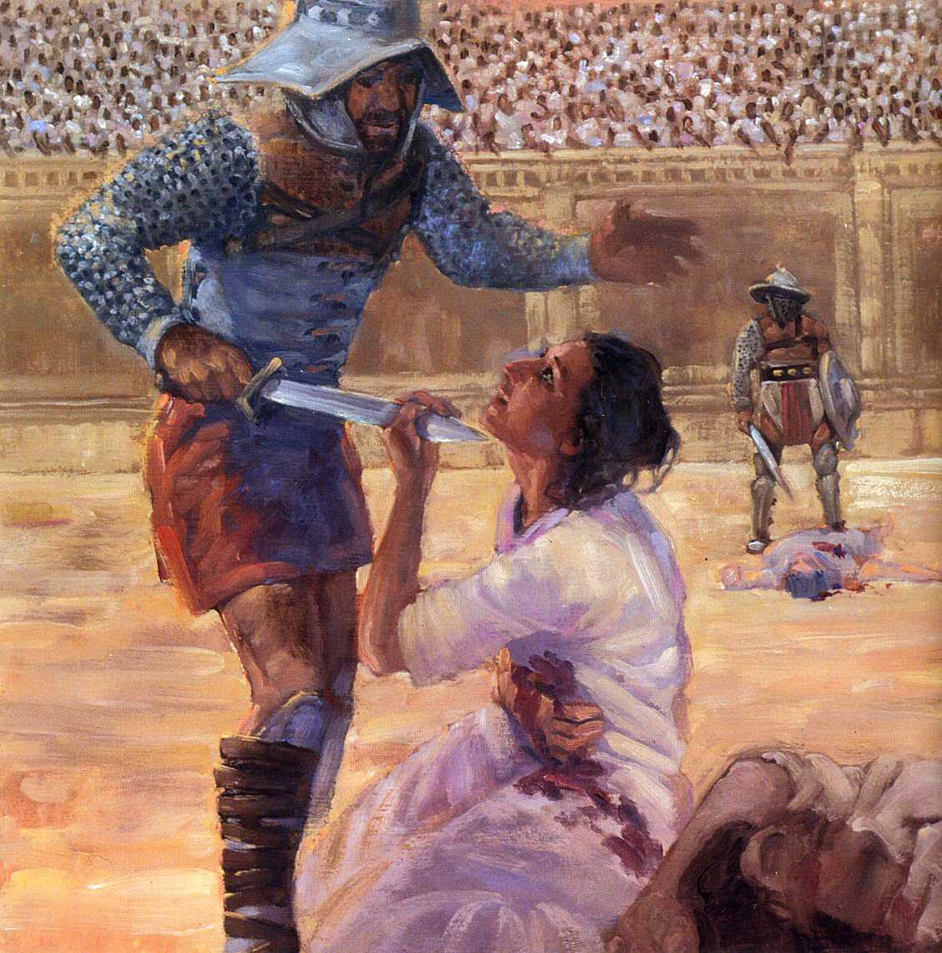
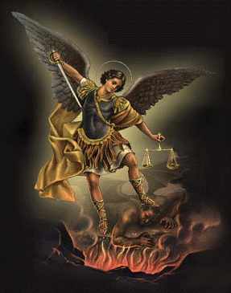
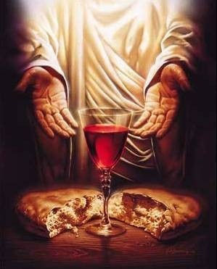
How to overcome Satan
Blood of the Lamb
Word of our testimony - Who we are in Christ
Total dedication

