Slide 1
Six Purposes of Marriage (Part 1-3)
Companionship
Enjoyment
Fruitfulness
Completeness
Protection
Typify Christ’s relationship with His Church

Slide 2
1# Companionship
True companionship grows out of a oneness of spirit – “Can two walk together, except they be agreed?” (Amos 3:3) “Every kingdom divided against itself is brought to desolation; and every city or house divided against itself shall not stand.” (Matt. 12:25)
Same doctrinal beliefs
Same philosophy of life
Same standards
Same convictions
“Behold, how good and how pleasant it is for brethren to dwell together in unity!” (Psalm 133:1)

Slide 3
Companionship Will Only Be Realized When Love is Being Expressed
At the heart of every human being is the desire to be loved by another (Matt. 22:37-39; John 15:12; I John 3:11)
Marriage is designed by God to meet that need (Gen. 2:18-25; Eph. 5:22-31; Col. 3:18-19; Titus 2:4)
There are five primary ways to communicate love to your mate.
In every successful marriage these five expressions of love will be evident -

Slide 4
Words of Affirmation
Encouragement - Proverbs 15:23
Edification - Ephesians 4:29
Exhortation - Proverbs 16:24
Approval - Matthew 25:21
Comfort - II Corinthians 1:4
Praise - Proverbs 27:2
Gratefulness - Colossians 3:15

Slide 5
Quality time (Matthew 19:5-6)
Activities (Vacations, Dates, Outings, Entertainment, etc.) - Ephesians 5:29
Conversation - I Peter 3:1-7
Togetherness (focused attention) - Psalms 34:3; 133:1-3
Maintain eye contact
Keep your mind from wandering
Give full attention

Slide 6
Don’t listen to your spouse and do something else at the same time.
Give your undivided attention.
Listen for feelings – “What emotion is my spouse experiencing?”
Observe body language – Body language can speak one message while words speak another.
Refuse to interrupt.
Goal – Discover your spouse’s thoughts, feelings and needs so that you can “Dwell with them according to knowledge…”

Slide 7
Receiving of Gifts (Luke 6:38)
Gifts of Money - If you are going to become an effective giver, you may have to change your attitude towards money - Acts 20:35
Gifts of Affection - Flowers, notes, candy, clothes, etc.
The Gift of Self (Heart) - Proverbs 23:26; I Peter 1:22; 3:4

Slide 8
Acts of Service (Luke 22:26-27)
Developing a servants spirit – Gal. 5:13
Helping each other with daily responsibilities - John 13:14
Going out of your way just to be helpful – Galatians 5:15
(Wife) Being a good house keeper – Titus 2:5
(Husband) Being a good provider – I Tim. 5:8

Slide 9
Physical Touch
Non-sexual Touch - Mark 10:13
Compassionate Touch (Holding her when she cries) - Ecclesiastes 3:5
Caressing Touch - Running the hand through the hair, giving back rubs, kissing, holding each other, etc.
Sexual Touch - I Corinthians 7:1-5

Slide 10
2# Enjoyment
“Marriage is honorable in all, and the bed undefiled: but whoremongers and adulterers God will judge .” (Heb. 13:4)
Honorable = of great worth or value
Bed = martial bed
Undefiled = to be kept unsoiled / pure
Whoremongers (pornos) = fornicators
Adulterers = unfaithfulness after marriage
God will Judge!

Slide 11
“Now concerning the things whereof ye wrote unto me: It is good for a man not to touch a woman. Nevertheless, to avoid fornication, let every man have his own wife, and let every woman have her own husband. Let the husband render unto the wife due benevolence: and likewise also the wife unto the husband. The wife hath not power of her own body, but the husband: and likewise also the husband hath not power of his own body, but the wife. Defraud ye not one the other, except it be with consent for a time, that ye may give yourselves to fasting and prayer;
and come together again, that Satan tempt
you not for your incontinency.”

Slide 12
“But I speak this by permission, and not of commandment. For I would that all men were even as I myself. But every man hath his proper gift of God, one after this manner, and another after that. I say therefore to the unmarried and widows, It is good for them if they abide even as I. But if they cannot contain, let them marry: for it is better to marry than to burn.” (I Cor. 7:1-9)

Slide 13
The Principle Behind Enjoyment is Self-control
“But the fruit of the Spirit is love, joy, peace, longsuffering, gentleness, goodness, faith, Meekness, temperance: against such there is no law. And they that are Christ's have crucified the flesh with the affections and lusts. If we live in the Spirit, let us also walk in the Spirit.”

Slide 14
Laws of Purification for Women (Leviticus 12, 15; Ezek. 18:5-6)
Abstinence seven days from the start of her monthly cycle.
Abstinence an additional seven days if physical problems exist.
Abstinence for 40 days after the birth of son.
Abstinence for 80 days after the birth of daughter.

Slide 15
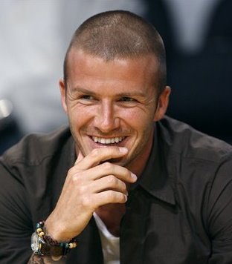

Slide 16
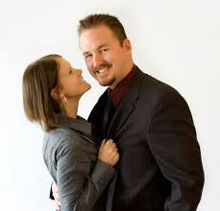

Slide 18
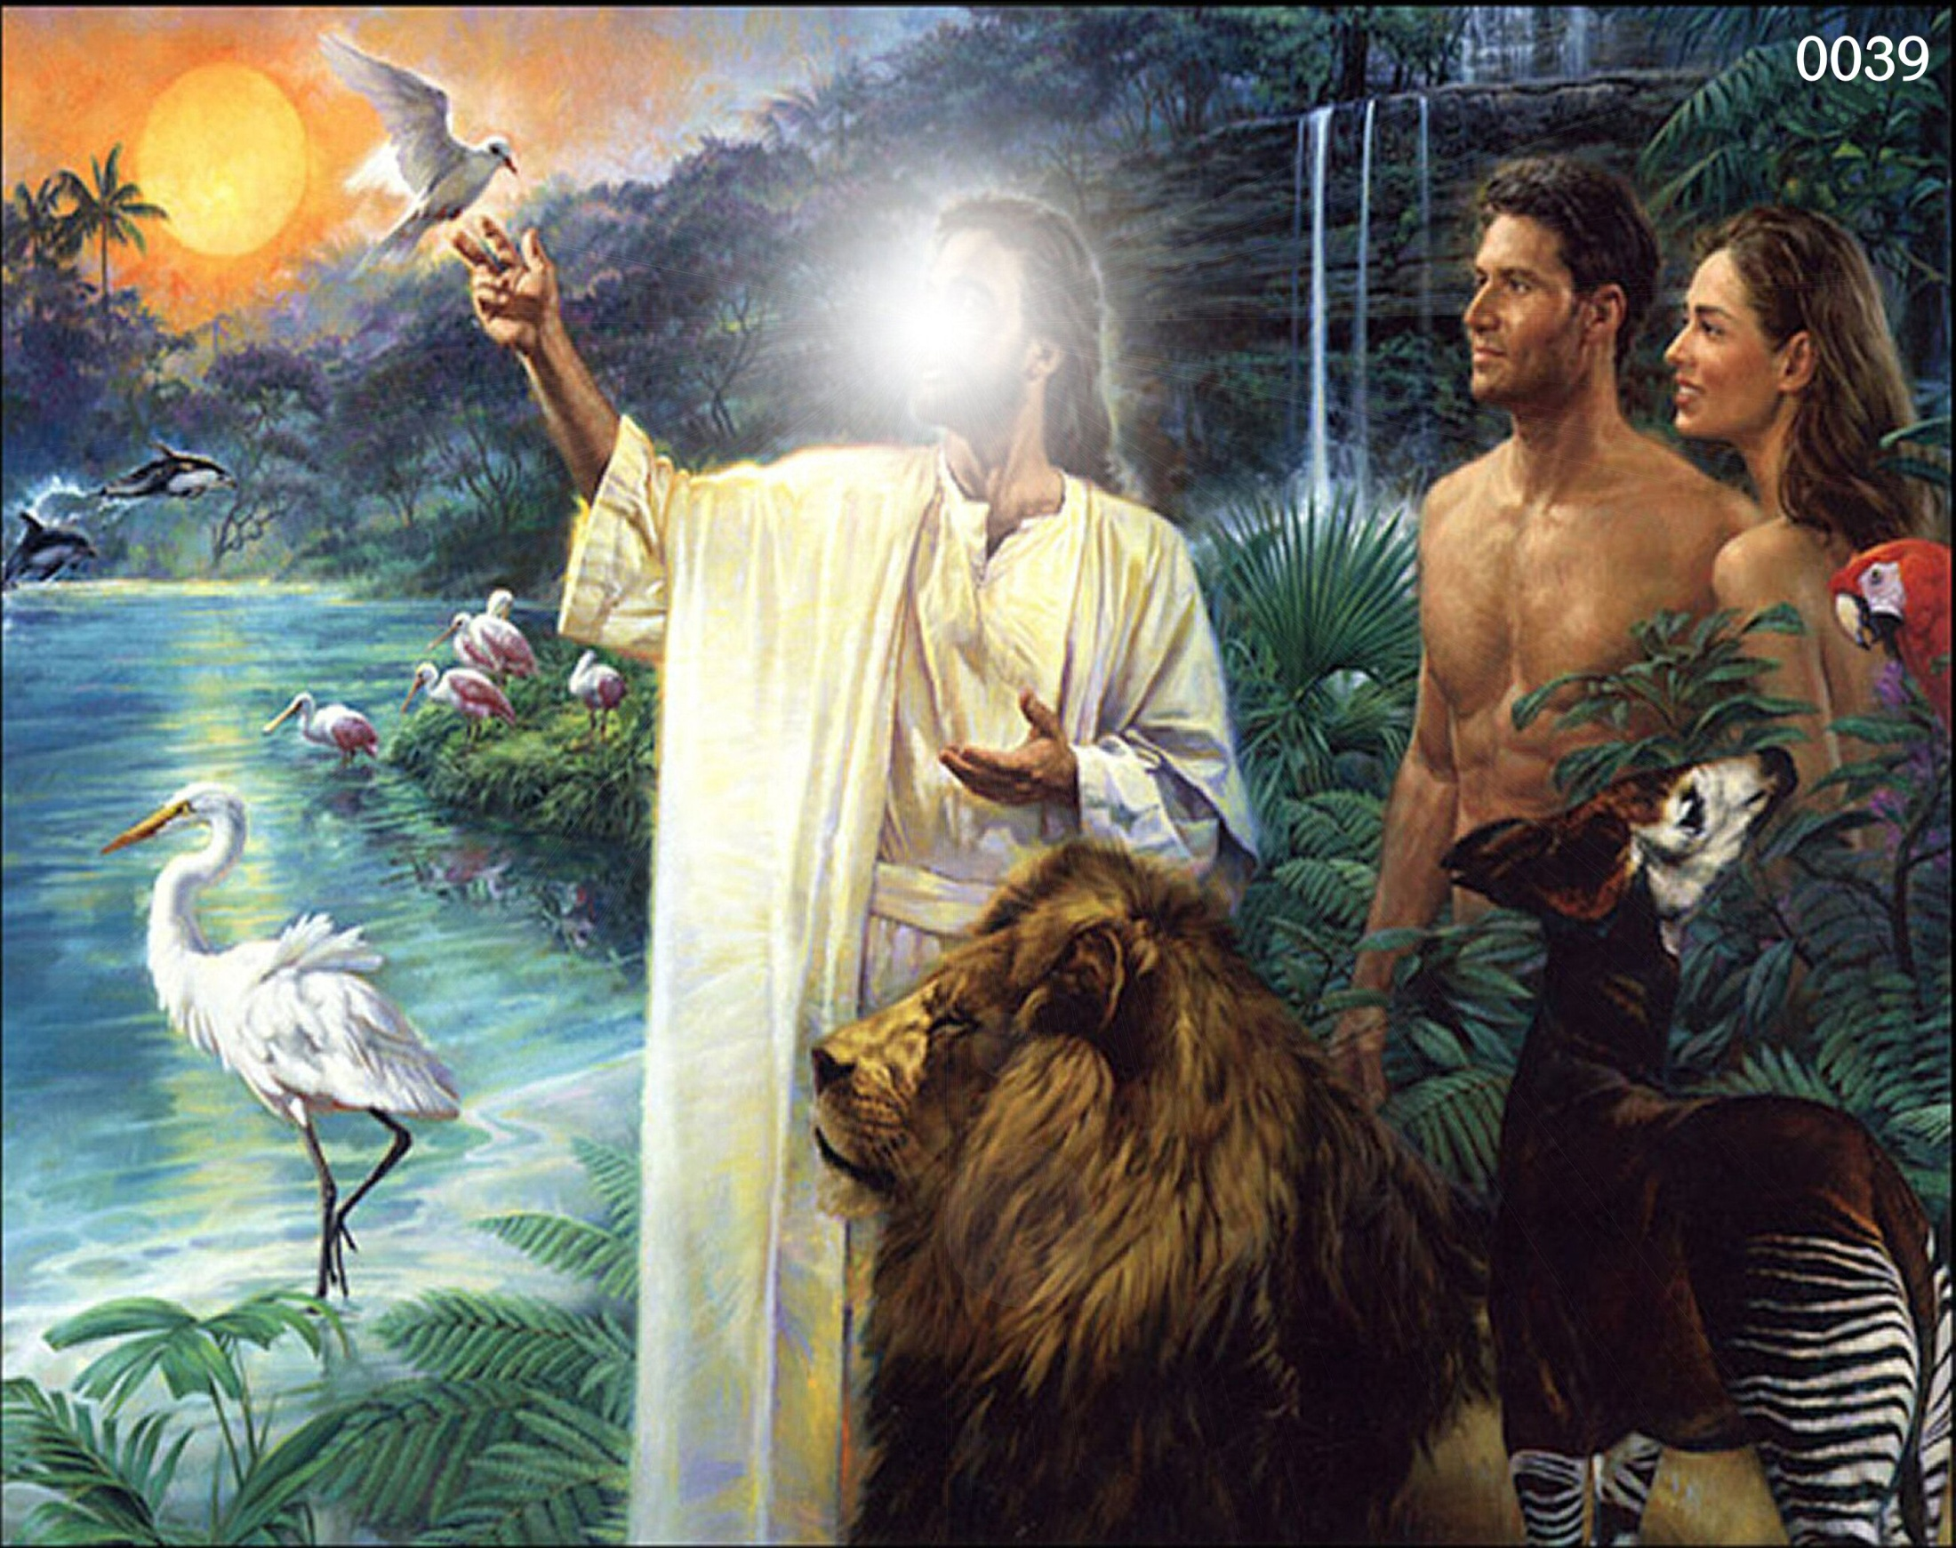
3# Fruitfulness
“So God created man in his own image, in the image of God created he him; male and female created he them. And God blessed them, and God said unto them, Be fruitful, and multiply, and replenish the earth, and subdue it: and have dominion over the fish of the sea, and over the fowl of the air, and over every living thing that moveth upon the earth.” (Gen. 1:26-28)
Fruitful = To make increase
Multiply = Increase with exceeding abundance
Replenish = Fill up the world to overflowing

Slide 19
“Lo, children are an heritage of the LORD: and the fruit of the womb is his reward. As arrows are in the hand of a mighty man; so are children of the youth. Happy is the man that hath his quiver full of them: they shall not be ashamed, but they shall speak with the enemies in the gate.”

Slide 20
Father
Children
Will of God

Slide 21
“Thy wife shall be as a fruitful vine by the sides of thine house: thy children like olive plants round about thy table. Behold, that thus shall the man be blessed that feareth the LORD.”
(Psalms 127-128)

Slide 22
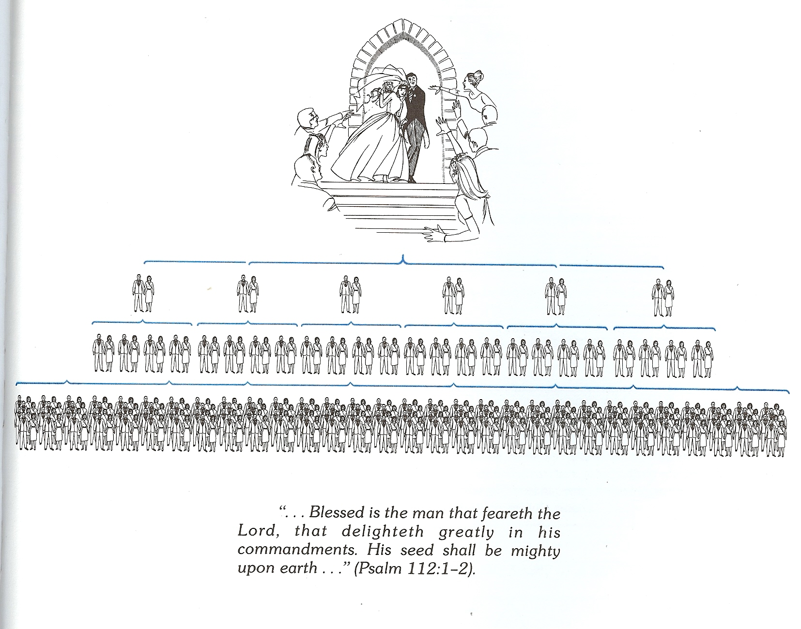

Slide 23
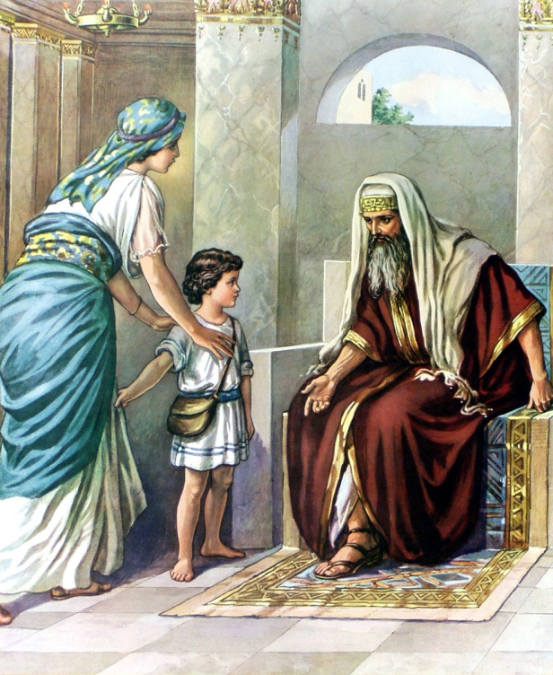
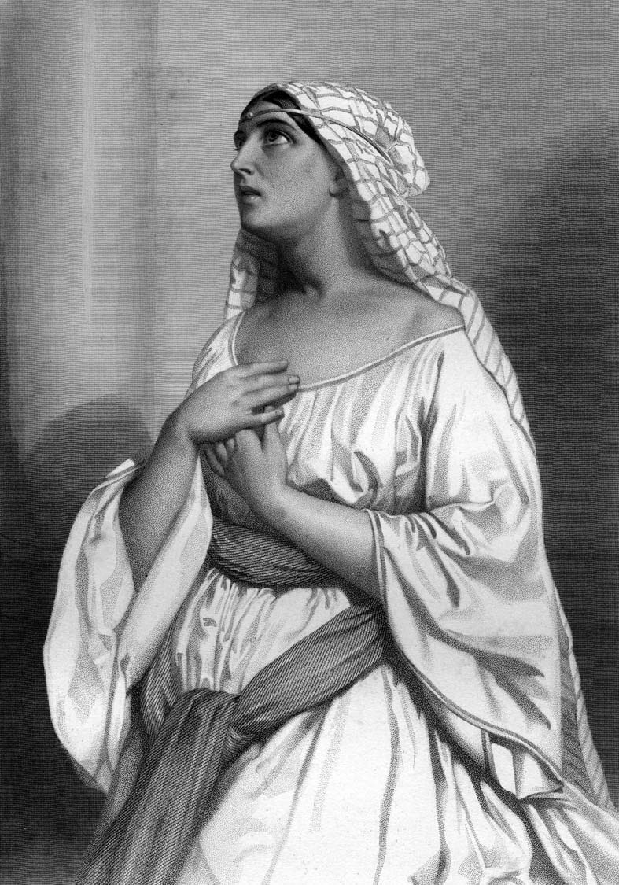
Steps a Barren Couple Can Take
Express fully to the Lord your desire for children –
Note: Hannah resolved her bitterness of soul and anxiety over not having children by fully yielding her rights to the Lord, God then gave her five children – (I Samuel 2)

Slide 24
2. Recognize that it is the Lord who opens and closes the womb –
God closes the womb – I Samuel 1:5 “The Lord shut up her womb.”
God opens the womb – Genesis 30:22 “And God remembered Rachel, and God hearkened to her, and opened her womb.”
3. Surrender your will to God – “Not my will but thine be done.”
4. Come to a place of contentment - “I have learned, in whatsoever state I am, therewith to be content.”
5. Call for the elders of the church – James 5:14-16

Slide 25
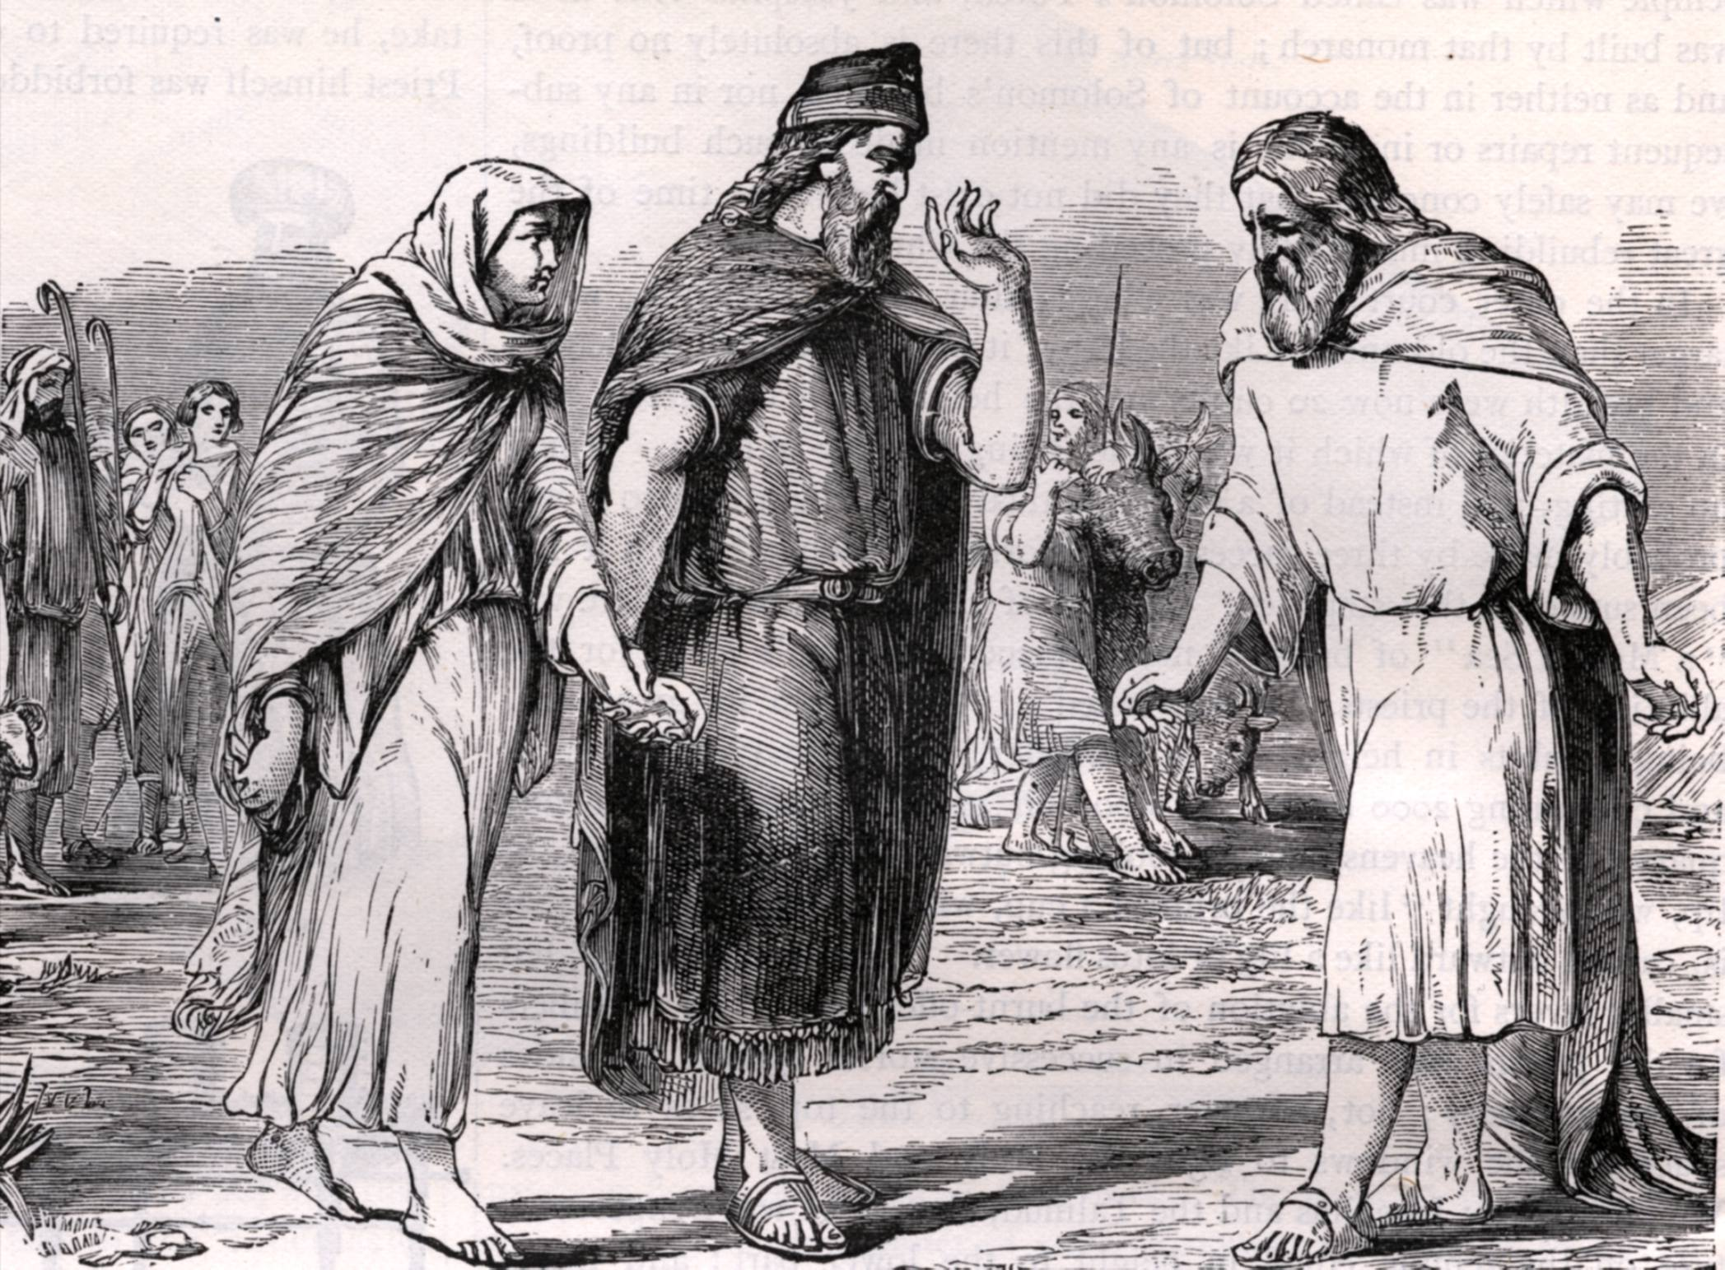
“So Abraham prayed unto God: and God healed Abimelech, and his wife, and they bare children.” (Genesis 20:17)

Slide 26
6. Consider reversing sterilization –
Legitimate reasons for sterilization -
Health and safety of the wife - Eph. 5:23-25; I Peter 3:7
Illegitimate reasons for sterilization – Psalms 127-128
We do not want children
We do not want any more children
We do not want to bring children into this evil world

Slide 27
We can not afford any more children
The more children we have the lower our standard of living will be
We will lose our freedom
Children may rebel against us
There may be medical complications
We have the right to decided how many children we will have
My wife will lose her physical attractiveness
The world is overpopulated

Slide 28
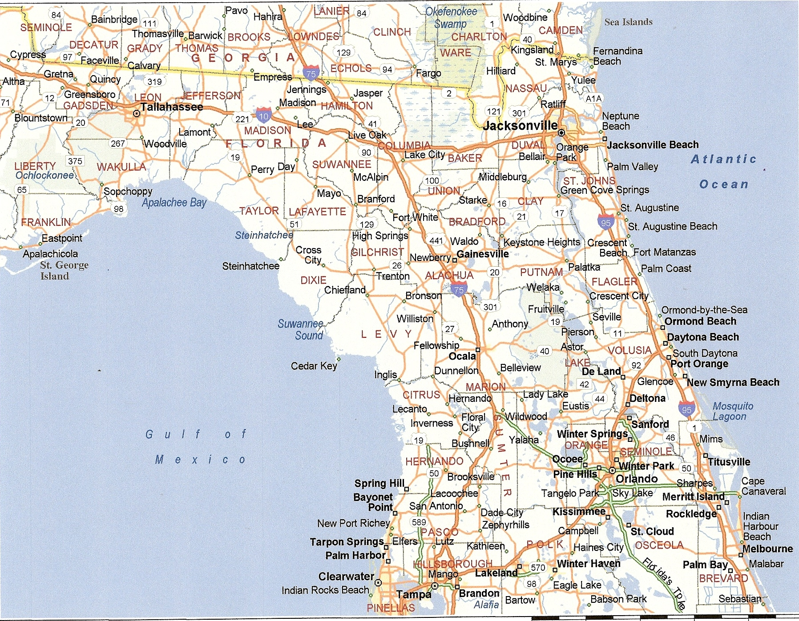
“Every person in the world could stand shoulder to shoulder in the city limits of Jacksonville, Florida”

Slide 29
Sterilizations cause many medical consequences -
Vasectomies can cause -
- Antibodies to infiltrate the bloodstream
- Cells manufacture antibodies against the sperm
- Effects the autoimmune system
- Inability to fight off infection and disease
Tubal ligations can cause -
- Heavy menstrual bleeding
- Menstrual disturbances
- Hormonal imbalances
- Cervical erosion
- Ovarian tumors

Slide 30
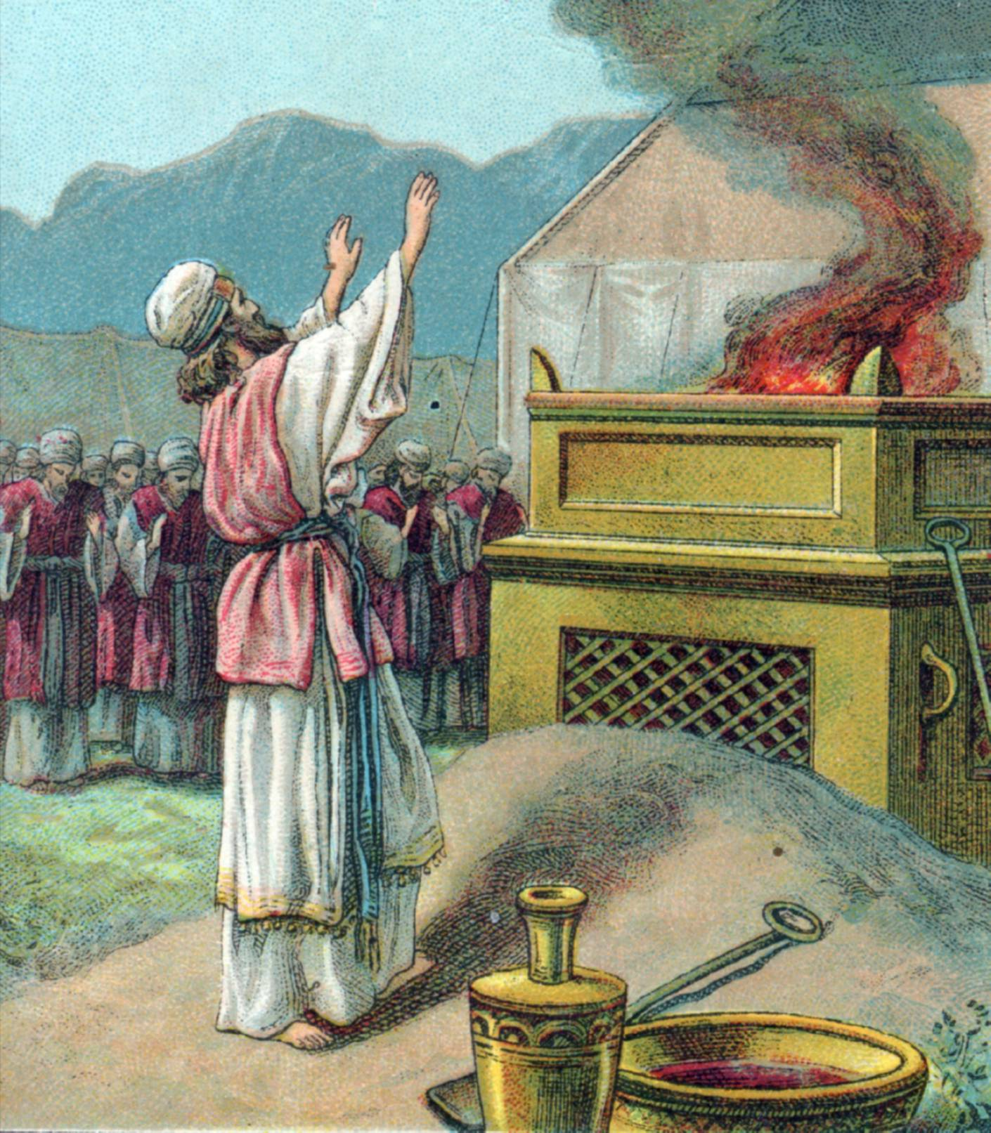
“I beseech you therefore, brethren, by the mercies of God, that ye present your bodies a living sacrifice, holy, acceptable unto God, which is your reasonable service.
And be not conformed to this world: but be ye transformed by the renewing of your mind, that ye may prove what is that good, and acceptable, and perfect, will of God.” (Romans 12:1-2)

