Slide 2
How to Make Wise Decisions

Slide 3
Life is composed of a series of decisions, which is why it’s so important to have a plan for making wise choices in the center of God’s Will.

Slide 4
We all know that Satan’s desire is to “deceive and tempt us” into thinking that our will is really God’s will or to get us to think that making a decision out of the will of God is really no big deal and that we will reap zero consequences. Prov. 16:25 “There is a way that seemeth right unto a man, but the end thereof are the ways of death.”

Slide 5
If you will follow a simple basic easy to understand plan that God has given us in His Word, you will be able to make decisions wisely and avoid the difficulties, heartaches and consequences that come from making wrong choices.

Slide 6
10 Simple Steps in Discerning the Will of God

Slide 7
Step One: Clear your heart of any known sin
(Psalms 66:18) “If I regard iniquity in my heart, the Lord will not hear me.”
(Psalms 139:23-24) “Search me, O God, and know my heart: try me, and know my thoughts: And see if there be any wicked way in me, and lead me in the way everlasting.”

Slide 8
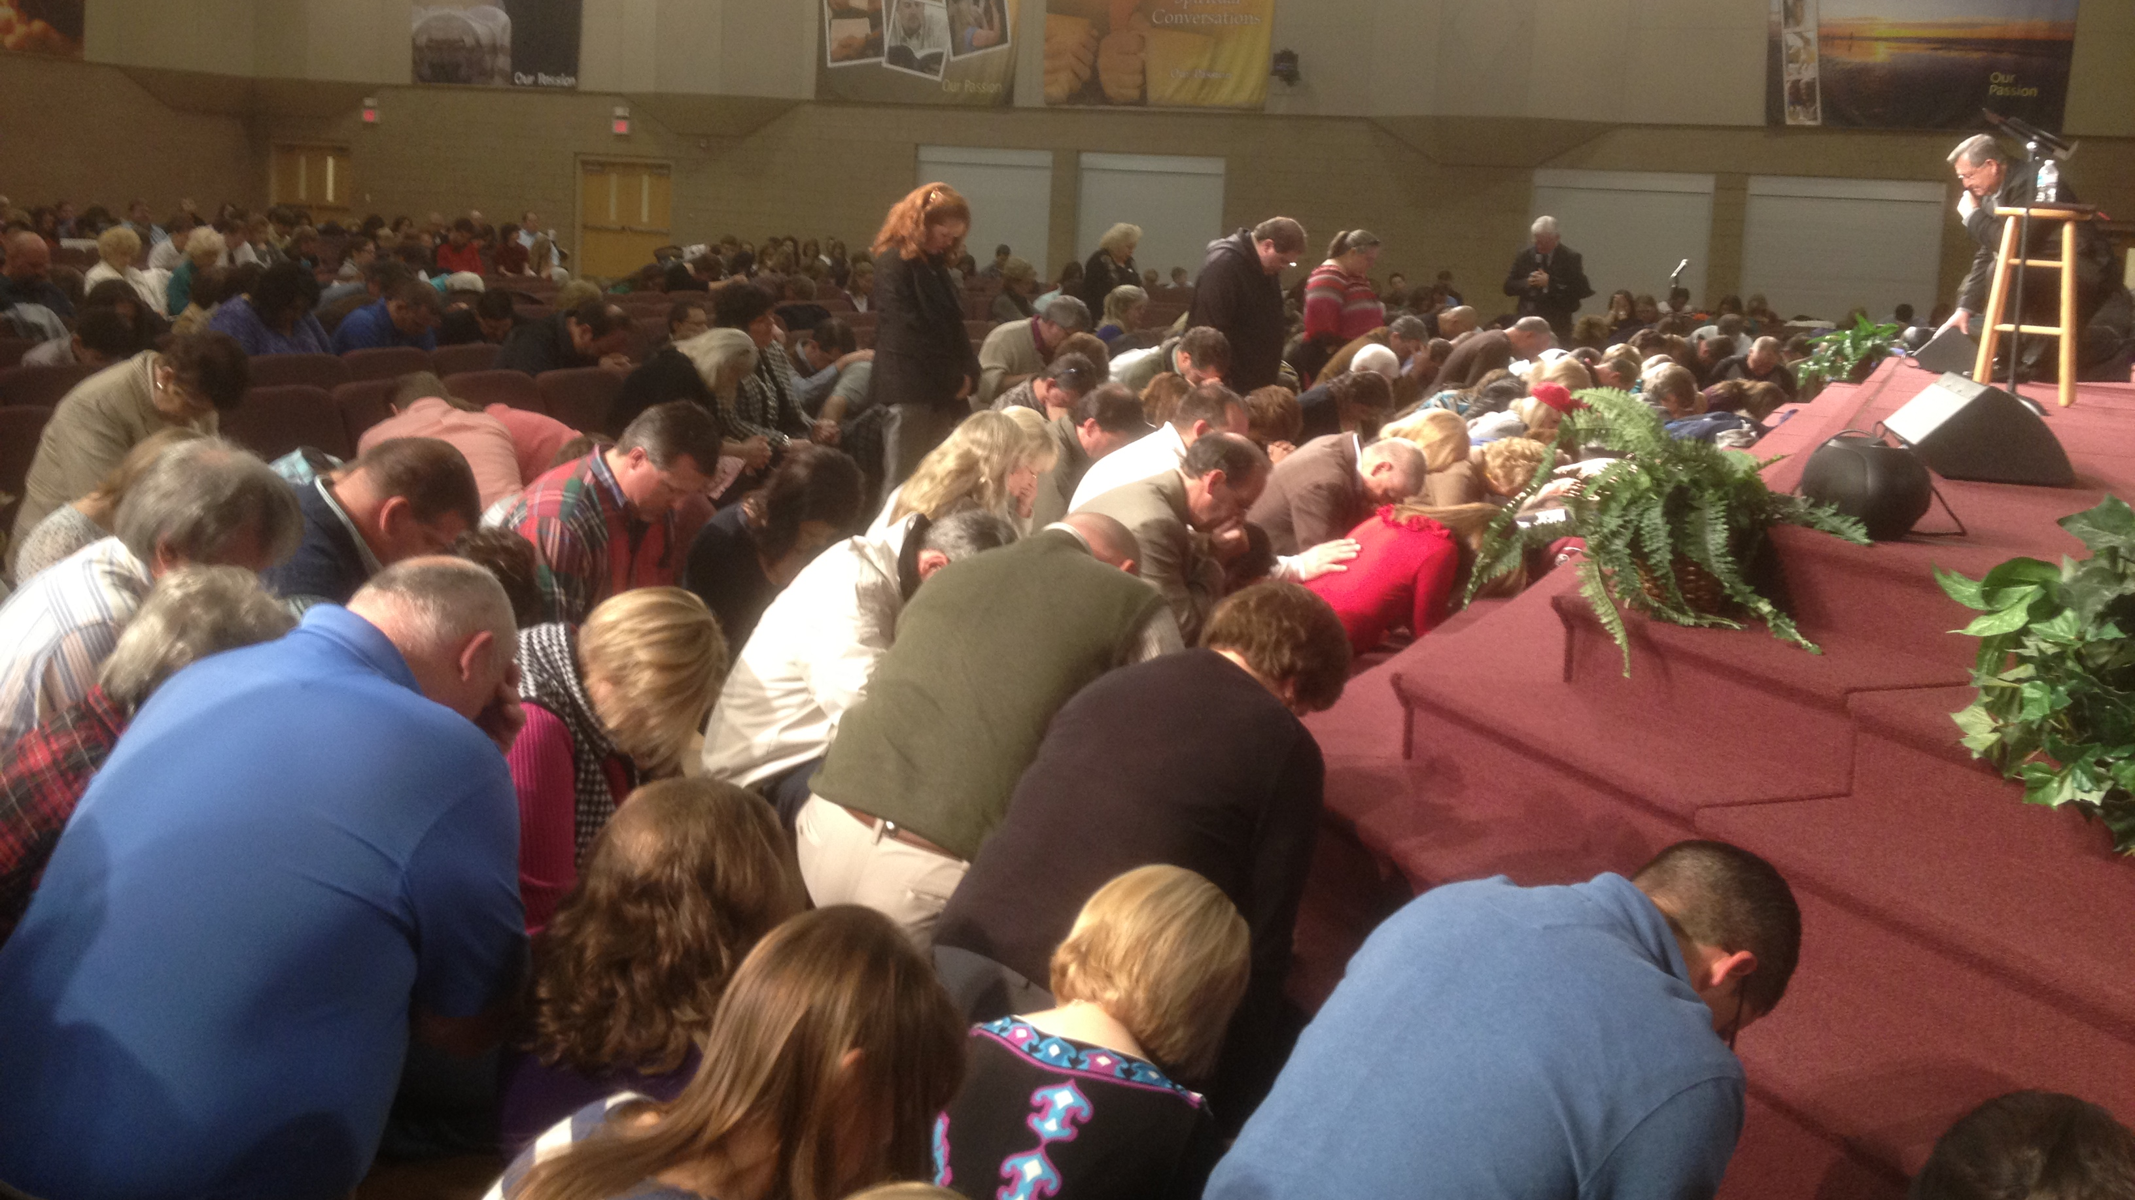

Slide 9
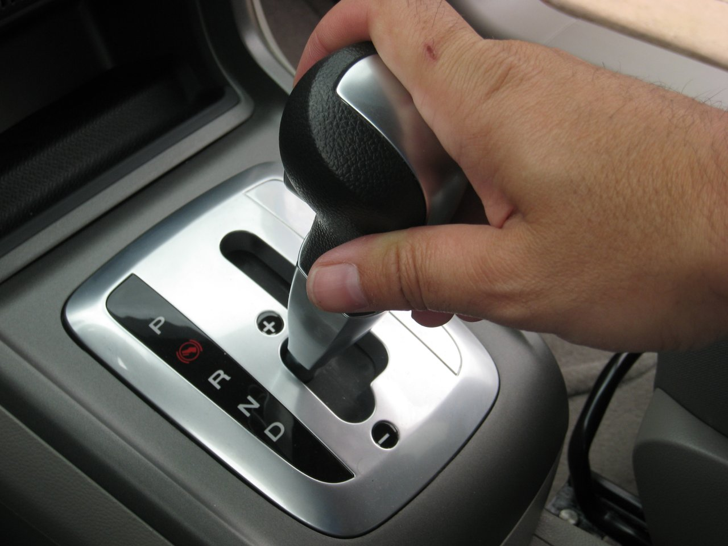
Step Two: Bring your desires to a position of neutrality
(Luke 22:42) “Saying, Father, if thou be willing, remove this cup from me: nevertheless not my will, but thine, be done.”
(Acts 9:6) “What wilt thou have me to do.”

Slide 10
This may be the biggest battle you will face in life when determining the will of God

Slide 11
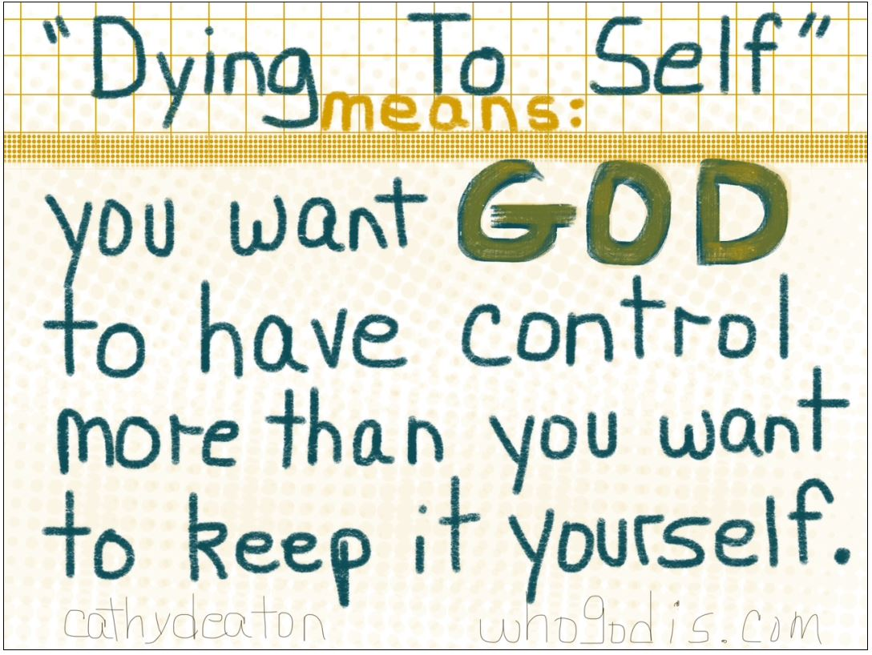

Slide 12
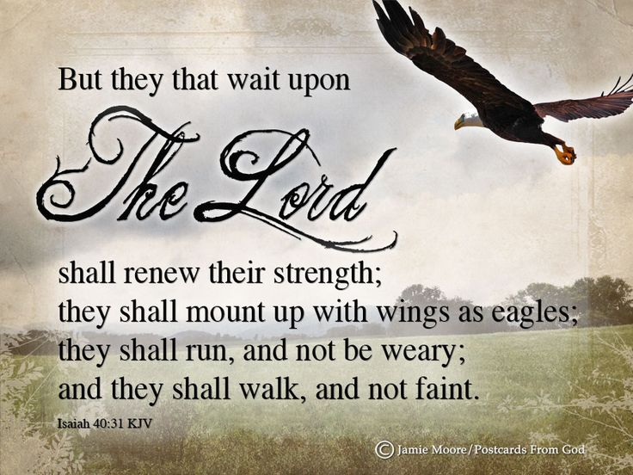
Step Three: Exercise patience
God seldom acts quickly (2 Peter 3:8) “But, beloved, be not ignorant of this one thing, that one day is with the Lord as a thousand years, and a thousand years as one day.”
God promises that if you ask and seek, you will receive and find, but He doesn’t say you will get an immediate response (Matt. 7:7).

Slide 14
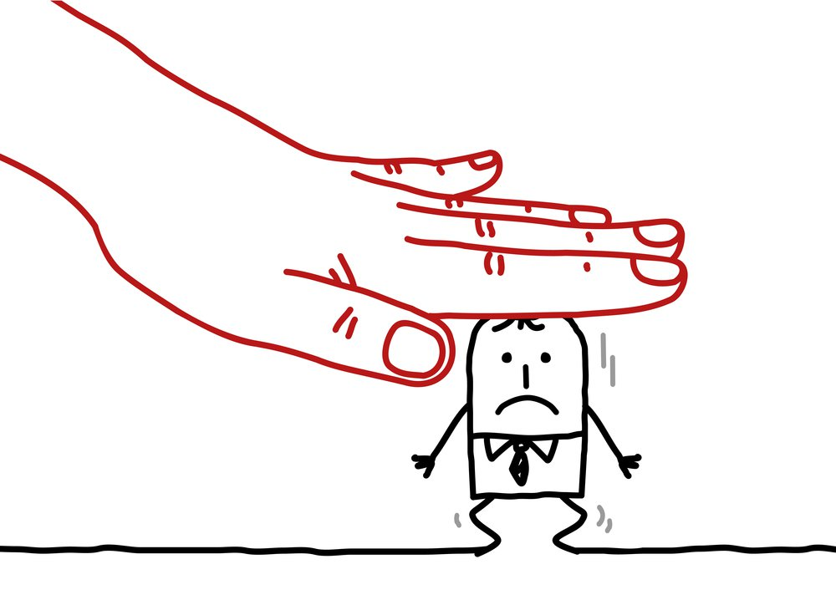
Step Four: Don’t give into pressure
(Phil. 4:6) “Be careful for nothing; but in everything by prayer and supplication with thanksgiving let your requests be made known unto God. And the peace of God, which passeth all understanding, shall keep your hearts and minds through Christ Jesus.”

Slide 16
Step Five: Don’t be stubborn
(1 Samuel 15:23) “For rebellion is as the sin of witchcraft, and stubbornness is as iniquity and idolatry.”

Slide 18
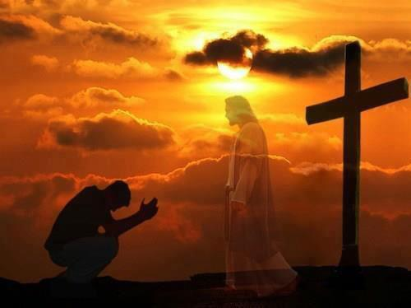
Step six: Be persistent in prayer
(1 Thessalonians 5:17) “Pray without ceasing.”
Even if you see no sign of an answer right away, you must not give up. While you are waiting, God is teaching you to trust Him. He wants you to move from doubt, fear, and unrest to confidence in Him and His timing.

Slide 20
Step seven: If there is any doubt in your mind Don’t
(Romans 14:23)
“And he that doubteth is damned if he eat, because he eateth not of faith: for whatsoever is not of faith is sin.”

Slide 21
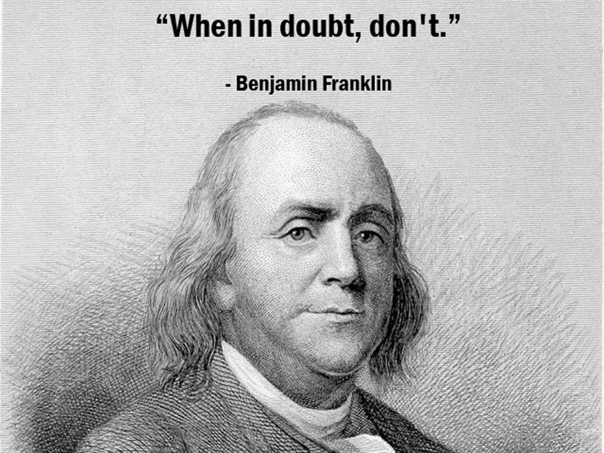

Slide 22
Step eight: Seek godly counsel
(Proverbs 11:14) “Where no counsel is, the people fall: but in the multitude of counsellors there is safety.”
Pastor – Shepherd
Older Christians – Proverbs 16:31
Godly Friends – Proverbs 27:6, 17
Parents – Proverbs 1:8-9
Husband - I Corinthians 11:3
Wife - Genesis 2:18
Older Children – Proverbs 12:15

Slide 23
(Proverbs 19:20-21) “Hear counsel, and receive instruction, that thou mayest be wise in thy latter end. There are many devices in a man's heart; nevertheless the counsel of the LORD, that shall stand.”

Slide 24
Step nine: Use some common Biblical sense
I Corinthians 14:33 “For God is not the author of confusion.”
List the pro’s and con’s – “But strong meat belongeth to them that are of full age, even those who by reason of use have their senses exercised to discern both good and evil.” Heb. 5:14
Think about the future and how your decision will affect others (church / family / friends) – “No man lives unto himself…”
Listen to the cautions of the Holy Spirit – “As many as are led by the Spirit of God they are the sons of God…” Rom. 8:4

Slide 25
Don’t make a decision based on money or benefits – “The love of money…lay not up for yourselves treasures on earth…”
Ask yourself – Is this a selfish carnal decision I am about to make
Ask yourself – Is my decision based on the temporal or eternal
Don’t make a decision when you are discontent – “I have learned, in whatsoever state I am, therewith to be content.”
Don’t make a decision when you are unhappy – “But the fruit of the Spirit is love, joy…”
Don’t let Satan appeal to your PRIDE – “Pride goeth before destruction…humble yourself…”

Slide 26
Step ten: Rest in God’s promise

Slide 27
(Psalm 37:7) “Rest in the LORD, and wait patiently for him.”

Slide 29
10 Steps in making wise decisions
1. Clear you heart of any known sin
2. Bring your desires to a position of neutrality
3. Exercise patience
4. Don’t not give into pressure
5. Don’t be stubborn
Be persistent in prayer
If there is any doubt in your mind Don’t
8. Seek godly counsel
9. Use some common biblical sense
10. Rest in God’s promise

