Slide 1
How to have the most positive influence on people

Slide 2
1. Don’t criticize, condemn or complain – Luke 6:37

Slide 3
2. Give honest and sincere appreciation – Rom. 16:3-4; I Thess. 3:9

Slide 4
3. Motivate and arouse in the other person an eagerness to want to do what’s right. This is done by presenting things in such a way that thy can see how it could benefit them – Psalm 24:1, 68:19

Slide 5
4. Be genuinely interest in the other person – Gal. 6:10

Slide 6
5. Smile it is contagious and makes others happy – Psalm 15:13

Slide 7
6. Remember that a person’s name is to that person the sweetest and most important sound in any language – John 10:3; III John 1:14

Slide 8
7. Be a good listener. Don’t dominate the conversation. Encourage others to talk about themselves and be interested – Psalm 21:13, 34;6

Slide 9
8. Talk in terms of the other person’s interest – Phil. 2:1-4

Slide 10
9. Make the other person feel important and do it sincerely – I Peter 2:17

Slide 11
10. Don’t argue. The only way to get the best of an argument is to avoid it – James 3:14-16

Slide 12
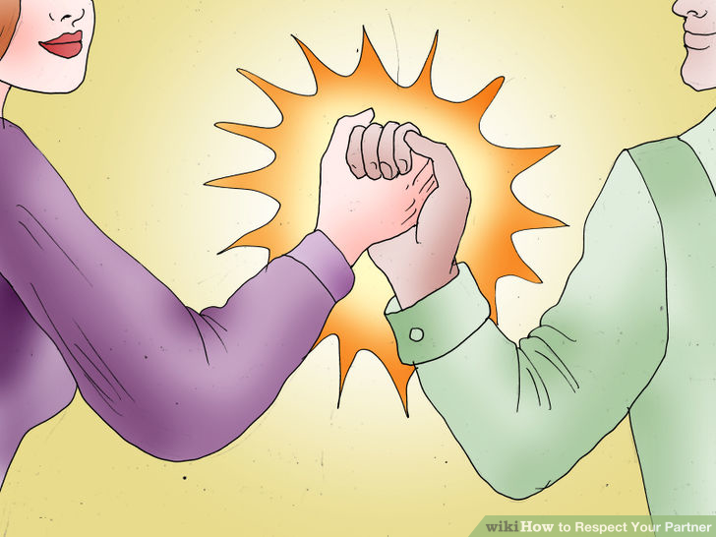
11. Show respect for the other person’s opinion – Prov. 1:5

Slide 13
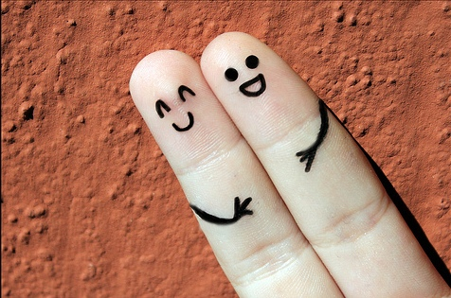
12. Begin in a friendly way when approaching a discussion involving disagreement or difference of opinion – Prov. 18:24

Slide 14
13. Emphasize the things which you agree on so that the other person has a chance to say “yes I agree” – Amos 3:3

Slide 15
14. Let the other person do the majority of the talking – Prov. 13:3

Slide 16
15. Let the other person take credit for an idea as his or hers – Rom. 12:10

Slide 17
16. Try honestly to see things from the other person’s point of view – Prov. 17:28

Slide 18
17. If you are wrong, admit it quickly and sincerely. “I was wrong for _________ will you please forgive me”? – James 5:16

Slide 19
18. Be sympathetic with the other person’s ideas and desires – Prov. 2:2, 12:15

Slide 20
19. Believe the best about a person and let them know you assume them to be honest, upright and fair – I Cor. 13:7; Phil. 4:8

Slide 21
20. Be interesting and impressive when presenting your ideas – Col. 3:23

Slide 22
21. Present a challenge. Stimulate healthy competition in order to help them excel. Most people love a contest and a chance to excel, win, feel important and prove his or her worth – Eccl. 9:10

Slide 23
22. If needing to exercise reproof, begin with praise and honest appreciation – Prov. 27:5, I Thess. 5:11

Slide 24
23. Talk about your own mistakes and failures before bringing reproof to the other person – James 5:16

Slide 25
24. Attempt to call attention to their mistakes indirectly – Matt. 18:5

Slide 26
25. Instead of being a boss hog, ask questions instead of giving direct orders. You might consider this = Do you think this would work? What do you think about this? – Matt. 23:11

Slide 27
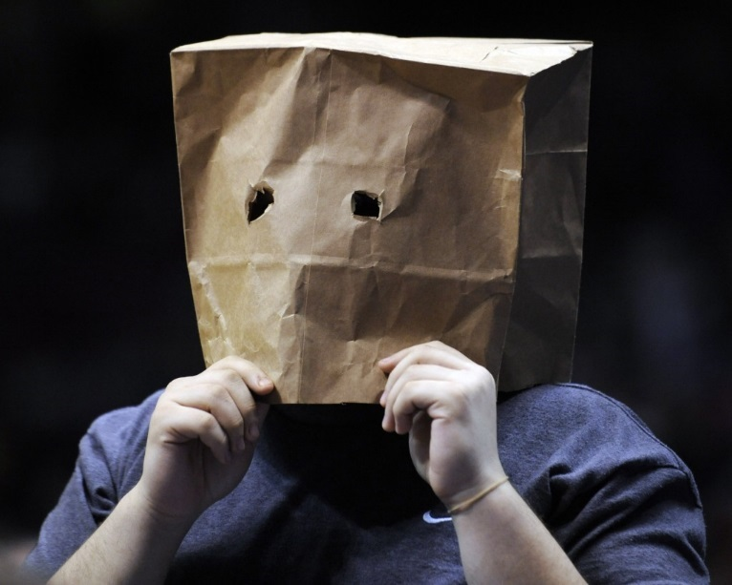
26. Let the other person save face – Col. 4:6 Quote: I have no right to say or do anything that diminishes a man in his own eyes or in the eyes of others. What matters in not what I think about him, but he thinks about himself and what others think about him. Hurting a man’s dignity is a crime.

Slide 28
27. Praise the slightest improvement and praise every improvement. Praise motivates a person to do better – I Thess. 5:11

Slide 29
28. Encourage the person to live up to a high standard of reputation – Rom. 12:1-2
Achieving a Great Reputation Requires High Standards

Slide 30
29. Use encouragement to make the fault seem easy to overcome and correct – Prov. 27:7; Rom. 12:11

Slide 31
30. Make the other person happy about doing the things you suggested by showing how it will benefit them – I Cor. 15:58

