Slide 1
The Revelation of Jesus Christ
A study of the book
of Revelation

Slide 2
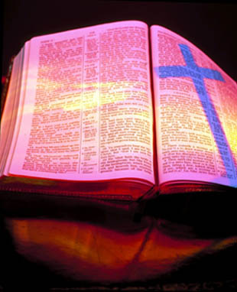
Revelation 15:1-16:21
“The Final Vial
(bowl) Judgments”

Slide 3
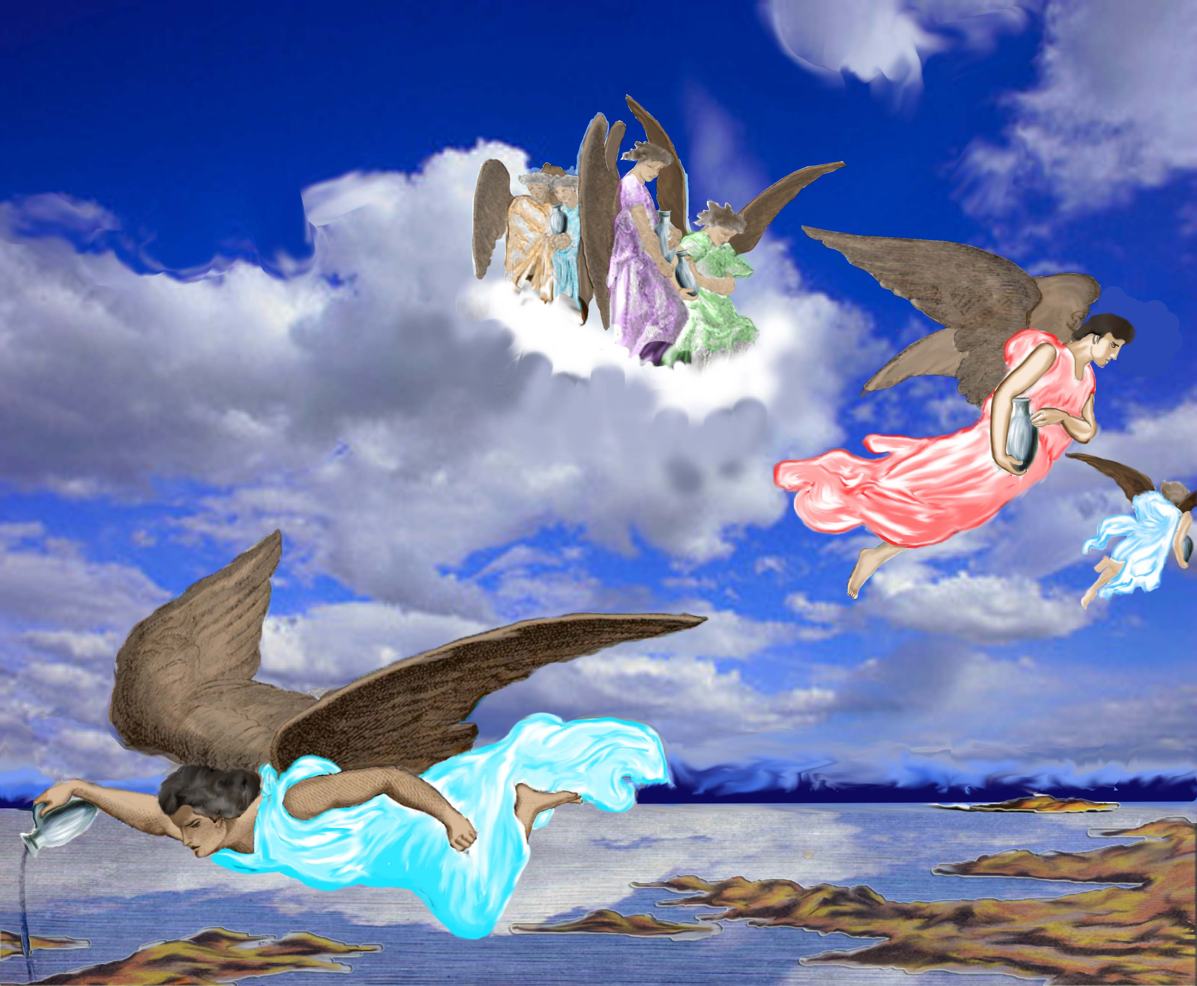
“And I saw another sign in heaven, great and marvellous, seven angels having the seven last plagues.”

Slide 4
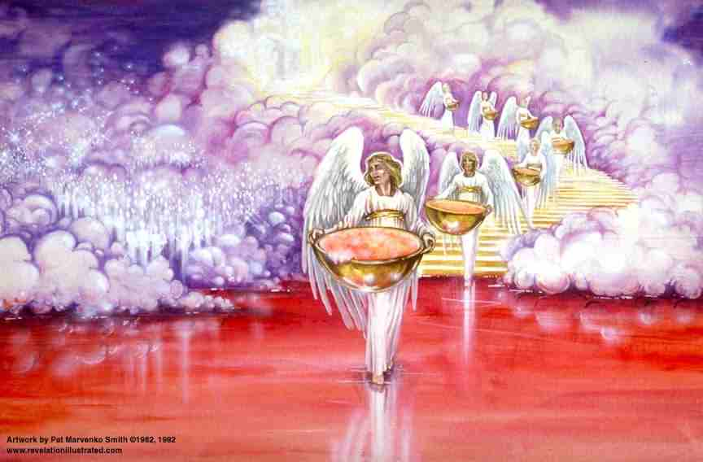
“Seven Angels Having the Seven Last Plagues.”

Slide 5
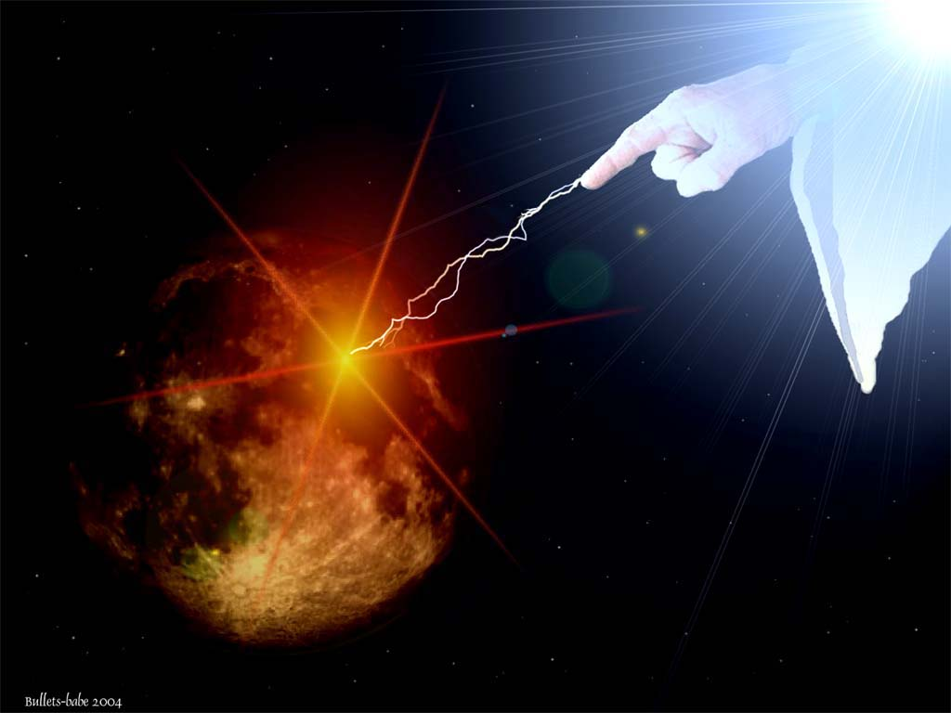
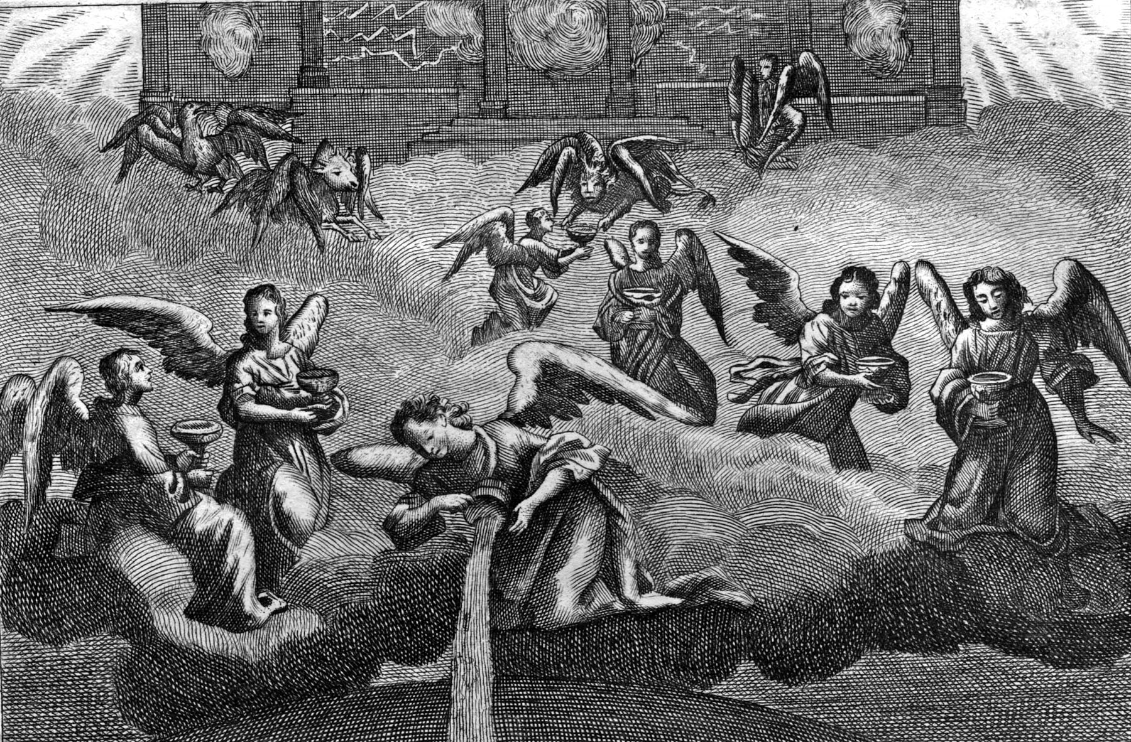
“For in them is filled up the wrath of God”

Slide 6
“It is a fearful thing to fall into the hands of
the living God.”
(Hebrews 10:31)

Slide 7
“And I saw as it were a sea of glass mingled with fire: and them that had gotten the victory over the beast, and over his image, and over his mark, and over the number of his name, stand on the sea of glass, having the harps of God.”

Slide 8
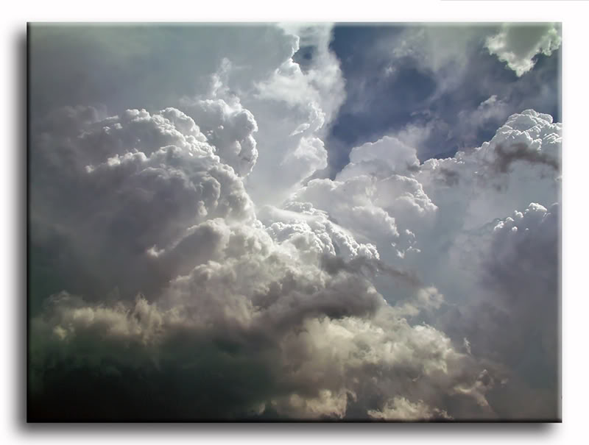
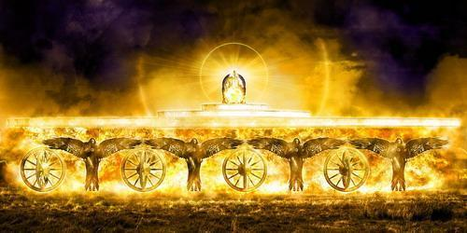
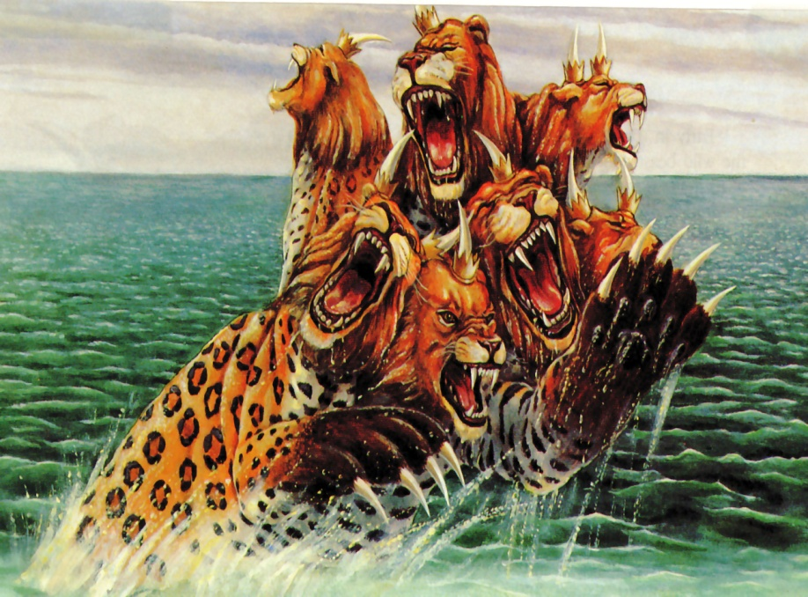
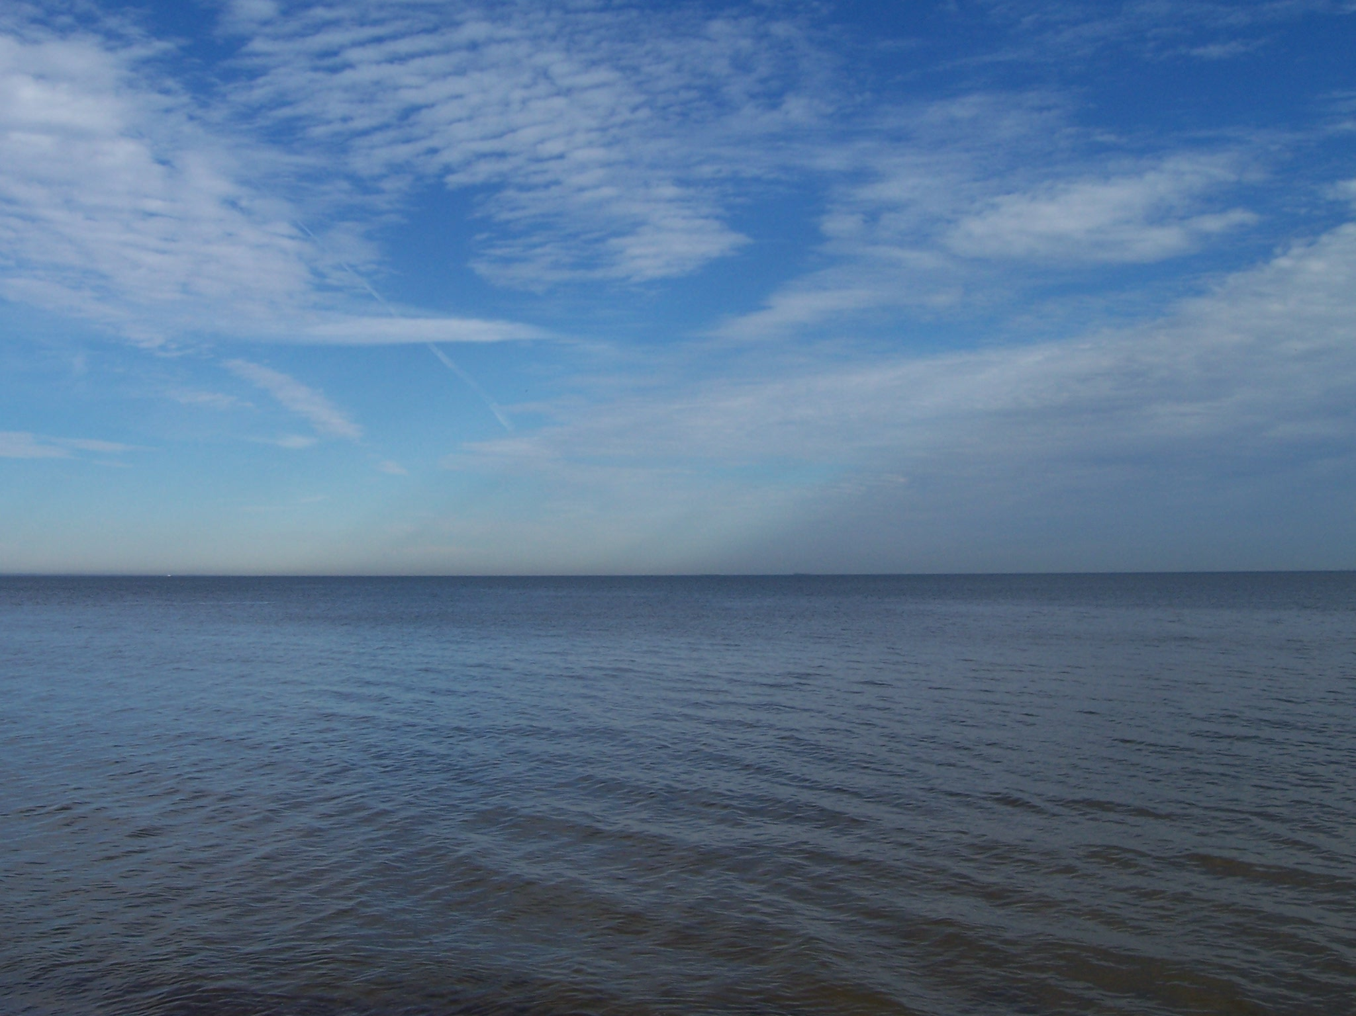
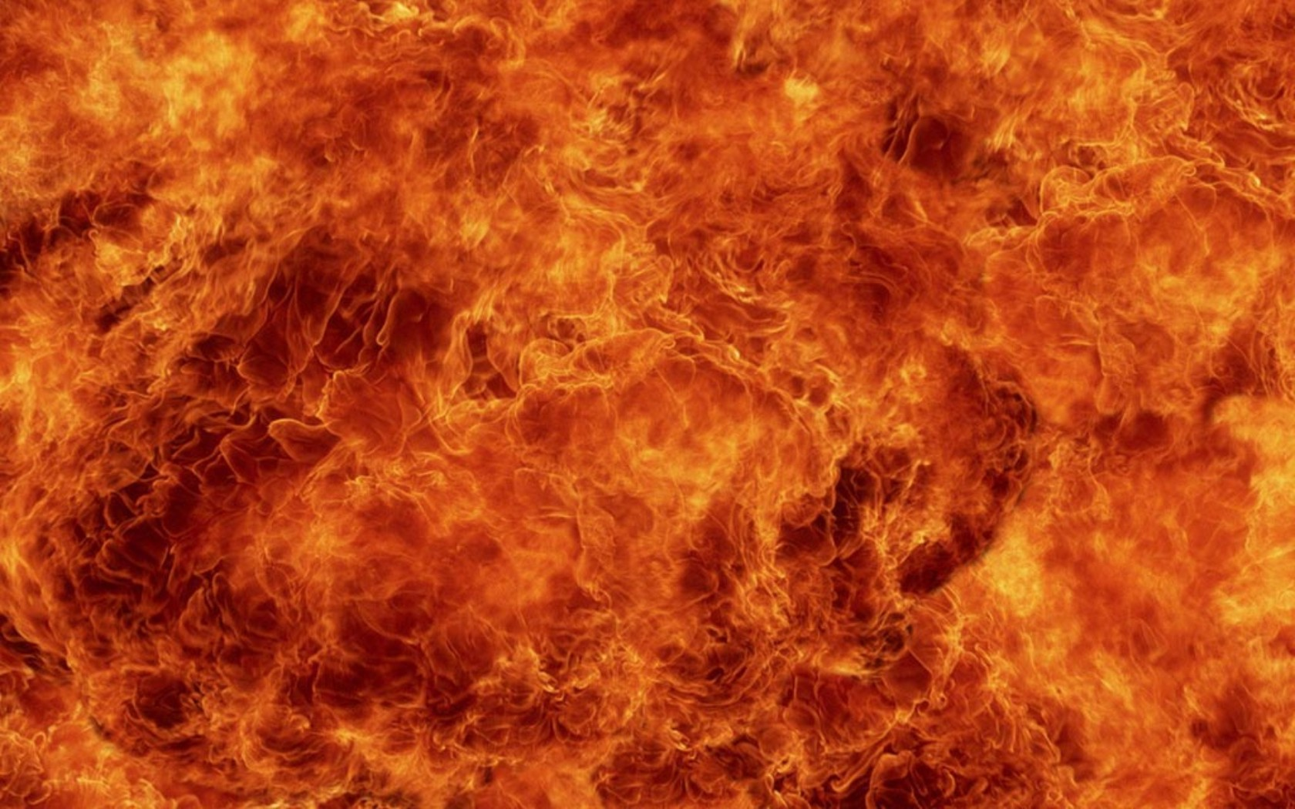

Slide 9
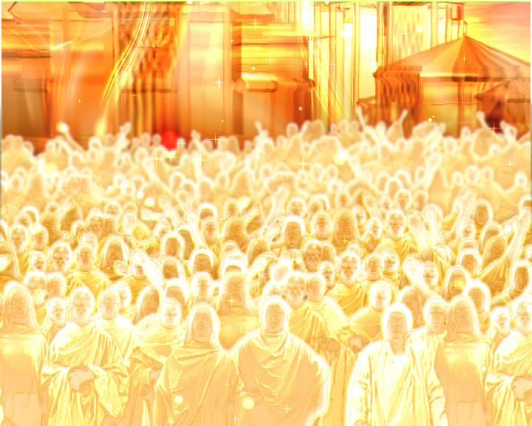
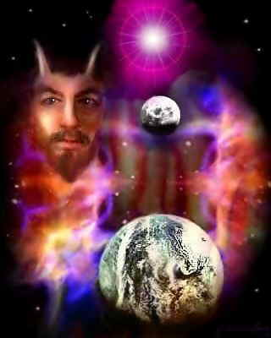
Victory over the Beast

Slide 10
“Death is swallowed up in victory. O death, where is thy sting? O grave, where is thy victory? But thanks be to God, which giveth us the victory through our Lord Jesus Christ.” - I Corinthians 15:54-56
“For to me to live is Christ, and to die is gain.” - Philippians 1:21
“Now thanks be unto God, which always causeth us to triumph in Christ.” - II Corinthians 2:14

Slide 11
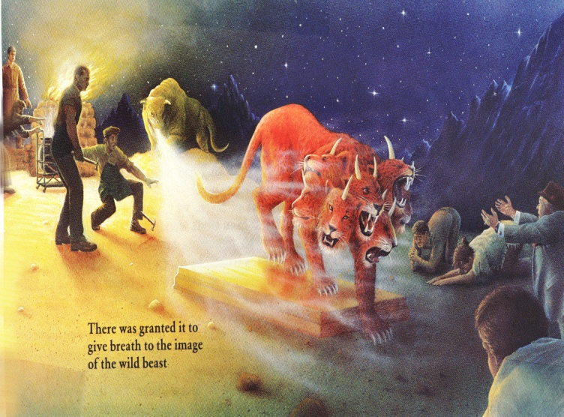
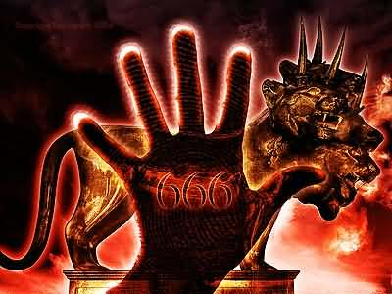
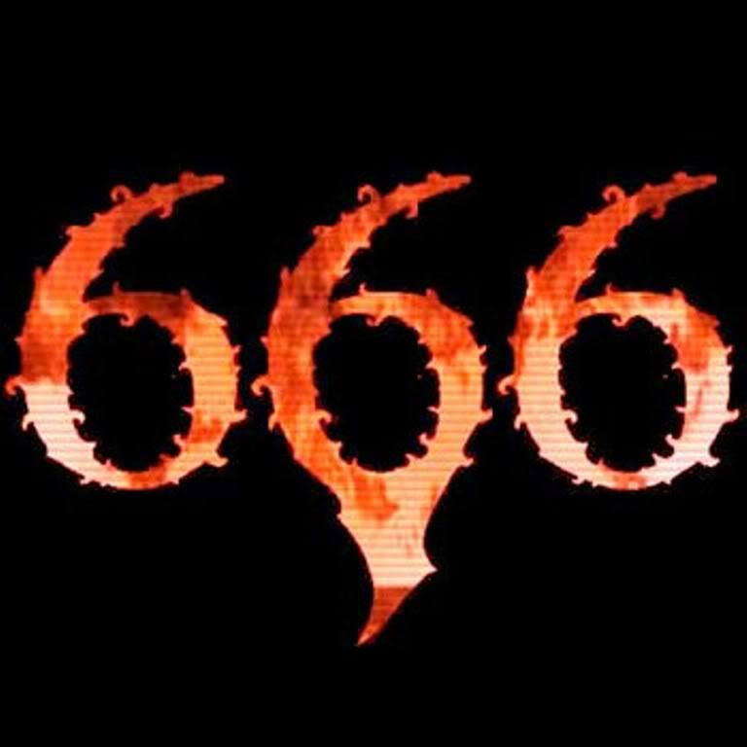
“They overcame him by the blood of the Lamb”- Revelation 12:11
Victory over the beast
Victory over his image
Victory over his mark
Victory over the number of his name

Slide 12
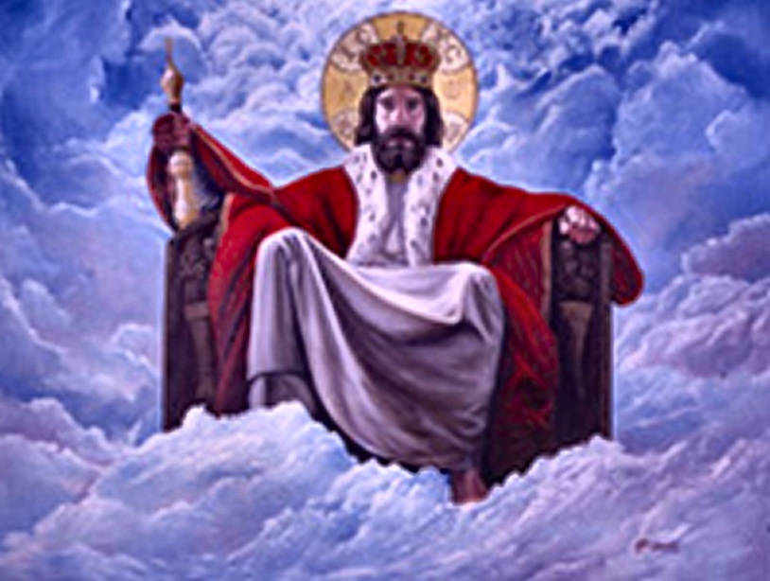
“Having the harps of God. And they sing the song of Moses the servant of God, and the song of the Lamb, saying, Great and marvellous are thy works, Lord God Almighty; just and true are thy ways, thou King of saints. Who shall not fear thee, O Lord, and glorify thy name? for thou only art holy: for all nations shall come and worship before thee; for thy judgments are made manifest.”

Slide 13
“And after that I looked, and, behold, the temple of the tabernacle of the testimony in heaven was opened: And the seven angels came out of the temple, having the seven plagues, clothed in pure and white linen, and having their breasts girded with golden girdles.”

Slide 14
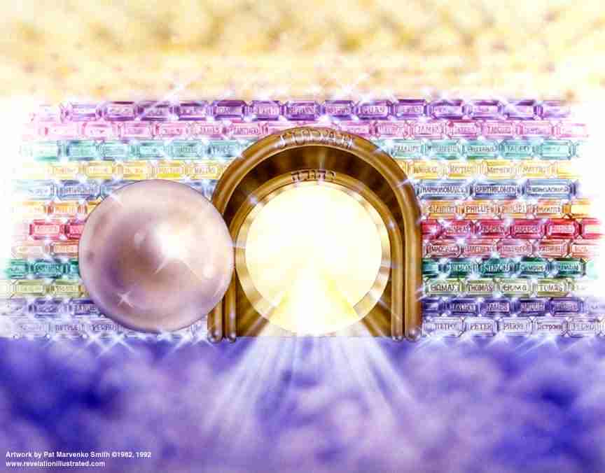
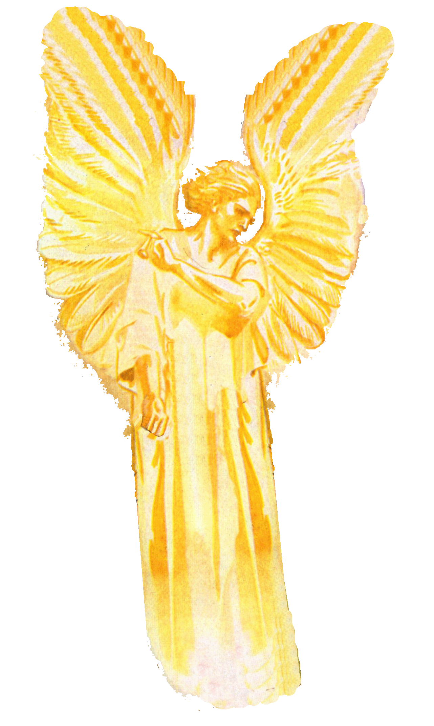

Slide 15
“And one of the four beasts gave unto the seven angels seven golden vials full of the wrath of God, who liveth for ever and ever.”

Slide 16
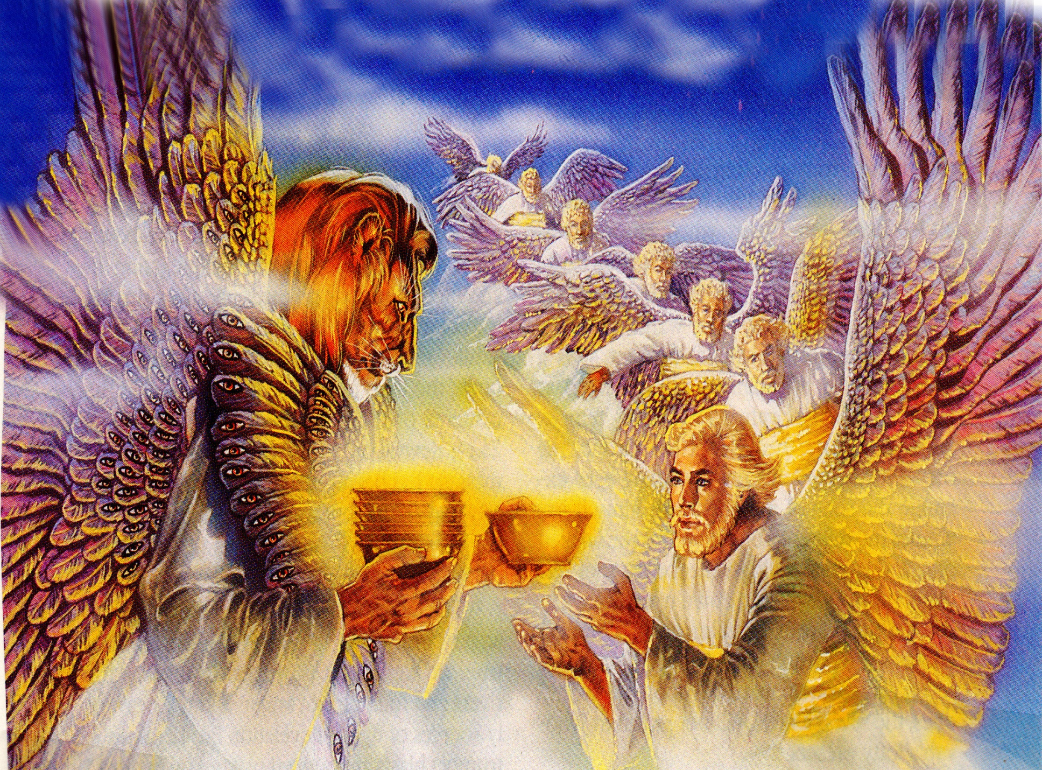
The Seven Vile Judgments (Revelation 16:1-21)

Slide 17
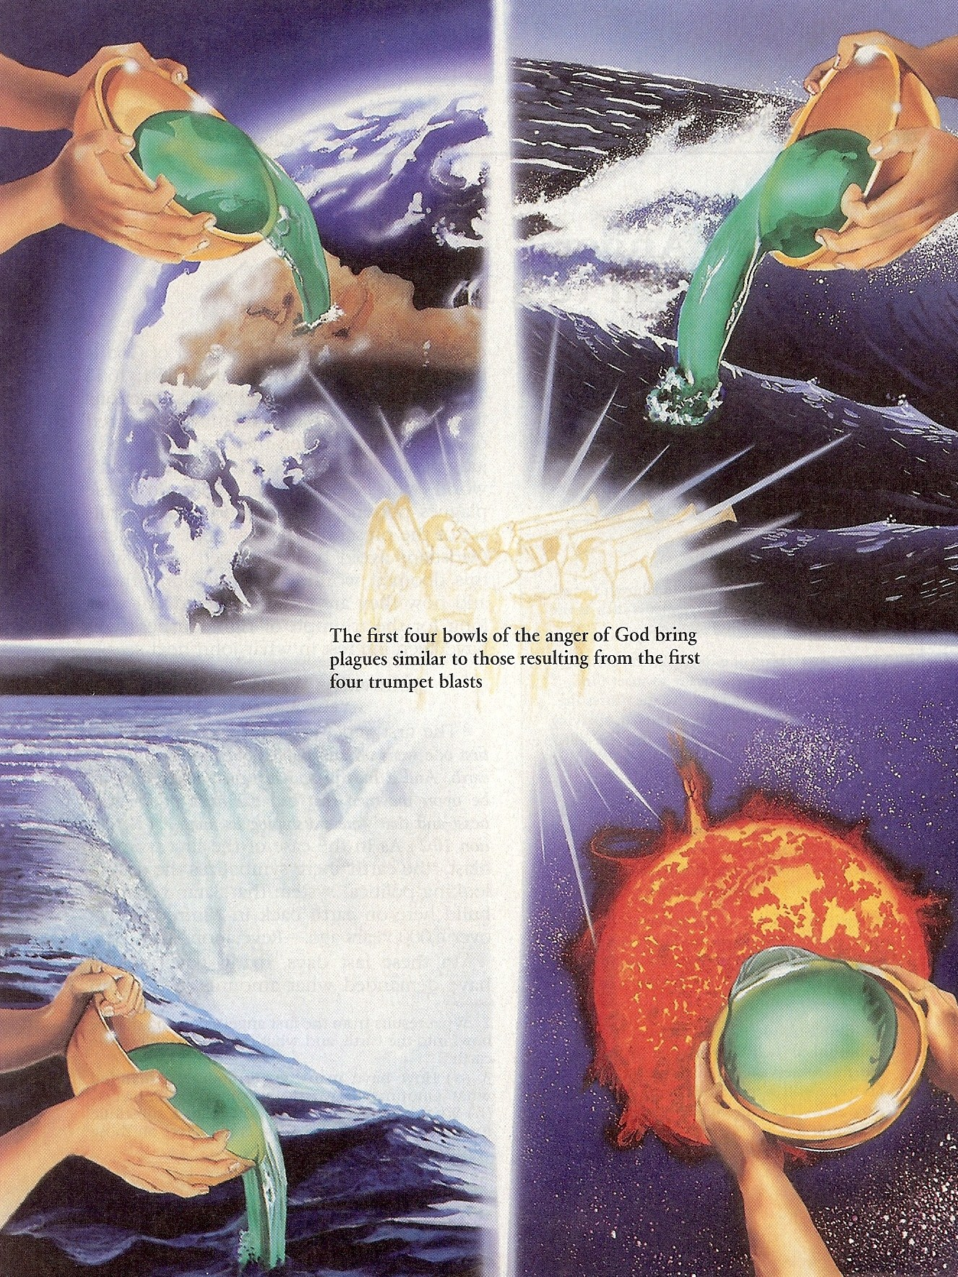
“And I heard a great voice out of the temple saying to the seven angels, Go your ways, and pour out the vials of the wrath of God upon the earth.”

Slide 18
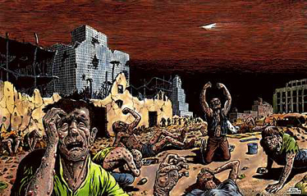
“And the first went, and poured out his vial upon the earth; and there fell a noisome and grievous (painful) sore upon the men which had the mark of the beast, and upon them which worshipped his image.”

Slide 19
“And the second angel poured out his vial upon the sea; and it became as the blood of a dead man: and every living soul died in the sea.”

Slide 20
“And the third angel poured out his vial upon the rivers and fountains of waters; and they became blood.”

Slide 21
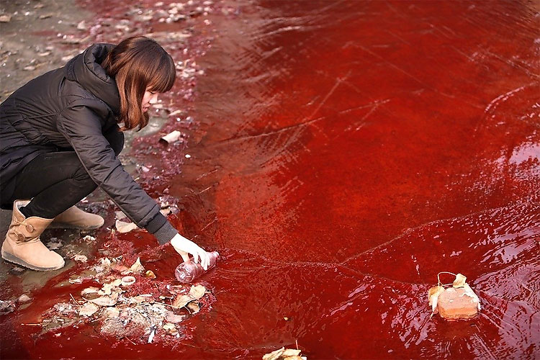
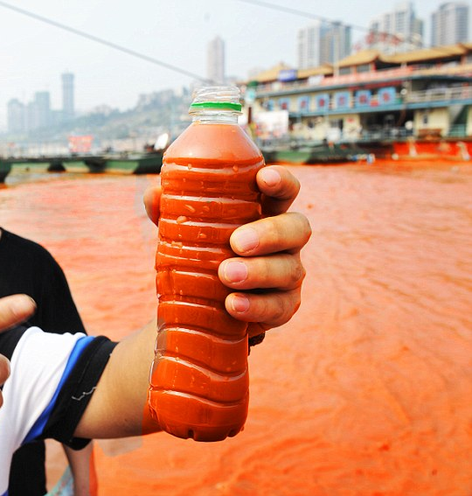
“And I heard the angel of the waters say, Thou art righteous, O Lord, which art, and wast, and shalt be, because thou hast judged thus. For they have shed the blood of saints and prophets, and thou hast given them blood to drink; for they are worthy.”

Slide 22
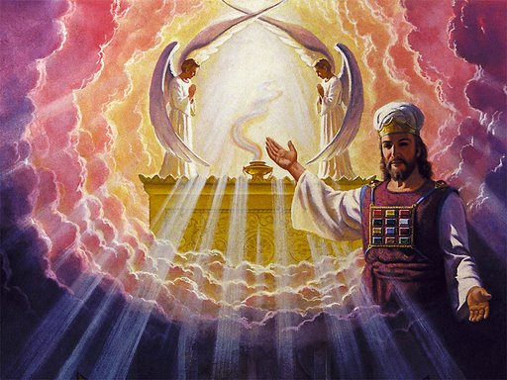
“And I heard another (angel) out of the altar say, Even so, Lord God Almighty, true and righteous are thy judgments.”

Slide 23
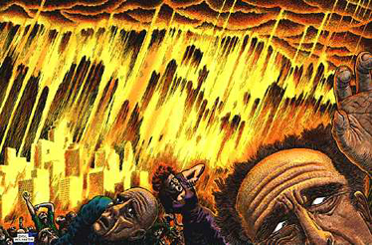
“And the fourth angel poured out his vial upon the sun; and power was given unto him to scorch men with fire. And men were scorched with great heat, and blasphemed the name of God, which hath power over these plagues: and they repented not to give him glory.”

Slide 24
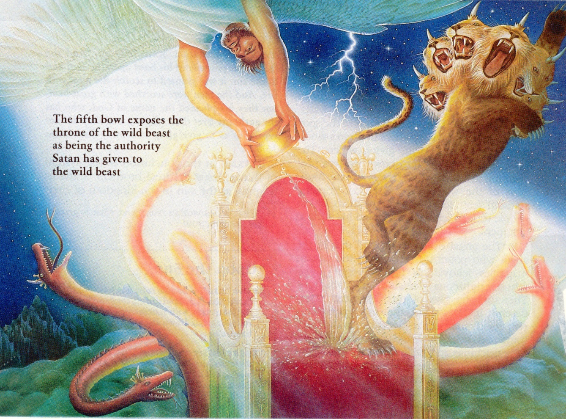
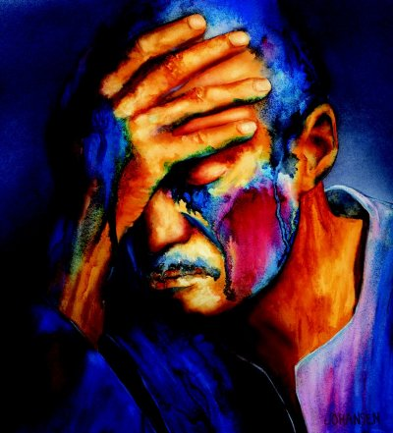
“And the fifth angel poured out his vial upon the seat of the beast; and his kingdom was full of darkness; and they gnawed their tongues for pain.”

Slide 25
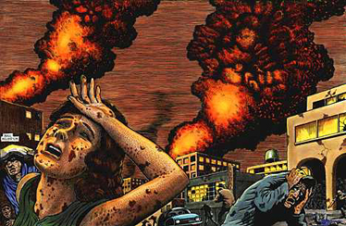
“And blasphemed the God of heaven because of their pains and their sores, and repented not of their deeds.”

Slide 26
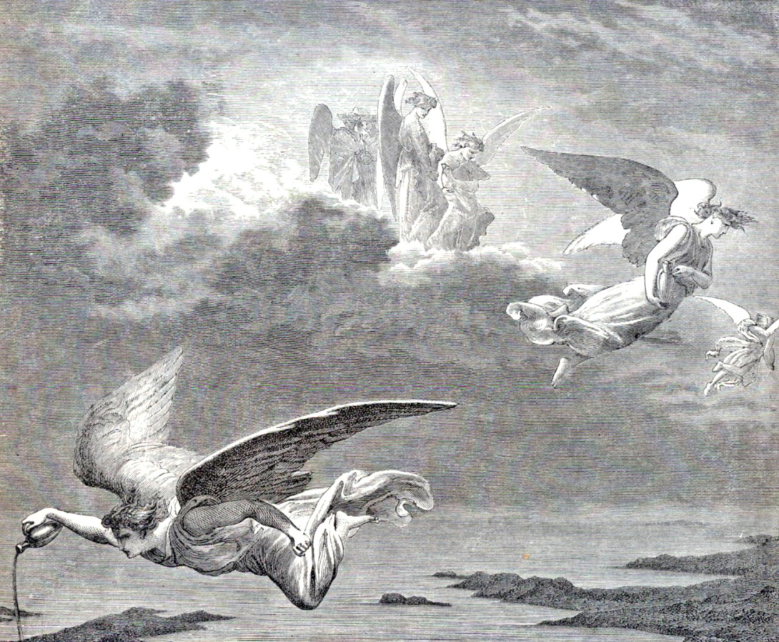
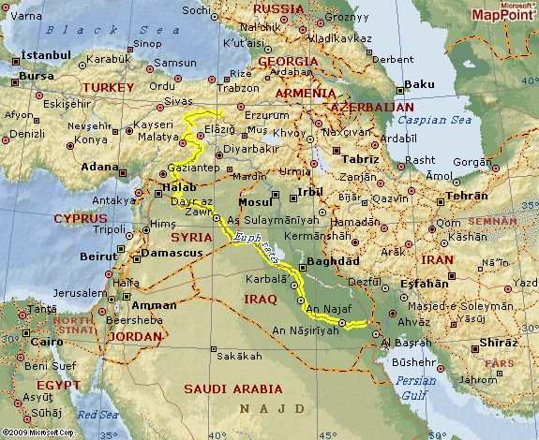
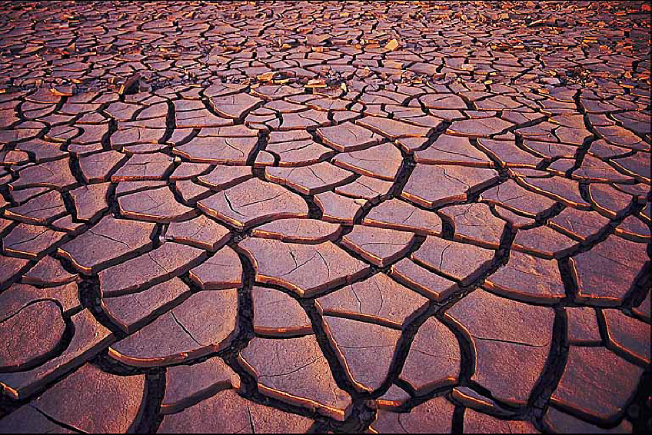
“And the sixth angel poured out his vial upon the great river Euphrates; and the water thereof was dried up, that the way of the kings of the east might be prepared.”

Slide 27
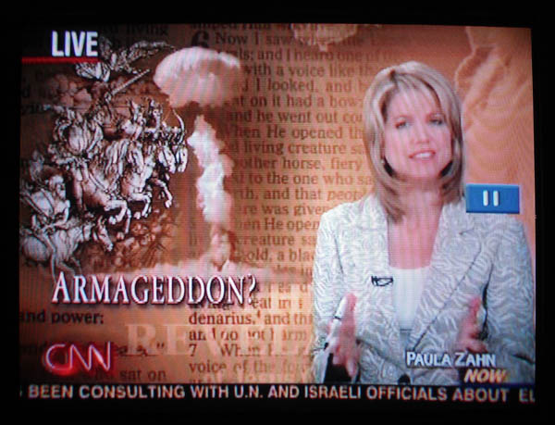
Preparation for the Battle of Armageddon Begins
“And he gathered them together into a place called in the Hebrew tongue Armageddon.”

Slide 28
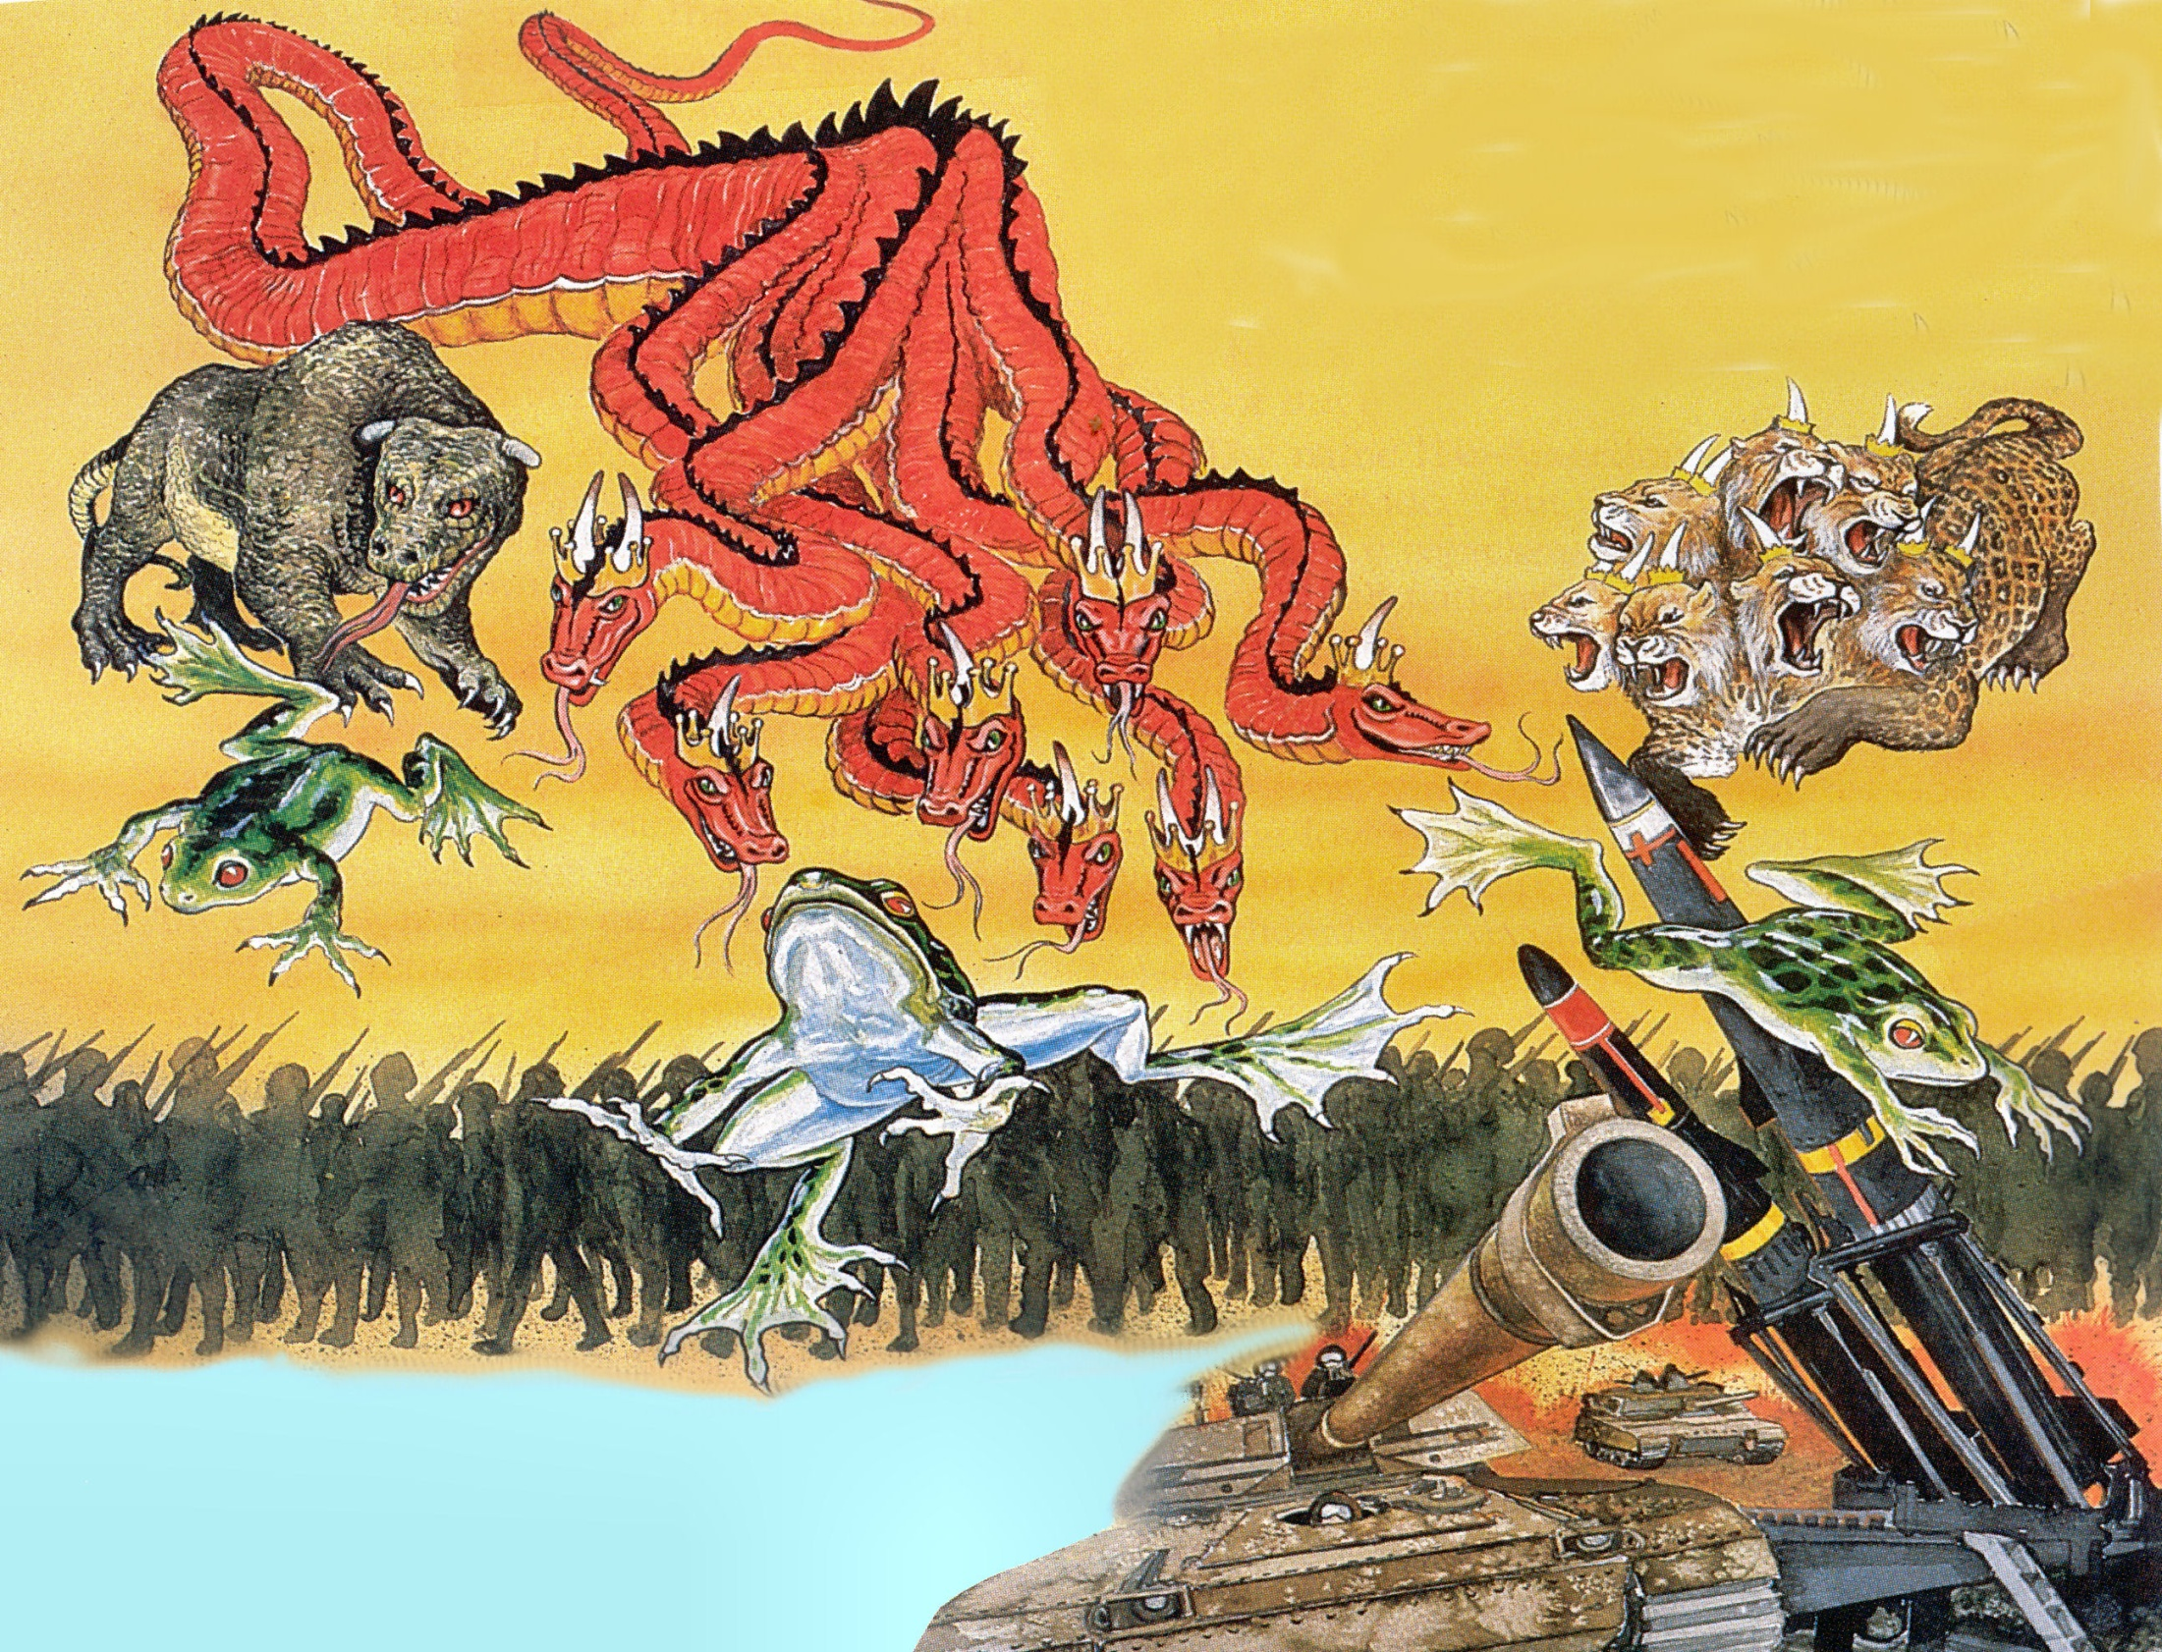
Revelation 16:12-14

Slide 29
“And I saw three unclean spirits like frogs come out of the mouth of the dragon, and out of the mouth of the beast, and out of the mouth of the false prophet. For they are the spirits of devils, working miracles, which go forth unto the kings of the earth and of the whole world, to gather them to the battle of that great day of God Almighty.”

Slide 30
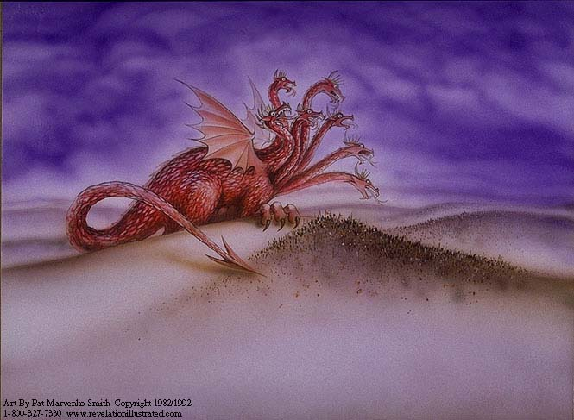
The Great Red Dragon “That old serpent called the Devil, and Satan, which deceiveth the whole world.” (Revelation 12:9)

Slide 31
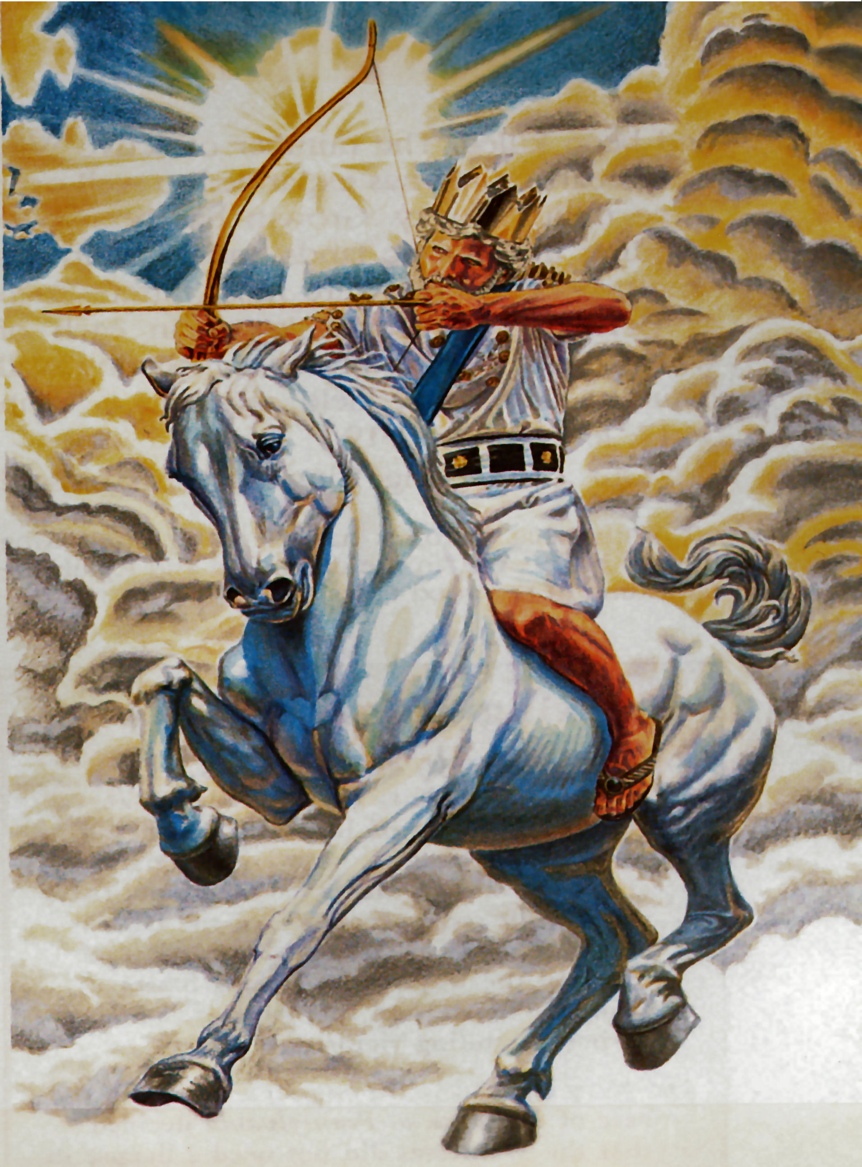
Anti-Christ (Revelation 13:1-10)

Slide 32
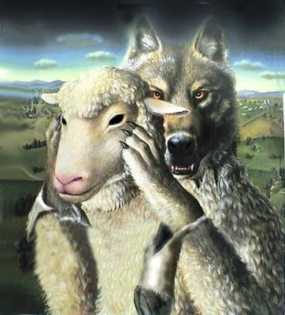
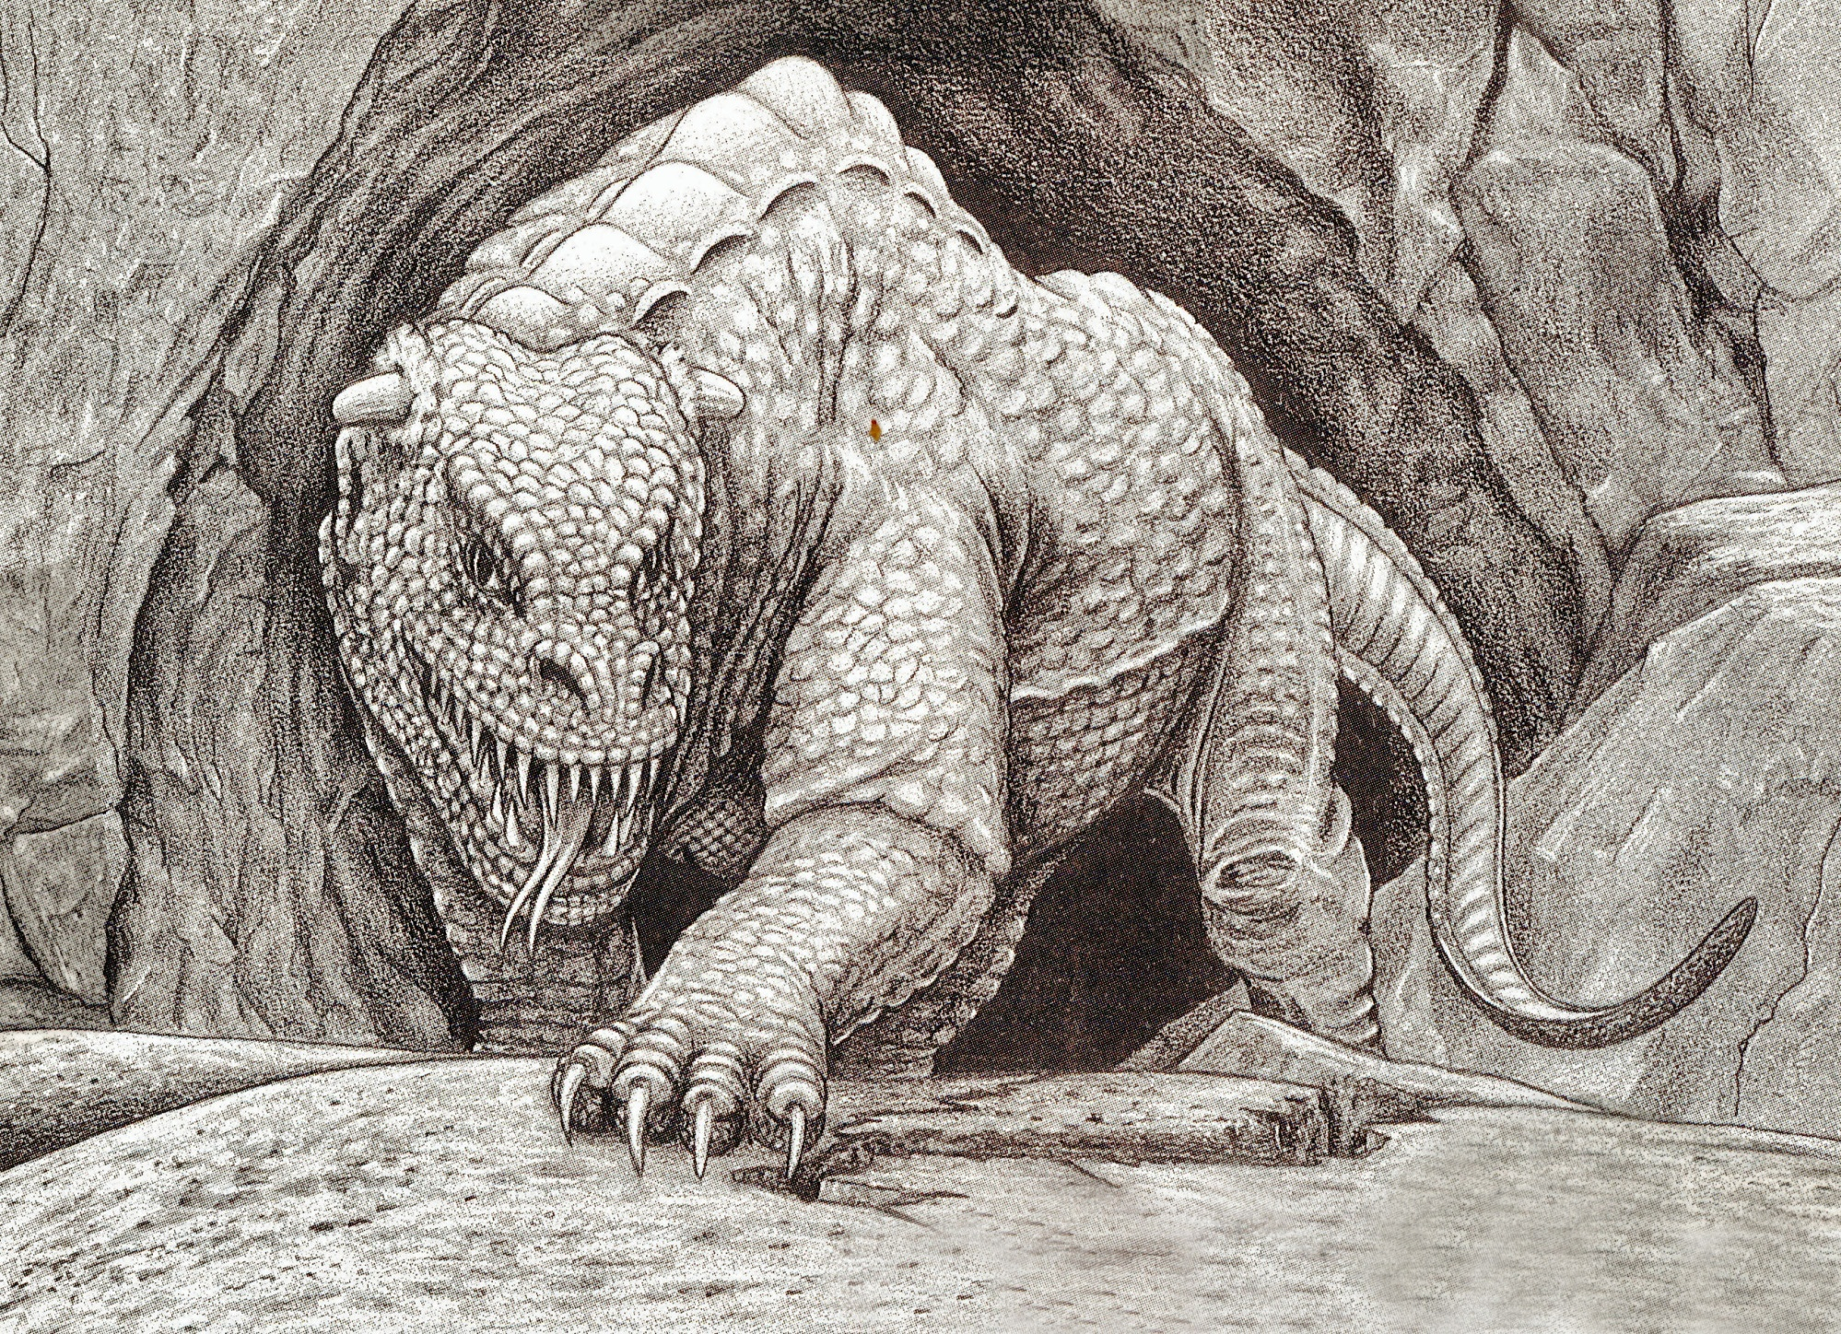
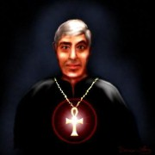
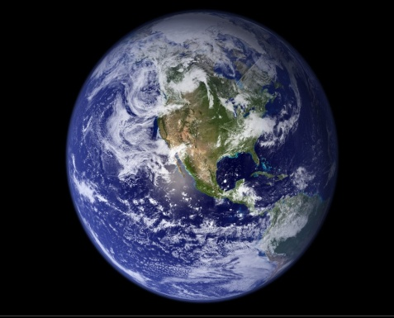
False Prophet (Revelation 13:11)

Slide 33
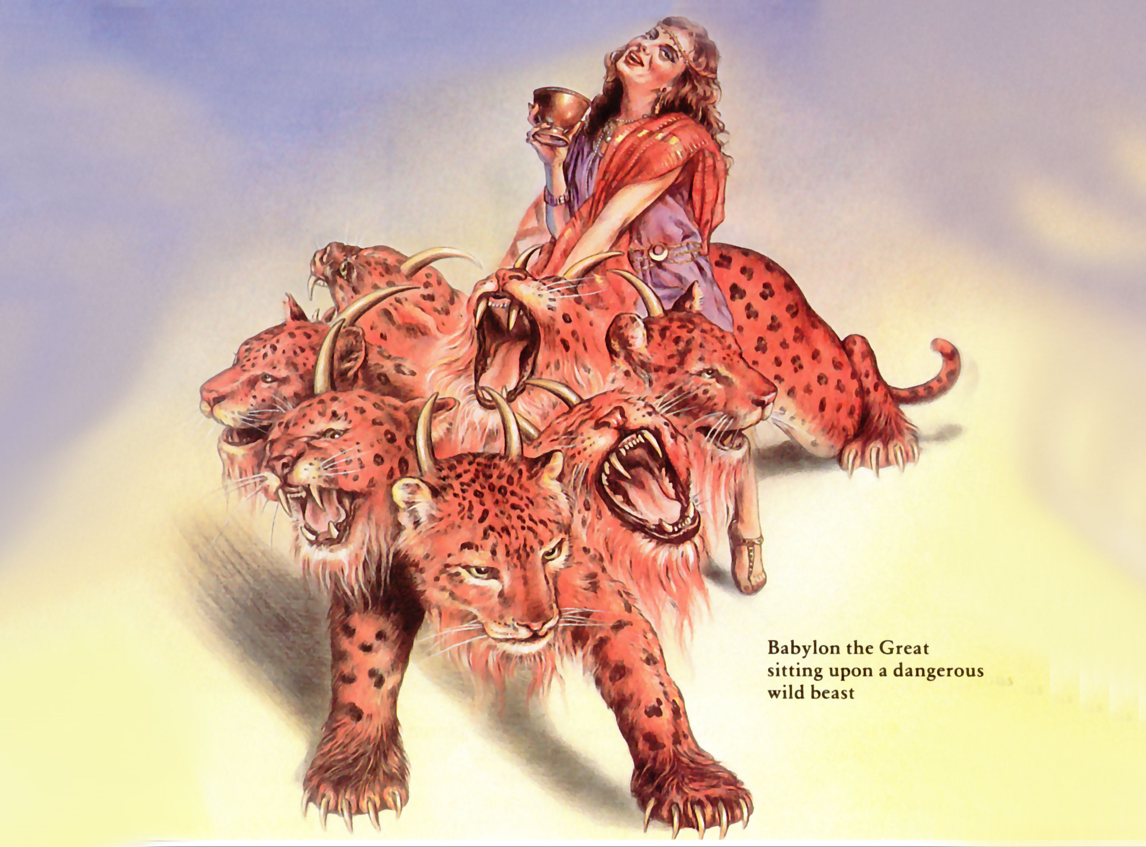
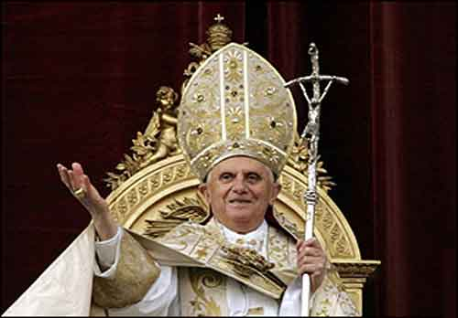
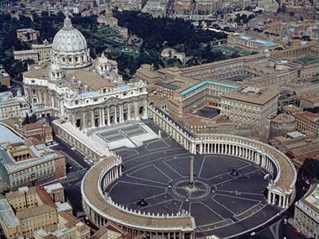
Apostate Church

Slide 34
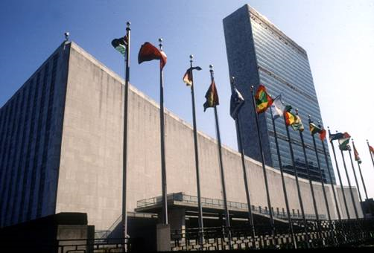
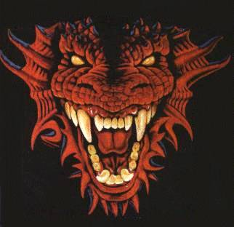
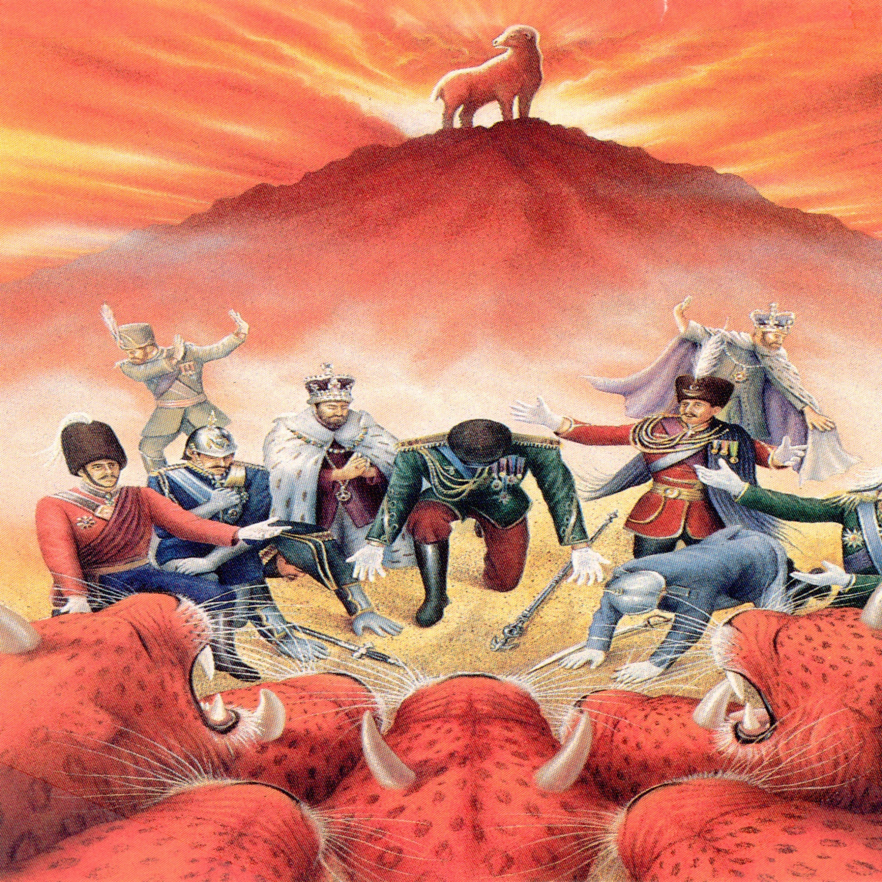

Slide 35
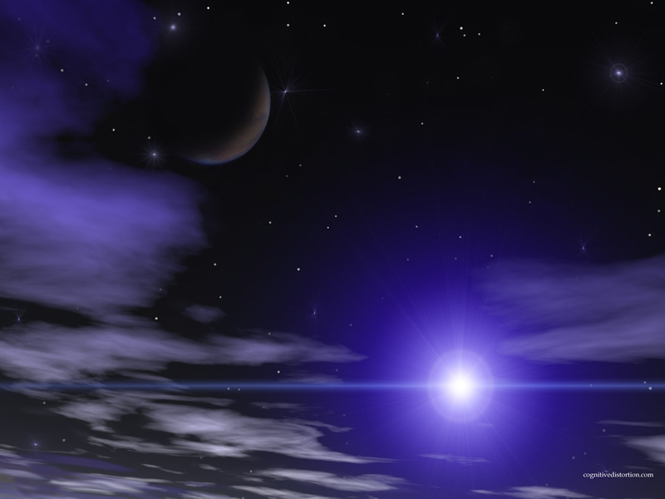
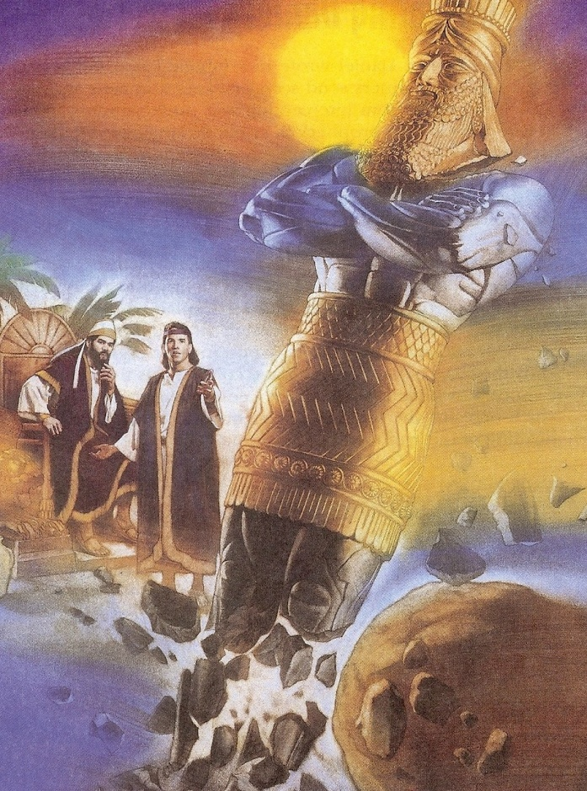
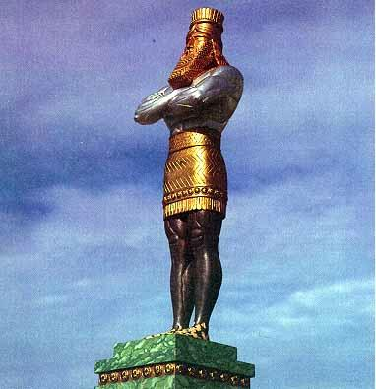
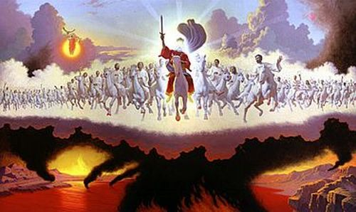
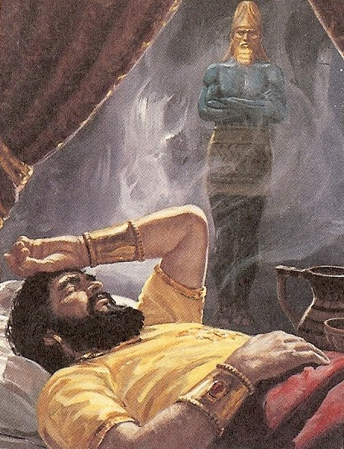

Slide 36
“These shall make war with the Lamb, and the Lamb shall overcome them: for he is Lord of lords, and King of kings.”

Slide 37
(Joel 3:11-16)
“Assemble yourselves, and come, all ye heathen, and gather yourselves together round about: thither cause thy mighty ones to come down, O LORD. Let the heathen be wakened, and come up to the valley of Jehoshaphat: for there will I sit to judge all the heathen round about. Put ye in the sickle, for the harvest is ripe: come, get you down; for the press is full, the vats overflow; for their wickedness is great.

Slide 38
Multitudes, multitudes in the valley of decision: for the day of the LORD is near in the valley of decision. The sun and the moon shall be darkened, and the stars shall withdraw their shining. The LORD also shall roar out of Zion, and utter his voice from Jerusalem; and the heavens and the earth shall shake: but the LORD will be the hope of his people, and the strength of the children of Israel.”

Slide 39
“And his feet shall stand in that day upon the mount of Olives, which is before Jerusalem on the east, and the mount of Olives shall cleave in the midst thereof toward the east and toward the west, and there shall be a very great valley; and half of the mountain shall remove toward the north, and half of it toward the south.” (Zechariah 14:4)

Slide 40
Revelation 19:11-20

Slide 41
(Revelation 19:11-20) “And I saw heaven opened, and behold a white horse; and he that sat upon him was called Faithful and True, and in righteousness he doth judge and make war. His eyes were as a flame of fire, and on his head were many crowns; and he had a name written, that no man knew, but he himself. And he was clothed with a vesture dipped in blood: and his name is called The Word of God. And the armies which were in heaven followed him upon white horses, clothed in fine linen, white and clean…

Slide 42
And out of his mouth goeth a sharp sword, that with it he should smite the nations: and he shall rule them with a rod of iron: and he treadeth the winepress of the fierceness and wrath of Almighty God. And he hath on his vesture and on his thigh a name written, KING OF KINGS, AND LORD OF LORDS…

Slide 43
And I saw the beast, and the kings of the earth, and their armies, gathered together to make war against him that sat on the horse, and against his army.”

Slide 44
“The kings of the earth set themselves, and the rulers take counsel together, against the LORD, and against his anointed, saying, Let us break their bands asunder, and cast away their cords from us. He that sitteth in the heavens shall laugh: the Lord shall have them in derision. Then shall he speak unto them in his wrath, and vex them in his sore displeasure.” (Psalms 2:2-5)

Slide 46
“And he gathered them together into a place called in the Hebrew tongue Armageddon.”

Slide 49
“Thrust in thy sickle, and reap: for the time is come for thee to reap; for the harvest of the earth is ripe…And the angel thrust in his sickle into the earth, and gathered the vine of the earth, and cast it into the great winepress of the wrath of God.”

Slide 51
“And the winepress was trodden without the city, and blood came out of the winepress, even unto the horse bridles, by the space of a thousand and six hundred furlongs (184 miles).” (Revelation 14:20)

Slide 54
“And I saw an angel standing in the sun; and he cried with a loud voice, saying to all the fowls that fly in the midst of heaven, Come and gather yourselves together unto the supper of the great God.”

Slide 55
“That ye may eat the flesh of kings, and the flesh of captains, and the flesh of mighty men, and the flesh of horses, and of them that sit on them, and the flesh of all men, both free and bond, both small and great.”

Slide 56
“And the beast was taken, and with him the false prophet that wrought miracles before him, with which he deceived them that had received the mark of the beast, and them that worshipped his image. These both were cast alive into a lake of fire burning with brimstone.”

Slide 57
“And the temple was filled with smoke from the glory of God, and from his power; and no man was able to enter into the temple, till the seven plagues of the seven angels were fulfilled.” (Revelation 15:8)

Slide 58
“And the seventh angel poured out his vial into the air; and there came a great voice out of the temple of heaven, from the throne, saying, It is done. And there were voices, and thunders, and lightnings; and there was a great earthquake, such as was not since men were upon the earth, so mighty an earthquake, and so great.”

Slide 59
“And the great city was divided into three parts, and the cities of the nations fell: and great Babylon came in remembrance before God, to give unto her the cup of the wine of the fierceness of his wrath.”

Slide 60
“Every island fled away, and the mountains were not found.”

Slide 61
“And there fell upon men a great hail out of heaven, every stone about the weight of a talent: and men blasphemed God because of the plague of the hail; for the plague thereof was exceeding great.”

Slide 63
The Seven Vile Judgments (Revelation 16:1-21)

Slide 64
Grievous sores upon those who have the mark of the beast and worship his image
Sea turns to the blood of a dead man
Every living thing in the sea dies
Rivers and fountains of waters become blood
Men are scorched with fire from heaven
Darkness over the face of the whole earth
Men are afflicted with great pain

Slide 65
Powerful storms
Great earthquakes
Major cities around the world are destroyed
Every island disappears
Every mountain is removed
Great hail the weight of a talent
Man blaspheme God
Battle of Armageddon

