Slide 1
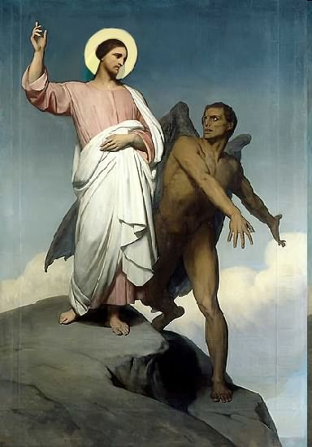

Slide 2
Topics to be studied
His existence
His origin
His fall
His personality
His names
His activities (Part 23)
His location – present and future
Our victory over him

Slide 4
Satan imitates God?

Slide 5
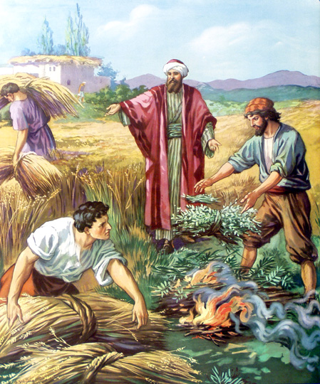
Matthew 13:24-42
Satan sows tares among God’s wheat

Slide 6
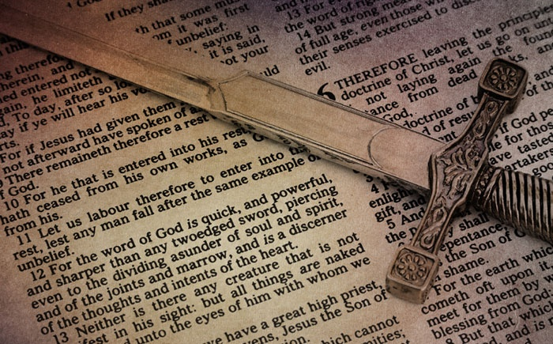
Satan perverts the Word of God
“For we are not as many, which corrupt the word of God.”
(2 Cor. 2:17)

Slide 7
Satan lays snares for men
“And that they may recover themselves out of the snare of the devil, who are taken captive by him at his will.”
(2 Tim. 2:26)

Slide 8
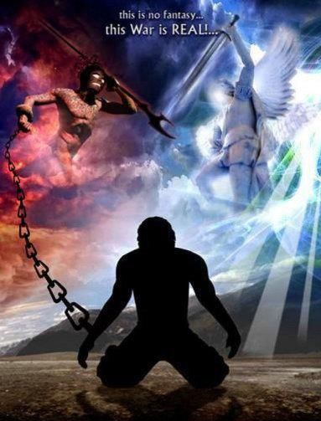
Satan hinders the work of the ministry
(1 Thessalonians 2:17-18) “But we, brethren, being taken from you for a short time in presence, not in heart, endeavoured the more abundantly to see your face with great desire. Wherefore we would have come unto you, even I Paul, once and again; but Satan hindered us.”

Slide 9
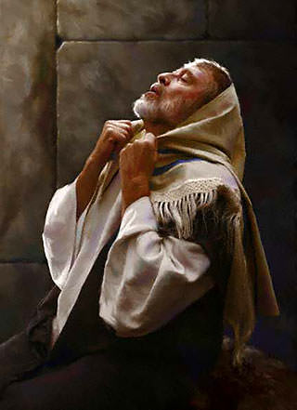
Satan resists the prayers of God’s servants
“Then said he unto me, Fear not, Daniel: for from the first day that thou didst set thine heart to understand, and to chasten thyself before thy God, thy words were heard, and I am come for thy words. But the prince of the kingdom of Persia (Satan) withstood me one and twenty days: but lo, Michael, one of the chief princes, came to help me; and I remained there with the kings of Persia.” (Dan. 10:12-13)

Slide 10
Satan blinds men from the truth of God’s Word
“Having the understanding darkened, being alienated from the life of God through the ignorance that is in them, because of the blindness
of their heart.”
(Eph. 4:18)

Slide 11
Satan steals the Word of God from human hearts
"When any one heareth the word of the kingdom, and understandeth it not, then cometh the wicked one, and catcheth away that which was sown in his heart. This is he which received seed by the way side." (Matt. 13:19)
“The thief cometh not, but for to steal, and to kill, and to destroy.”

Slide 12
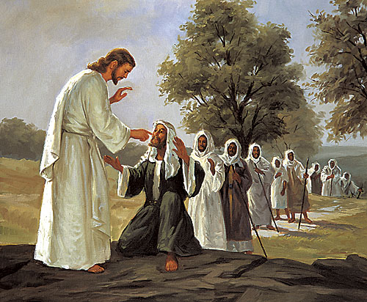
Satan afflicts men with physical and mental illness
“How God anointed Jesus of Nazareth with the Holy Ghost and with power: who went about doing good, and healing all that were oppressed of the devil; for God was with him.”
(Acts 10:38).

Slide 13
Satan deceives and tempts men to sin
“And the devil that deceived them was cast into the lake of fire.” (Revelation 20:10)

Slide 14
Satan deceives and tempts men to sin
“Submit yourselves therefore
to God. Resist the devil (temptation), and he will flee from you.” (James 4:7)

Slide 15
Satan deceives and tempts men to sin
1 Timothy 2:13-14 “For Adam was first formed, then Eve. And Adam was not deceived, but the woman being deceived was in the transgression.”

Slide 16
2 Corinthians 11:3 “But I fear, lest by any means, as the serpent beguiled Eve through his subtilty, so your minds should be corrupted from the simplicity that is in Christ.”

Slide 17
Genesis 3:1 “Now the serpent was more subtil than any beast of the field which the LORD God had made. And he said unto the woman, Yea, hath God said, Ye shall not eat of every tree of the garden?”

Slide 18
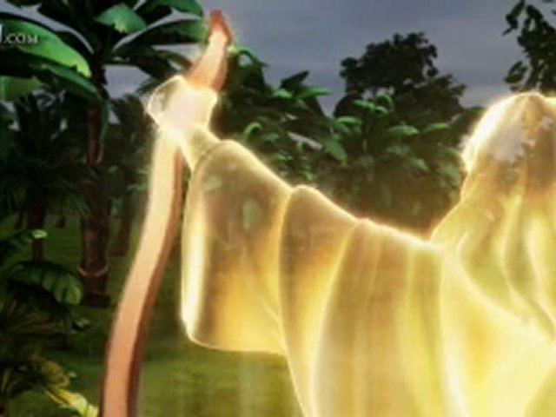
Genesis 3:13 “And the LORD God said unto the woman, What is this that thou hast done? And the woman said, The serpent beguiled me, and I did eat.”

Slide 19
Satan’s two greatest weapons

Slide 21
Deut. 11:16 “Take heed to yourselves, that your heart be not deceived.”
Luke 21:8 “And he said, Take heed that ye be not deceived.”
1 Cor. 6:9 “Be not deceived.”
1 Cor. 15:33 “Be not deceived.”
Gal. 6:7 “Be not deceived.”

Slide 22
Why was Eve deceived? “If I tempted you, you would know it. If I deceived you, you wouldn’t know it. If you know you are being deceived, then you are not being deceived. Eve was deceived because she believed the lie that God did not want what was best for her, but didn’t know it was a lie. We can see from Genesis 3 that deception was the primary strategy of Satan from the beginning. Perhaps some of us look down on Eve for being deceived by the serpent in the garden? But each time we sin we’re deceived by the same lie.”

Slide 23
There’s not going to be any consequences
No one will ever know
It will bring you fulfillment
Pleasure awaits you
Every one is doing it
It’s no big deal
You deserve it
God will not judge you
Your parents don’t know what they are talking
Your pastor is wrong

Slide 24
“He (Satan) was a murderer from the beginning, and abode not in the truth, because there is no truth in him. When he speaketh a lie, he speaketh of his own: for he is a liar, and the father of it.” (John 8:44)

Slide 25
“For such are false apostles, deceitful workers, transforming themselves into the apostles of Christ. And no marvel; for Satan himself is transformed into an angel of light. Therefore it is no great thing if his ministers also be transformed as the ministers of righteousness; whose end shall be according to their works.” (2 Corinthians 11:13-15)

Slide 26
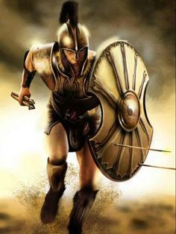
“Put on the whole armour of God, that ye may be able to stand against the wiles of the devil.” (Ephesians 6:11)

Slide 27
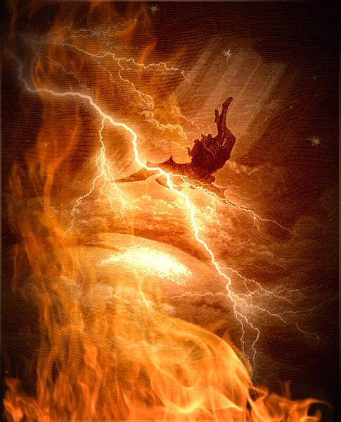
“And the great dragon was cast out, that old serpent, called the Devil, and Satan, which deceiveth the whole world: he was cast out into the earth, and his angels were cast out with him.” (Revelation 12:9)

Slide 28
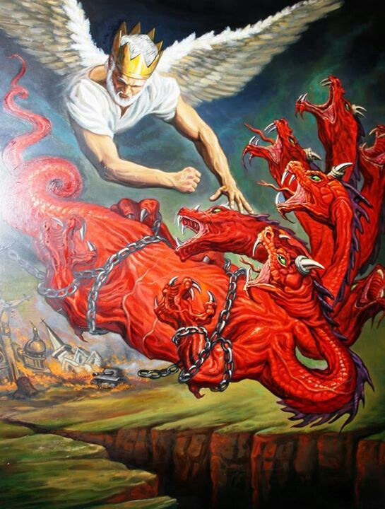
“And cast him into the bottomless pit, and shut him up, and set a seal upon him, that he should deceive the nations no more, till the thousand years should be fulfilled: and after that he must be loosed a little season.” (Revelation 20:3)

Slide 29
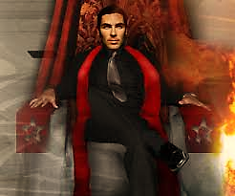
“Even him (Anti-Christ), whose coming is after the working of Satan with all power and signs and lying wonders, And with all deceivableness of unrighteousness in them that perish; because they received not the love of the truth, that they might be saved.” (2 Thessalonians 2:9-10)

Slide 30
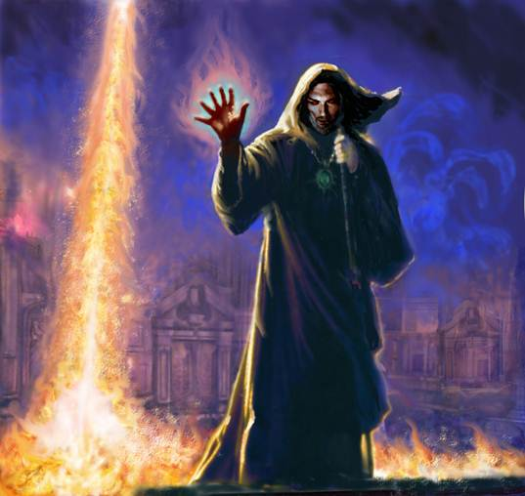
”And he (False Prophet) doeth great wonders, so that he maketh fire come down from heaven on the earth in the sight of men, And deceiveth them that dwell on the earth by the means of those miracles which he had power to do in the sight of the beast; saying to them that dwell on the earth, that they should make an image to the beast, which had the wound by a sword, and did live.” (Revelation 13:13-14)

Slide 31
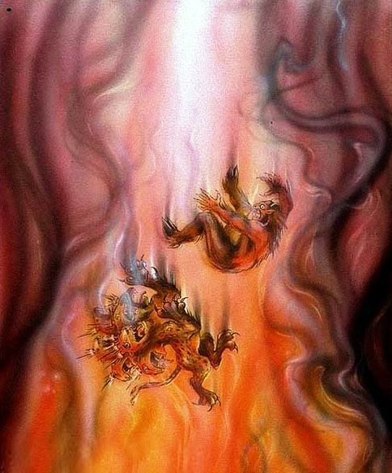
“And the beast (Anti-Christ) was taken, and with him the false prophet that wrought miracles before him, with which he deceived them that had received the mark of the beast, and them that worshipped his image. These both were cast alive into a lake of fire burning with brimstone.” (Revelation 19:20)

Slide 32
“…lest he fall into reproach and the snare of the devil.” 1 Timothy 3:7 “And that they may recover themselves out of the snare of the devil, who are taken captive by him at his will.” 2 Timothy 2:26

Slide 33
“But evil men and seducers shall wax worse and worse, deceiving, and being deceived.” 2 Timothy 3:13

Slide 34
“For there shall arise false Christs, and false prophets, and shall shew great signs and wonders; insomuch that, if it were possible, they shall deceive the very elect.” Matthew 24:24
“Beloved, believe not every spirit, but try the spirits whether they are of God: because many false prophets are gone out into the world.” 1 John 4:1

Slide 35
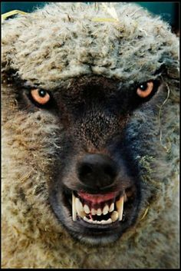
“How long shall this be in the heart of the prophets that prophesy lies? yea, they are prophets of the deceit of their own heart.” Jeremiah 23:26 “Beware of false prophets, which come to you in sheep's clothing, but inwardly they are ravening wolves.” Matthew 7:15

Slide 36
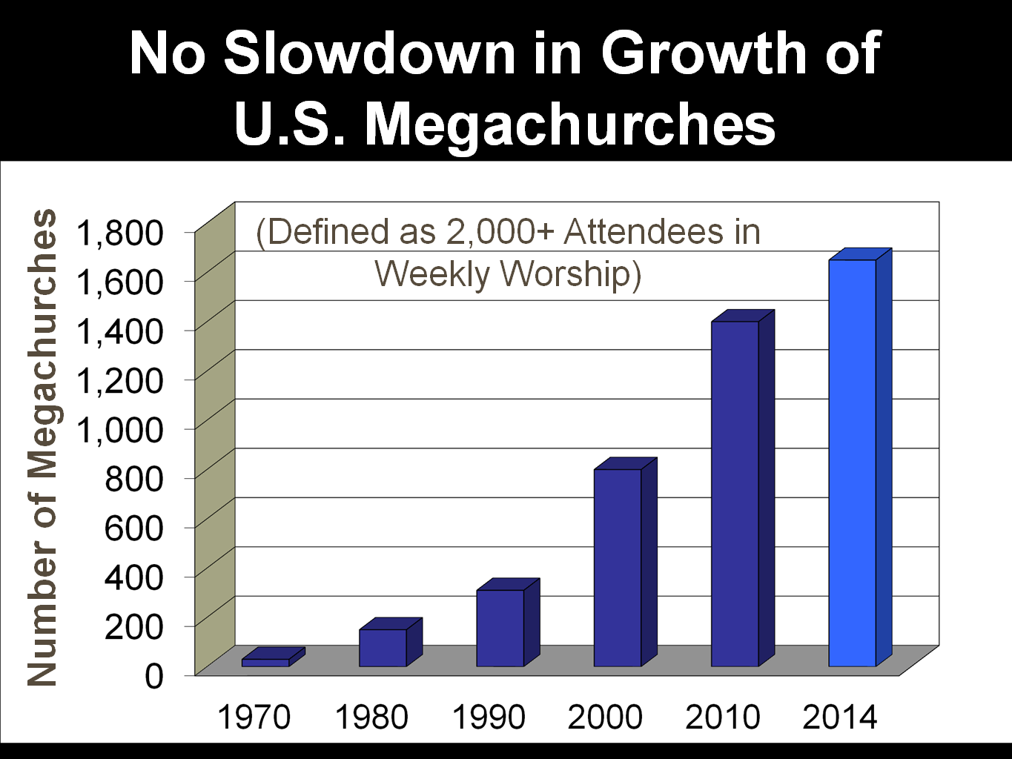
“Now the Spirit speaketh expressly, that in the latter times some shall depart from the faith, giving heed to seducing spirits, and doctrines of devils.” 1Timothy 4:1

Slide 37
“But there were false prophets also among the people, even as there shall be false teachers among you, who privily shall bring in damnable heresies…And many shall follow their pernicious (destructive) ways; by reason of whom the way of truth shall be evil spoken of.

Slide 38
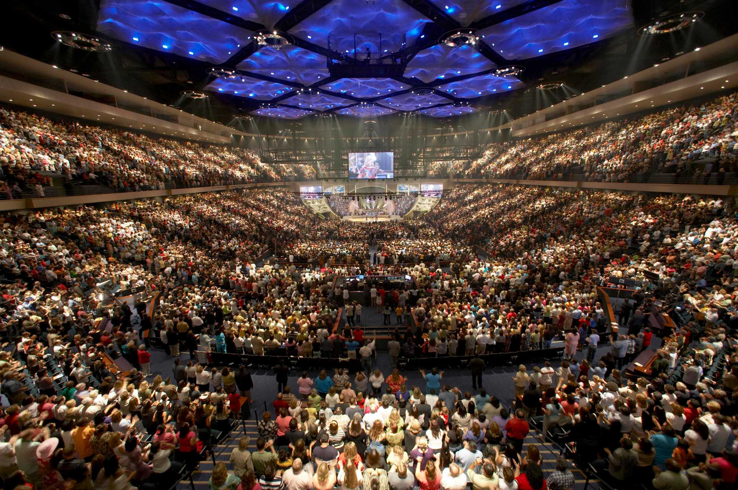
And through covetousness shall they with feigned (deceptive) words make merchandise of you: whose judgment now of a long time lingereth not, and their damnation slumbereth not.” 2 Peter 2:1-3

Slide 39
“And this I say, lest any man should beguile you with enticing words.” Colossians 2:4
Lives in a $10.5 million 17,000 square foot home with six bedrooms, six bathrooms, three elevators, five fireplaces, a guest house and pool house.

Slide 41
“For they that are such serve not our Lord Jesus Christ, but their own belly; and by good words and fair speeches deceive the hearts of the simple.” Romans 16:18

Slide 42
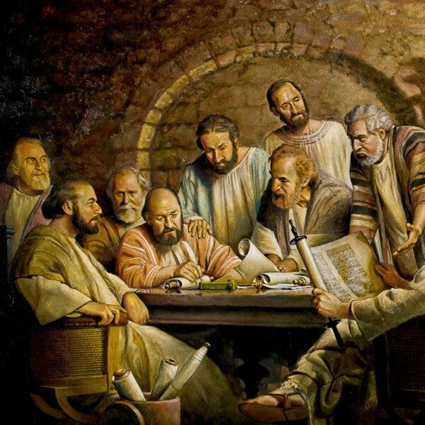
“For I have not shunned to declare unto you all the counsel of God.” Acts 20:27

Slide 43
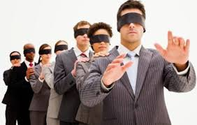
“In whom the god of this world hath blinded the minds (deception) of them which believe not.” 2 Corinthians 4:4 “He hath blinded their eyes, and hardened their heart; that they should not see with their eyes, nor understand with their heart, and be converted, and I should heal them.” John 12:40 “Be not deceived; God is not mocked: for whatsoever a man soweth, that shall he also reap. For he that soweth to his flesh shall of the flesh reap corruption.” Galatians 6:7-8

Slide 44
How does Satan deceive?
Not attending a Fundamental Bible preaching church – Heb. 10:25
Lack of knowledge concerning Biblical truth – Hosea 4:8
False teaching – 2 Peter 2:1
Secular humanistic education – Col. 2:8
Adopting the wisdom (philosophy) of this world - Jam. 3:13-18
Influence of wrong friends – Prov. 1:7-33
Following the crowd – Exod. 23:2
Not recognizing a Satanic blessing – Ps. 73:1-28
Fulfilling the desires of the flesh and of the mind – Eph. 2:3
Carnality (worldly minded) – Rom. 8:7

Slide 45
How to guard against Satan’s Deceptions
Attending a Fundamental Bible preaching church – Jude 3-4
Read, Study, Memorize and Meditate on Scripture – 2 Tim. 2:15
Reject false teaching “Try the spirits” – 1 John 4:1
Get a Biblical education – Jer. 10:2
Adopt the wisdom of God / Biblical world view – Jam. 3:13-18
Develop godly friendships – Prov. 17:17
Do not follow the crowd – Prov. 1:7-33
Recognize Satanic blessing – Ps. 73:1-28
Refuse to fulfill the desires of the flesh and of the mind – I Cor. 15:31
Spiritually minded – Rom. 8:6

